Slide 1
Summer Project Overview and Progress Update
Hang Xiang
EngSci 1T9

Slide 2
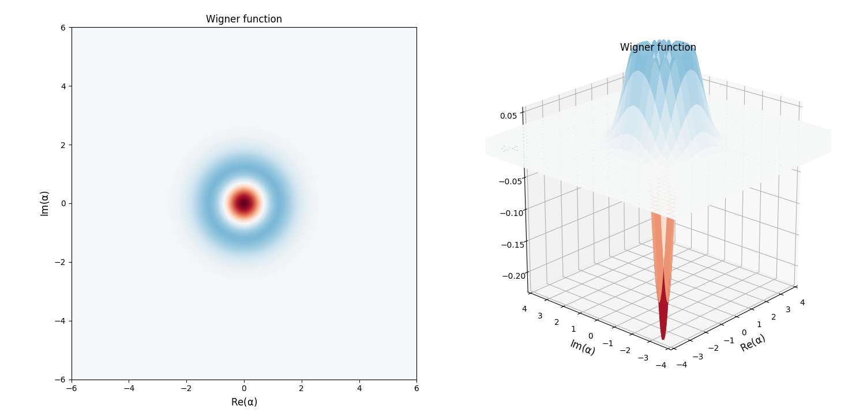

State Engineering with Integrated Photonic Circuits
One Mode Fock State
Projection of TMSV onto |1,1> Fock state
Projection of Two Mode Gaussian State onto |1,1> Fock state
Two Mode Squeezed Vacuum (TMSV)
Generic Formula for more General Cases
Projection of Generic One Mode Gaussian State onto |1> Fock State
I am here right now

