Slide 1

Improve the Bw-tree
Hyeon Cheol, Kim

Slide 2
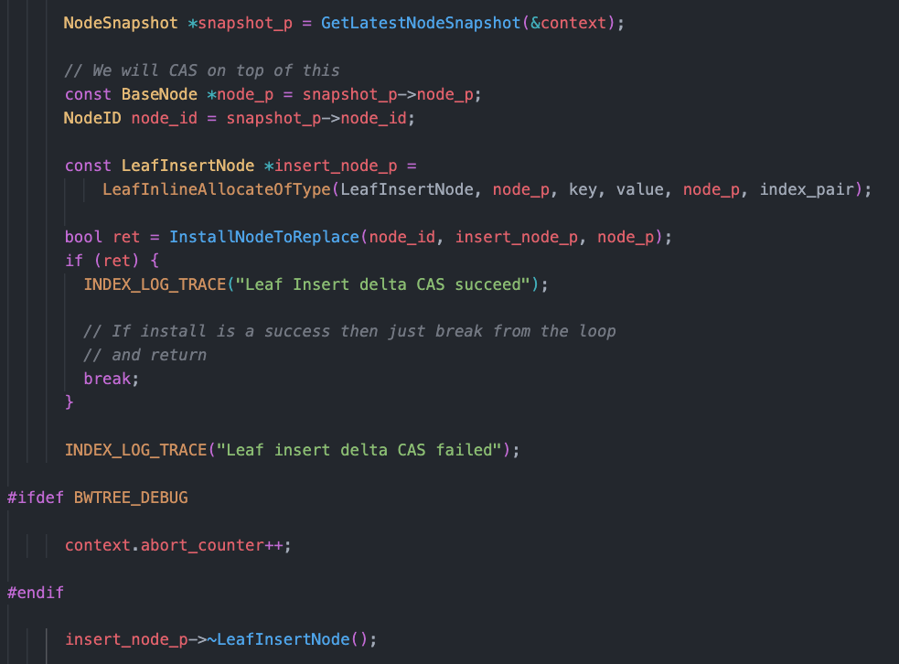
Motivation
After finding the node that
delta node should be attached

Slide 3
Motivation
Steps of attaching leaf Insert delta node
1. Allocate delta node
2. Try to attach with CAS
3. If CAS failed, deallocate the delta node

Slide 4
Motivation
CAS fail will result useless operations
Alloc delta node
Dealloc delta node
(CAS itself)

Slide 5
Motivation
CAS fail will result useless operations
Alloc delta node
Dealloc delta node
(CAS itself)
Why should we alloc delta node before CAS
even for the failed thread?
-> don’t know the following CAS will succeed or not.

Slide 6
Motivation
CAS fail will result useless operations
Alloc delta node
Dealloc delta node
(CAS itself)
Why should we alloc delta node before CAS
even for the failed thread?
-> don’t know the following CAS will succeed or not.
If we know CAS will fail without actually doing CAS,
Useless operations can be skipped

Slide 7
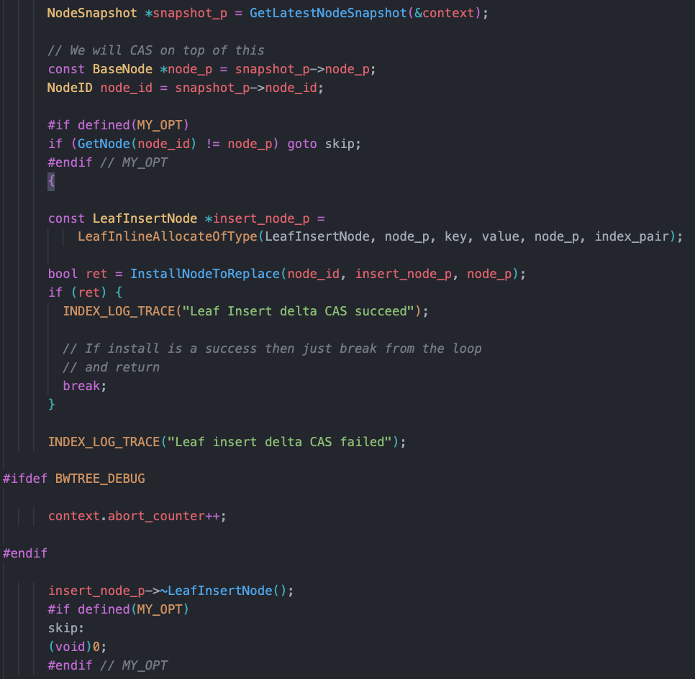
Design
Like the TTAS lock try TAS only when it is likely to succeed
by checking it’s status,

Slide 8
Design
Like the TTAS lock try TAS only when it is likely to succeed
by checking it’s status,
try CAS only when the node_p of mapping_table is unchanged with last snapshot’s node_p

Slide 9
Design
Like the TTAS lock try TAS only when it is likely to succeed
by checking it’s status,
try CAS only when the node_p of mapping_table is unchanged with last snapshot’s node_p
If changed, can safely assume following CAS will fail
Skip the useless operations

Slide 10
Design
Additional overhead by checking status?

Slide 11
Design
Additional overhead by checking status?
vanila
optimized
Success
Fail
Success
Fail
atomic::load()
Alloc
CAS
atomic::load()
Alloc
CAS
Alloc
CAS
Dealloc

Slide 12
Design
Additional overhead by checking status?
vanila
optimized
Success
Fail
Success
Fail
atomic::load()
Alloc
CAS
atomic::load()
Alloc
CAS
Alloc
CAS
Dealloc
Difference = load * (#succ + #fail) - (alloc + CAS + dealloc) * #fail
= load * #succ - (alloc + dealloc) * #fail
(Assume load , CAS has similar latency)

Slide 13
Design
Additional overhead by checking status?
vanila
optimized
Success
Fail
Success
Fail
atomic::load()
Alloc
CAS
atomic::load()
Alloc
CAS
Alloc
CAS
Dealloc
Difference = load * (#succ + #fail) - (alloc + CAS + dealloc) * #fail
= load * #succ - (alloc + dealloc) * #fail
(Assume load , CAS has similar latency)
More fail -> improvement
More success -> slower

Slide 14
Evaluation
Evaluation setting
Processor : 12th Gen Intel(R) Core(TM) i7-12700
Configuration : 20 Cores
Hyperthreading : disabled
Main Memory : 32GB
Operating System : Ubuntu 20.04.5 LTS
Evaluation protocol
Each thread try to insert random (key, val) until 4M key value pair inserted
Measured number and time of useless operations (when CAS failed) as increasing the leaf_node_size_upper_threshold. (which means contention on CAS of single leaf node, probability of failure of CAS)
Repeat whole procedure 10 times to get average

Slide 15
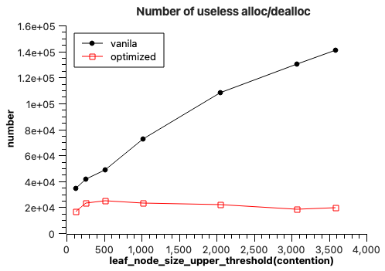
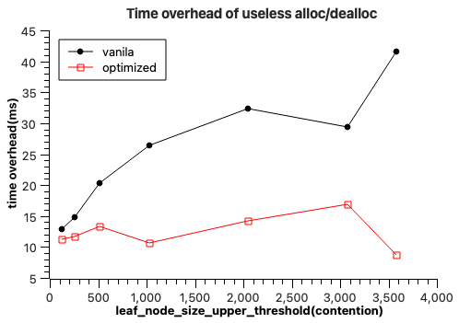
Evaluation
The optimization result seems to be fine

Slide 16
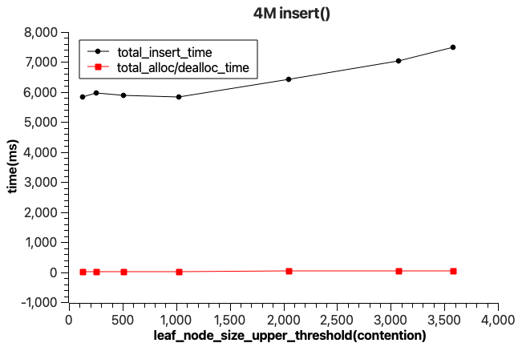
Evaluation
Ratio of alloc, dealloc time
the ratio of optimization target is extremely low,
Performance improvement is almost zero
However, as the alloc-CAS-dealloc execution flow
can be seen in many place(delete, consolidate..),
Optimizing entire can show more improvements..

Slide 17
Thank you

