Slide 1
Storyboard
for Print Policy
1/26/2017
Version 1.0

Slide 2
Approved Print Policy CR
Printer Requirements
- Minimum Requirement: Printer MAY ignore the IPP attribute sent from Print Client and use the default value to prioritize Print Policies.
- If there are one or more conflicts between selected print options contained in "Validate-Job" request and defined print policies, Printer MAY return a "preferred-attributes" collection attribute indicating which substitute values will be used to resolve those conflicts.
Print Client Requirements
- Print Client SHALL support the IPP operation for "preferred-attributes".
- If the Print Client receives "preferred-attributes" collection sent from the printer, the Print Client SHALL inform the user which print setting options will be used instead.
Ex. The dialog box may show a message "The printing will be performed with duplex."

Slide 3
Limitations
IPP
Based on the user authentication, Get-Printer-Attributes does NOT provide any user restricted attributes
preferred-attributes is issued only to Validate-Job request
preferred-attributes is sent by printer when printer finds any conflicts in the user selected settings
Android Printing Framework
Once user taps Print icon, MPS cannot open a print settings screen when MPS gets a preferred-attributes from printer

Slide 4
Print Policy Workflow
User
Client
Printer
Input user/pass
Set print options
Find
a conflicts
Tap print icon
Send Validate-Job
Return
preferred-attributes
Show
Notification Dialog
Tap OK/CANCEL
Send Print-Job
OK: Continue to print
CANCEL: Cancel the job

Slide 5
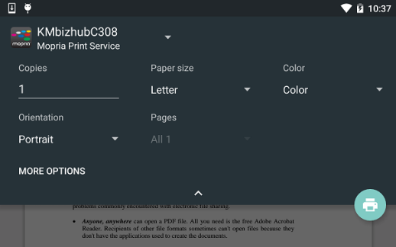

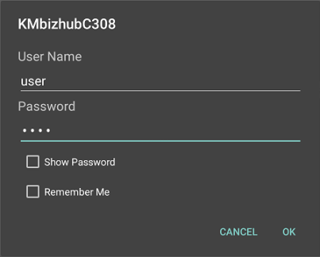
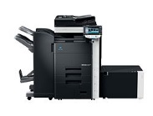

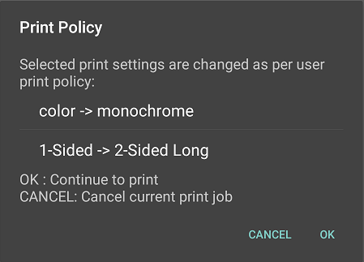
Print Policy Workflow
Conflicts happen in settings
Input user/pass
Set print options
Tap print icon
Validate-Job
preferred-attributes
two-sided-long-edge
monochrome
OK
- Continue to print
CANCEL
- Cancel the print job

Slide 6
Notification Dialog
Notification Message
Policy Setting List
OK/CANCEL
Button
MPS ask user to continue printing even though conflict options are changed by printer
MPS displays a conflict options to user
If user selects OK, MPS will continue to print with Policy settings
If user selects CANCEL, MPS will cancel the print job

Slide 7
Appendix: preferred-attributes
Quoted from PWG 5100.13-2012 - Printer Working Group
1.3 Constraints and "preferred-attributes"
Printers can impose constraints between Job Creation attributes for practical (e.g., duplexing on transparency media), physical (e.g., label printing from a paper tray), and policy (e.g., no color printing for students) reasons. This specification defines two mechanisms on the Client and Printer that allow a Client to discover what those constraints are prior to creating a print job.
Client constraint resolution uses two new Printer attributes that list the constraints and a list of changes used by the printer for resolving them automatically. These attributes allow the Client user interface to present a simple choice to the user when a selection triggers a constraint: revert to the previous settings or make the following additional changes.
Printer constraint resolution uses the Validate-Document and Validate-Job operations. Clients submit a Validate-Document or Validate-Job request with Template attributes that will be used in the actual document or job creation request. If conflicts are present in the supplied Template attributes, the Printer returns a "preferred-attributes" collection attribute indicating which substitute values will be used to resolve those conflicts.
There is no Validate-Subscription operation because subscriptions always enforce attribute

