Slide 1
Evolution of Microservices

Slide 2
Topics
Definitions:
What is Monolith
What is Microservices
Need for Microservices
Components of Microservices
Frameworks of Microservices
Spring Cloud Services
Istio

Slide 3
Typical Monolith
Frontend
Bankend services:
Product Catalog
User Management Service
Purchase Service
Payment Service
Shipment Service
Database
HTML/ CSS
Spring, JSP,
JSTL, ThymeLeaf
Angular/ React
Spring Boot REST

Slide 4
Controller-Service-Repository Pattern
Controller
Service (Mock)
Repository
ControllerTest
Controller
Service
Repository (Mock)
ServiceTest
Controller
Service
Repository
RepositoryTert

Slide 5
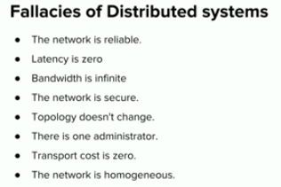
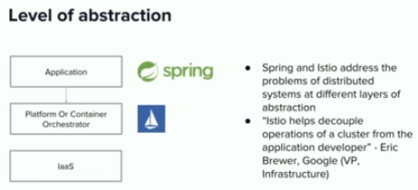

Slide 6
Typical Microservices (Follows Domain Driven Design)
Frontend
API
Gateway
(Spring
Cloud
Gateway)
Service
Registry
(Eureka)
Bankend services:
User
Mgmt
Service
Product
Catalog
Service
Load
Balancing
(Zuul)
Purchase
Service
Payment
Service
Circuit Breaker
(Hystrix)
Config
Server
(Spring
Config
Server)
Shipment
Service
Inventory
Service
Angular/ React
Spring Boot REST

Slide 7
Issues With the Spring Cloud Services
Tightly coupled to the Java Platform. However, in a polyglot architecture you need to look for libraries .
Libraries need to be embedded inside each microservice along with side business functionalities. This causes application bloat since you will need to duplicate similar code across all your services.
Having both the business logic and infrastructure logic increases the overall application complexity.
Operational complexity is also enhanced since you now need to handle the patching/upgrades to the components.
Additional tooling is required to improve the observability of your microservices architecture.

Slide 8
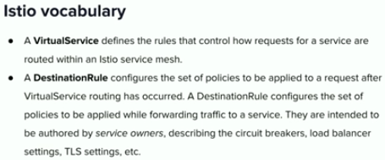
Typical Microservices (Istio)
Frontend
API
Gateway
(Ingress)
Service
Registry
Bankend services:
User
Mgmt
Service
Product
Catalog
Service
Sidecar
(Envoy Proxy)
Sidecar
(Envoy Proxy)
Load
Balancing
Purchase
Service
Payment
Service
Sidecar
(Envoy Proxy)
Circuit Breaker
Sidecar
(Envoy Proxy)
Config
Server
Shipment
Service
Inventory
Service
Sidecar
(Envoy Proxy)
Sidecar
(Envoy Proxy)
Angular/ React
Istio

Slide 9
Benefits of Using a Istio (Sidecar Pattern)
Supports open standard Kubernates
Support Polyglot programming
Reduces the complexity in the microservice code by abstracting the common infrastructure-related functionalities to a different layer.
Reduces code duplication in a microservice architecture since you do not need to write configuration code inside each microservice.
Provides loose coupling between the application code and the underlying platform.

