Slide 1

HCM CPP USER GROUP
Le Phong Vu

Slide 2
What is HCM CPP User Group?
Achievement
The group is growing fast with 30 positive members over 100 members after 3 months.

Meetup
The meetup is held every month at a venue. Programs includes 2 to 3 presentations from community members.

HCM CPP User Group
This group is found to be the place where members can socialize and exchange knowledge.
Idea
Meeting CPP is an activity that is held in many cities around the world by CPP User Groups.
Statistical
1st meetup: 13 members
2nd meetup: 20 members
3rd meetup: 23 members

Slide 3

Target
●


BLUE TARGET
GREEEN TARGET
YELLOW TARGET
RED TARGET
C/C++
Connect
Chance
What is your target?
Improve C/C++ programming skills
Developers, technical gurus, companies
More knowledge, hot jobs

Slide 4
ACTIVITIES

Meetup
Talk about C/C++ and technology every month at FO Coffee
Hack Night
Do more practice every month


Hot jobs
Temporary, we do not accept any recruitment activity in the meetup
Discussion
Discuss face to face at the meetup or online via slack


Slide 5
TIMELINE
Jan
Feb
Mar
Apr
May
First Meetup
Cache & Performance
C++ 11/14 News
std::vector
C++ Talk
Smart Pointer
Internet of Things Thread programming Technical Architect Function Programming
Waiting for submission

Slide 6
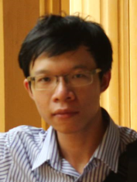
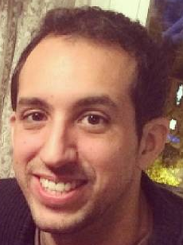
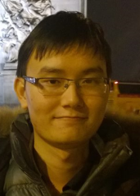
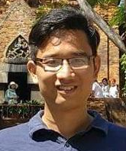
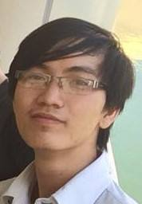
Organizers
1
2
3
4
5
Le Phong Vu
German Diago
Do Ngoc Tan
Du Nguyen A Huy
Huynh Ngoc Thi
Senior C++ at FSoft
Technical management and Engineering at SDK team at Emotiv
RD Engineer at Mauna Kea Technology
Senior iOS, team leader at DKMobility
Embedded programing at TMA Solution

Slide 7
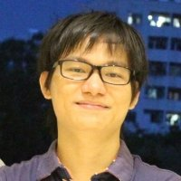
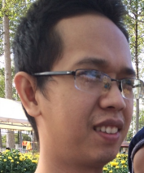
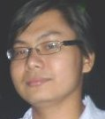
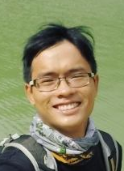

Key Members
6
7
8
9
10
Nguyen Q.Dinh
Thai Cuong
Pham Hoang
Vu Nam Son
Ho Van Tan
Senior Software Engineer at Cvision. Completed Master at Kumoh National Institute of Technology
VOIP/XMPP developer
A lecturer at University of Science
Saleforce Engineer
Senior C/C++ at Global Cyber Soft

Slide 8
Next Meetup
9:00 AM 24 April 2016 126 Dien Bien Phu street
Internet Of Things
Technical Architect
Nguyen Q Dinh C/C++ Senior Engineer
PhD Nguyen Vu
Thread Programming
Functional Programming
Ngoc Tan Do RD Engineer
German Diago Technical Leader at Emotiv
Start
Finish
Register
Please register via this link
http://goo.gl/forms/0g7ETUHwxl

Slide 9
Connect with us
01
04
Meetup
Slack
http://www.meetup.com/hcmcpp/
https://hcmcppug.slack.com/
02
05
Group
Github
https://www.facebook.com/groups/hcmcpp/
https://github.com/hcmcppug/meetupdata/
03
06
Page
Email
https://www.facebook.com/hcmcpp/
hcmcppug@gmail.com

