Slide 1
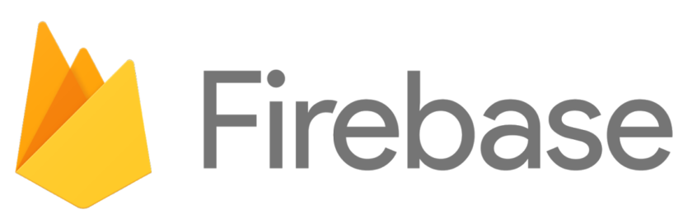
NOSQL, Cloud Storage, Realtime Database

Slide 2


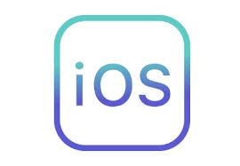

What is Firebase?
Firebase is a mobile and web app development platform that provides developers with a plethora of tools and services to help them develop high-quality apps, grow their user base.
Some Platform Firebase Support

Slide 3
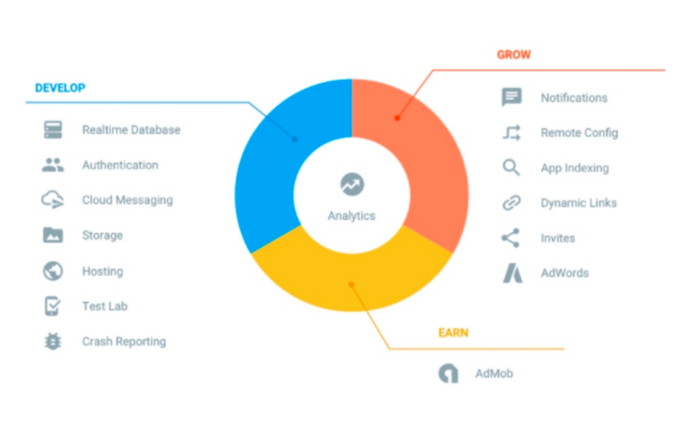
Firebase Service

Slide 4
How Firebase communicate with client?

Slide 5
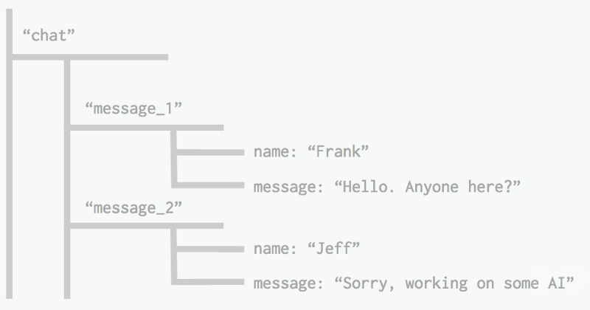
What is Firebase?
Firebase is NoSQL Database and Realtime Database. Data is stored in Cloud.

Slide 6
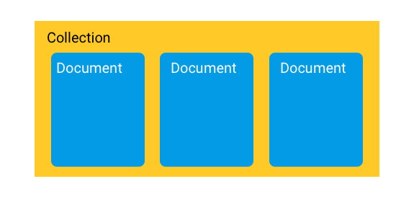
Firebase FireStore NoSQL Database

Slide 7
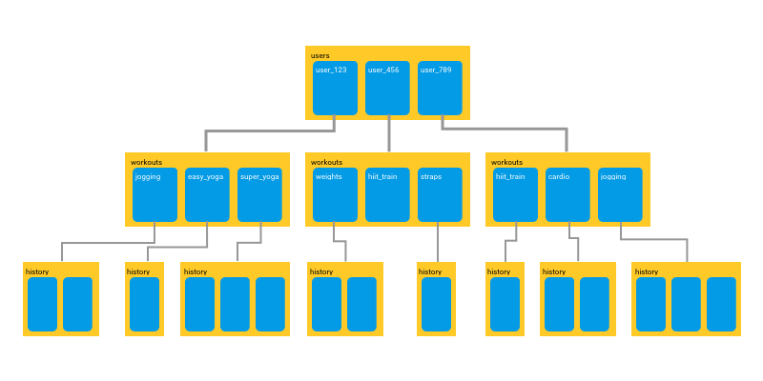

Slide 8
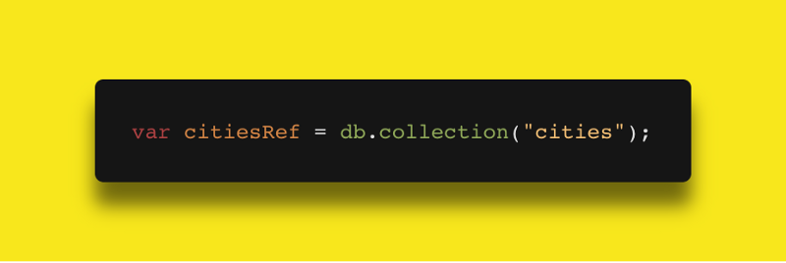
Query FireStore NoSQL Database
Get Specific Collection

Slide 9
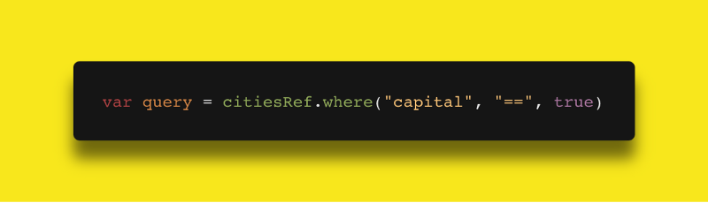
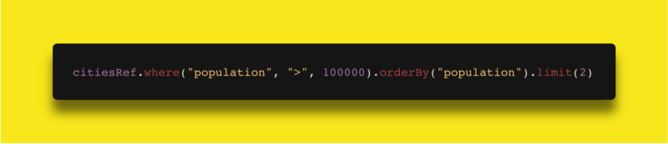
Query FireStore NoSQL Database
Get Specific Document from Collection
Get Specific Document from Collection and Order, limit record

Slide 10
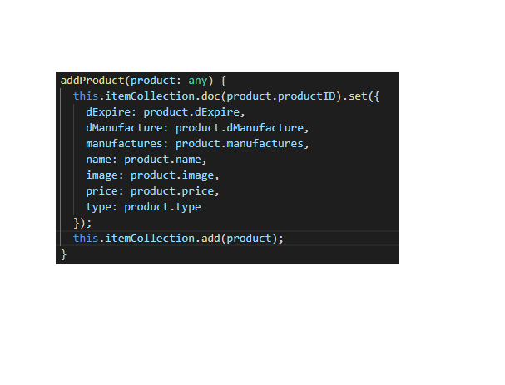
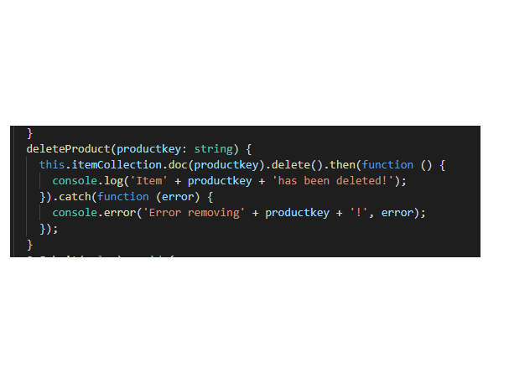
Add, Delete query

Slide 11
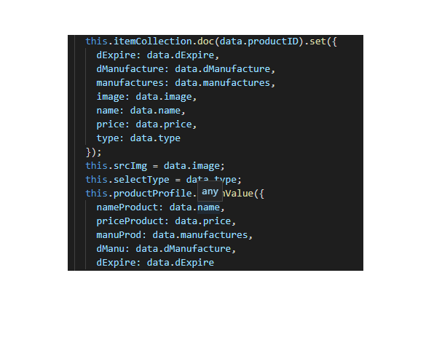
Update query

Slide 12
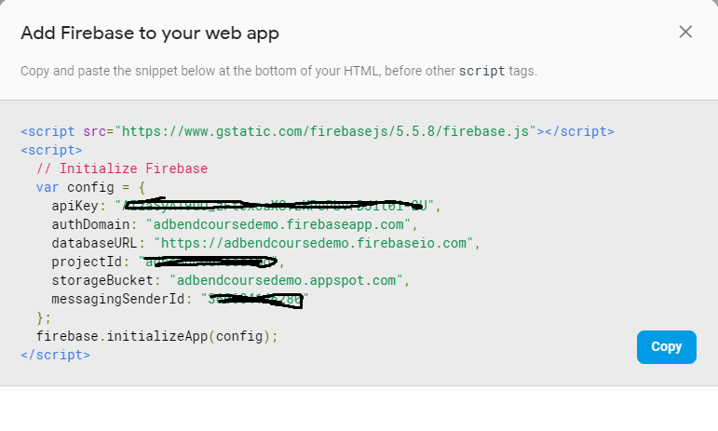
Add Firebase to Your Project

Slide 13
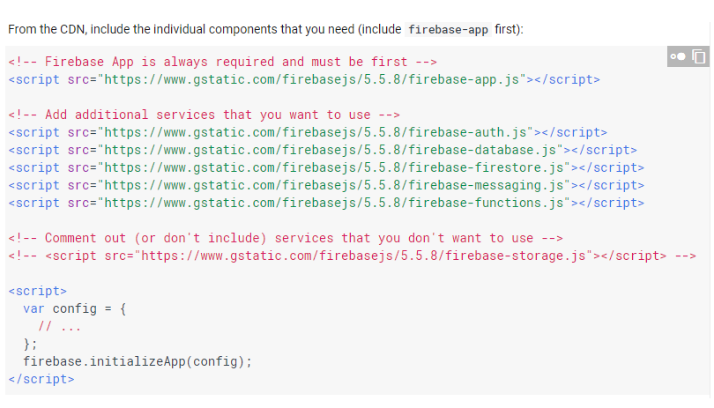
Add Firebase to Your Project

Slide 14
Demo Web Application
Demo Using Angular JS Framework v6.7.1 + Firebase Firestore Cloud Storage
API support fetching data using Angularfire2

Slide 15
Link Relate
https://firebase.google.com/docs/
https://hackernoon.com/introduction-to-firebase-218a23186cd7
https://www.youtube.com/watch?v=5qoU1EirSmo
https://github.com/angular/angularfire2
https://material.angular.io

Slide 16
Thank for watching!!!

