Slide 1
SW PIONEER HACKERTHON :
See with Emotion!
KLOUD
Taeseung Kim
Hocheol Nam
Gyeonghyun Lim

Slide 2
Why we select this topic

Slide 3
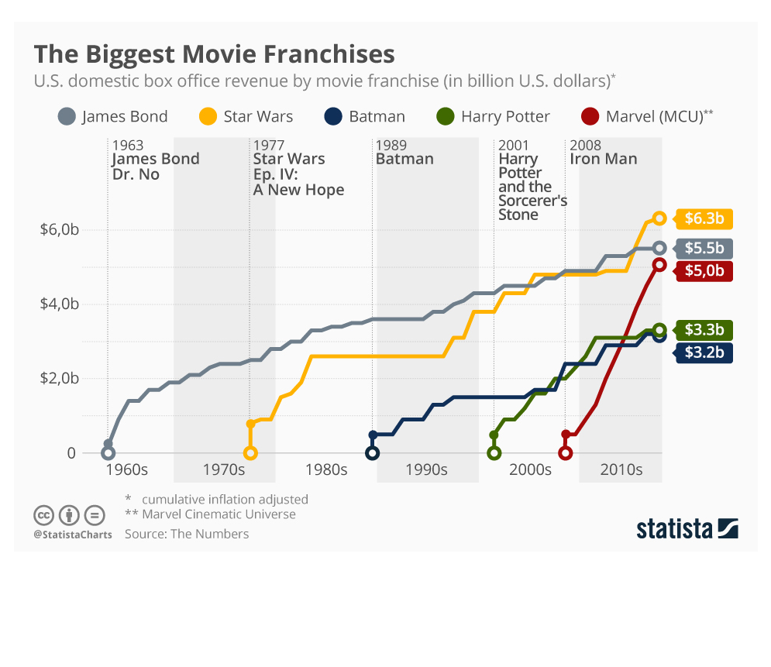
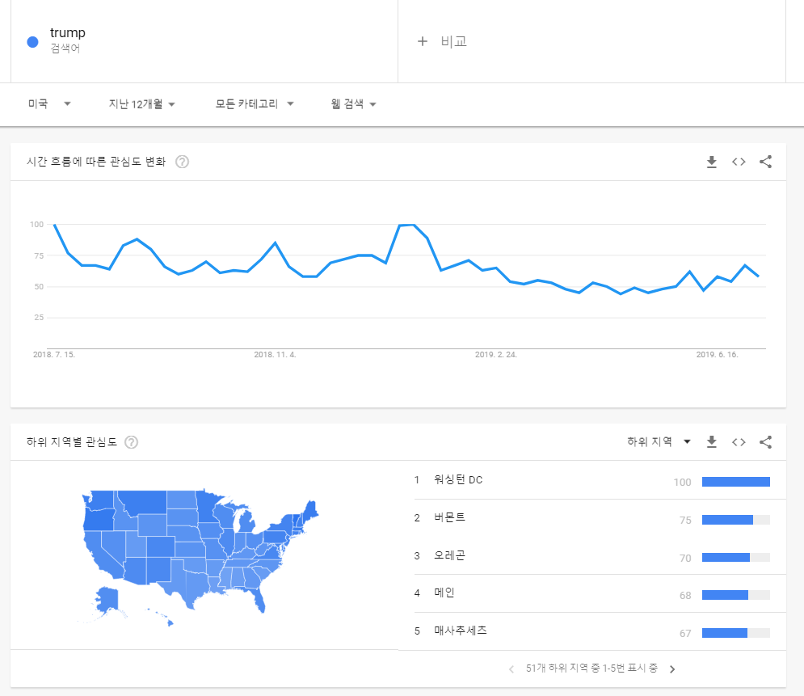

Why we select this topic

Slide 4

what we made

Slide 5
How
Tweet
Collecting
Data
Analyzing
Visualization

Slide 6
what we used

Slide 7
Thank you!

