Slide 1


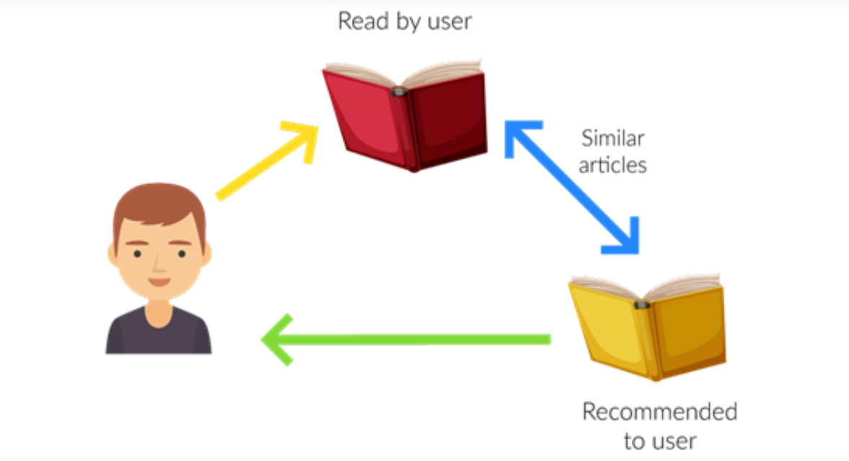
Recommendation System
Group 3
Ankita Bagaria, Hao Chun Niu (Eric), Jing Xie, Riya Khurana, Travis St. Louis
Notes:
Hello. I’m Travis, along with my teammates Ankita, Eric, Jing, and Riya, we’ll be presenting our recommendation system for books.

Slide 2
Outline
01
Business Problem
02
Collaborative Filter Recommender System03
03
Technology Used
04
System Instruction
05
Future Steps
Notes:
We’ll start our presentation by discussing the business problem. Next, we’ll describe what an item-based recommendation system is and then move into the technologies we used to build our book recommendation system. After explaining the technology, we’ll walk you through the data storage process, prediction steps, and show an actual book recommendation output. Finally, we’ll talk about a few limitations of our recommender system.

Slide 3




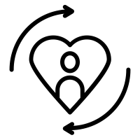


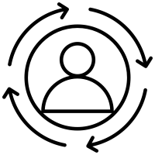
Business Problem
Value for Customer
Improve Customer Experience
Discover new things
Reduced transaction costs
Complementary items
Value for Business
Improved Customer Loyalty
More customer knowledge
Personalized Service
Increased sales & conversion rate

Slide 4
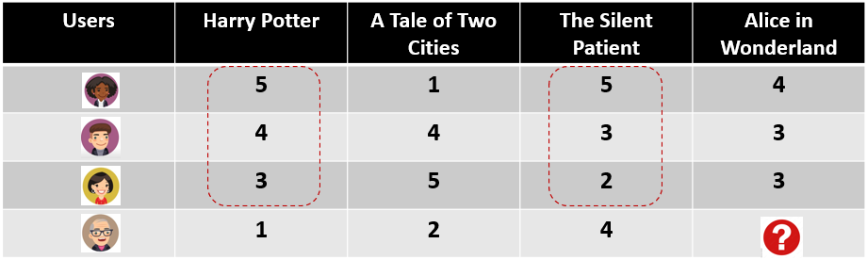
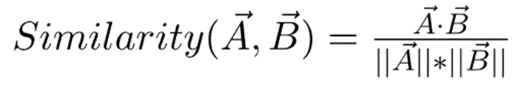
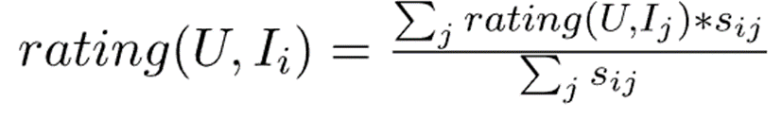
Item Based Recommender System
Item to Item Similarity
Prediction Computation

Slide 5


Technology Used
Data Set
Amazon S3
Amazon Sagemaker
End users
Historical data obtained on books rating from Kaggle
Stored data into S3 for further processing
Built memory based recommendation system within Sagemaker
Promote cross-selling by showing top recommended books to customers
The implementation of recommendation system is quite straightforward and requires only a storage platform and Machine Learning tool

Slide 6
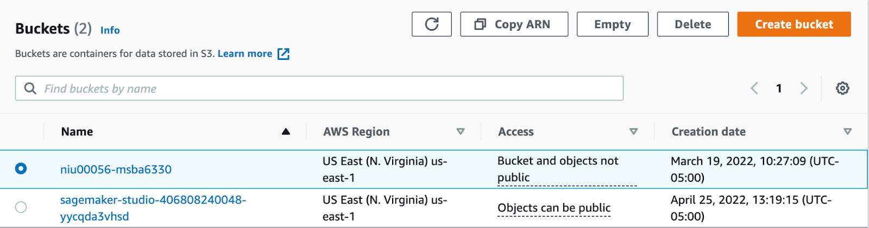
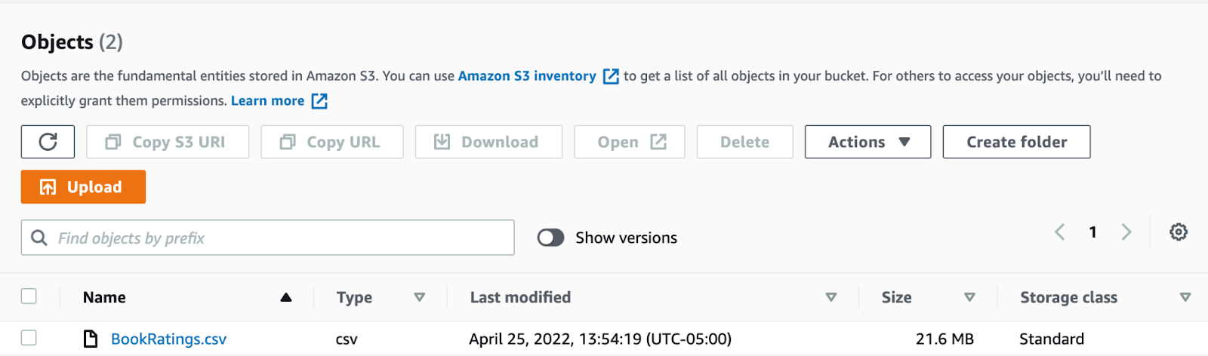
S3 Data Storage Process Flow
Step1. Create S3 Storage Bucket
Step2. Upload Data into Bucket

Slide 7
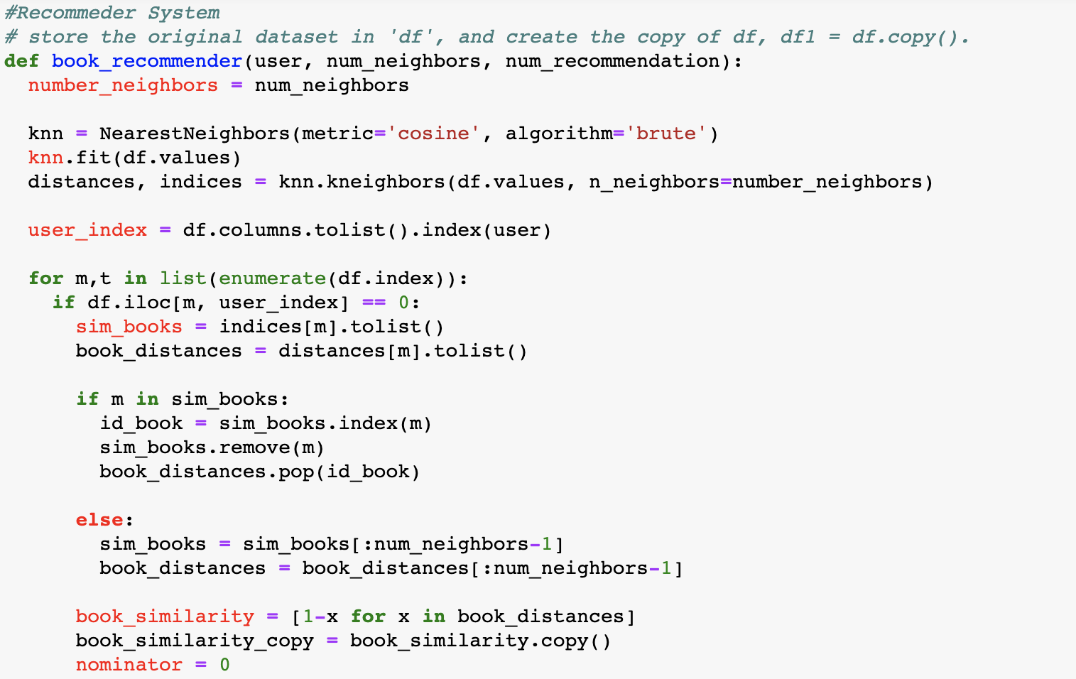
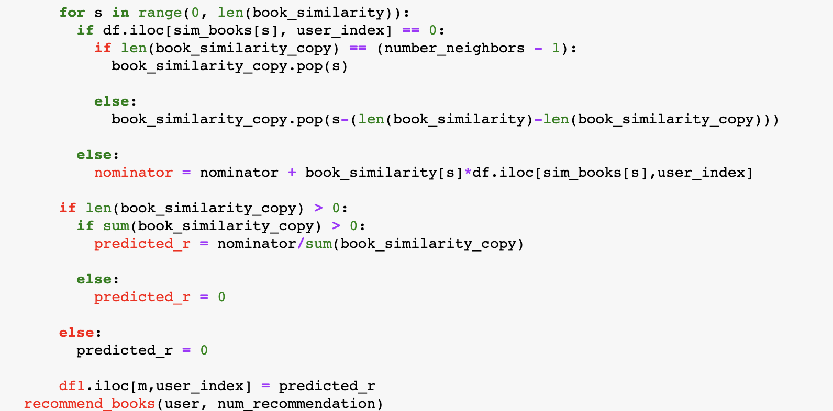
Model Development Using Sagemaker
Step1. Calculate Book Similarity
Step2. Make Predictions

Slide 8

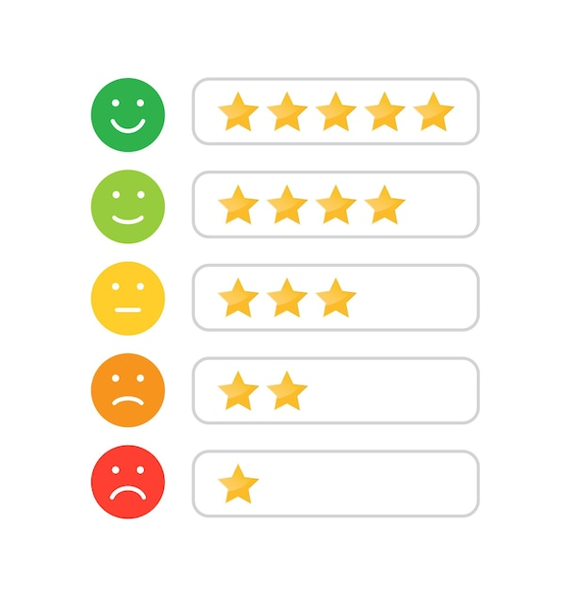


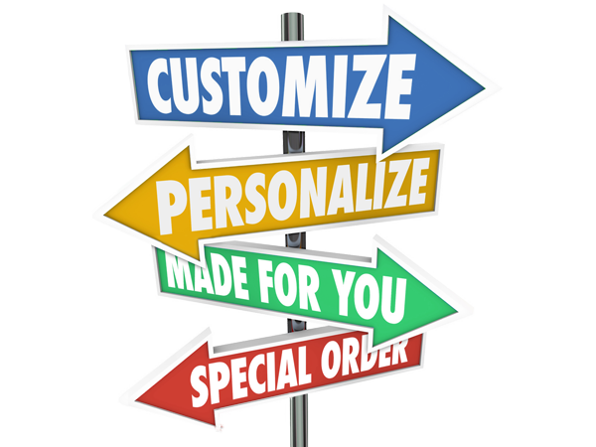
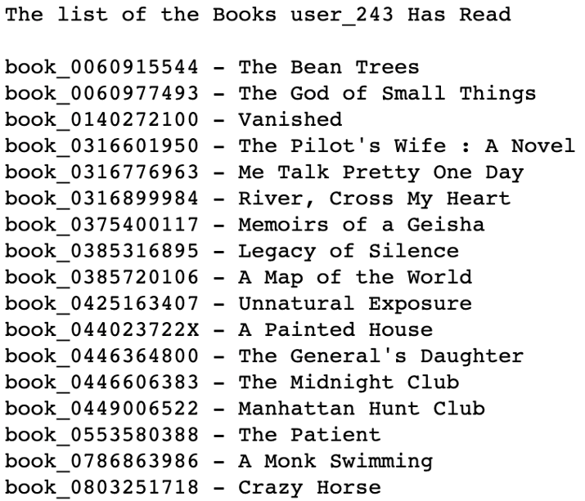

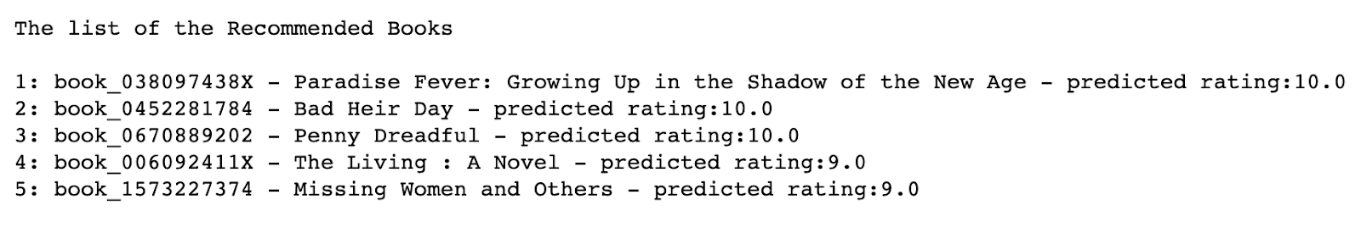

System Instruction - Result
Input
User ID
Items
Ratings
Books Already Read
Personalized Recommendations
Output

Slide 9
Limitations
1
2
3
4
Limited computational resources
Number of recommendations
Measurement of recommendation system
Finding niche items
Notes:
With the limited computational resources available to us, we were unable to run our book recommendation system on the entire dataset. We successfully loaded all data into Amazon S3 and built the model with Jupyter Notebook in SageMaker; however, we pulled a subset of the data to test that our model performed as expected. The recommendation model is fully operational and can be implemented for any business use cases that have the appropriate computational resources. Another limitation is the number of recommendations provided to a user. It’s not feasable to provide all book recommendations to a user; therefore, a business decision needs to be made regarding the top number of books, for example 20 or 30, provided to a specifc user. Third, evaluating the effectiveness of any recommendation system is challenging due to underlying preference assumptions. Finally, finding similar products is difficult for niche books.

Slide 10
Conclusion
Business value
How recommendation system works
Our book recommendation system
Technology used
Prediction process
Recommendation output
Limitations of recommender system
Benefits
Improved customer experience
Personalized service
Increased sales
Notes:
In summary, our team talked about the customer and business value of a recommendation system and how an item-based recommendation system works. We then shared specific details about the technology, prediction process, and output of our book recommendation system. Our team highlighted a few limitations of the recommendation system; however, the improved customer experience, personalized service, and increased sales benefits far outweigh any limitations of our book recommendation system, or any recommendation system in general. Thank you for your time and attention

