Slide 2
Success is walking from failure to failure with no loss of enthusiasm.
King
Queen
Man
Woman

Slide 3
Success is walking from failure to failure with no loss of enthusiasm.
Success is walking from failure to failure with no loss of enthusiasm.
Success is walking from failure to failure with no loss of enthusiasm.
Success is walking from failure to failure with no loss of enthusiasm.
Success is walking from failure to failure with no loss of enthusiasm.
Success is walking from failure to failure with no loss of enthusiasm.
Success is walking from failure to failure with no loss of enthusiasm.
Success is walking from failure to failure with no loss of enthusiasm.

Slide 4
나는
너를
사랑해
<EOS>
RNN
RNN
RNN
RNN
RNN
RNN
RNN
RNN
I
Love
You
<EOS>
<BOS>
나는
너를
사랑해
<Encoder>
<Decoder>

Slide 5
나는
너를
사랑해
<EOS>
Context
Attention
RNN
RNN
RNN
RNN
RNN
RNN
RNN
RNN
I
Love
You
<EOS>
<BOS>
나는
너를
사랑해
<Encoder>
<Decoder>

Slide 7
5
1
2
4
5
6
7
10
2
7
1
4
6
10

Slide 8




5
$$2^{0}=1$$
2
7
$$2^{1}=2$$
$$⋮$$
1
4
6
10
$$2^{k−1}$$

Slide 9
15
7
6
6
5
A
B
C
D
E
15
7
6
A
B
C
11
6
5
D
E

Slide 10
2
3
5
7
9
13
A
B
C
D
E
F
5
7
9
13
5
C
D
E
F
2
3
A
B

Slide 11
2
3
5
7
9
13
A
B
C
D
E
F
7
9
13
10
D
E
F
5
5
C
2
3
A
B

Slide 12
2
3
5
7
9
13
A
B
C
D
E
F
13
10
16
F
5
7
9
5
C
D
E
2
3
A
B

Slide 13
2
3
5
7
9
13
A
B
C
D
E
F
23
16
13
7
9
10
F
D
E
5
5
C
2
3
A
B

Slide 14
39
16
23
7
9
13
D
E
10
F
5
5
C
2
3
A
B

Slide 15
39
16
23
7
9
13
D
E
10
F
5
5
C
2
3
A
B

Slide 16
39
Right of 39
16
23
7
9
Left of 23
13
D
E
10
F
5
5
C
2
3
Right of 10
A
B

Slide 17



$$K$$
Attention Score
$$V$$
I
I
want
want
$$Q$$
to
to
live
live
나는
in
in
멋진
Seoul,
Seoul,
Context Vector
볼거리가
where
where
많은
there
there
서울에
are
are
살고
many
many
싶다.
wonderful
wonderful
things
things
to
to
see.
see.

Slide 18
$$K$$
Attention Score
$$V$$
I
I
want
want
$$Q$$
to
to
live
live
나는
in
in
멋진
Seoul,
Seoul,
Context Vector
볼거리가
where
where
많은
there
there
서울에
are
are
살고
many
many
싶다.
wonderful
wonderful
things
things
to
to
see.
see.

Slide 19
$$K$$
Attention Score
$$V$$
I
I
want
want
$$Q$$
to
to
live
live
나는
in
in
멋진
Seoul,
Seoul,
Context Vector
볼거리가
where
where
많은
there
there
서울에
Dot-Product
Weighted Sum
are
are
살고
many
many
싶다.
wonderful
wonderful
things
things
to
to
see.
see.

Slide 20
$$K$$
Attention Score
$$V$$
I
I
want
want
$$Q$$
to
to
live
live
나는
in
in
멋진
Seoul,
Seoul,
Context Vector
볼거리가
where
where
많은
there
there
서울에
Dot-Product
Weighted Sum
are
are
살고
many
many
싶다.
wonderful
wonderful
things
things
to
to
see.
see.

Slide 21
$$K$$
Attention Score
$$V$$
I
I
want
want
$$Q$$
to
to
live
live
나는
in
in
멋진
Seoul,
Seoul,
Context Vector
볼거리가
where
where
많은
there
there
서울에
Dot-Product
Weighted Sum
are
are
살고
many
many
싶다.
wonderful
wonderful
things
things
to
to
see.
see.

Slide 22
$$K$$
Attention Score
$$V$$
I
I
want
want
$$Q$$
to
to
live
live
나는
in
in
멋진
Seoul,
Seoul,
Context Vector
볼거리가
where
where
많은
there
there
서울에
Dot-Product
Weighted Sum
are
are
살고
many
many
싶다.
wonderful
wonderful
things
things
to
to
see.
see.

Slide 23
나는
너를
사랑해
<EOS>
나는
너를
사랑해
<EOS>
나는
너를
사랑해
<EOS>
나는
너를
사랑해
<EOS>
Decoder
Decoder
Decoder
Decoder
Masking
Masking
Masking
<BOS>
나는
너를
사랑해
<BOS>
나는
너를
사랑해
<BOS>
나는
너를
사랑해
<BOS>
나는
너를
사랑해
Time Step: 1
Time Step: 2
Time Step: 3
Time Step: 4

Slide 24
나는
나는
너를
나는
너를
사랑해
나는
너를
사랑해
<EOS>
Decoder
Decoder
Decoder
Decoder
<BOS>
<BOS>
나는
<BOS>
나는
너를
사랑해
<BOS>
나는
너를
사랑해
Time Step: 1
Time Step: 2
Time Step: 3
Time Step: 4

Slide 25

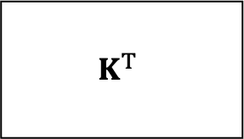
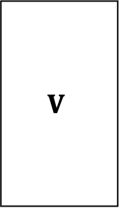

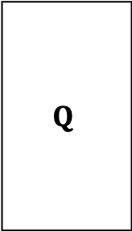
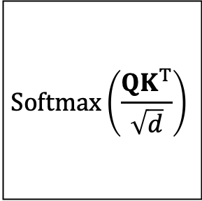




$$d times$$
$$Q$$
$$K^{T}$$
$$n^{2} times$$
$$∙$$
$$=$$
$$Softmax\left(\frac{QK^{T}}{\sqrt{d}}\right)$$
$$V$$
$$∙$$
$$=$$
$$n∙d times$$
$$n times$$

Slide 26
















$$T_{1}$$
$$T_{2}$$
$$⋯$$
$$T_{N}$$
$$Trm$$
$$Trm$$
$$⋯$$
$$Trm$$
$$LSTM$$
$$Trm$$
$$Trm$$
$$⋯$$
$$Trm$$
$$E_{1}$$
$$E_{2}$$
$$⋯$$
$$E_{N}$$

Slide 27
$$T_{1}$$
$$T_{2}$$
$$⋯$$
$$T_{N}$$
$$Trm$$
$$Trm$$
$$⋯$$
$$Trm$$
$$LSTM$$
$$Trm$$
$$Trm$$
$$⋯$$
$$Trm$$
$$E_{1}$$
$$E_{2}$$
$$⋯$$
$$E_{N}$$

Slide 28













$$T_{1}$$
$$T_{2}$$
$$⋯$$
$$T_{N}$$
$$LSTM$$
$$LSTM$$
$$⋯$$
$$LSTM$$
$$LSTM$$
$$LSTM$$
$$⋯$$
$$LSTM$$
$$LSTM$$
$$LSTM$$
$$LSTM$$
$$⋯$$
$$LSTM$$
$$LSTM$$
$$LSTM$$
$$⋯$$
$$LSTM$$
$$E_{1}$$
$$E_{2}$$
$$⋯$$
$$E_{N}$$

