Slide 2
Success is walking from failure to failure with no loss of enthusiasm.
King
Queen
Man
Woman

Slide 3
Success is walking from failure to failure with no loss of enthusiasm.
Success is walking from failure to failure with no loss of enthusiasm.
Success is walking from failure to failure with no loss of enthusiasm.
Success is walking from failure to failure with no loss of enthusiasm.
Success is walking from failure to failure with no loss of enthusiasm.
Success is walking from failure to failure with no loss of enthusiasm.
Success is walking from failure to failure with no loss of enthusiasm.
Success is walking from failure to failure with no loss of enthusiasm.

Slide 4
나는
너를
사랑해
<EOS>
RNN
RNN
RNN
RNN
RNN
RNN
RNN
RNN
I
Love
You
<EOS>
<BOS>
나는
너를
사랑해
<Encoder>
<Decoder>

Slide 5
나는
너를
사랑해
<EOS>
Context
Attention
RNN
RNN
RNN
RNN
RNN
RNN
RNN
RNN
I
Love
You
<EOS>
<BOS>
나는
너를
사랑해
<Encoder>
<Decoder>

Slide 7
5
1
2
4
5
6
7
10
2
7
1
4
6
10

Slide 8




5
$$2^{0}=1$$
2
7
$$2^{1}=2$$
$$⋮$$
1
4
6
10
$$2^{k−1}$$

Slide 9
15
7
6
6
5
A
B
C
D
E
15
7
6
A
B
C
11
6
5
D
E

Slide 10
2
3
5
7
9
13
A
B
C
D
E
F
5
7
9
13
5
C
D
E
F
2
3
A
B

Slide 11
2
3
5
7
9
13
A
B
C
D
E
F
7
9
13
10
D
E
F
5
5
C
2
3
A
B

Slide 12
2
3
5
7
9
13
A
B
C
D
E
F
13
10
16
F
5
7
9
5
C
D
E
2
3
A
B

Slide 13
2
3
5
7
9
13
A
B
C
D
E
F
23
16
13
7
9
10
F
D
E
5
5
C
2
3
A
B

Slide 14
39
16
23
7
9
13
D
E
10
F
5
5
C
2
3
A
B

Slide 15
39
16
23
7
9
13
D
E
10
F
5
5
C
2
3
A
B

Slide 16
39
Right of 39
16
23
7
9
Left of 23
13
D
E
10
F
5
5
C
2
3
Right of 10
A
B

Slide 17

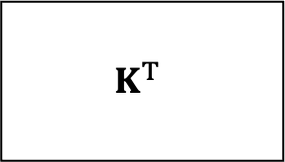
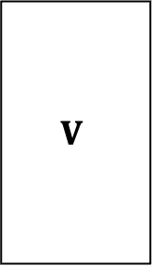

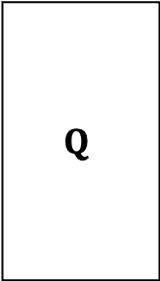
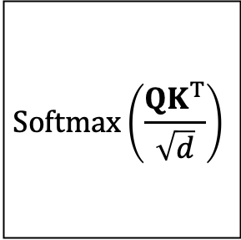




$$d times$$
$$Q$$
$$K^{T}$$
$$n^{2} times$$
$$∙$$
$$=$$
$$Softmax\left(\frac{QK^{T}}{\sqrt{d}}\right)$$
$$V$$
$$∙$$
$$=$$
$$n∙d times$$
$$n times$$

Slide 18
















$$T_{1}$$
$$T_{2}$$
$$⋯$$
$$T_{N}$$
$$Trm$$
$$Trm$$
$$⋯$$
$$Trm$$
$$LSTM$$
$$Trm$$
$$Trm$$
$$⋯$$
$$Trm$$
$$E_{1}$$
$$E_{2}$$
$$⋯$$
$$E_{N}$$

Slide 19
$$T_{1}$$
$$T_{2}$$
$$⋯$$
$$T_{N}$$
$$Trm$$
$$Trm$$
$$⋯$$
$$Trm$$
$$LSTM$$
$$Trm$$
$$Trm$$
$$⋯$$
$$Trm$$
$$E_{1}$$
$$E_{2}$$
$$⋯$$
$$E_{N}$$

Slide 20













$$T_{1}$$
$$T_{2}$$
$$⋯$$
$$T_{N}$$
$$LSTM$$
$$LSTM$$
$$⋯$$
$$LSTM$$
$$LSTM$$
$$LSTM$$
$$⋯$$
$$LSTM$$
$$LSTM$$
$$LSTM$$
$$LSTM$$
$$⋯$$
$$LSTM$$
$$LSTM$$
$$LSTM$$
$$⋯$$
$$LSTM$$
$$E_{1}$$
$$E_{2}$$
$$⋯$$
$$E_{N}$$

