Slide 1

CUCUMBER
By Ariel Yanarico, Lucero Peñarrieta, Alejandra Neolopan
JALA-FOUNDATION
2016

Slide 2
Outline
TDD - BDD overview
What is Cucumber?
How it works?
Reports
Common Failures

Slide 3


Test Driven Development
TDD is a programming technique that encourages an evolutionary approach to the design and development of a system.
“ Write tests before they code ”
Focus the programmer's attention on
problem to solve rather than the solution.

Slide 4

Behaviour-Driven Development
BDD is an evolution in the thinking behind TDD.
BDD uses natural language to describe the "desired behavior" of the system, that can be understood by customer, developers, testers, analysts & managers

Slide 5

What Is Cucumber?

Slide 6
What Is Cucumber?
Cucumber is a framework for writing and executing high level descriptions of your software's functionality.
It uses Natural language process.
It is useful for Acceptance Test, Regression Tests, Smoke Tests, “Living Documentation,” etc.

Slide 7
Advantages
Cucumber tests or scenarios or examples or specifications share the benefit of traditional specification documents.
They can be written and read by business stakeholders.

Slide 8
How integrate with Maven?

Slide 9
Dependencies
<dependency>
<groupId>info.cukes</groupId>
<artifactId>cucumber-junit</artifactId>
<version>1.2.4</version>
<scope>test</scope>
</dependency>
<dependency>
<groupId>info.cukes</groupId>
<artifactId>cucumber-testng</artifactId>
<version>1.2.4</version>
</dependency>
<dependency>
<groupId>info.cukes</groupId>
<artifactId>cucumber-java</artifactId>
<version>1.2.4</version>
<scope>test</scope>
</dependency>

Slide 10
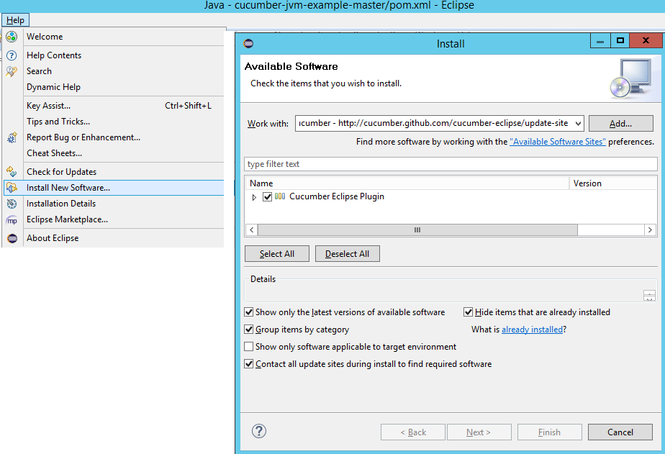
Cucumber eclipse plugin

Slide 11
How it works?

Slide 12
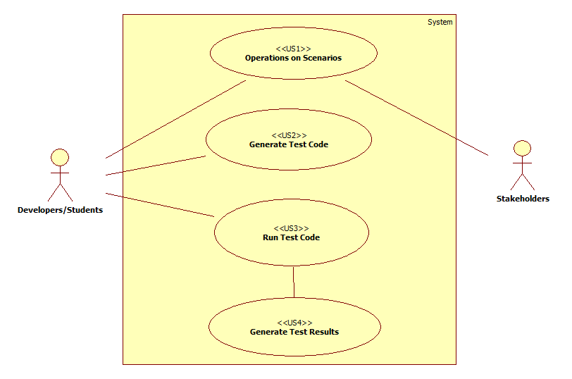
User Scenarios: Defining WHAT TO DO

Slide 13
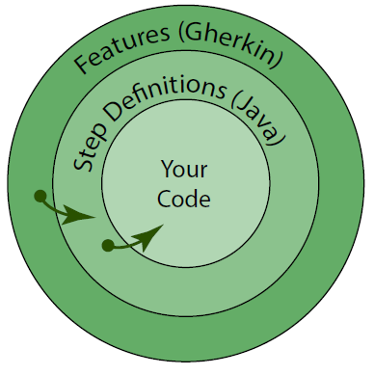
Gherkin
Cucumber tests are expressed using a syntax called Gherkin.
Gherkin files are plain text and have a .feature extension.
Features contains
Scenarios
Steps
This steps call step definitions
providing link between
Gherkin features
application being built.

Slide 14
Creating a simple Scenario
Feature: Email account sign in
Scenario: Duplicate email
Where someone tries to create an account for an email address that already exists.
Given I have chosen to sign up
When I enter an email address that has already registered
Then I should be told that the email is already registered
And I should be offered the option to recover my password

Slide 15
Creating a Scenario Outline
Lets us specify multiple scenarios using a table
Feature: Adding
Scenario Outline: Add two numbers
Given the input "<input>"
When the calculator is run
Then the output should be "<output>"
Examples:
| input | output |
| 2+2 | 4 |
| 98+1 | 99 |

Slide 16
Step Definitions - HOW TO DO
Using eclipse cucumber plugin, we can generate this code:
public class CheckoutSteps {
@Given("^the input "<input>"$")
public void the_input_input(String arg1) throws Throwable {
Calculator.read(arg1);
}
@When("^the calculator is run$")
public void the_calculator_is_run() throws Throwable {
Calculator.run();
}
@Then("^the output should be "<output>"$")
public void the_output_shouldBe(String arg1) throws Throwable {
Assert.assertTrue(Calculator.verifyOutput());
}
}

Slide 17
Runner Class
This class will search for feature files and run them
From JUnit
import cucumber.api.junit.Cucumber;
import org.junit.runner.RunWith;
@RunWith(Cucumber.class)
public class RunCukesTest {
}

Slide 18
Runner Class
From TestNG
import cucumber.api.CucumberOptions;
import cucumber.api.testng.AbstractTestNGCucumberTests;
@CucumberOptions(plugin = "json:target/cucumber-report.json")
public class RunCukesTest extends AbstractTestNGCucumberTests {
}
or
public class LoginScenarioTest {
@Test
public void run_cukes () throws IOException {
new TestNGCucumberRunner(getClass()).runCukes();
}
}

Slide 19
Runner cucumber steps (glue code)
@CucumberOptions annotation let us change options to the runner classes.
@CucumberOptions(plugin={"pretty", "html:out.html"}, glue="nicebank",features ="src/test/resources/nicebank")
To run all our scenarios tagged with either @TagA or @TagB, we’d write:
@CucumberOptions(tags="@TagA,@TagB", glue="step_definitions", features ="features")
To run all scenarios tagged with both @TagA and @TagB, we’d write:
@CucumberOptions(tags={"@TagA", "@TagB"},
glue="step_definitions", features ="features")

Slide 20
Reports
Pretty plugin
Example

Slide 21
Formaters
Cucumber produce a more verbose report similar to the Gherkin source text using the pretty plugin.
JSON result:
format = { "pretty", "json:target/cucumber.json" }
Native HTML plugin:
format = { "pretty", "html:target/site/cucumber-pretty", "json:target/cucumber.json" }
Cucumber Reports HTML plugin:
format = { "pretty", "html:target/cucumber", "json:target/cucumber.json" } Adding dependencies.

Slide 22
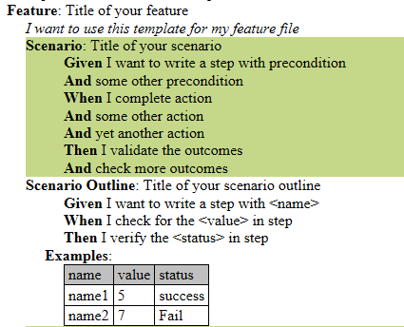
Example:

Slide 23
Common failures…

Slide 24
Failure mode #1 - Too implementation dependent
BAD
Given I have entered 50 into the calculator
And I have entered 70 into the calculator
When I press add
Then the result should be 120 on the screen
BETTER
When I add 50 and 70
Then the result is 120

Slide 25
Failure mode #2 - Programmatic Scripts
BAD
When I set x to 1
And while x < 50
And set row x to "empty"
BETTER
Then set the first 50 rows to "empty"

Slide 26
Failure mode #3 - Too low level
BAD
When I go to the login page
And enter "bob" into the username field
And enter "pass123" into the password field
And click login
Then I am logged in as "bob"
BETTER
When I log in as "bob"

Slide 27
Failure mode #4 - Not exploring interesting cases
BAD
When I add 50 and 70
Then the result is 120
BETTER
When I add 50 and 70
Then the result is 120
When I add 1e90, 0.1, and -1e90
Then the result is 0.1

Slide 28
Failure mode #5 - Not using regex
BAD
@When("Set the budget to 100")
public void setBudget()
{
...
}
BETTER
@When("Set the budget to (.*)")
public void setBudget(int amount)
{
...
}

Slide 29
Failure mode #6 - Complex parsing logic
BAD
@When("(.*) the (.*) to (.*)")
public void doAction(String action, String name, String value)
{
if (action.equals("set") && name.equals("budget")
}
BETTER
@When("Set the budget to (.*)")
public void setBudget(int amount)
{
...
}

Slide 30
Failure mode #7 - Leaking code details
BAD
When I click the BTN-REFRESH-ALL button
BETTER
When I refresh all

Slide 31
Failure mode #8 - Bad test architecture
BAD
Calling entry points in code that are fragile, or disappear
BETTER
Using supported public or test API's

Slide 32
THANKS!
JALA-FOUNDATION
2016

