Slide 1
Theme 4: Design Portfolio
Hayden Coffey and Ashwin Poduval

Slide 2
Stacked bars and positional encodings
The first set of designs described here were inspired by a mix of stacked bar charts and area charts
One axis in stacked bars is used for scalability/comparison
We decided to encode distribution information along that axis, retaining the other axis’s role in providing information about part-whole relationships
Our first set of designs merely encoded standard deviation using the thickness of the graph, as shown in the slide after the next one

Slide 3
Normalized vs Absolute standard deviation
We realized that categories with higher means would be more likely have higher values of standard deviation
Thus, we chose to normalize the value of standard deviation by the mean to obtain a ratio helping us understand spread with respect to mean
For some of the hand-drawn figures, we grouped some of the tasks together to make it easier to create data accurate sketches; the stats are listed below
Category | Mean | Std. Dev./Normalized Std. Dev.
T01 (Personal Care) | about 576 min (40% of day) | 143.3/0.25
T12 (Leisure, Socializing) | about 300 min (20-21% of day) | 212.6/0.7
T05 (Work) | about 158 min (10-11% of day) | 240.2/1.5
T02 (Household Activities) | about 121 min (8.4% of day) | 141.1/1.17
All others | about 285 min (~20% of day) | 190.9/0.67

Slide 4
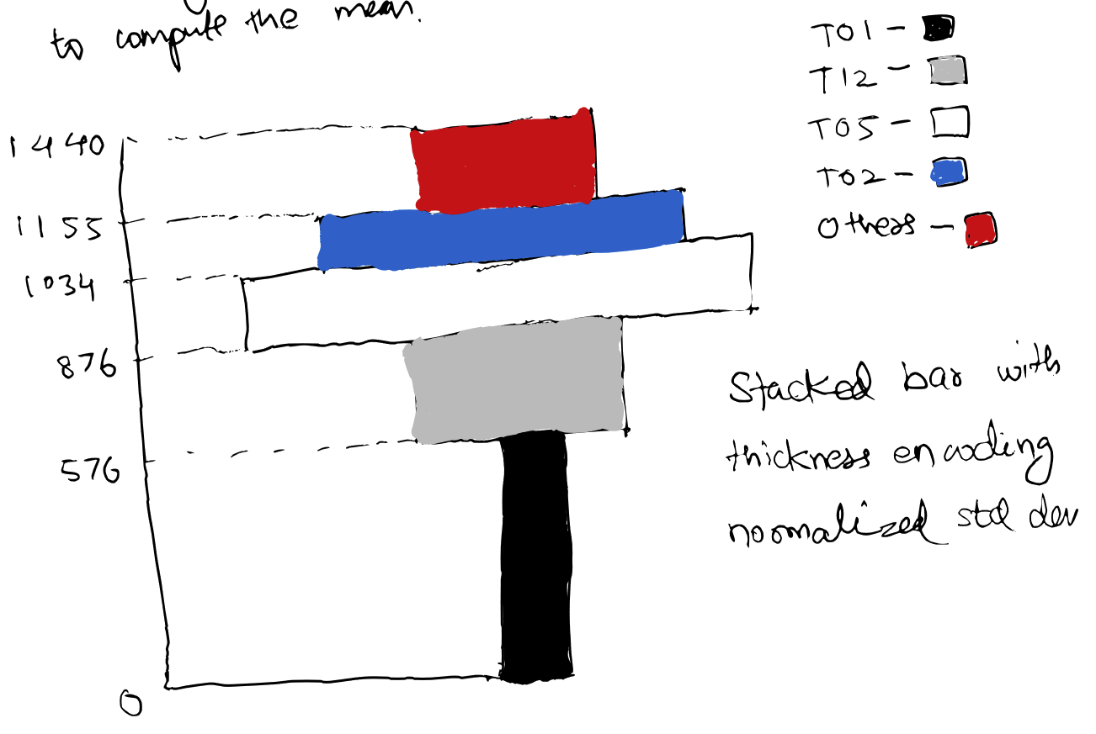
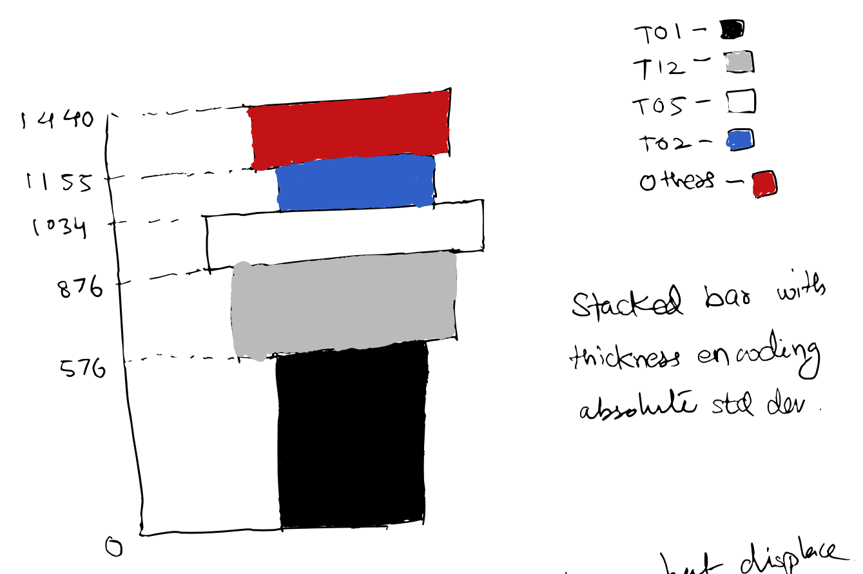
Hand drawn sketches: stats used in table on previous slide

Slide 5
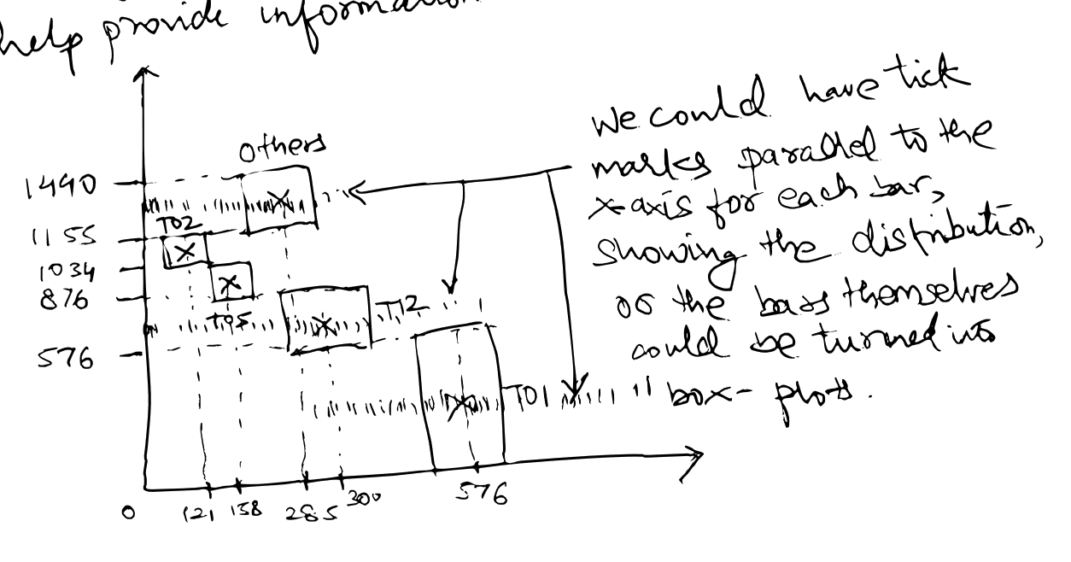
Making further use of the x-axis
While information about standard deviation is helpful, it may not provide the full story to a viewer
Our next design used bars of uniform thickness, we placed category bars at the corresponding mean locations
To prevent overlap, we had the bars span differents heights
This was like a stacked bar chart, with displaced bars
We encoded distribution information using tick marks

Slide 6
Refinement
Placing bars at different locations hurt readability
Viewers eyes would have to jump around the figure
We decided to scrap the bars
We could stack areas parallel to the x-axis which respected the part-whole relation
Represented the distribution of the aggregated variable in this band
Iterated and developed an initial design, as shown in the next slide
Decided to implement it programmatically because drawing accurate hand-drawn figures was becoming an increasingly expensive proposition

Slide 7
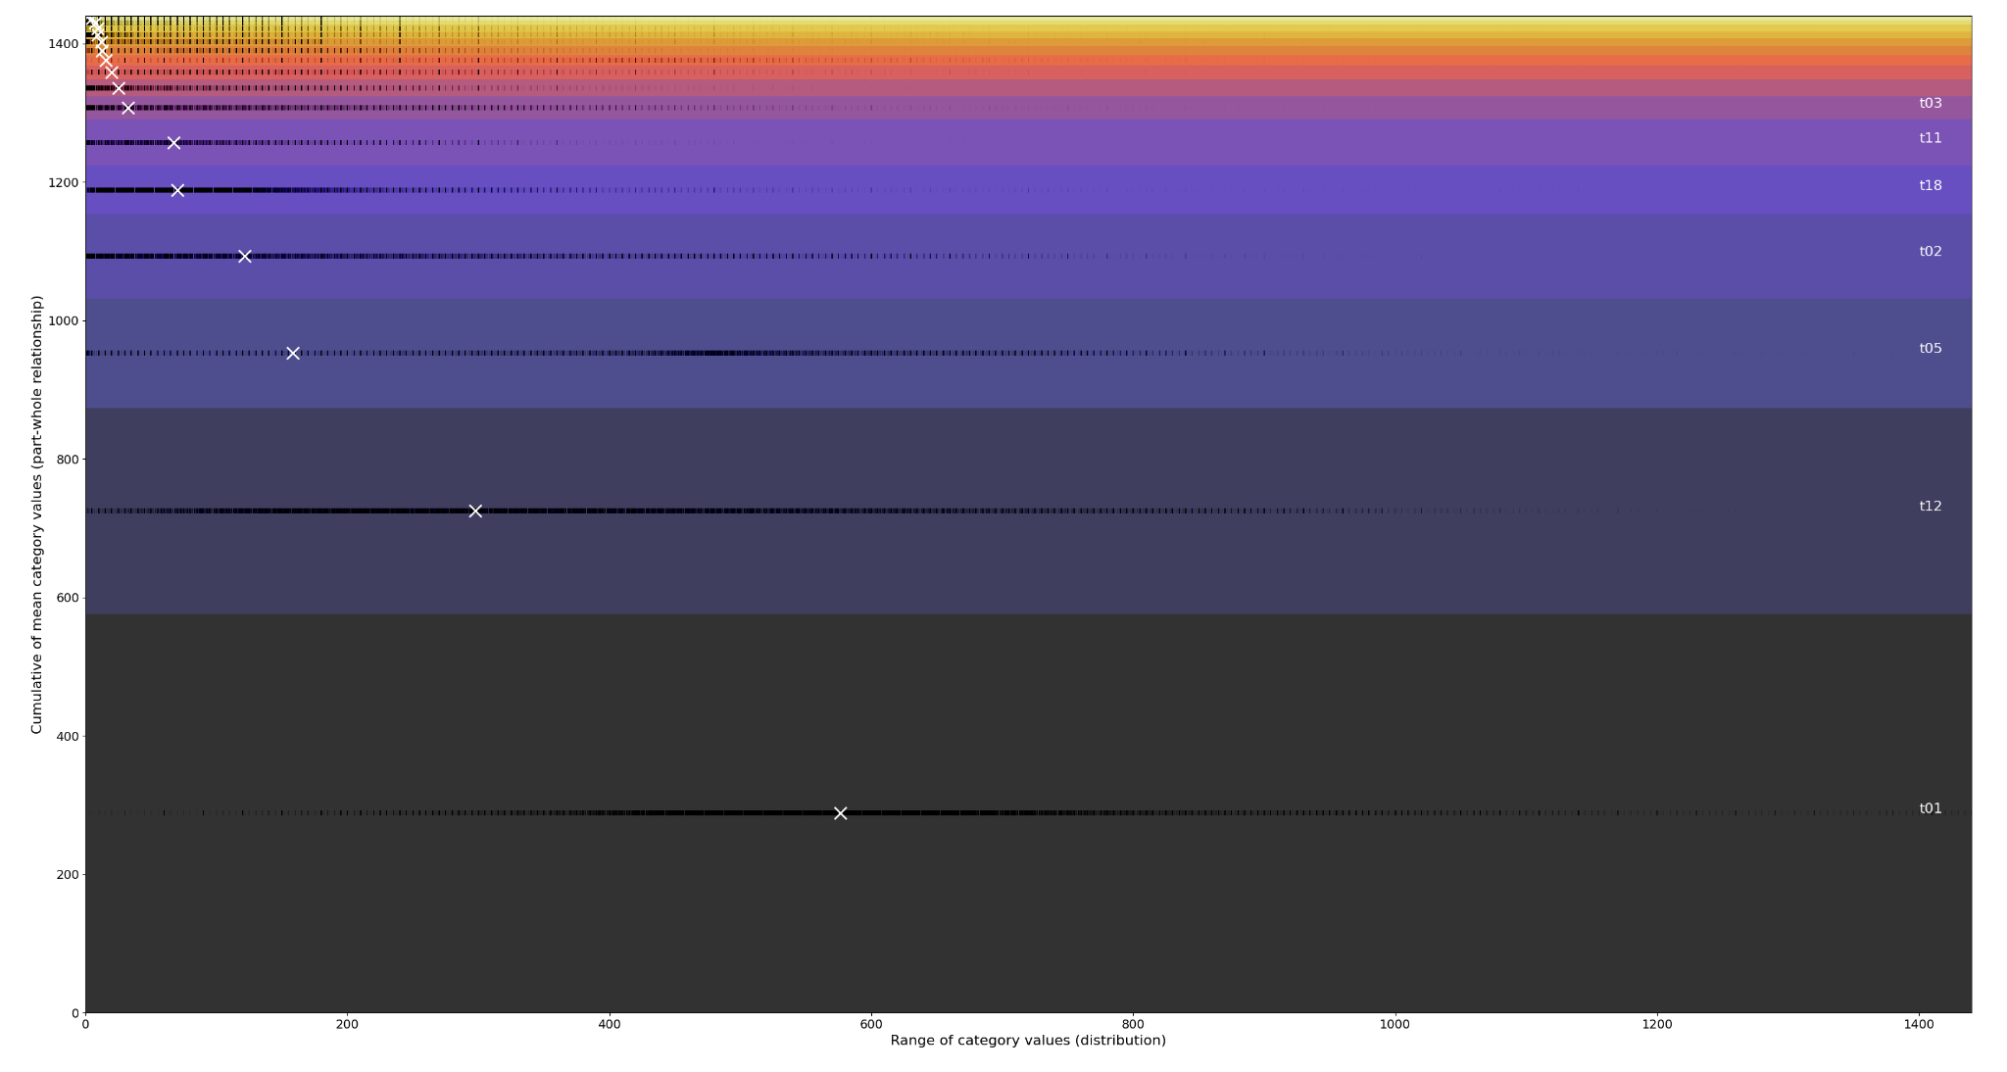

Slide 8
Problems with initial design
Some categories are bound to contribute to only a small fraction of the whole
We sorted the areas from bottom to top for readability, the largest contributors to the part whole are placed at the bottom, and the smallest at the top
We marked category mean values, shown by the white crosses
However, a bunch of smaller values ended up clustered in the top left
We represented distributions with bands of black tick marks parallel to x-axis
However, it was hard to tell if they were concentrated at a number, especially if they were at 0, since they would overlap with the y-axis

Slide 9
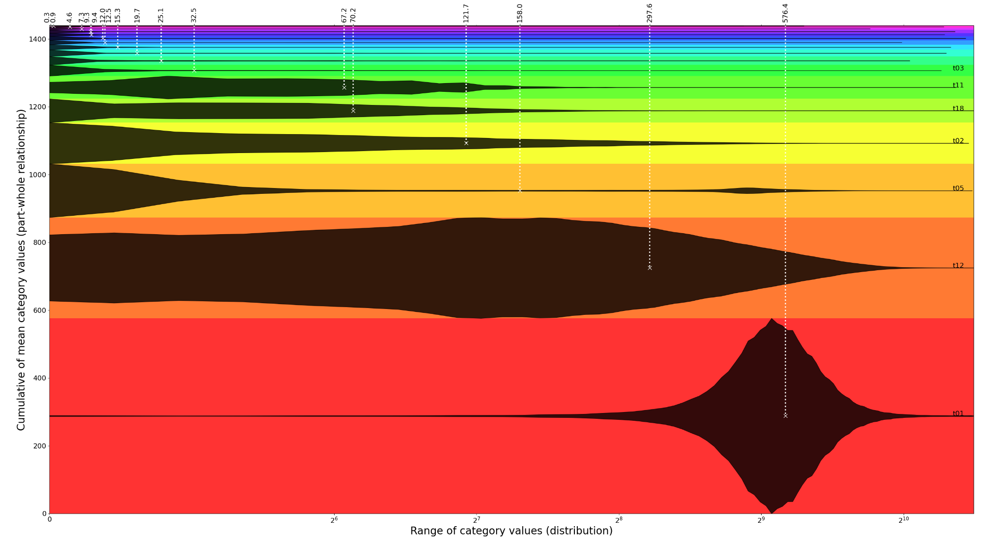
Shifted to a semilog scale & used violin plots to see if it made things better
Changed color encoding - weren’t sure if the colors previously implied some order
Added dashed lines from means to top of fig with readings and marked category text on the far right, for readability

Slide 10
Combining some of the best aspects of both
Scrapped colors - used spanning arrows and category codes to indicate regions
Used linear scale to avoid distorting violin plots
Added violin plots & tick marks to give users max information about distribution
Used subplot to zoom into region of unreadable elements in part-whole
In this case, 12 categories contributed to about 150 minutes out of 1440
These were mostly unreadable
Interesting takeaways from the graph - we can clearly see that T05 has a bimodal distribution of sorts, and its mean is between both peaks

Slide 11
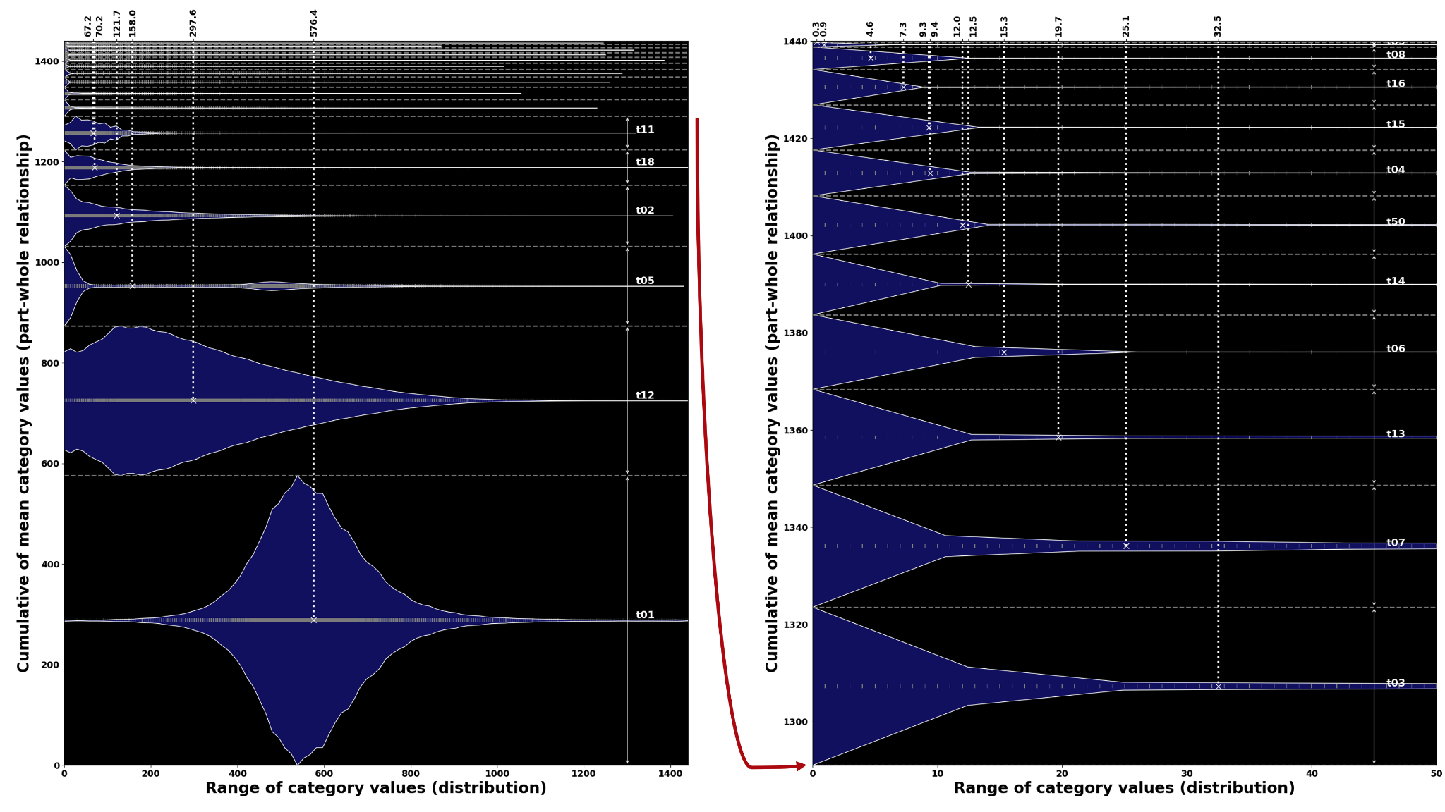

Slide 12
More effective part-whole representation
Even with the sub-plot, some of the smallest elements were indistinguishable
One might argue that such categories may not be interesting given their miniscule contribution
We tested area encodings to see if they could help draw attention to all members
We used treemaps, with standard deviation encoded with color
Provided exact mean and std. dev. values as text inside each block
Added violin plots to as many blocks as possible for distribution information
Made treemaps for both absolute and normalized standard deviation

Slide 13
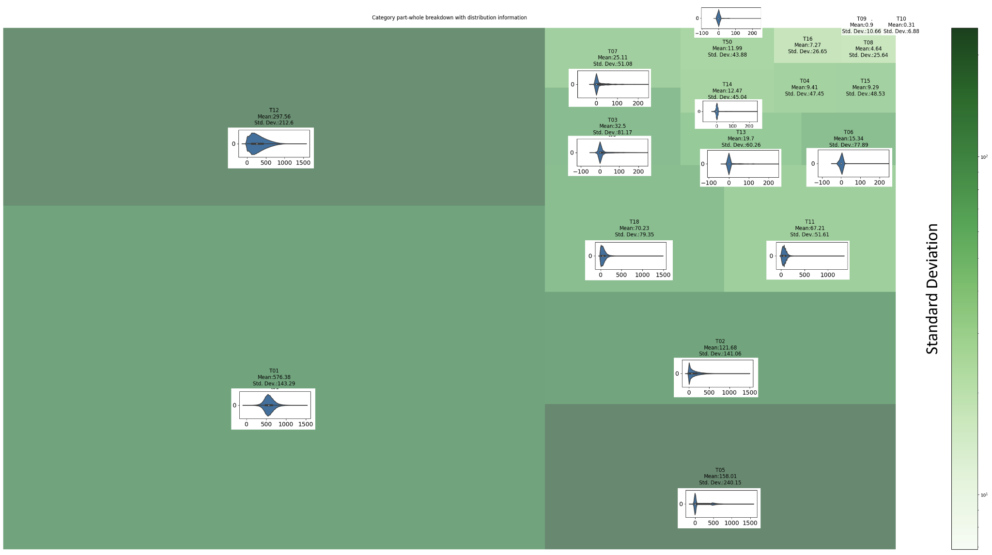

Slide 14
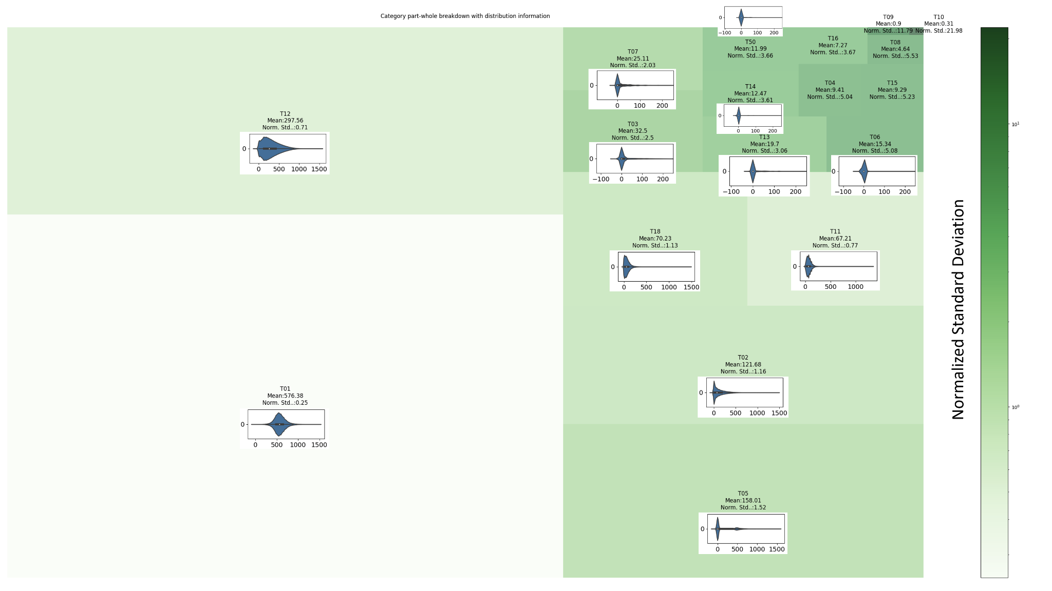

Slide 15
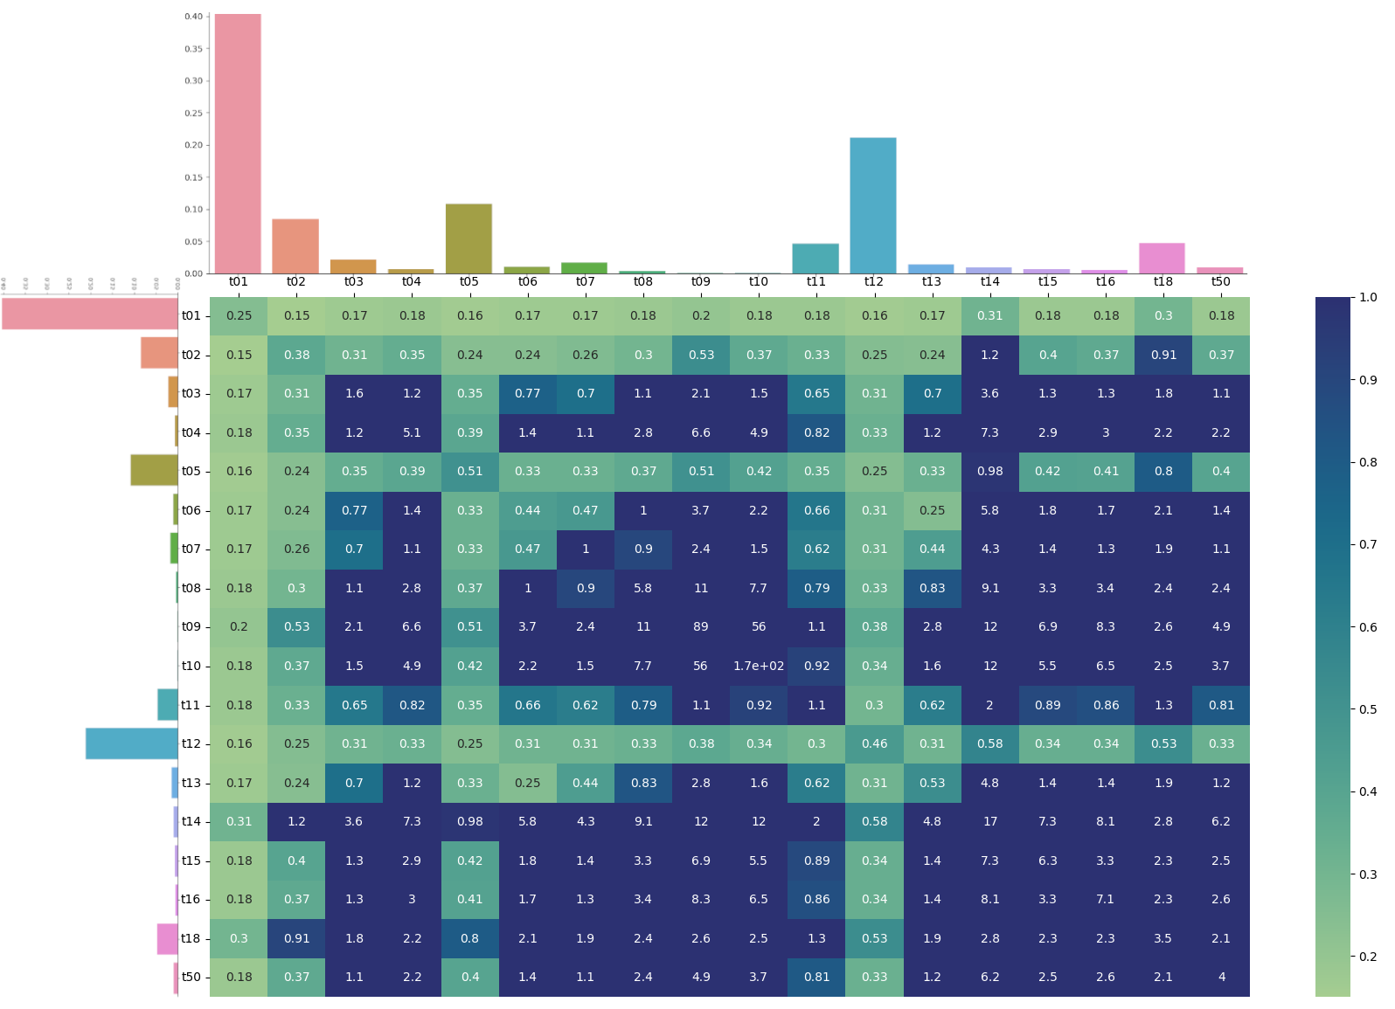
Heatmap Rough Draft: Standard Dev Encoded as %
Too many maxed out cells.

Slide 16
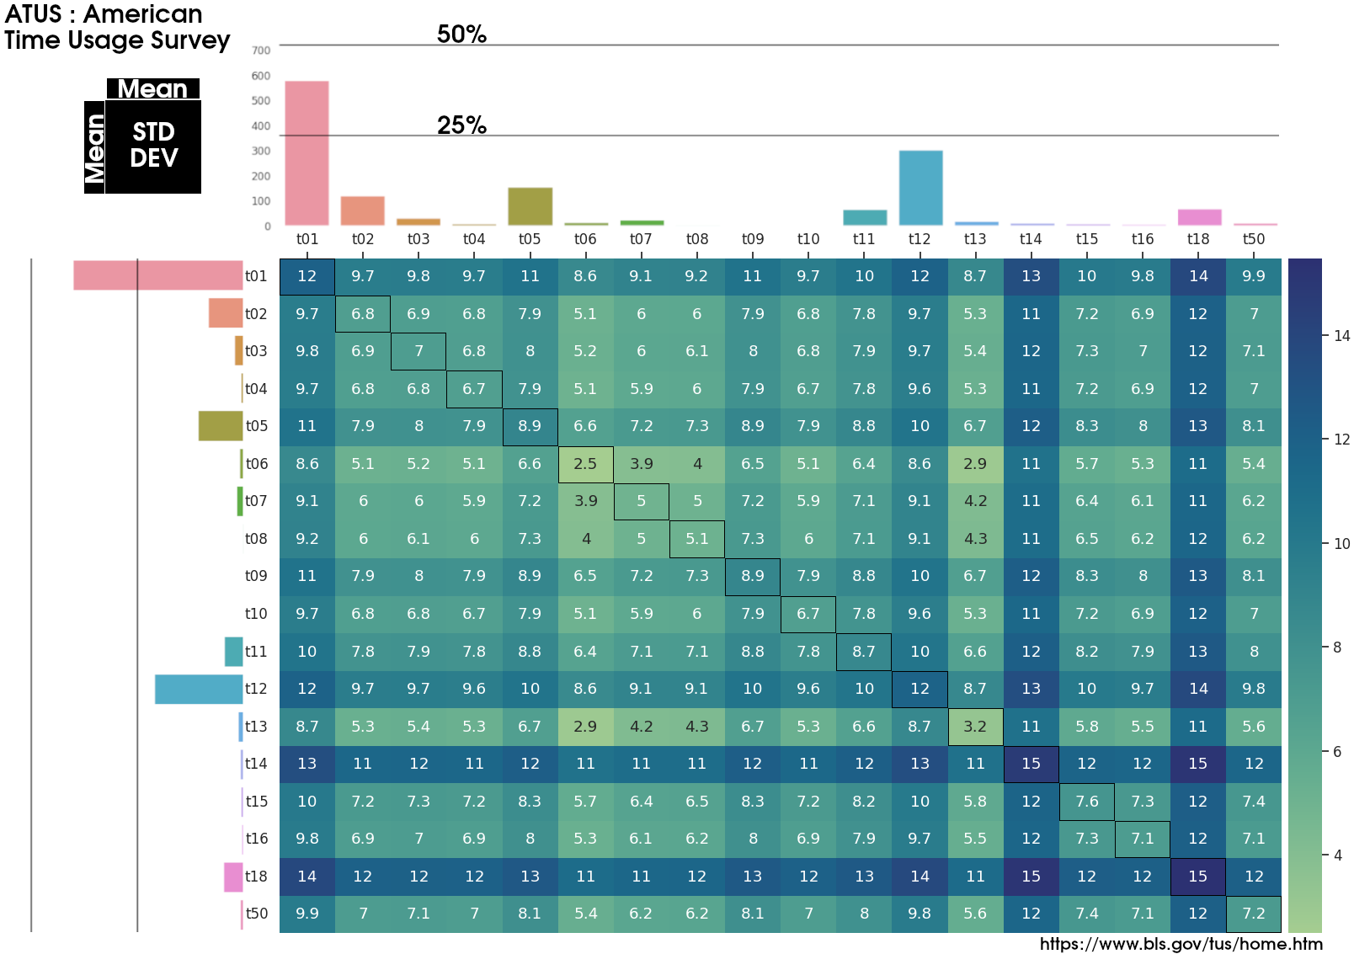
Heatmap Final : Present Actual Standard Dev, Not %

Slide 17
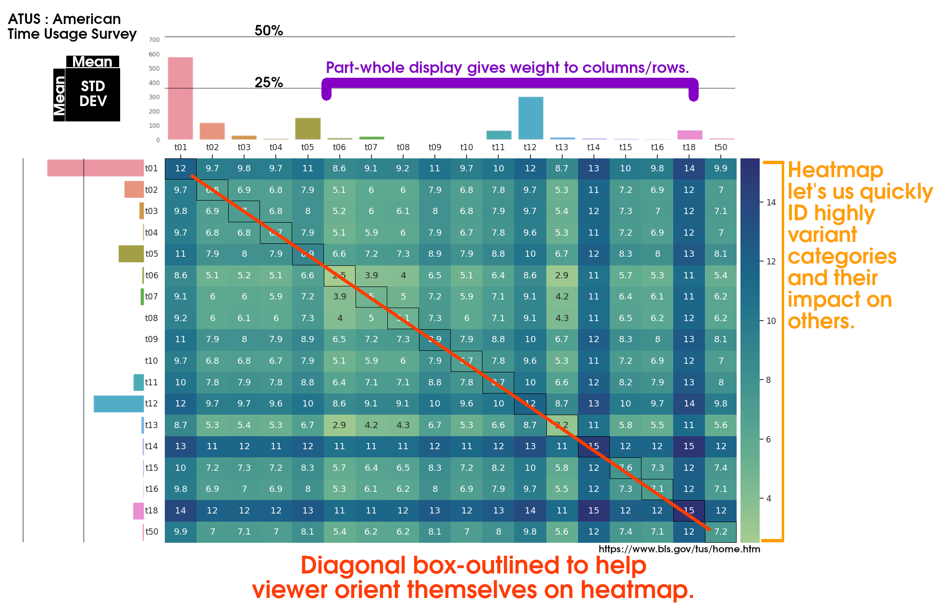
Heatmap Final: Design Overview

Slide 18
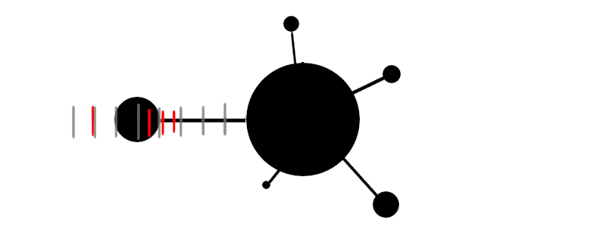
Node-Link: Rough Draft
Size encode mean with node.
Grey ticks provide sense of scale.
Red ticks capture quantiles.

Slide 19
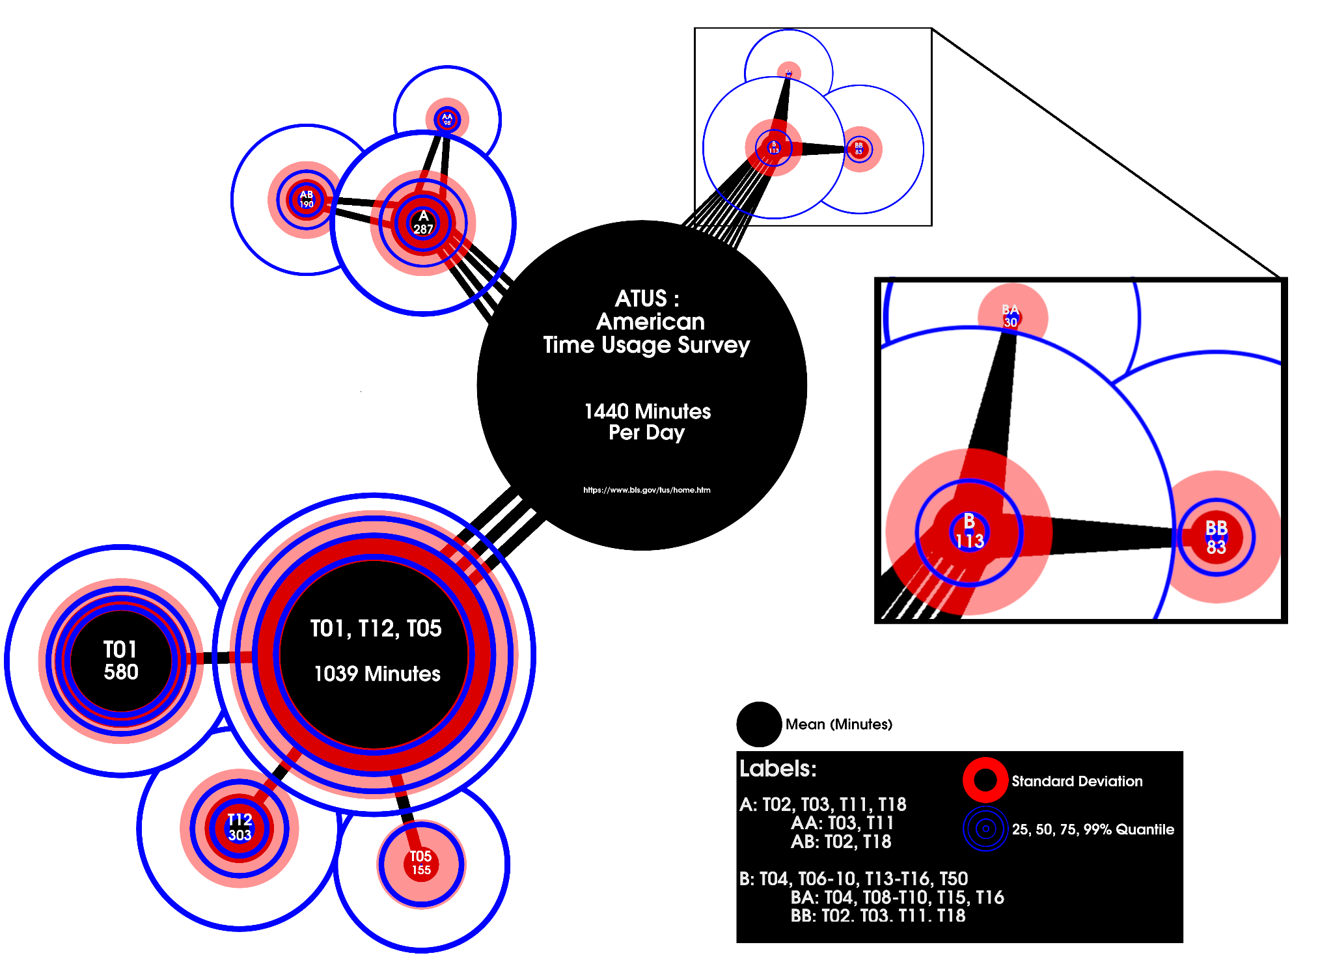
Node-Link: Final

Slide 20
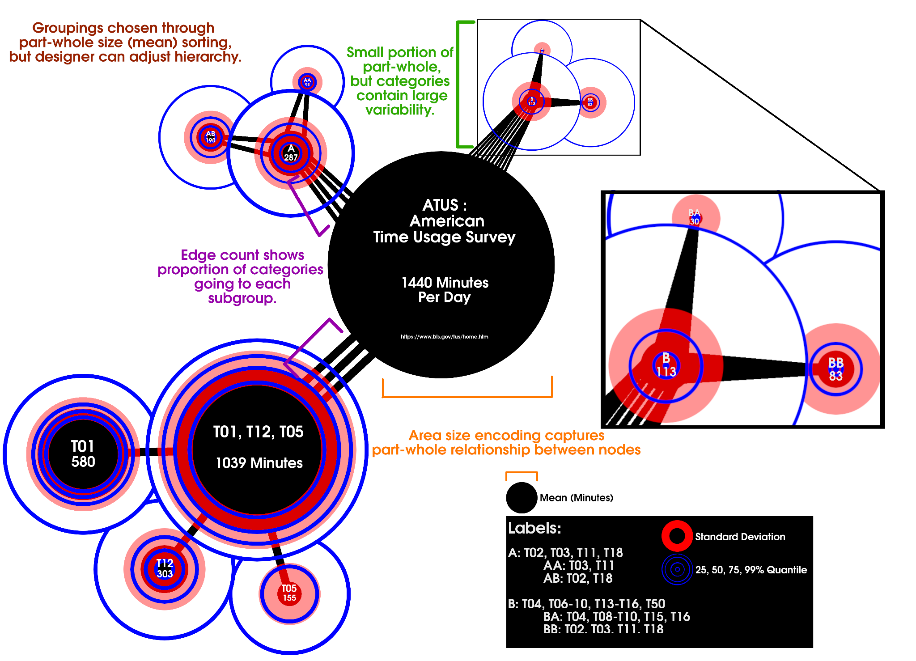
Node-Link: Final Design Overview

