Slide 1
CMSC423: Bioinformatic Algorithms, Databases and Tools
Alignment heuristics

Slide 2
Heuristics
What if limit the # of differences allowed? E.g. we expect the sequences to be very similar.
Compute 'banded' alignment – stay within # of differences (k) from the diagonal.
Optimal alignment cannot stray too far from diagonal
What if we do not know k? Do binary search to find it
k
O(km) running
time and space
k

Slide 3
Exclusion methods
Assume P must match T with at most k errors. Find places in T where P cannot match.
Split P into floor(n/k+1)-sized chunks.
If P matches T with less than k errors => at least one chunk matches with no errors
Use any exact matching algorithm to find places where a chunk matches T, then run dynamic programming in that vicinity.
Running time, on average O(m)

Slide 4
Exclusion methods
Putative alignment
Text
Pattern
Exact match

Slide 5
"Famous" approaches
FASTA (Pearson et al.)
  Take all k-mers (substrings of length k) from Pattern and identify whether and where they match in the Text
  Assume the k-mer starting at pos'n i in Pattern matches at position j in Text, remember (j – i) – the diagonal on which the match occured
  Identify "heavy" diagonals – diagonals where many k-mers match, then refine the diagonals with Smith Waterman
  Also look for off-diagonal matches to account for gaps

Slide 6
"Famous" approaches
BLAST (Altschul et al.)
  Find short k-mer matches
  Also search for possible inexact matches, e.g. all k-mers within 1 difference from current one.
  Extend exact matches with Smith-Waterman algorithm
  Assign probabilistic scores to matches: what is the probability of finding a match with the same S-W alignment score just by chance (e.g. matching a random string)?

Slide 7
Aside: viewing alignments with dot-plots
axes – two sequences/genomes, 'dots' – regions that match in the two genomes

Slide 8
Chaining approach
Extends the FASTA idea
Search for exact matches
Find the longest consistent chain of exact matches
Fill in the gaps in the chain using Smith-Waterman
This is the approach used by MUMmer (Delcher et al.)
MUM – maximally unique match (see mummer.sourceforge.net)

Slide 9
Chaining in 1-D
Input: multiple overlapping intervals on a line
Output: highest weight set of non-overlapping intervals
Weight could be length of interval, or Smith-Waterman score, etc.

Slide 10
Chaining in 1D
Basic idea – dynamic programming
V[j] – weight of best chain ending with interval j
V[j] = maxk < j, intervals k & j do not overlap(V[k] + weight(j))
i.e. find all possible ways of building a chain ending at j and pick the best one (the key to all dynamic programming algorithms)
Where do we find the answer?
How do we find the actual chain?
What is the running time?
largest value in V array
backtracking
O(n^2)

Slide 11
Chaining in 1D
Sort the endpoints (starts, ends) of the intervals
For every interval j, store V[j] – best score of a chain ending in j
MAX – store highest V[j] seen sofar
Process endpoints in increasing order of x coordinate
If we encounter left end (start) of interval j
  V[j] = weight(j) + MAX
If we encounter right end (end) of interval j
  MAX = max{V[j], MAX}
Running time?
O(n log n) – from sorting

Slide 12
Chaining in 1-D
Input: multiple overlapping intervals on a line
Output: highest weight set of non-overlapping intervals
Weight could be length of interval, or Smith-Waterman score, etc.
Rationale? The pattern can have multiple inconsistent exact matches to the text – we want to pick a longest consistent set
T
P

Slide 13
Path “planning” and dynamic programming
One intuitive way to think about dynamic programming
  similar to finding shortest path between two points
  at each “point” ask – what are all possible ways to get here?
  pick the best (shortest, fastest, etc.)
Harrisburg
NYC
Frederick
Philly
Baltimore
DC
DC

Slide 14
Chaining in 2-D
Easy to do in O(n²) (n - # of intervals)
View alignments as "boxes"
All boxes in a chain must follow each other in a "diagonal" order, i.e. the range of the x coordinates and y coordinates of any two boxes in a chain cannot overlap
Similar to 1-D approach except at each step we must check if current box can extend any of the previously built chains
V[j] = max_{all previous boxes k} {V[k] + weight(j)}
More complex algorithm leads to O(n log n) running time

Slide 15
Suffix trees + dynamic programming
Idea: find inexact seeds (rather than exact matches)
Observation: if two sequences match within x% identity there must be some short subsequence that also matches with at least x% identity
Why is this useful? You can backtrack quickly if error rate exceeded (short sequences will have to be almost perfect).
e
f(i)
k
l

Slide 16
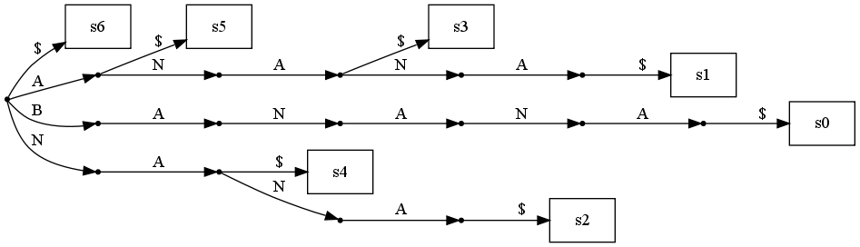
suffix trees + dynamic programming
? | ? | ? | ? | ? | ?
A | 3 | 2 | 1 | 1 | ?
N | 2 | 1 | 0 | 1 | ?
A | 1 | 0 | 1 | 2 | ?
- | 0 | 1 | 2 | 3 | ?
 | - | A | N | N | ?

