Slide 1
CMSC423: Bioinformatic Algorithms, Databases and Tools
Biological databases

Slide 2
What's a database?
Take CMSC424 for in-depth view
Essentially a collection of Excel sheets or tables
(note: only true for the “relational model” - most popular)
Key
ID | Country | Disease | Age (mo)
6007123 | Gambia | Giardia | 18
4001102 | Mali | Vibrio cholerae | 6
Tables
Foreign key
Run | ID | # seqs | File
22 | 6007123 | 5733 | full_run123.seq
27 | 6007123 | 230 | pilot123.seq

Slide 3
Chado
http://www.gmod.org
Relational schema for storing biological data types in a relational database (e.g. MySQL, Oracle, Sybase, ...)
SELECT o.organism_id,o.abbreviation,o.genus,o.species,
o.common_name, count(f.feature_id) as n_features,
o.comment
FROM organism o LEFT JOIN feature f USING (organism_id)
GROUP by o.organism_id,o.abbreviation,o.genus,o.species,
o.common_name,o.comment
ORDER BY o.genus,o.species

Slide 4
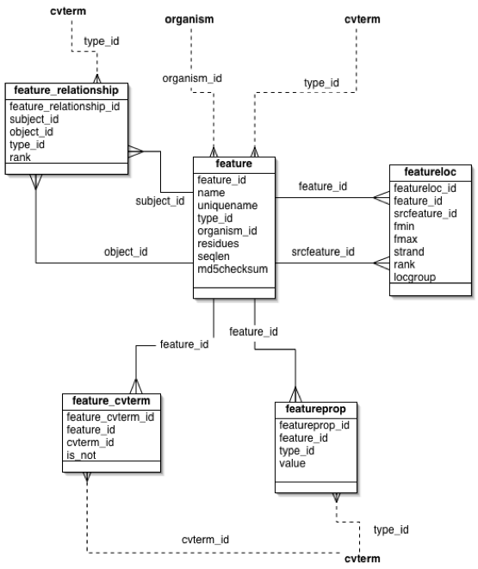

Slide 5
Chado...more
Bio... generally provide ability to interface with relational database.
Understanding SQL and Chado is useful irrespective of language used.
Relational DB particularly useful for web services
Gbrowse example....if time

Slide 6
Biological databases
General
  GenBank - US
  EMBL - Europe
Specialized by data type
  NCBI Trace Archive – raw sequencing data
  SwissProt – curated protein information
  KEGG – biological pathways
  Gene Expression Omnibus – microarray data
Specialized by organism
  ZFIN – zebrafish
  SGD – yeast
  WormBase - worms

Slide 7
What data gets stored?
DNA
  string of letters
  quality information, maybe chromatograms
  location of genes (ranges along a chromosome)
Proteins
  string of letters
  protein domains
  3D coordinates of each atom
Pathways
  graph of interactions between genes
For all – often store link to scientific articles related to data

Slide 8
How the data get accessed
Gene by gene/object by object – targeted at manual inspection of data
  usually lots of clicking involved
  simple search capability
  similarity searches in addition to text queries
Bulk – targeted at computational analyses
  often programmatic access through web server
  most frequently – just bulk download (ftp)

Slide 9
NCBI - National Center for Biotech. Info.
Virtually all biological data generated in the US gets stored here!
One-stop-shop for biological data
Primarily focused on gene-by-gene analyses
Provides simple scripts for programmatic access
Provides ftp access for bulk downloads
http://www.ncbi.nlm.nih.gov

Slide 10
EMBL European Molecular Biology Lab.
European version of NCBI
BioMart query builder
http://www.ebi.ac.uk/embl/

Slide 11
Expasy proteomics server
Home of Swisprot and other useful information on proteins
http://www.expasy.org

Slide 12
Kyoto Encyclopedia of Genes & Genomes
Central repository of pathway information
http://www.genome.jp/kegg/

Slide 13
Genome browsers
UCSC Genome Browser – http://genome.ucsc.edu
ENSEMBL Genome Browser – http://www.ensemble.org
Gbrowse http://www.gmod.org

Slide 14
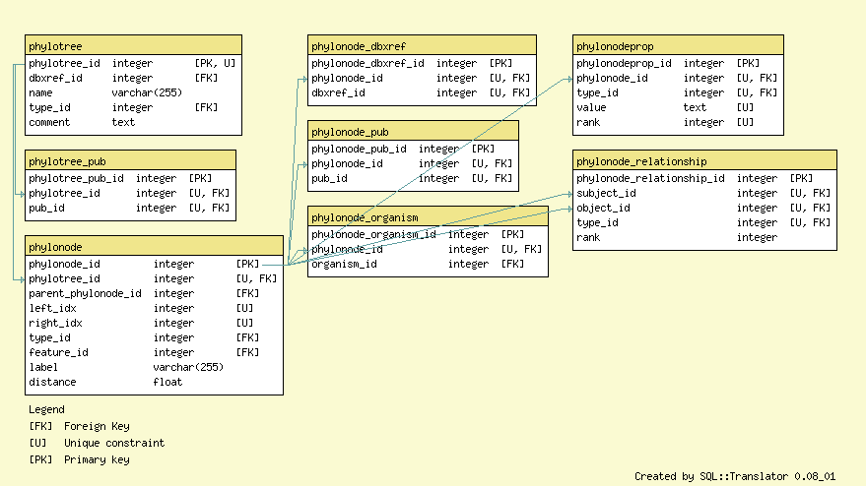
Direct database access - SQL
CHADO schema – www.gmod.org

Slide 15
SQL
select pt.phylotree_id, pn.parent_phylonode_id, po.organism_id
from phylotree pt, phylonode pn, pylonode_organism po
where
pt.name = "Archaea" and
pt.phylotree_id = pn.phylotree_id and
pn.phylonode_id = 1000 and
po.phylonode_id = pn.parent_phylonode_id
# Selects parent node and organism IDs for archaeon with ID 1000

Slide 16
Programmatic database access
use DBI;
my $dbh = DBI->connect("dbi:Sybase:server=SERV;packetSize=8092",
"anonymous", "anonymous");
if (! defined $dbh) {
die ("Cannot connect to server\n");
}
my $mysqlqry = <STDIN>;
$dbh->do("set textsize 65535");
my $qh = $dbh->prepare($mysqlqry) || die ("Cannot prepare\n");
$qh->execute() || die ("Cannot execute\n");
while (my @row = $qh->fetchrow()){
processrow($row);
}

Slide 17
NCBI programmatic access
http://eutils.ncbi.nlm.nih.gov/entrez/query/static/eutils_help.html
  must write your own HTTP client (LWP Perl module helps)
  queries go directly to web server
  data returned in XML
http://www.ncbi.nlm.nih.gov/Traces/trace.cgi?cmd=show&f=doc&m=obtain&s=stips
  stub script provided (query_tracedb)
  queries still go through web server
  data returned in a variety of user selected formats
For both, limits are set on the amount of data retrieved, e.g. less than 40,000 records at a time
Download procedure:
  figure out # of records to be retrieved ("count" query)
  read data in allowable chunks
  combine the chunks

Slide 18
Biological Ontologies
Gene Ontology. http://www.geneontology.org
The Gene Ontology project provides a controlled vocabulary to describe gene and gene product attributes in any organism. (text from GO homepage)
Note: similar to semantic web
GO not the only one: http://www.obofoundry.org

Slide 19
Exercises
Write a simple script that wraps around the query_tracedb script from NCBI and allows a user to download an entire data-set without worrying about “page limits”.
Note: set your page limit to 4000 records (rather than the 40,000 allowed) so as not to overload the NCBI servers.
Create a FASTA file containing all recA genes found in bacteria. Note: you can use a combination of manual queries and additional scripts (sometimes an NCBI query doesn't quite return what you want)

