Slide 1
CMSC423: Bioinformatic Algorithms, Databases and Tools
Mihai Pop
Molecular biology primer

Slide 2
Admin...
Have you tried your glue accounts?
Issues/concerns/questions about class and policies?
Reading “assignment” - Chapter 1 in the book.
Homework 1 – available on syllabus website in PDF, ODF, DOC formats (I prefer electronic submission)
Part of HW1 will require you to use glue system
Grades will be available through the grade server
grades.cs.umd.edu

Slide 3
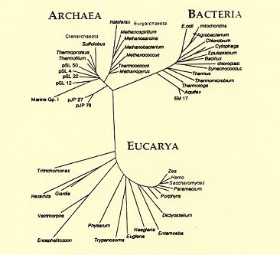
The tree of life
http://www.fossilmuseum.net/Tree_of_Life/Domains_Archaea_Bacteria/

Slide 4
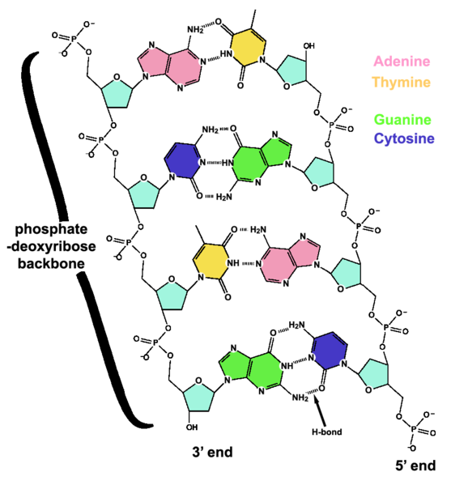
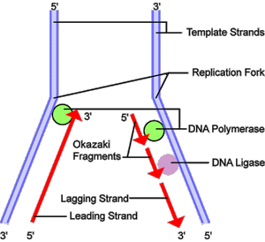
DNA – the code of life
Purines A, G, caffeine
Pyrimidines C, T
Sugar backbone (ticker tape)
Double-stranded – allows replication
pictures from wikipedia

Slide 5
DNA in the computer
FASTA/multi-FASTA file format
>gi|110227054|gb|AE004091.2| Pseudomonas aeruginosa PAO1, complete genome
TTTAAAGAGACCGGCGATTCTAGTGAAATCGAACGGGCAGGTCAATTTCCAACCAGCGATGACGTAATAG
ATAGATACAAGGAAGTCATTTTTCTTTTAAAGGATAGAAACGGTTAATGCTCTTGGGACGGCGCTTTTCT
GTGCATAACTCGATGAAGCCCAGCAATTGCGTGTTTCTCCGGCAGGCAAAAGGTTGTCGAGAACCGGTGT
CGAGGCTGTTTCCTTCCTGAGCGAAGCCTGGGGATGAACGAGATGGTTATCCACAGCGGTTTTTTCCACA
CGGCTGTGCGCAGGGATGTACCCCCTTCAAAGCAAGGGTTATCCACAAAGTCCAGGACGACCGTCCGTCG
Parsers easy to write, also available in a variety of software libraries

Slide 6
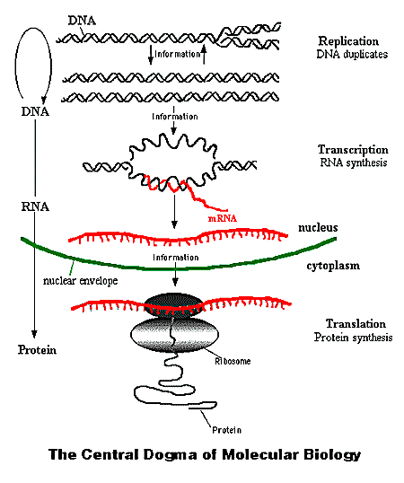
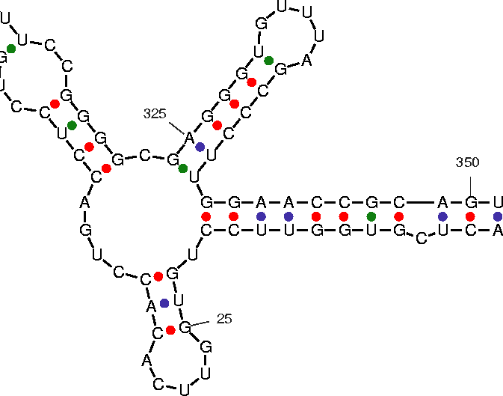
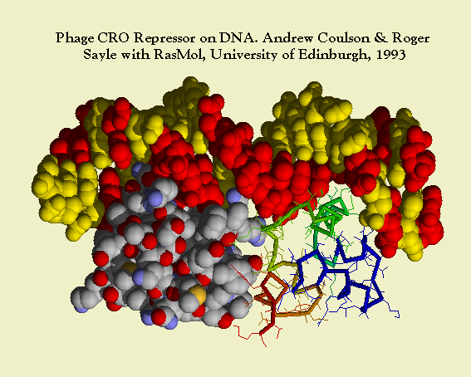
Central dogma
AGGTACGCGTACCTGACAGG
http://www.accessexcellence.org/RC/VL/GG/central.html

Slide 7
Genes, transcription, translation
DNA – RNA - Thymine replaced by Uracil (T-U)
The transcribed segments are called genes
AUG – start codon (also amino-acid Methionine)
UAA, UAG, UGA – stop codons
Genes are read in sets of 3 nucleotides during translation – 4³ = 64 possible combinations
Each combination codes for one of 20 amino-acids – the building blocks for proteins
ACCGUACCAUGUUA...AUAGGCUGAGCA

Slide 8
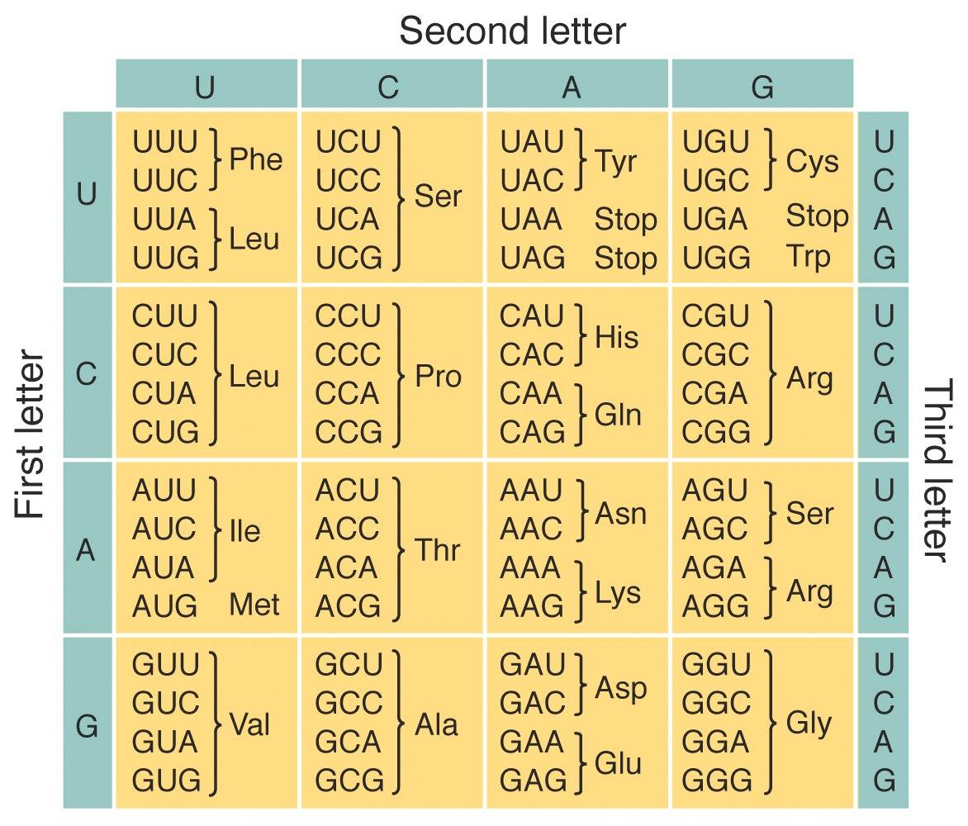
Amino-acid translation table

Slide 9
Genes/proteins in the computer
>gi|15596155|ref|NP_249649.1| basic amino acid,
MKVMKWSAIALAVSAGSTQFAVADAFVSDQAEAKGFIEDSSLDLLLRNYYFNRDGKSGSGDRVDWTQGFL
TTYESGFTQGTVGFGVDAFGYLGLKLDGTSDKTGTGNLPVMNDGKPRDDYSRAGGAVKVRISKTMLKWGE
MQPTAPVFAAGGSRLFPQTATGFQLQSSEFEGLDLEAGHFTEGKEPTTVKSRGELYATYAGETAKSADFI
GGRYAITDNLSASLYGAELEDIYRQYYLNSNYTIPLASDQSLGFDFNIYRTNDEGKAKAGDISNTTWSLA
AAYTLDAHTFTLAYQKVHGDQPFDYIGFGRNGSGAGGDSIFLANSVQYSDFNGPGEKSWQARYDLNLASY
GVPGLTFMVRYINGKDIDGTKMSDNNVGYKNYGYGEDGKHHETNLEAKYVVQSGPAKDLSFRIRQAWHRA
NADQGEGDQNEFRLIVDYPLSIL
Same FASTA/multi-FASTA but with bigger alphabet

Slide 10
Genes/proteins in the computer
gene complement(1043983..1045314)
/gene="oprD"
/locus_tag="PA0958"
CDS complement(1043983..1045314)
/gene="oprD"
/locus_tag="PA0958"
/note="Product name confidence: Class 1 (Function
experimentally demonstrated in P. aeruginosa)"
/codon_start=1
/transl_table=11
/product="Basic amino acid, basic peptide and
imipenem outer membrane porin OprD precursor"
/protein_id="AAG04347.1"
/db_xref="GI:9946864"
GenBank file format

Slide 11
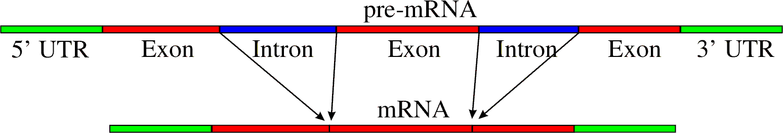
Translation – complications

Slide 12
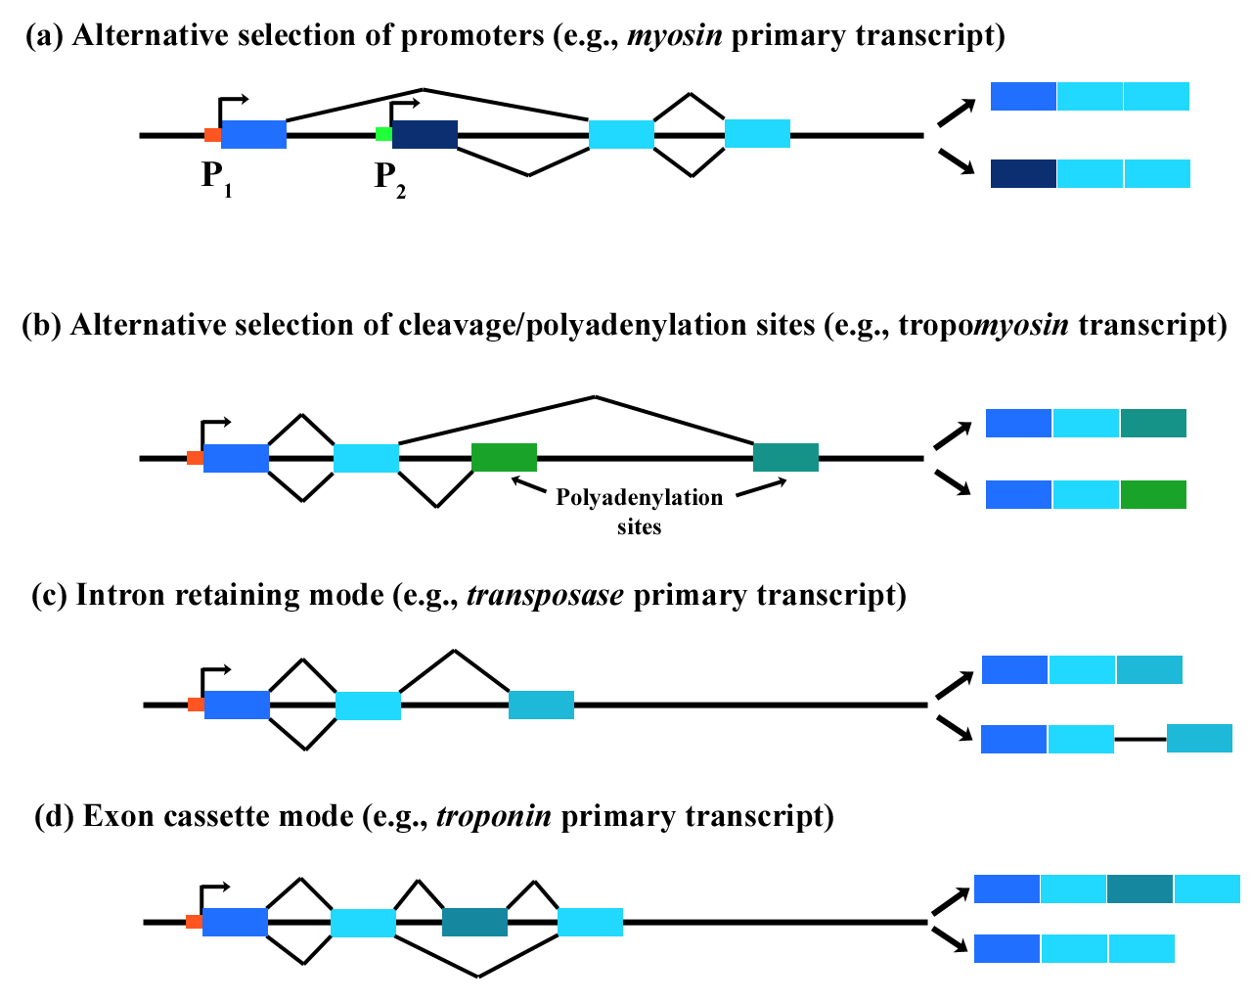
Alternative splicing examples

Slide 13
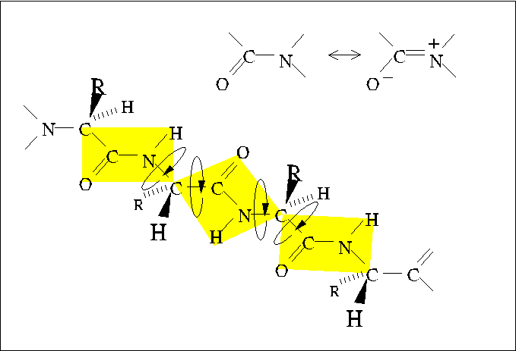
Protein structure
http://www.tulane.edu/~biochem/med/second.htm

Slide 14
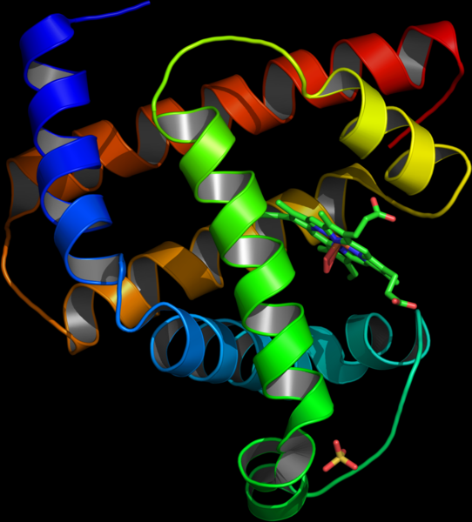
Protein structure
Primary structure – sequence
Secondary structure – structure motifs
Tertiary structure – 3D position of atoms
Quaternary structure – docking of proteins

Slide 15
Protein structure data (PDB format)
ATOM 1 N MET A 1 20.020 28.662 42.801 1.00 51.80 N
ATOM 2 CA MET A 1 20.598 29.950 42.438 1.00 52.13 C
ATOM 3 C MET A 1 22.118 29.937 42.576 1.00 47.63 C
ATOM 4 O MET A 1 22.660 29.623 43.636 1.00 49.97 O
ATOM 5 CB MET A 1 20.009 31.073 43.293 1.00 51.36 C
ATOM 6 CG MET A 1 20.331 32.468 42.765 1.00 51.13 C
ATOM 7 SD MET A 1 21.406 33.373 43.921 1.00103.49 S
ATOM 8 CE MET A 1 21.129 32.396 45.410 1.00 55.43 C
ATOM 9 N LEU A 2 22.799 30.285 41.490 1.00 41.99 N
ATOM 10 CA LEU A 2 24.249 30.178 41.424 1.00 37.25 C

Slide 16
RECAP
DNA is a string formed with letters A, C, T, G (called nucleotides or bases)
DNA is double-stranded – allows replication: transfer of genetic “code” from parents to offspring
DNA is naturally oriented from 5’ to 3’ and the two strands are anti-parallel
If you know the sequence of one strand, you can obtain the sequence of the other by reverse-complementation
5’ AGACCTAGTGCACGGCTACTACC 3’
5’ CCATCATCGGCACGTGATCCAGA 3’
Reverse
5’ GGTAGTAGCCGTGCACTAGGTCT 3’
Complement

Slide 17
RECAP
Central Dogma of molecular biology:
  DNA – RNA (transcription)
  RNA – Protein (translation)
The transcribed segments of DNA are called “genes”
Translation occurs in sets of 3 nucleotides – codons
Each codon encodes one of 20 amino-acids and 3 stop-codons
In eukaryotes the genes may be split into multiple exons, separated by introns: DNA segments that will not get translated
The protein is translated from an RNA representing the concatenation of the exons of the gene

Slide 18
The “new” biology
DNA is not the only heritable information
  Epigenetic information: RNA molecules, DNA methylation patterns (affects coiling on DNA on histones)
Complex regulation patterns
  Genes turn on other genes
  Genes inhibit other genes
  RNA interference – small RNA molecules can destroy specific transcripts (down-regulate production)

Slide 19
Playing with DNA
Biologists can:
Cut the DNA – restriction enzymes (often palindromes) (Nobel prize – Arber, Nathans, Smith)
Attach “things” to DNA (either single or double-strand)
“Amplify” DNA – Polymerase Chain Reaction
(Nobel prize – Mullis)
5'GAATTC 5'---G AATTC---3'
3’CTTAAG 3'---CTTAA G---5'
TAGGCACGTTGCAACTACGGC
TGCAACGT

Slide 20
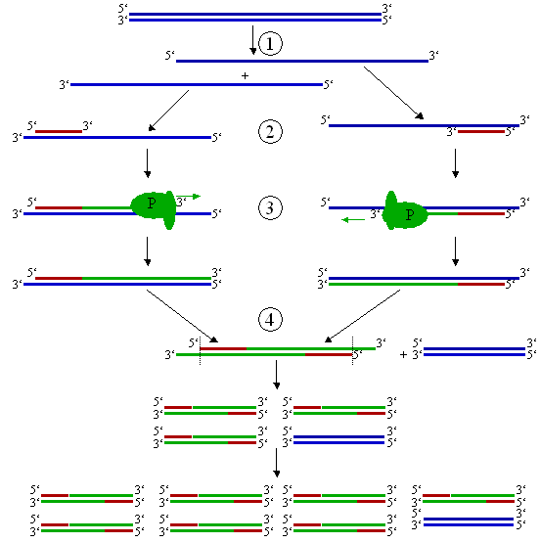
Polymerase chain reaction (PCR)
1. Denature
2. Anneal (attach
primer)
3. Extend
4. Repeat

Slide 21
How does PCR work?
1. Start: 1 double-stranded molecule
1. Denature: 2 single-stranded molecules
1. Anneal: 2 single-stranded molecules with primers attached
1. Extend: 2 double-stranded molecules – one “long” (L) strand and one “short” (S) (terminated at a primer)
2. Start: 2 double-stranded molecules: L+S, L+S
2. Denature: 2 x L strands,
2 x S strands
2. Anneal: all strands with primers attached
2. Extend: 2 double-stranded molecules: L+S, L+S, 2 double-stranded molecules: S+SS, S+SS
SS – strand terminated at both ends with a primer

Slide 22
PCR Recurrences
L_{n}, S_{n}, SS_{n} - # of strands of each type at cycle n
L_{n} = L_{n – 1} = 2
S_{n} = S_{n – 1} + L_{n – 1} = S_{n – 1} + 2 = 2 * (n – 1) = O(n)
SS_{n} = S_{n-1} + 2 * SS_{n – 1} = O(2^{n})
The sequence between the primers (SS) is amplified exponentially – will quickly overtake the solution

Slide 23
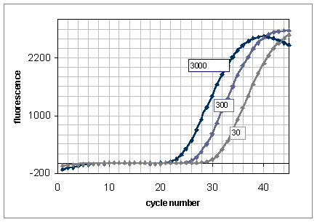
Quantitative PCR
Measure # of PCR cycles needed to reach a certain concentration of DNA – depends on initial # of molecules
Used in diagnostics: e.g. is this a random Anthrax spore from the environment or lots of spores from an attack
http://www.dxsgenotyping.com/technology_main.htm

Slide 24
DNA sequencing
Most techniques “trick” the polymerase into revealing the sequence
The traditional method – Sanger sequencing – based on “terminator” bases – prevent the polymerase from extending the DNA
Sanger sequencing is essentially PCR + terminator bases
Other methods “spy” on the polymerase as it incorporates nucleotides

Slide 25
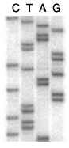
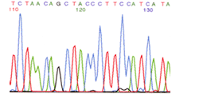
Sanger sequencing
Sanger, F, Coulson AR. A rapid method for determining sequences in DNA by
primed synthesis with DNA polymerase. J.Mol.Biol. 94 (1975)
A
A
C
G
G
G
T
TCTAATT
G
TCTAATTA
TCTAATTAG
TCTAAT
A
G
A
TCTAATTAGA
AGATTATCTAACAGCTACCCTTCCATCA
TCTAATTAGAT
pictures from http://www.uvm.edu/~cgep/Education/Sequence.html

Slide 26

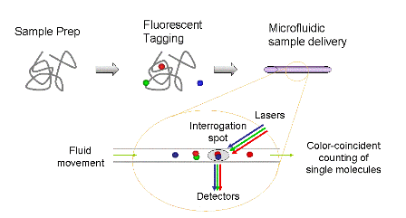
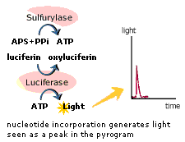
The future of sequencing
Single molecule sequencing - current technology requires many copies
of DNA being sequenced - requires DNA amplification
Massively-parallel sequencing - 100k sequencing reactions occuring at
the same time
Sequencing by synthesis
Micro-fluidics
A
G
TCTAAT
A
AGATTATCTAACAGCTACCCTTCCATCA
http://www.genetics.ucla.edu/sequencing/pyro.php
http://www.usgenomics.com

Slide 27

The future of sequencing
Massively parallel sequencing
each spot is a molecule or amplified from one
molecule
image processing used to track molecules
during sequencing by synthesis
often micro-fluidics/lab-on-a-chip used
http://arep.med.harvard.edu/

Slide 28
The evolution of DNA sequencing
Since | Technology | Read length | Throughput/run | Throughput/hour | cost/run
1977- | Sanger sequencing | > 1000bp | 4hr 400-500 kbp | 100 kbp | $200
2005- | 454 pyrosequencing | 250-400bp | 4hr 100-500 Mbp | 25-100 Mbp | $13,000
2006- | Illumina/Solexa | 50-100bp | 3 days 2-3 Gbp | 25-40 Mbp | $3,000
2007- | ABI SOLiD | 35-50bp | 3 days 6-20 Gbp | 75-250 Mbp | est. $3-5,000
2008- | Helicos single molecule | 25-50 bp | 8 days 10 Gbp | ~50 Mbp est. 1Gbp/hour | ~$18,000
TBA (2010) | Pacific Biosciences single molecule | 100-200 kbp | ? | ? | ?

