Slide 1
CMSC423: Bioinformatic Algorithms, Databases and Tools
Data clustering

Slide 2
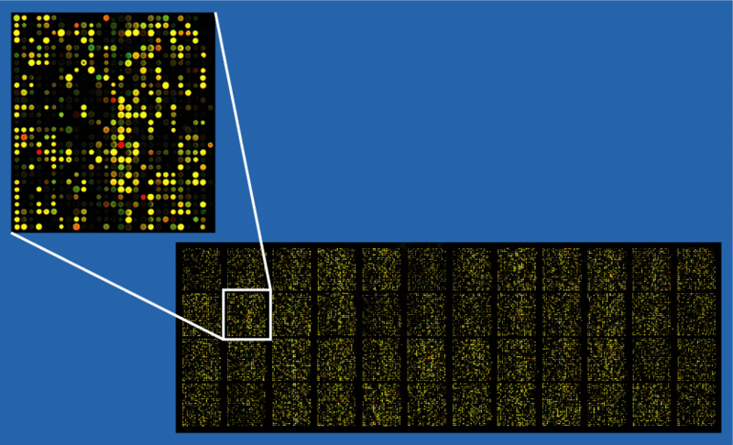
Why data clustering?
What does this mean?

Slide 3
Data clustering...
>F4BT0V001CZSIM rank=0000138 x=1110.0 y=2700.0 length=57
ACTGCTCTCATGCTGCCTCCCGTAGGAGTGCCTCCCTGAGCCAGGATCAAACGTCTG
>F4BT0V001BBJQS rank=0000155 x=424.0 y=1826.0 length=47
ACTGACTGCATGCTGCCTCCCGTAGGAGTGCCTCCCTGCGCCATCAA
>F4BT0V001EDG35 rank=0000182 x=1676.0 y=2387.0 length=44
ACTGACTGCATGCTGCCTCCCGTAGGAGTCGCCGTCCTCGACNC
>F4BT0V001D2HQQ rank=0000196 x=1551.0 y=1984.0 length=42
ACTGACTGCATGCTGCCTCCCGTAGGAGTGCCGTCCCTCGAC
>F4BT0V001CM392 rank=0000206 x=966.0 y=1240.0 length=82
AANCAGCTCTCATGCTCGCCCTGACTTGGCATGTGTTAAGCCTGTAGGCTAGCGTTCATC
CCTGAGCCAGGATCAAACTCTG
>F4BT0V001EIMFX rank=0000250 x=1735.0 y=907.0 length=46
ACTGACTGCATGCTGCCTCCCGTAGGAGTGTCGCGCCATCAGACTG
>F4BT0V001ENDKR rank=0000262 x=1789.0 y=1513.0 length=56
GACACTGTCATGCTGCCTCCCGTAGGAGTGCCTCCCTGAGCCAGGATCAAACTCTG
>F4BT0V001D91MI rank=0000288 x=1637.0 y=2088.0 length=56
ACTGCTCTCATGCTGCCTCCCGTAGGAGTGCCTCCCTGAGCCAGGATCAAACTCTG
>F4BT0V001D0Y5G rank=0000341 x=1534.0 y=866.0 length=75
GTCTGTGACATGCTGCCTCCCGTAGGAGTCTACACAAGTTGTGGCCCAGAACCACTGAGC
CAGGATCAAACTCTG
>F4BT0V001EMLE1 rank=0000365 x=1780.0 y=1883.0 length=84
ACTGACTGCATGCTGCCTCCCGTAGGAGTGCCTCCCTGCGCCATCAATGCTGCATGCTGC
TCCCTGAGCCAGGATCAAACTCTG

Slide 4
Data clustering...
Given a collection of data-points can we identify any patterns?
Data-points:
  DNA sequences
  Gene expression levels
  Organism abundances in an environment
  Vitals
Patterns:
  do certain points group together?

Slide 5
Example
16S rRNA sequences from gut microbiome
How many types of organisms are there?
Assumption: organisms that are similar have similar 16S sequences
Operational Taxonomic Unit – sequences within 2% distance from each other
Next step: given OTU abundances for a number of patients, do the patients cluster by age/disease/etc?

Slide 6
Types of clustering algorithms
Agglomerative
  Start with single observations
  Group similar observations into the same cluster
Divisive
  All datapoints start in the same cluster
  Iteratively divide cluster until you find good clustering
Hierarchical
  Build a tree – leaves are datapoints, internal nodes represent clusters

Slide 7
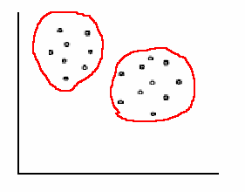
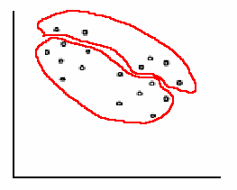
Measures of goodness of clustering
Homogeneity
  All points in a cluster must be similar
Separation
  Points in different clusters are disimilar

Slide 8
Microarray (gene abundance) clustering
Each gene can be viewed as an array of numbers
  expression of gene at different time-points
  expression of gene in different conditions (normal, variants of a disease, etc.)
Each time-point or tissue sample can also be viewed as an array of numbers
  expression levels for all genes
Basic idea: cluster genes and/or samples to highlight genes involved in disease

Slide 9
Hierarchical clustering
Need: definition of distance between data-points (e.g. individual genes).
Some measures:
  Euclidean distance
  Manhattan distance
  Pearson correlation
  Angle between vectors (centered Pearson correlation)
Clustering algorithm
  group together data-points that are most similar
  repeat...

Slide 10
Hierarchical clustering
Key element: how do you compute distance between two clusters, or a point and a cluster ?
UPGMA/average neighbor (average linkage)
  average distance between all genes in the two clusters
Furthest neighbor (complete linkage)
  largest distance between all genes in clusters
Nearest neighbor (single linkage)
  smallest distance between all genes in clusters
Ward's distance
  inter-cluster distance is variance of inter-gene distances

Slide 11
Hierarchical clustering...cont
Irrespective of distance choice, algorithm is the same
  1. compute inter-gene/cluster distances
  2. join together pair of genes/clusters with smallest distance
  3. recompute distances to include the newly created cluster
  4. repeat until all points in one cluster
Output of program is a tree
Cluster sets – defined by “cut” nodes – any subset of internal tree nodes defines a set of clusters – the sets of leaves in the corresponding subtrees
Choice of cut can be tricky – usually problem-specifi
Note: all this can be done easily in R

Slide 12
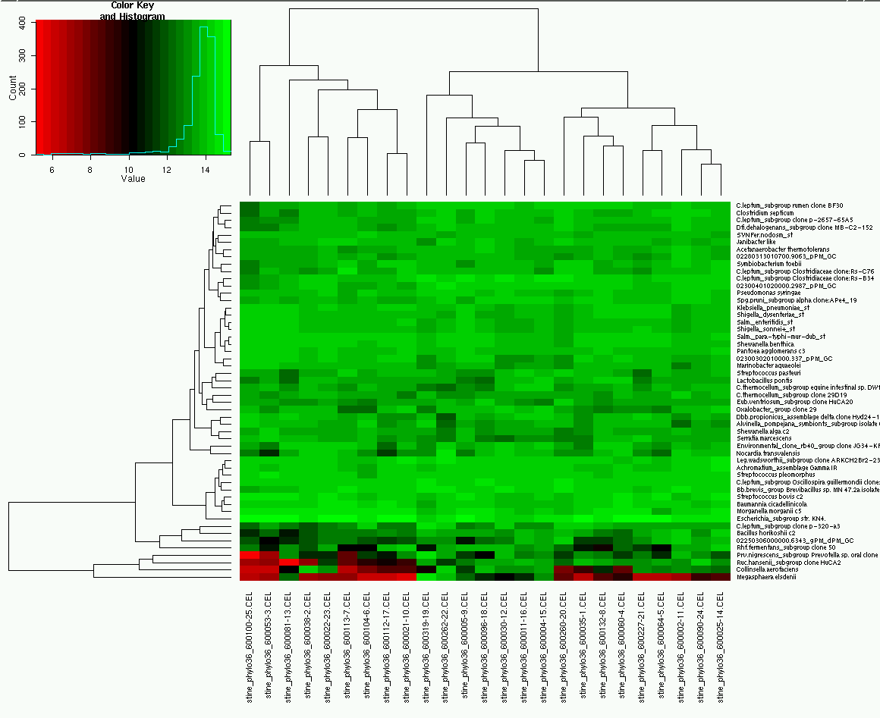
Example: gut microbiome in children

Slide 13
k-means clustering
Goal: split data into exactly k clusters
Basic algorithm:
  Create k arbitrary clusters - pick k points as cluster centers and assign each other point to the closest center
  Re-compute the center of each cluster
  Re-assign points to clusters
  Repeat
Another approach: pick a point at and see if moving it to a different cluster will improve the quality of the overall solution. Repeat!

Slide 14
K-means clustering... K=2

Slide 15
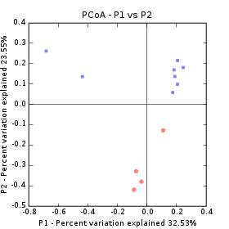
Other clustering approaches
Principal component analysis
  Identify a direction (vector V) such that the projection of data on V has maximum variance (first principal component)
  repeat (vector V' != V such that project of data on V' has maximum variance)
  Usually plot the first 2 or 3 principal components

Slide 16
Other clustering approaches
Self-organizing maps
  Neural-network based approach
  Output layer of network are points in a low-dimensional space
Graph theoretic
  Points are connected by edges representing strength of "connection" (e.g. similarity or dissimilarity)
  Pick clusters such that number of "similar" edges spanning boundaries is minimized, or number of "dissimilar" edges within each cluster is minimized
Markov chain clustering
  basic idea – a random walk through a graph will stay within a local strongly connected region

Slide 17
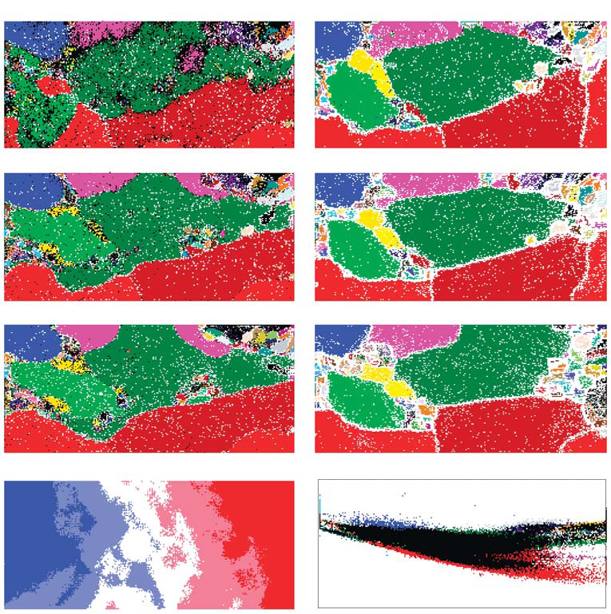
Self organizing map of genomes
http://www.jamstec.go.jp/esc/esc/publication/journal/jes_vol.6/pdf/JES6_22-Abe.pdf

Slide 18
Questions
Compare nearest, farthest, average, and Ward's cluster distances in terms of how compact the resulting clusters might be.

