Slide 1
CMSC423: Bioinformatic Algorithms, Databases and Tools
Gene finding

Slide 2
Signals in DNA
we have the genome sequence... now what?
...see chapter 9 ...
Motifs are a kind of “signal” - pattern of DNA that is “unexpected” in the genome of an organism
Uncovering new motifs – already did this – Gibbs sampling (local multiple alignment).
Given a motif – how do we find where it occurs in a genome?
Remember? Motif=
  k consecutive positions
  frequency of occurrence of each base at these positions

Slide 3
Finding/scoring motifs
Given motif M of length k – can be represented as a Position Weight Matrix (PWM) – same thing as a multiple alignment profile
Scoring a region of the genome according to motif? Given consecutive characters s₁,...,s_{k}
How surprising is this? Need to compare to background probabilities

Slide 4
Scoring motifs
Note: Score usually presented as a log-likelihood (log(p(M|s₁...s_{k}))
The p/q ratios in the motif are often called Position Specific Scoring Matrix (PSSM)
The program psi-blast can search a sequence against a database of PSSMs
Motifs are just one piece of the puzzle
How do we handle more complex “signals”

Slide 5
Gene finding/prediction
Given a string of DNA, identify regions that might be genes
Question: What does a gene look like?
Start codon: ATG
Stop codon: TGA, TAG, TAA
Splicing: GT...intron...AG
Also, DNA composition is different in genes – mutations are more likely in the third position of codons.

Slide 6
Simple gene finder (in bacteria)
Find all stop-codons in the genome
For each stop-codon, identify an in-frame start-codon upstream of it.
Each section between a start and a stop is called an ORF – open reading frame.
The long ORFs are likely genes – evolution prevented stop codons from occurring
3 stop codons, 64 possible codons => in random DNA every 22nd codon is a stop.
GGC TAG ATG AGG GCT CTA ACT ATG GGC GCG TAA

Slide 7
Gene finding as machine learning
Main question: does the ORF look like a gene?
Given a set of examples – genes we already know
and a string of DNA (e.g. ORF)
compute the likelihood that the ORF is a gene.
Note: more complex than motif finding
Codon usage bias – not all codons for a same amino-acid are equally likely
K-mer (e.g. 6-mer) frequencies (instead of single-base frequencies in motif finding)

Slide 8
Bacillus anthracis codon usage
UUU F 0.76 UCU S 0.27 UAU Y 0.77 UGU C 0.73
UUC F 0.24 UCC S 0.08 UAC Y 0.23 UGC C 0.27
UUA L 0.49 UCA S 0.23 UAA * 0.66 UGA * 0.14
UUG L 0.13 UCG S 0.06 UAG * 0.20 UGG W 1.00
CUU L 0.16 CCU P 0.28 CAU H 0.79 CGU R 0.26
CUC L 0.04 CCC P 0.07 CAC H 0.21 CGC R 0.06
CUA L 0.14 CCA P 0.49 CAA Q 0.78 CGA R 0.16
CUG L 0.05 CCG P 0.16 CAG Q 0.22 CGG R 0.05
AUU I 0.57 ACU T 0.36 AAU N 0.76 AGU S 0.28
AUC I 0.15 ACC T 0.08 AAC N 0.24 AGC S 0.08
AUA I 0.28 ACA T 0.42 AAA K 0.74 AGA R 0.36
AUG M 1.00 ACG T 0.15 AAG K 0.26 AGG R 0.11
GUU V 0.32 GCU A 0.34 GAU D 0.81 GGU G 0.30
GUC V 0.07 GCC A 0.07 GAC D 0.19 GGC G 0.09
GUA V 0.43 GCA A 0.44 GAA E 0.75 GGA G 0.41
GUG V 0.18 GCG A 0.15 GAG E 0.25 GGG G 0.20

Slide 9
Simple gene finder...better
Find ORFs
For each ORF, compute likelihood of codon composition given codon usage table for organism:
p(codon 1)*p(codon 2)*... * p(codon n)
if likelihood exceeds a certain threshold – call it a gene
note: you should calculate likelihood on equal-length windows to eliminate effect of ORF-length.

Slide 10
Simple gene finder: picking the threshold
What is the right threshold?
Answer: use training data (organism with known genes)
Forall thresholds t between 0 and 1, stepping by 0.05
  label all ORFs as gene/not gene
  compare labels to known truth
Pick threshold that makes fewest mistakes
Actually: find best compromise between sensitivity (ability to fish out the genes) and specificity (ability to make few false predictions)

Slide 11
Assessing accuracy
Confusion matrix: compare predictions to truth
truth
 | Gene | Not-gene
Gene | True positive | False positive Type I error
Not-gene | False negative Type II error | True negative
prediction

Slide 12
Measures of accuracy
Sensitivity (Sn, recall) – TP/TP+FN
Specificity (Sp) – TN/TN+FP
Precision – TP/TP+FP
Usually reported as (Sp, Sn), or (precision, recall).
Also:
F-score = 2*Precision*Recall/(Precision + Recall)
TP | FP
FN | TN

Slide 13
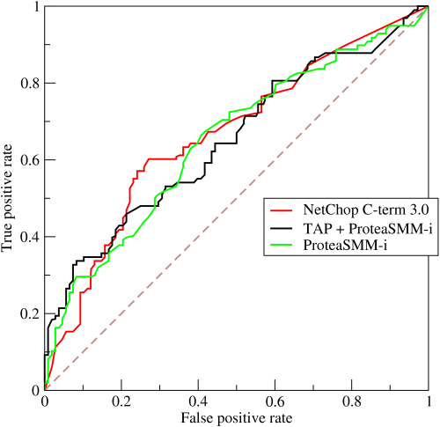
ROC(receiver operating characteristic) curve
If you vary the threshold, how do TP/FP rates change?
Higher curves are better (usually measured as Area Under ROC curve)

Slide 14
A more general solution
Hidden Markov models
States, transition probabilities, emission probabilities
p(S_{i}|S_{j}) – probability of transitioning to state i if we are in state j
p(σ_{i}|S_{j}) – probability of emitting symbol σ_{i} if we are in state j
p(S1|S1)
p(S2|S2)
p(S3|S3)
p(S2|S1)
p(S3|S2)
...
S1
S2
S3
...
p(S1|S2)
p(S2|S3)
p(σi|S1)
p(σi|S1)
p(σi|S1)

Slide 15
Why “Hidden”?
Observers can see the emitted symbols of an HMM but have no ability to know which state the HMM is currently in.
Thus, the goal is to infer the most likely hidden states of an HMM based on the given sequence of emitted symbols.

Slide 16
HMM Parameters
Σ: set of emission characters.
  Ex.: Σ = {H, T} for coin tossing
  Σ = {1, 2, 3, 4, 5, 6} for dice tossing
  Σ = {A, C, T, G} for DNA
Q: set of hidden states, each emitting symbols from Σ.
  Q={Fair,Biased} for coin tossing
  Q={gene, not gene} for bacteria
  Q={exon, intron, intergenic) for eukaryotes

Slide 17
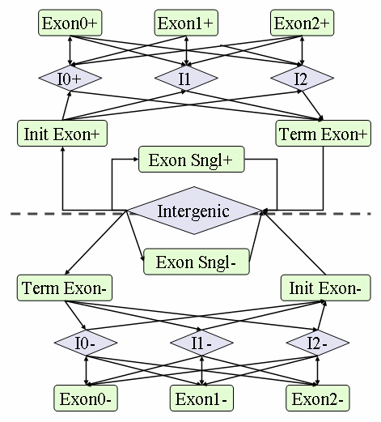
GlimmerHMM model

Slide 18
Questions we can ask with HMMs
Given an observed sequence of emitted characters (a string of DNA), what is the most likely sequence of states that generated the observed sequence?
  given a string of DNA and the model, break it up into genes
  solved by Viterbi algorithm
Given an observed sequence of emitted characters, what is the most likely state the model was in at time t?
  given a string of DNA, how likely is it that a certain location is inside a gene?
  solved by forward-backward algorithm

Slide 19
Training – the key to HMMs
So far we've assumed that all probabilities are known.
The training problem:
  given an HMM (just the states and connections)
  given several examples (e.g. known genes and intergenic regions)
  compute the transition and emission probabilities
Training is difficult!!
Baum-Welch algorithm – iterative optimization
  start with estimates of the probabilities
  run model with training data
  re-estimate probabilities based on performance on training data

Slide 20
Questions
Given the G/C content for a genome (fraction of letters in the genome that are G or C), what is the expected distance between two stop codons? - requires Poisson statistics

Slide 21
Advanced material (not on exam)

Slide 22
Viterbi algorithm
Given an HMM and an output string, compute the most likely path through the HMM that would result in the given string
p(Exon|Exon)
p(Intr|Intr)
p(Inter|Exon)
p(Inter|Inter)
p(Exon|Intr)
Intron
Exon
Intergenic
p(Intr|Exon)
p(Exon|Inter)
p(emission|Inter)
p(emission|Intr)
p(emission|Exon)

Slide 23
Viterbi algorithm
t0
t1
t2
Intron
Intron
Intron
Exon
Exon
Exon
...
Intergenic
Intergenic
Intergenic
Observations:
x0
x1
x2
maximize
over all possible state paths
dynamic programming algorithm

Slide 24
Viterbi algorithm
S(k,i) – most likely path for x₀..x_{i} ends in state k
S(l, i + 1) = max_{k} { S(k, i) * p(l|k) * p(emission of x_{i+1}|l)}
= p(emission of x_{i+1}|l) * max_{k} {S(k,i) * p(l|k)}
The optimal path is found by back-tracking
Note: Viterbi is equivalent to finding longest path in a graph
Implementation problem: underflow – many products of very small values
Solution: work in log-space
  instead of probabilities use logarithm of probabilities
  instead of products use sums

Slide 25
Forward-backward algorithm
Given an HMM and an output string of length n, what is the probability that the HMM was in state k
at time i < n?
Similar dynamic programming as Viterbi however done twice:
  from t0 to ti (forwards)
  from tn to ti (backwards)
In Viterbi recurrence replace max with ∑
  likelihood is a sum of probabilities - all possible paths that go through state k at time i

Slide 26
Notes on training an HMM
Gene finder output
  a set of predictions (exon, intron, intergenic, etc.)
  a probability (likelihood) for each prediction
In addition to setting parameters for the model you also need to pick a threshold – how high should the probability be before you "believe" it.

Slide 27
Picking the "right" threshold
Cross-validation (hold-out cross validation)
  divide training set into Training and Hold sets
  train in "Training"
  test result on "Hold" – adjust threshold until results look best
k-fold cross-validation
  divide training set into K sub-sets
  train on K-1 sets and test on one of them
  repeat for different choices of "test" set

Slide 28
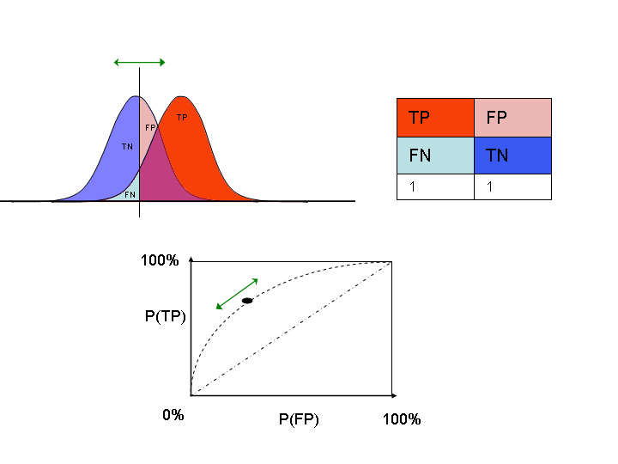
Receiver operating characteristic

