Slide 1
CMSC423: Bioinformatic Algorithms, Databases and Tools
Writing bioinformatics software
Libraries & misc.

Slide 2
Libraries/utilities
Bio::Perl (Perl)
BioJava (Java)
BioPython (Python)
BioRuby (Ruby)
seqAn (C++)
Bioconductor (R)
Chado (SQL)

Slide 3
Bio::Perl
http://www.bioperl.org
use Bio::Perl;
my $seq = read_sequence(“mytest.fa”, “fasta”);
my $gbseq = read_sequence(“mytest.gb”, “genbank”);
write_sequence(“>test.fasta”, 'fasta', $gbseq);
' vs “ ?

Slide 4
Bio::Perl
Find sequences longer than 500 letters
use Bio:Perl;
while ($seq = read_sequence(“test.fa”, 'fasta')) {
if ($seq ->length() > 500) {
print $seq->primary_id(), “\n”;
}
}

Slide 5
Bio::Perl
Other useful stuff
$seqio = new Bio::SeqIO(-format => 'largefasta',
-file => 't/data/genomic-seq.fasta');
$pseq = $seqio->next_seq();
$gb = new Bio::DB::GenBank;
$seq1 = $gb->get_Seq_by_id('MUSIGHBA1');
etc...

Slide 6
BioJava
http://www.biojava.org
import org.biojava.bio.*;
String filename = args[0];
BufferedInputStream is =
new BufferedInputStream(new FileInputStream(filename));
//get the appropriate Alphabet
Alphabet alpha = AlphabetManager.alphabetForName(args[1]);
//get a SequenceDB of all sequences in the file
SequenceDB db = SeqIOTools.readFasta(is, alpha);

Slide 7
BioJava
BufferedReader br =
new BufferedReader(new FileReader(args[0]));
String format = args[1];
String alphabet = args[2];
SequenceIterator iter =
(SequenceIterator)SeqIOTools.fileToBiojava(format,alphabet, br);
while (iter.hasNext()){
Sequence seq = iter.nextSequence();
if (seq.length() > 500) {System.out.println(seq.getName());}
}

Slide 8
BioJava...more
Same as Bio::Perl:
  can directly connect to databases
  various sequence manipulations (reverse complement, translate, etc.)
  basic bioinformatics algorithms
  etc.

Slide 9
BioPython
http://www.biopython.org
from Bio import SeqIO
handle = open(“file.fasta”)
seq_record = SeqIO.parse(handle, “fasta”)
SeqIO.write(my_records, handle2, "fasta")

Slide 10
BioPython
from Bio import SeqIO
handle = open("test.fasta")
for seq_record in SeqIO.parse(handle, "fasta") :
if len(seq_record) > 500 :
print seq_record.id
handle.close()

Slide 11
BioPython...more
Same as Bio::Perl:
  can directly connect to databases
  various sequence manipulations (reverse complement, translate, etc.)
  basic bioinformatics algorithms
  etc.

Slide 12
BioRuby
http://www.bioruby.org
require 'bio'
input_seq = ARGF.read # reads all files inarguments
my_naseq = Bio::Sequence::NA.new(input_seq)

Slide 13
BioRuby
#!/usr/bin/env ruby
require 'bio'
ff = Bio::FlatFile.new(Bio::FastaFormat, ARGF)
ff.each_entry do |f|
if f.length > 500
puts f.entry_id
end
end

Slide 14
BioRuby...more
Same as Bio::Perl:
  can directly connect to databases
  various sequence manipulations (reverse complement, translate, etc.)
  basic bioinformatics algorithms
  etc.

Slide 15
SeqAn
http://www.seqan.de
#include <seqan/sequence.h>
#include <seqan/file.h>
using namespace seqan;
using namespace std;
String <Dna> seq;
String<char> name;
fstream f;
f.open(“test.fasta”);
readMeta(f, name, Fasta());
readMeta(f, seq, Fasta());

Slide 16
SeqAn
String <Dna> seq;
String<char> name;
fstream f;
f.open(“test.fasta”);
while (! f.eof()){
readMeta(f, name, Fasta());
readMeta(f, seq, Fasta());
if (length(seq)){
cout << name << endl;
}
}

Slide 17
SeqAn...more
Not quite as much as Perl/Java/Python, but still lots of utilities (including graph algorithms)

Slide 18
R/BioConductor
http://www.bioconductor.org
Mainly for statistical applications, e.g. microarray analysis
library("affy")
library("geneplotter")
library("gplots")
data <- ReadAffy()
eset <- rma(data)
e <- exprs(eset)
heatmap.2(e, margin=c(15,15), trace="none", col=redgreen(25), cexRow=0.5)

Slide 19
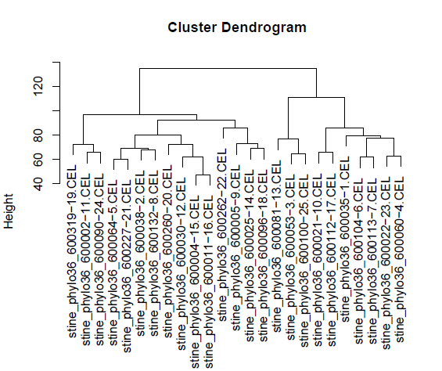
R/BioConductor
Book has lots of examples
Worth learning more about it – easy to do various cool things

Slide 20
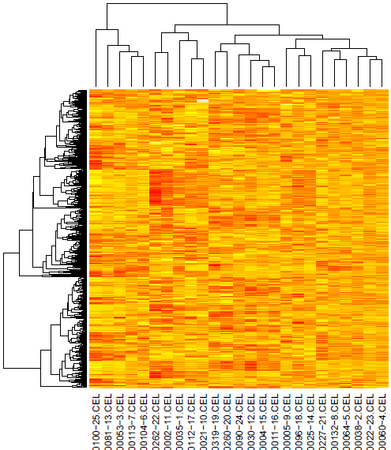
R... more cool stuff

Slide 21
Programming for bioinformatics
Details of specialized libraries beyond scope of course
Good software engineering practices are essential
Often, “correct” is undefined – output of program defines correctness
Pitfalls – e.g. papers retracted from Science due to software bugs
Key – be proactive and learn by yourselves from online resources!

