Slide 1
CMSC423: Bioinformatic Algorithms, Databases and Tools
Some Genetics

Slide 2
Reading assignment
Chapter 13

Slide 3
Gene association studies
Goal: identify genes/markers associated with disease
Example: BRCA1 – associated with risk of breast cancer
Lots of hype on the news recently: companies promise to “sequence” your genome and tell you:
  likely ancestry
  risk for disease
Examples:
  www.23andme.com
  www.decodeme.com
  and many others

Slide 4
First...definitions
Genotype – genetic composition of our genome
Phenotype – observable consequence of genotype – e.g. skin/hair color, IQ, disease state, etc.
We have two copies of each chromosome (homologous chromosomes), each received from one of the parents
Each gene can, thus, have two forms (alleles), e.g. A1/A2
Each gene may be associated with a phenotype
Dominant gene – phenotype of A1/A2 is the same as phenotype of A1/A1
Recessive gene - otherwise

Slide 5
More definitions
Genotype A/A is called homozygous (both chromosomes have the same allele)
Genotype A/B is called heterozygous (mother and father's chromosomes disagree)
Notes:
  phenotypes not necessarily directly correlated with a single gene – polygenic traits
  probability gene correlates with a phenotype – penetrance
  link between genotype and phenotype can be qualitative (gene “form” matters) or quantitative (gene dosage matters)

Slide 6
Technology – what we measure?
Definition of allele/genotype depends on what we can measure – constantly changing
We are looking for things that differ within a population – polymorphic markers:
  Restriction fragment length polymorphism (RFLP)– measures presence/absence of particular sites in the genome
  Variable number tandem repeats (VNTR) – specific repeat elements that occur in different copy numbers
  Single-nucleotide polymorphisms (SNPs) – single letter differences between chromosomes (>500,000 characterized)
  Copy number variants (CNV) – genomic regions whose copy number differs between individuals

Slide 7
Allele frequencies
Population genetics questions:
  what alleles exist in a certain population?
  what is the relative abundance of the alleles?
  how “diverse” is a population?
Given a locus (gene or genomic region), assume there are K possible alleles in a population and allele j occurs with frequency pj
How “uniform” is the locus in the population? Likelihood two random individuals have same allele

Slide 8
Allele frequencies...
Usually we focus on the differences:
Interesting tidbit – most variation occurs within populations rather than between, e.g. two Africans are more different from each other than the average African is from the average Chinese (see book for details)
However, allele frequencies can be used to infer population membership for an individual

Slide 9
Who am I?
My alleles are A₁, B₂, C₁, D₃ (assume homozygous for clarity)
Am I European or Asian?
Need to know:
p_{A1}^{Europe}, p_{B2}^{Europe}, p_{C1}^{Europe}, p_{D3}^{Europe}
p_{A1}^{Asia}, p_{B2}^{Asia}, p_{C1}^{Asia}, p_{D3}^{Asia}
p(me, European) = (p_{A1}^{Europe} )²X (p_{B2}^{Europe} )²X (p_{C1}^{Europe} )²X (p_{D3}^{Europe})²
similarly for p(me, Asian)
if p(me, European) > p(me, Asian) I can infer that I have European ancestry

Slide 10
Who am I?
Inferring ancestry as described is overly-simplistic
Can do more fancy statistics
However: any statistical approach is error prone – answer is associated with level of confidence, i.e. probability answer is wrong (remember P-values?)
Beware of anyone who claims to infer your ancestry from genotype
Beware of anyone who claims to infer disease susceptibility from genotype - need genetic/risk counselors not companies providing information for “entertainment purposes”

Slide 11
Recombination
Genetic change not only caused by mutations
Recombination – DNA “jumps” between homologous chromosomes due to cross-over events
A1
B1
C1
D1
A1
B1
C1
D1
A2
B2
C2
D2
A2
B2
C2
D2
A1
B1
C2
D2
A1
B1
C2
D1
A2
B2
C1
D1
A2
B2
C1
D2

Slide 12
Association studies
The set of alleles on a same chromosome – haplotype
If a particular allele of a gene is always associated with a phenotype (disease) – is this gene causing the disease?
Most likely – gene is associated/nearby with the gene causing the disease (their alleles always appear on the same haplotype)
Due to recombination a set of original haplotypes rapidly becomes broken apart
How likely is it that two alleles remain on the same haplotype (are linked) during evolution?

Slide 13
Linkage analysis
Preservation of linkage depends on distance between the genes and rate of recombination
Given two genes (A, B) – how can we estimate whether recombination occurred between them?
How likely is it that A₁ and B₁ are both on the same haplotype by chance?
  p(A₁)p(B₁)
How different is this from the observed ratios? - Linkage Desequilibrium
  D = p(A₁B₁) – p(A₁)p(B₁)
  D = p(A₂B₂) – p(A₂)p(B₂)
  D = p(A₁B₁)p(A₂B₂) - p(A₁B₂)p(A₂B₁)

Slide 14
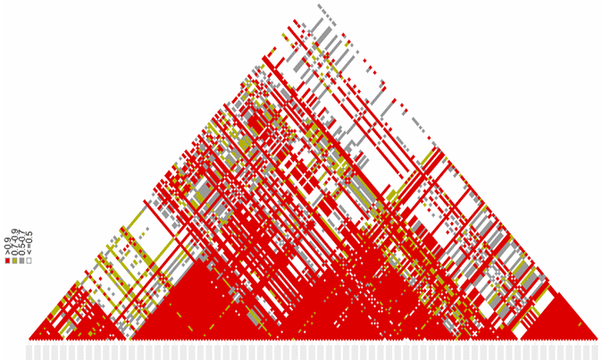
Linkage analysis
Linkage desequilibrium usually measured as ratio to maximum possible desequilibrium - D/Dmax
Dmax = min(p(A₂)p(B₁), p(A₁)p(B₂)) if D > 0
Dmax = min(p(A₁)p(B₁), p(A₂)p(B₂)) if D < 0
Another measure – Pearson's correlation coefficient
  r² = D²/(p(A₁)p(A₂)p(B₁)p(B₂)

Slide 15
Additional resources
www.hapmap.org
www.1000genomes.org
www.personalgenomes.org
http://www.ncbi.nlm.nih.gov/sites/entrez?db=omim

Slide 16
Questions
Prove the equalities on slide 13 (D = ...)
Derive the formula for Dmax on slide 14 (problem 3.5 in book)

