Slide 1
CMSC423: Bioinformatic Algorithms, Databases and Tools
Genome assembly

Slide 2
Reading assignment
http://www.cbcb.umd.edu/research/assembly_primer.shtml
Chapter 4.5 – coverage statistics
Chapter 8 – genome assembly
http://amos.sourceforge.net

Slide 3
Shotgun sequencing
shearing
sequencing
original DNA (hopefully)
assembly

Slide 4
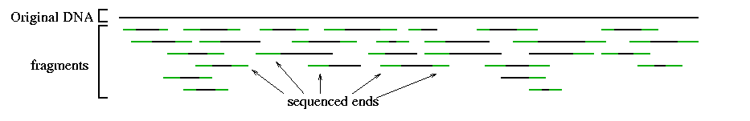
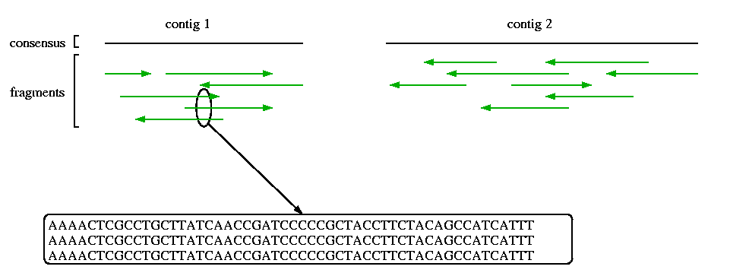
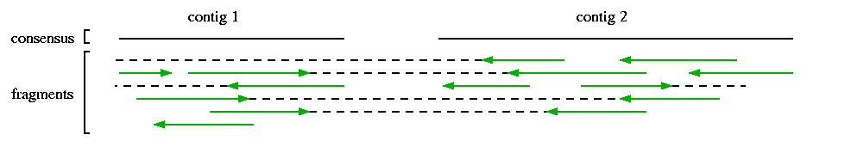
Overview of terms
Assembly
Scaffolding

Slide 5
Assembly Glossary
Read – small (50-2000bp) segment of DNA "read" by a sequencing instrument
Mate-pair, paired ends – pair of reads whose distance from each other within the genome is approximately known
Contig – contiguous segment of DNA reconstructed (unambiguously) from a set of reads
Scaffold – group of contigs that can be ordered and oriented with respect to each other (usually with the help of mate-pair data)

Slide 6
So...
Sequencing technologies only "read" small chunks of DNA, yet genomes are substantially larger
The shotgun sequencing approach generates many random fragments from the original DNA
The task of the assembly program is to stitch together the many small pieces into a reconstruction of the genome
Essentially..... a huge jigsaw puzzle
Think: shred a collection of Harry Potter books at random then try to rebuild the original without any additional information.

Slide 7
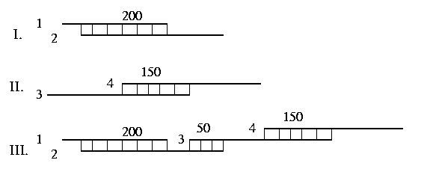
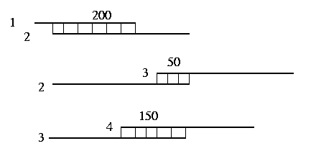
Shortest common superstring problem
Given a set of strings, Σ=(s₁, ..., s_{n}), determine the shortest string S
such that every s_{i} is a sub-string of S.
NP-hard
approximations: 4, 3, 2.89, ...
...ACAGGACTGCACAGATTGATAG
ACTGCACAGATTGATAGCTGA...
Greedy algorithm (4-approximation)
phrap, TIGR Assembler, CAP

Slide 8
Greedy algorithm details
Compute all pairwise overlaps
*Pick best (e.g. in terms of alignment score) overlap
Join corresponding reads
Repeat from * until no more joins possible
How do you compute an overlap alignment?
Hint: modify Smith-Waterman dynamic programming algorithm

Slide 9
Repeats (where greedy fails)
AAAAAA
AAAAAA
AAAAAAAAAAAAAAAAAAAA
AAAAAA
AAAAAA
AAAAAA
AAAAAA
AAAAAA
AAAAAA
AAAAAA
AAAAAA
AAAAAA
AAAAAA
AAAAAA
AAAAAA
AAAAAA

Slide 10
Impact of randomness – non-uniform coverage
Imagine raindrops on a sidewalk

Slide 11
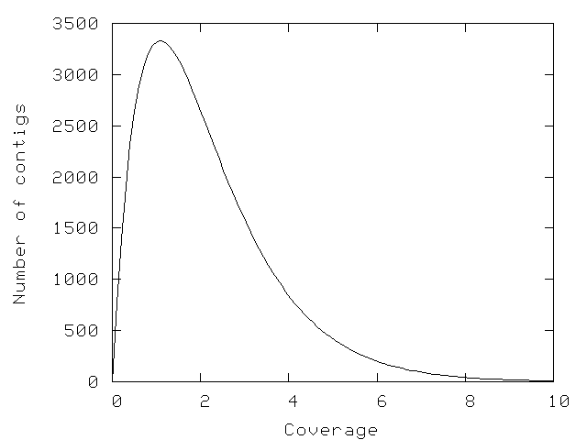
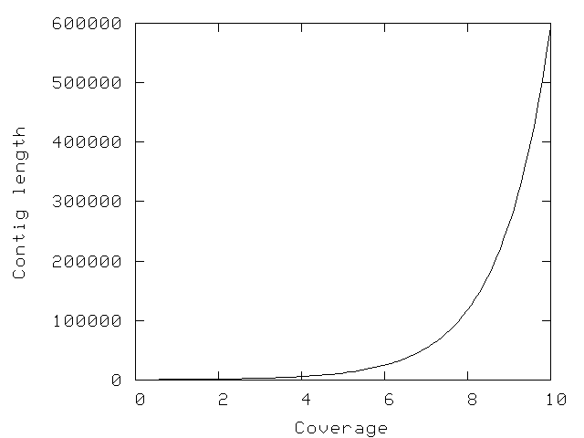
Lander-Waterman statistics
L = read length
T = minimum overlap
G = genome size
N = number of reads
c = coverage (NL / G)
σ = 1 – T/L
E(#islands) = Ne^{-cσ}
E(island size) = L(e^{cσ} – 1) / c + 1 – σ
contig = island with 2 or more reads
See chapter 4.5

Slide 12
All pairs alignment
Needed by the assembler
Try all pairs – must consider ~ n² pairs
Smarter solution: only n x coverage (e.g. 8) pairs are possible
  Build a table of k-mers contained in sequences (single pass through the genome)
  Generate the pairs from k-mer table (single pass through k-mer table)
k-mer

Slide 13
Additional pairwise-alignment details
4 types of overlaps
Often – assume first read is “forward”
Representing the alignment
Why not store length of overlap?
Normal
Innie
Outie
Anti-normal
A-hang
B-hang

Slide 14
Brief aside (assembly paradigms)
Greedy algorithm
  easy to implement
  relatively efficient
  but... can make mistakes because it is greedy (only takes into account local information)
How can you "reason" about repeats?
Graph theory can help: 2 paradigms
  Overlap-Layout-Consenusus: nodes=reads, edges= reads overlap
  deBruijn/repeat graph: nodes = k-mers, edges = k+1-mers (extracted from the reads).
Both translate into: find a constrained path within a graph

Slide 15
Overlap-layout-consensus
Main entity: read
Relationship between reads: overlap
3 Stages: overlap (btwn reads) + layout (find placement of reads
wrt each other) + consensus (multiple alignment of reads)
1
4
7
2
5
8
3
6
9
1
2
3
4
5
6
7
8
9
ACCTGA
ACCTGA
AGCTGA
ACCAGA
1
2
3
1
2
3
1
2
3
1
2
3
1
3
1
3
2
2

Slide 16
Paths through graphs and assembly
Hamiltonian circuit: visit each node (city) exactly once, returning to the start
I.e. use every read in the genome exactly once
Genome

Slide 17
Aside: graph traversals
Hamiltonian path: visit every single node of a graph EXACTLY once (NP-hard)
Eulerian path: visit every edge of a graph EXACTLY once (polynomial time)
Chinese Postman: find the shortest path in a graph that visits all the edges (i.e. Eulerian path where you allow a minimum number of edges to be reused)
Note: a Hamiltonian path or an Eulerian path are not guaranteed to exist. A Chinese postman path can always be constructed

Slide 18
Sequencing by hybridization
AAAA
AAAC
AAAG
AAAT
AACA
AACG
AACT
AAGA
...
AACAGTAGCTAGATG
AACA TAGC AGAT
ACAG AGCT GATG
CAGT GCTA
AGTA CTAG
GTAG TAGA
probes - all possible k-mers

Slide 19
Assembling SBH data
Main entity: oligomer (overlap)
Relationship between oligomers: adjacency
ACCTGATGCCAATTGCACT...
CTGAT follows CCTGA (they share 4 nucleotides: CTGA)
Problem: given all the k-mers, find the original string
In assembly: fake the SBH experiment - break the reads into k-mers

Slide 20
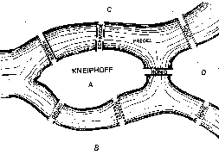
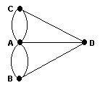
Eulerian circuit
Eulerian circuit: visit each edge (bridge) exactly once and come back to the start
an edge (roughly) corresponds to a read
ACCTAGATTGAGGTCG
ACCTAGATTGAGGTC
CCTAGATTGAGGTCG

Slide 21
deBruijn graph
Nodes – set of k-mers obtained from the reads
Edges – link k-mers that overlap by k-1 letters
ACCAGTGCA
CCAGTGCAT
This formulation particularly useful for very short reads
Solution – Eulerian path (actually Chinese postman) through the graph
Note – multiple Eulerian paths possible (exponential number) due to repeats

Slide 22
de Bruijn Graph Assembly
It was the best
was the best of
the best of times,
it was the worst
best of times, it
was the worst of
of times, it was
the worst of times,
times, it was the
worst of times, it
it was the age
the age of foolishness
was the age of
the age of wisdom,
age of wisdom, it
of wisdom, it was
wisdom, it was the

Slide 23
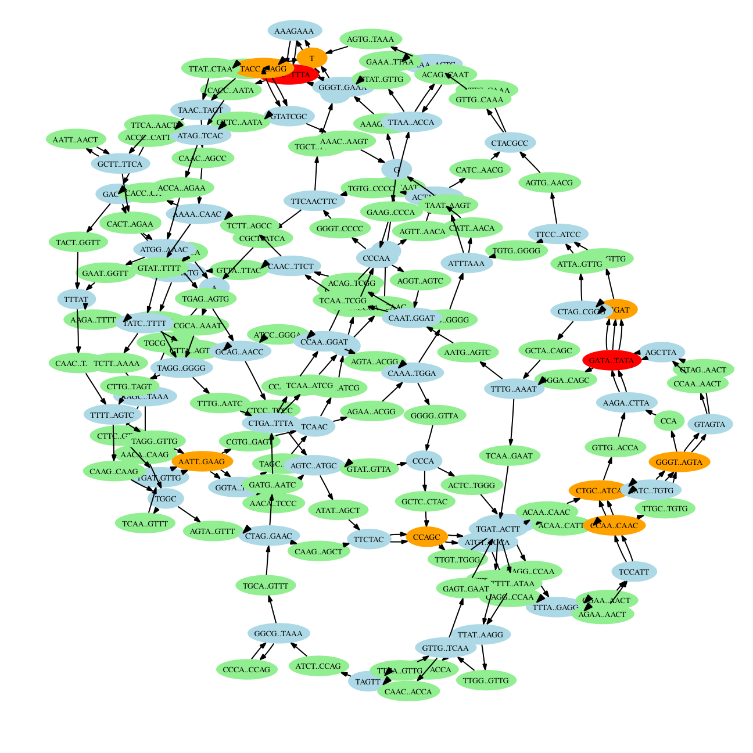
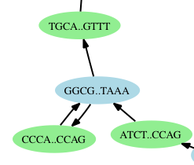
deBruijn graph of Mycoplasma genitalium

Slide 24
Assembly...parting thoughts
The basic idea of both OLC and deBruijn approaches: identify sections of DNA that MUST be present in the actual genome:
  OLC – each read must be used because it is a piece of the original genome
  deBruijn – each edge must be used because the DNA string corresponding to it is a piece of the original genome

Slide 25
Assembly... recap
Greedy algorithm... pretty good but gets stuck at repeats
Overlap layout consensus – equivalent to Hamiltonian path (NP-hard)
deBruijn graph – equivalent to Eulerian path (polynomial time)
... BUT – exponential # of Eulerian paths consistent with reads (because of repeats)
Ultimately... still NP-hard

Slide 26
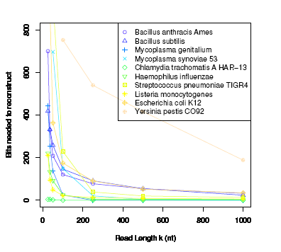
Read-length vs. genome complexity

Slide 27
In practice: graph simplifications
Collapse paths
Remove Tips
Pop Bubbles
Thread Reads
Split Half Decision
B’
B’
A
B
B
A
B
A
A
C
r
A
r
BC
B
C
D
C
A
r
B
r
B
AB
A
BC
A
B*
C
A
C
r
D
r
C
Collapse trees of cycles
C
Thm: a graph has a unique
Eulerian path if and only if
its cycle graph is a tree.
Defn: cycle graph – each node is a cycle in the original graph, nodes are connected by an edge if the corresponding cycles intersect.
B
D
E
F
A
ABCDEFDA
Velvet

Slide 28
AMOS quick tour
amos.sourceforge.net
Basic workflow:
  sequences are converted into the AMOS format (.afg)
  an .afg file is loaded into a flat-file database (the "bank")
  all programs interact through the bank
scaffolder
overlapper
reads
inserts
overlaps
contigs
scaffolds
etc.
error
corrector
viewer
...
contigger
etc.

Slide 29
An AMOS pipeline
#!runAmos -C
#--------------------------------------- USER DEFINED VALUES ------------------#
# allow input to be either <file>.afg or just <file>
REF = $(PREFIX).1con
TGT = $(strip .afg PREFIX).afg
#------------------------------------------------------------------------------#
BINDIR = /usr/local/bin
NUCMER = $(shell which nucmer)
SEQS = $(PREFIX).seq
BANK = $(PREFIX).bank
ALIGN = $(PREFIX).delta
LAYOUT = $(PREFIX).layout
CONFLICT = $(PREFIX).conflict
CONTIG = $(PREFIX).contig
FASTA = $(PREFIX).fasta
INPUTS = $(TGT) $(REF)
OUTPUTS = $(CONTIG) $(FASTA)
## Building AMOS bank
10: $(BINDIR)/bank-transact -c -z -b $(BANK) -m $(TGT)
## Collecting clear range sequences
20: $(BINDIR)/dumpreads $(BANK) > $(SEQS)
## Running nucmer
30: $(NUCMER) --maxmatch --prefix=$(PREFIX) $(REF) $(SEQS)
## Running layout
40: $(BINDIR)/layout-align -U $(LAYOUT) -C $(CONFLICT) -b $(BANK) $(ALIGN)
## Running consensus
50: $(BINDIR)/make-consensus -B -b $(BANK)
## Outputting contigs
60: $(BINDIR)/bank2contig $(BANK) > $(CONTIG)
## Converting to FastA file
70: $(BINDIR)/ctg2fasta < $(CONTIG) > $(FASTA)

Slide 30
Project
You will need to modify the Minimus pipeline to use your own overlapper program (replacing the hash-overlap command with your own)
Part of the project is figuring out how to do this (using the AMOS documentation)

Slide 31
AMOS interchange format
Based on Celera message format
3-letter object tag (RED= read)
single-line attribute (action: ADD)
internal identifier (int32)
external identifier
multi-line attribute

Slide 32
Basic flow...
Start with an AMOS .afg file (I will provide one)
Load it in the bank
  bank-transact -cf -b mybank.bnk -m myfile.afg
Dump the reads back out in a multi-fasta file
  dumpreads mybank.bnk > myfile.fa
  why? the IDs are now the internal IDs within the bank
Use your program to compute overlaps (output an afg file)
  myoverlapper myfile.fa > myoverlaps.afg
Load the new overlaps in the bank
  bank-transact -b mybank.bnk -m myoverlaps.afg
Continue with standard Minimus pipeline

Slide 33
Overlap format
{OVL
adj:N
rds:159,161
scr:0
ahg:-32
bhg:0
}
{OVL
adj:N
rds:159,162
scr:0
ahg:-17
bhg:43
}
{OVL
adj:I
rds:159,163
scr:0
ahg:362
bhg:560
}
adj – "Normal", "Innie"
rds: iid1, iid2
ahg, bhg – ahang, bhang
-32
A(159)
0
B (161)
Note: output is "redundant"
both A ovl B and B ovl A
are reported
-17
43
A (159)
B (162)
362
A (159)
560
B (163)

