Slide 1
CMSC423: Bioinformatic Algorithms, Databases and Tools
inexact alignment
dynamic programming, gapped alignment

Slide 2
Inexact matching: why?
Redundancy in genetic code: nucleotide sequence may differ, but proteins the same
Different amino-acid sequences still fold the same way: function unchanged (generally changing an amino-acid with a similar one doesn't affect protein function)
Aligning ESTs (RNA sequences) to DNA need to account for gaps corresponding to exons
Need to account for sequencing errors
Read chap 6.1!!! (define: ortholog, paralog, homolog)
S Y P T D
TCTTATCCTACTGAT
TCATACCCCACAGAC

Slide 3
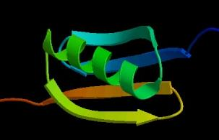
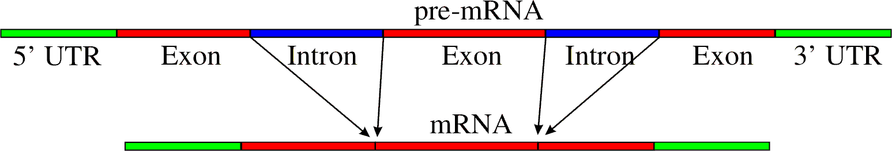
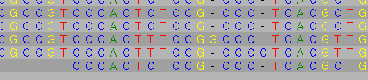

Slide 4
Several hemoglobins
HBB_HUMAN FFESFGDLSTPDAVMGNPKVKAHGKKVL-----GAFSDGLAHLDNLKGTF
HBB_HORSE FFDSFGDLSNPGAVMGNPKVKAHGKKVL-----HSFGEGVHHLDNLKGTF
HBA_HUMAN YFPHF-DLS-----HGSAQVKGHGKKVA-----DALTNAVAHVDDMPNAL
HBA_HORSE YFPHF-DLS-----HGSAQVKAHGKKVG-----DALTLAVGHLDDLPGAL
MYG_PHYCA KFDRFKHLKTEAEMKASEDLKKHGVTVL-----TALGAILKKKGHHEAEL
GLB5_PETMA FFPKFKGLTTADQLKKSADVRWHAERII-----NAVNDAVASMDDTEKMS
LGB2_LUPLU LFSFLKGTSEVP--QNNPELQAHAGKVFKLVYEAAIQLQVTGVVVTDATL
* : . . .:: *. : :. :
From http://bioinfo.cnio.es/docus/courses/SEK2003Filogenias/seq_analysis/multiple.html

Slide 5
Warm-up – Longest Common Subsequence
Given two strings of letters, identify longest string of letters that occurs, in the same order, in both strings
AG C GTAG
G C G A
GTCAG A
Find the longest chain of 1s, moving to the right and down
A
G
C
G
T
A
G
G
1
1
1
T
1
C
1
A
1
1
G
1
1
1
A
1
1

Slide 6
Dynamic programming
Idea: re-use previously computed information
LCS[i,j] – longest common subsequence of strings S1[1..i], S2[1..j]
i
A
G
C
G
T
A
G
LCS[i,j] is the maximum of:
1.if S1[i] = S2[j]
LCS[i-1, j-1] + 1
else
LCS[i -1, j-1]
2. LCS[i – 1, j]
3. LCS[i, j – 1]
G
1
1
1
T
1
C
1
j
A
1
1
G
1
1
1
A
1
1
Goal: find LCS[m,n]

Slide 7
Computing the LCS table
Row 0 and column 0 easy to fill
Fill the rest column by column
Find the actual sequence:
trace-back pointers
A
A
G
C
G
T
A
G
A
G
G
C
C
G
G
T
T
A
A
G
G
G
G
0
1
0
1
0
0
1
G
0
0
1
1
0
0
1
1
0
0
0
0
0
1
T
T
0
1
1
1
2
2
2
T
0
0
1
C
C
0
1
2
2
2
2
2
C
0
0
1
A
A
1
1
2
2
2
3
3
A
1
1
1
G
G
0
2
2
3
3
3
4
G
0
0
2
A
A
1
2
2
3
3
4
4
A
1
1
2

Slide 8
Extending to sequence alignment
AG-C-GTAG
-GTCAG-A-
In LCS, mis-alignments were free
What happens if we pay for our "mistakes"? (this also allows us to account for "similar" amino-acids)
  Value[A, A] = 10
  Value[A,G] = -5
  Value[A,-] = -2
  etc.
The same dynamic programming algorithm works!

Slide 9
The recurrences
AG-C-GTAG
-GTCAG-A-
Score[i,j] is the maximum of:
1. Score[i-1, j-1] + Value[S1[i],S2[j]]
AG-C-G AG-C-G
-GTCAG -GTCAT
2. Score[i – 1, j] + Value[S1[i], -] (S1[i] aligned to gap)
AG-C-GT
-GTCAG-
3. Score[i, j – 1] + Value[-, S2[j]] (S2[j] aligned to gap)
AG-C-
-GTCA

Slide 10
The dynamic programming table
Score[i,j] is the maximum of:
1. Score[i-1, j-1] + Value[S1[i],S2[j]] (S1[i-1], S2[j-1] aligned)
2. Score[i – 1, j] + Value[S1[i], -] (S1[i] aligned to gap)
3. Score[i, j – 1] + Value[-, S2[j]] (S2[j] aligned to gap)
-
A
G
C
G
T
A
G
Value (A, A) = 10
Value (A, G) = -5
Value (A, -) = -2
-
0
-2
-4
-6
-8
-10
-12
-14
G
-2
-4
8
6
T
-4
-6
6
4
C
-6
-8
4
16
A
-8
G
-10
Note: we only look
at 3 adjacent boxes
A
-12

Slide 11
Intuition
What is the best way to align strings S1 and S2?
just look at last character for now – what is it aligned to?
S1[n]
S2[m]
AG-C-GTAG
-GTCAG-A-
S1[n]
S2[m]
S1[n]
S2[m]

Slide 12
The recurrences
AG-C-GTAG
-GTCAG-A-
Score[i,j] is the maximum of:
1. Score[i-1, j-1] + Value[S1[i],S2[j]]
AG-C-G AG-C-G
-GTCAG -GTCAT
2. Score[i – 1, j] + Value[S1[i], -] (S1[i] aligned to gap)
AG-C-GT
-GTCAG-
3. Score[i, j – 1] + Value[-, S2[j]] (S2[j] aligned to gap)
AG-C-
-GTCA

Slide 13
The dynamic programming table
Score[i,j] is the maximum of:
1. Score[i-1, j-1] + Value(S1[i],S2[j]) (S1[i-1], S2[j-1] aligned)
2. Score[i – 1, j] + Value(S1[i], -) (S1[i] aligned to gap)
3. Score[i, j – 1] + Value(-, S2[j]) (S2[j] aligned to gap)
-
A
G
C
G
T
A
G
Value (A, A) = 10
Value (A, G) = -5
Value (A, -) = -2
-
0
-2
-4
-6
-8
-10
-12
-14
G
-2
-4
8
6
T
-4
-6
6
4
C
-6
-8
4
16
A
-8
G
-10
Note: we only look
at 3 adjacent boxes
A
-12

Slide 14
How do you output the result?
Goal: produce the “nice” string with gaps that is shown in the examples
Idea: create the string backwards – starting from the right
As you follow backtrack pointers:
  if you follow diagonal pointer – add characters to both output strings (aligned versions of original strings)
  if you move up – add gap character to string represented on the y axis, add string character to string represented on x axis
  if you move left – gap goes in string on x axis and character in string on y axis
When you reach (0,0) output the two aligned strings

Slide 15
Local vs. global alignment
Can we change the algorithm to allow S1 to be a substring of S2?
ACAGTTGACCCGTGCAT
----TG-CC-G------
Key idea: gaps at the end of S2 are free
Simply change the first row in the DP table to 0s
Answer is no longer Score[n, m], rather the largest value in the last row

Slide 16
Sub-string alignment
-
A
G
C
G
T
A
G
-
0
0
0
0
0
0
0
0
C
-2
10
8
G
-4
8
20
18
T
-6
6
18
30
28
26
AGCGTAG
CGT

Slide 17
Local alignment
What if we just want a region of similarity?
ACAGTTGACCCGTGCAT
|| || |
GTCATG-CC-GAGATCG
First row and column set to 0s
Allow alignment to start anywhere:
Score[i,j] = max{0, case 1, case 2, case 3}
Answer is location in matrix with highest score

Slide 18
Local alignment
A
G
C
G
T
A
G
0
0
0
0
0
0
0
0
C
0
T
0
0
C
0
10
G
0
20
T
0
30
C
0
AGCGTAG
|||
CTCGTC

Slide 19
Various flavors of alignment
Alignment problem also called "edit distance" – how many changes do you have to make to a string to convert it into another one.
Edit distance also called Levenshtein distance
Local alignment – Smith-Waterman
Global alignment – Needleman-Wunsch

Slide 20
Gap penalties

Slide 21
How much do we pay for gaps?
In the edit-distance/alignment framework
Cost(n gaps in a row) = n * Cost(gap)
This doesn't work for e.g. RNA-DNA alignments
ACAGTTCGACTAGAGGACCTAGACCACTCTGT
TTCGA----------TAGACCAC
Affine gap penalties
Cost(n gaps in a row) = Cost(gap open) + n * Cost(gap)
Gap opening penalty is high, gap extension penalty is low (once we start a gap we might as well pile more gaps on top)

Slide 22
Arbitrary gap penalties
Assume gap penalty given by function f(k) for gap of length k
Can change traditional dynamic programming as follows:
1. Score[i-1, j-1] + Value(S1[i],S2[j]) (S1[i-1], S2[j-1] aligned)
2. max _{k} Score[i – k, j] + f(k) (S1[i-k .. i] aligned to gaps)
3. max _{k} Score[i, j – k] + f(k) (S2[j-k .. j] aligned to gaps)
Note: if f(a + b) > f(a) + f(b) we need to make sure Score[i-k, j] did not end in a gap – stay tuned

Slide 23
Dynamic programming solution
Traditional 1-table approach doesn't work anymore
Instead, use 4 tables:
  V – stores value of best alignment between S1[1..i], S2[1..j]
  G – best alignment between S1[1..i], S2[1..j] s.t. S1[i] aligned with S2[j]
  E – best alignment between S1[1..i], S2[1..j], s.t. alignment ends with gap in S1
  F – best alignment between S1[1..i], S2[1..j], s.t. alignment ends with gap in S2
V[i,j] = max(E[i,j], F[i,j], G[i,j])
As in traditional approach, find box in V matrix where V[i,j] is maximal.

Slide 24
Affine gap recurrences
V[i,j] = max[E[i,j], F[i,j], G[i,j] ]
G[i,j] = V[i-1, j-1] + Value(S1[i], S2[j])
  irrespective how we got here (hence use of V), S1[i] and S2[j] are matched
E[i,j] = max{E[i, j-1], V[i, j-1] – GapOpen} – GapExtend
  either we add a gap in S1 to an existing one (E-GapExtend)
  or we add a gap in S1 when there was none (V-GapOpen-GapExtend)
F[i,j] = max{F[i-1, j], V[i-1, j] – GapOpen} – GapExtend
  either we add a gap in S2 to an existing one (F–GapExtend)
  or we add a gap in S2 when there was none (V-GapOpen-GapExtend)

Slide 25
Running times
All these algorithms run in O(mn) – quadratic time
Note – this is significantly worse than exact matching
Next we'll talk about speed-up opportunities
BTW, how much space is needed?
If we only need to find the best score (not the exact alignment as well) – O(min(m,n))
If we need to find the best alignment – elegant divide and conquer algorithm leads to linear space solution.

Slide 26
Where do the alignment scores come from?
PAM matrices
  PAM1 – based on frequency of mutations between closely related proteins (within 1 "evolutionary step")
  PAM 2 - ... within 2 evolutionary steps
  ... PAM 250 – commonly used
BLOSUM matrices
  Frequency of mutations between proteins that are x% similar
  BLOSUM100 – based on proteins that are exactly the same (e.g. score(A,A) is defined but not score(A,G) )
  BLOSUM62 – commonly used
gap scores usually determined empirically

Slide 27
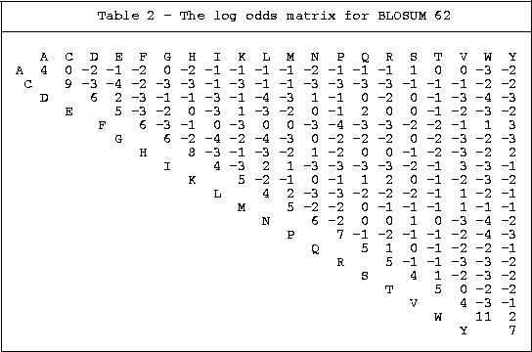
BLOSUM62

Slide 28
Questions
How would you modify the dynamic programming algorithm described in the class in order to perform alignments anchored at the beginning of the sequences (i.e. not penalize gaps at the end of the sequences)?
How would you modify the dynamic programming algorithm to find 'overlap' alignments – the alignment must include one end from each of the sequence (see below)?

