Slide 1
CMSC423: Bioinformatic Algorithms, Databases and Tools
Multiple sequence alignment
Motif finding

Slide 2
Multiple sequence alignment
Simultaneously identify relationship between multiple sequences
Note: multiple alignment implies (not necessarily optimal) pairwise alignment between the individual sequences
HBB_HUMAN FFESFGDLSTPDAVMGNPKVKAHGKKVL-----GAFSDGLAHLDNLKGTF
HBB_HORSE FFDSFGDLSNPGAVMGNPKVKAHGKKVL-----HSFGEGVHHLDNLKGTF
HBA_HUMAN YFPHF-DLS-----HGSAQVKGHGKKVA-----DALTNAVAHVDDMPNAL
HBA_HORSE YFPHF-DLS-----HGSAQVKAHGKKVG-----DALTLAVGHLDDLPGAL
MYG_PHYCA KFDRFKHLKTEAEMKASEDLKKHGVTVL-----TALGAILKKKGHHEAEL
GLB5_PETMA FFPKFKGLTTADQLKKSADVRWHAERII-----NAVNDAVASMDDTEKMS
LGB2_LUPLU LFSFLKGTSEVP--QNNPELQAHAGKVFKLVYEAAIQLQVTGVVVTDATL
* : . . .:: *. : :. :
HBA_HUMAN YFPHF-DLS-----HGSAQVKGHGKKVA-----DALTNAVAHVDDMPNAL
HBA_HORSE YFPHF-DLS-----HGSAQVKAHGKKVG-----DALTLAVGHLDDLPGAL

Slide 3
Multiple alignment – formal definition
M – multiple sequence alignment for s₁,...,s_{k}
D(s_{i},s_{j}) – optimal score of alignment between s_{i}, s_{j}
d(s_{i},s_{j}) – score of alignment btwn s_{i}, s_{j} induced by M
score of M d(M) = sum_{all pairs si, sj} d(s_{i}, s_{j})
also called sum-of-pairs
Optimal multiple alignment minimizes d(M)
Computing optimal d(M) is NP hard
Note: in multiple alignment we think of "distance" rather than "similarity"

Slide 4
But....here's a solution
Dynamic programming solution. e.g. 3 sequences
Score(i, j, k) – optimal alignment between s1[1..i], s2[1..j], s3[1..k] – do DP as usual
s(i,j,k) = max {
s(i-1, j-1, k-1) +
match(s1[i], s2[j], s3[k]),
...
s₁
s₂
s₃

Slide 5
But... it's expensive
3 sequences – need to fill in the cube O(n³)
k sequences – k-dimensional cube O(n^{k}) time/space
There are tricks that can help – similar to AI techniques for reducing the search space
Basic idea – if we can estimate optimal score, we can prune the search space.
Note – these are just heuristics – not guaranteed to work faster

Slide 6
Alternative – approximation algorithm
Can we efficiently compute a multiple alignment with a score that's not too bad?
The Star method:
  build all k² pairwise alignments (O(k²n²))
  pick sequence sc that is closest to all other sequences:
  sum _{si} D(sc, s_{i}) is minimal over all choices of sc
  iteratively align each sequence to sc
Theorem: sum-of-pairs score of star alignment is at most twice as big as optimal multiple alignment score

Slide 7
Iterative alignment
Take sequences si in order:
  align s1 with sc - results in gaps being inserted in both sequences
  align s2 with sc - if gaps must be inserted – insert in previously aligned sequences
  and so on (note: if gaps coincide with previously introduced gaps no need to change previously aligned sequences)
SC YFPHFDLSHGSAQVKAHGKKVGDALTLAVGHLDDLPGAL
SC YFPHFDLSHGSAQVKAHGKKVGDALTLAVGHLDDLPGAL
S1 YFPHFDLSHG-AQVKG--KKVADALTNAVAHVDDMPNAL
SC YFPHF-DLS-----HGSAQVKAHGKKVG-----DALTLAVAHLDDLPGAL
S1 YFPHF-DLS-----HG-AQVKG—GKKVA-----DALTNAVAHVDDMPNAL
S2 FFPKFKGLTTADQLKKSADVRWHAERII-----NAVNDAVASMDDTEKMS
SC YFPHF-DLS-----HGSAQVKAHGKKVG-----DALTLAVAHLDDLPGAL
S1 YFPHF-DLS-----HG-AQVKG—GKKVA-----DALTNAVAHVDDMPNAL
S2 FFPKFKGLTTADQLKKSADVRWHAERII-----NAVNDAVASMDDTEKMS
S3 LFSFLKGTSEVP--QNNPELQAHAGKVFKLVYEAAIQLQVTGVVVTDATL

Slide 8
Theorem proof
Theorem: star alignment is 2-optimal
Assumption: distances obey triangle inequality
OPT = ∑_{si,sj} d(s_{i},s_{j}) ≥ ∑_{si,sj} D(s_{i},s_{j})≥ k ∑_{si} D(s_{i}, sc)
STAR = ∑_{si,sj} d*(s_{i},s_{j}) ≤ ∑_{si,}sj(D(s_{i}, sc) + D(sj, sc)) # triangle ineq.
= ∑_{sj,sj}D(s_{j}, sc) + ∑_{sj,sj}D(s_{i}, sc)
= 2k ∑_{si}D(s_{i}, sc)
=> STAR/OPT ≤ 2 Q.E.D
note: ∑_{si}D(s_{i}, sc) – is score optimized by choice of sc
d(si,sj) – score of alignment btwn si, sj within
optimal alignment
d*(si,sj) – score of alignment btwn si, sj within
star alignment
D(si,sj) – score of optimal alignment btwn
si, sj
s_{i}
sc
s_{j}

Slide 9
Consensus sequence
For every column j in the alignment, pick the amino-acid AA that minimizes ∑_{i}d(AA, S_{i}[j]) (usually becomes majority rule)
Intuitively – this is the sequence of the ancestor of all the sequences in the multiple alignment
We can define the multiple alignment problem as:
  find the multiple alignment that minimizes ∑_{i}D(CO, S_{i})
Still NP – hard, but consensus sequence useful on it's own.
CO YFPHFKDLS-----HGSAQVKAHGKKVG-----DALTLAVAHVDDTPGAL
S1 YFPHF-DLS-----HGSAQVKAHGKKVG-----DALTLAVAHLDDLPGAL
S2 YFPHF-DLS-----HG-AQVKG—GKKVA-----DALTNAVAHVDDMPNAL
S3 FFPKFKGLTTADQLKKSADVRWHAERII-----NAVNDAVASMDDTEKMS
S4 LFSFLKGTSEVP--QNNPELQAHAGKVFKLVYEAAIQLQVTGVVVTDATL

Slide 10
Iterative alignment revisited
Pick a sequence (e.g. SC) as a starting point
Align S1 to it & build consensus for the alignment
Take S2 and align it to the consensus (instead of SC)
repeat...
Problem: consensus (or any single sequence) ignores the other sequences being aligned.
Solution: keep track of % of each amino-acid aligned in each column
score of alignment to profile – combination of scores to each AA.

Slide 11
Profile alignment
Solution: keep track of % of each amino-acid aligned in each column
score of alignment to profile – combination of scores to each AA.
Score(prof1, prof2) = weighted average of all pairs of amino-acids
50% S
25% N
25% -
75% A
25% Q
100% F
S1 YFPHF-DLS-----HGSAQVKAHGKKVG-----DALTLAVAHLDDLPGAL
S2 YFPHF-DLS-----HG-AQVKG—GKKVA-----DALTNAVAHVDDMPNAL
S3 FFPKFKGLTTADQLKKSADVRWHAERII-----NAVNDAVASMDDTEKMS
S4 LFSFLKGTSEVP--QNNPELQAHAGKVFKLVYEAAIQLQVTGVVVTDATL

Slide 12
Profile alignment..cont
Score(50%A,20%L,30%K ; 20%A,30%C,50%G) =
0.5 * 0.2 * Score(A,A) +
0.5 * 0.3 * Score(A,C) +
0.5 * 0.5 * Score(A,G) +
0.2 * 0.2 * Score(L,A) +
0.2 * 0.3 * Score(L,C) +
0.2 * 0.5 * Score(L,G) +
0.3 * 0.2 * Score(K,A) +
0.3 * 0.3 * Score(K,C) +
0.3 * 0.5 * Score(K,G)
hard to write down, easy to compute

Slide 13
CLUSTALW
Compute pairwise distances between strings
Build phylogenetic tree
Build iterative alignment by following tree edges
s3
s4
s1
s6
s5
s2

Slide 14
MUSCLE
Just like ClustalW but different
Build pairwise distances – uses fast heuristic (just count # of k-mers in common)
Build phylogenetic tree
Build multiple alignment based on tree
Re-estimate distances based on tree
Re-build tree
Re-build multiple alignment
etc. etc. etc.

Slide 15
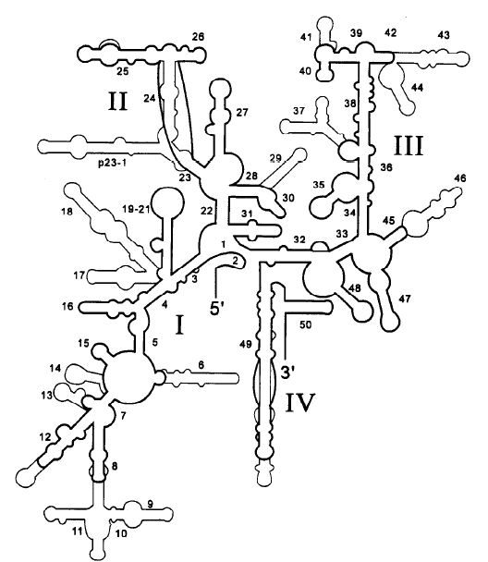
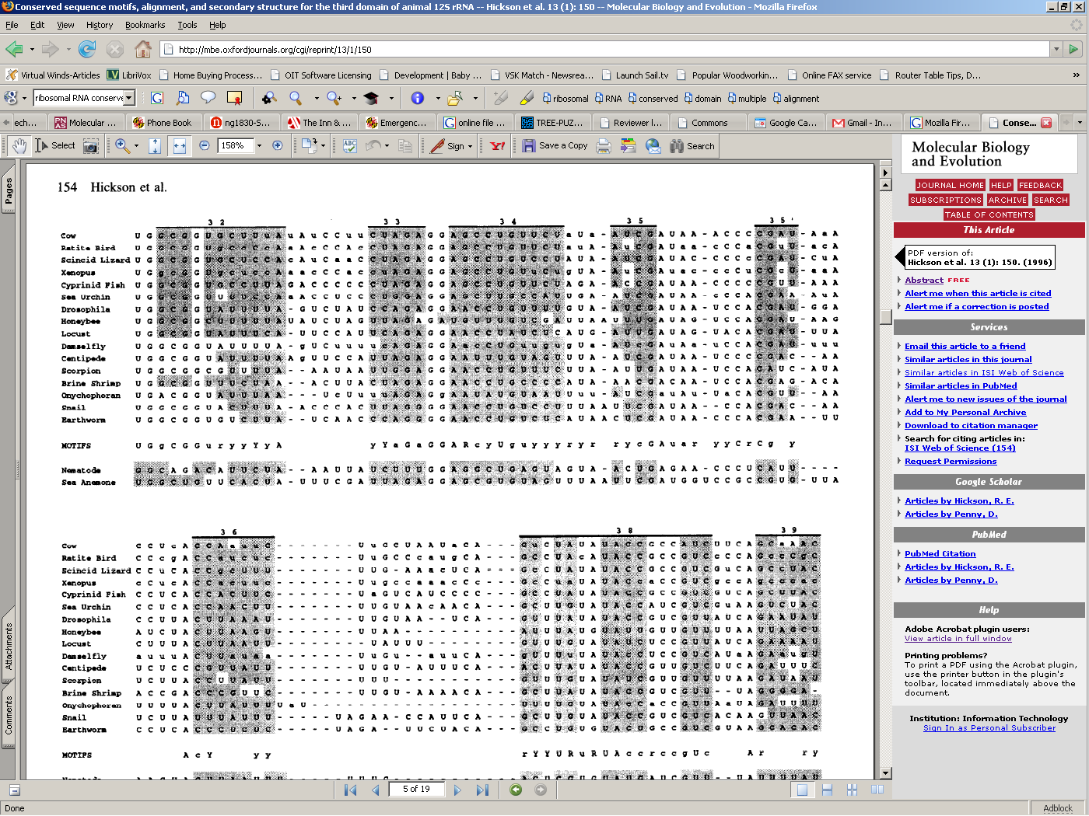
Biological relevance of multiple alignments

Slide 16
Motif finding

Slide 17
Motif finding
Special case of multiple alignment – find short “motif” that occurs almost identically in multiple DNA sequences
Local multiple alignment (the definition of multiple alignment sofar was global)
Motif finding – special requirements
  inexact alignment sought
  but no gaps allowed
Biological significance
  gene promoters
  transcription factor binding sites
  other elements involved in gene regulation

Slide 18
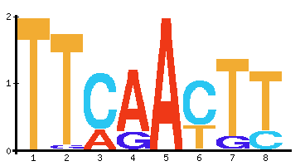
Motif finding...example
TTAGAGGTTGACTATTCAACTTTTGAGGAGGCCTAGTAGAGC
AGCCGACTTGCAACTTAGGCGTGGTCAGTGCCCTAATAGAGC
GGCCTATTTGGGCCACTTAGACCTTCAACTTTTGCATAGAGC
CCACAGTTAGATGTCCAAAAGACAAATATAGAGGGCTAGAGC
ACACGGACTGCGTTCAATGCTTACAGCAGATTGAGTTAGAGC
TTCAAAGACTTGACTATTGTTCAACTTTGAAGACTATAGAGC
Promoter region
Gene
Motif “sequence logo”
From genetics.mgh.harvard.edu/sheenlab/

Slide 19
Finding motifs – Gibbs sampling
Observations:
  since no gaps – all motifs have equal length (assume known value - m)
  exhaustive search of promoter region is impractical:
  all combinations of substrings of length m among k sequences of length L = (L – m + 1)^{k}

Slide 20
Gibbs sampling... the algorithm
1. Pick random substring of length m from each of the strings
2. Construct multiple alignment (easy since no gaps) and compute profile
3. Pick random sequence s and remove from multiple alignment. Recompute profile.
4. Within removed sequence, search for best fit to profile and insert into alignment
5. Repeat until profile does not improve

Slide 21
Gibbs sampling...cont
How do you find best match to profile?
What is overall running time of algorithm?

