Slide 1
CMSC423: Bioinformatic Algorithms, Databases and Tools
Phylogenetic trees

Slide 2
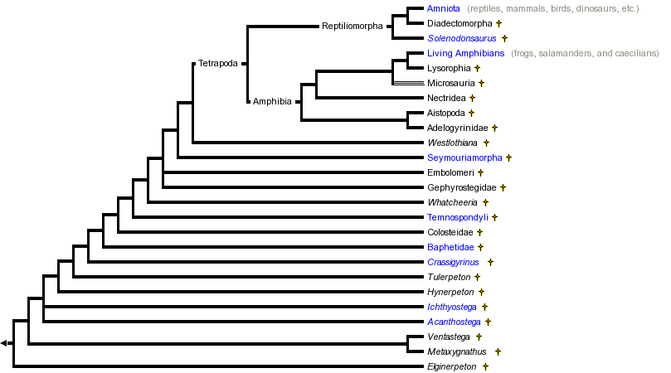
Phylogenetic trees – how evolution works
http://www.tolweb.org/tree/ - the tree of life

Slide 3
Anatomy of a tree
Root
Unrooted tree
bacteria
node
eukarya
leaf
archaea
branch length
Phylogenetic trees are usually binary (though they don't have to)

Slide 4
Phylogeny questions
Given several organisms & a set of features (usually sequence, but also morphological: wing shape/color...)
A. Given a phylogenetic tree – figure out what the ancestors looked like (what are the features of internal nodes)
B. Find the phylogenetic tree that best describes the common evolutionary heritage of the organisms
?
wings, feathers, teeth
claws, no wings, fur
A
C
B
B
A
A
C
B
C

Slide 5
Phylogeny questions
A. Easy-ish – can be done with dynamic programming
B. Hard – Many possible trees
rooted trees with n leaves

Slide 6
Scoring a tree – Sankoff's algorithm
Assumption – we try to minimize # of state changes from root to leaves – Parsimony approach
Small parsimony
  given a tree where leaves are labeled with m-character strings
  find labels at internal nodes s.t. # of state transitions is minimzed
Weighted small parsimony
  same as parsimony except that state transitions are assigned weights
  minimize the overall weight of the tree

Slide 7
Example
0
1
0
1
0
1
0
0
0
0
1
1
0
0
0
1
1
0
0
1
0
1
0
0
1
1
0

Slide 8
Sankoff's algorithm
At each node v in the tree store s(v,t) – best parsimony score for subtree rooted at v if character stored at v is t
Traverse the tree in post-order and update s(v,t) as follows
  assume node v has children u and w
  s(v,t) = min_{i} {s(u,i) + score(i,t)} + min_{j} {s(w,j) + score(j,t)}
Character at root will be the one that maximizes s(root, t)
Note – this solves the weighted version. For unweighted set score (i,i) = 0, score(i,j) = 1 for any i,j

Slide 9
Trees as clustering
Start with a distance matrix – distance (e.g. alignment distance) between any two sequences (leaves)
Intuitively – want to cluster together the most similar sequences
UPGMA – Unweighted Pair Group Method using Arithmetic averages
  Build pairwise distance matrix (e.g. from a multiple alignment)
  Pick pair of sequences that are closest to each other and cluster them – create internal node that has the sequences as children
  Repeat, including newly created internal nodes in the distance matrix
  Key element – must be able to quickly compute distance between clusters (internal nodes) – weighted distance

Slide 10
Trees as clustering
Note that UPGMA does not estimate branch lengths – they are all assumed equal
Neighbor-joining
  distance between two sequences is not sufficient – must also know how each sequence compares to every other sequence
  NJdist(i,j) = D(i,j) – (r_{i} + r_{j}) -r_{i}, r_{j} correction factors

Slide 11
Neighbor joining
Pick two nodes with NJdist(i,j) minimal
  Create parent k s.t.
  D(k, m) = 0.5 (D(i,m) + D(j,m) – D(i,j)) for every other node m
  D(i, k) = 0.5 (D(i,j) + r_{i} – r_{j}) - length of branch between i &k
  D(j, k) = 0.5 (D(i,j) + r_{j} – r_{i}) – length of branch between j & k

Slide 12
Trees as clustering
Note that both UPGMA and NJ assume distance matrix is additive: D(i,j) + D(j,k) = D(i,k) - usually not true but close
Also, NJ can be proven to build the optimal tree!
But, simple alignment distance is not a good metric

Slide 13
Maximum likelihood
For every branch S->T of length t, compute P(T|S,t) – likelihood that sequence S could have evolved in time t into sequence T
Find tree that maximizes the likelihood
Note that likelihood of a tree can be computed with an algorithm similar to Sankoffs
However, no simple way to find a tree given the sequences – most approaches use heuristic search techniques
Often, start with NJ tree – then "tweak" it to improve likelihood

Slide 14
Tree analysis & display

Slide 15
Three types of trees
Cladogram Phylogram Ultrametric tree
Taxon B
6
Taxon B
Taxon B
1
Taxon C
1
Taxon C
Taxon C
3
Taxon A
1
Taxon A
Taxon A
Taxon D
5
Taxon D
Taxon D
no meaning
genetic change
time
All show the same evolutionary relationships, or branching orders, between the taxa.
from www.albany.edu/faculty/cs812/StewartTalk2.ppt

Slide 16
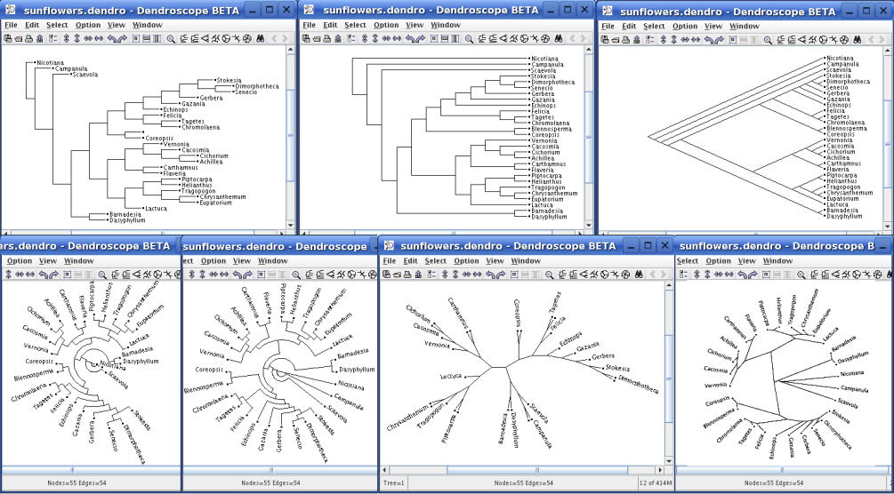
Different tree views
http://www-ab.informatik.uni-tuebingen.de/software/dendroscope/welcome.html

Slide 17
Drawing trees
Trees are easy to draw – just need to figure out how much space the leaves will take
Step 1 – calculate how much space each node will take (how many leaves from current node)
Step 2 – spread out the nodes according to # of leaves
Many ways of optimizing: e.g. width, area
For large trees
  3D displays (there's more room in 3D)
  interactive displays (expand contract nodes as needed)

Slide 18
Analysis example
Build multiple alignment (e.g. Muscle, ClustalW)
Clean up alignment
  manual editing
  filters (pre-defined structure information)
Build tree
  PAUP – parsimony & others
  Phylip – maximum likelihood
  Tree-Puzzle –maximum likelihood
  etc... (many packages)
Integrated system – ARB
  www.arb-home.de

Slide 19
Antibiotic resistance in
Staphylococcus aureus
Green boxes – individual
strains in a phylogenetic tree
Red diamonds, yellow triangle
- acquisition of resistance
Hexagon – loss of resistance

Slide 20
Questions
Why do you need a multiple alignment for phylogeny?
What is the running time of the neighbor-joining algorithm, given k sequences of length L?
What is the parsimony score of the following tree, and what are the labels at internal nodes?
C
T
G
T
A
T

