Slide 1
CMSC423: Bioinformatic Algorithms, Databases and Tools
RNA folding

Slide 2
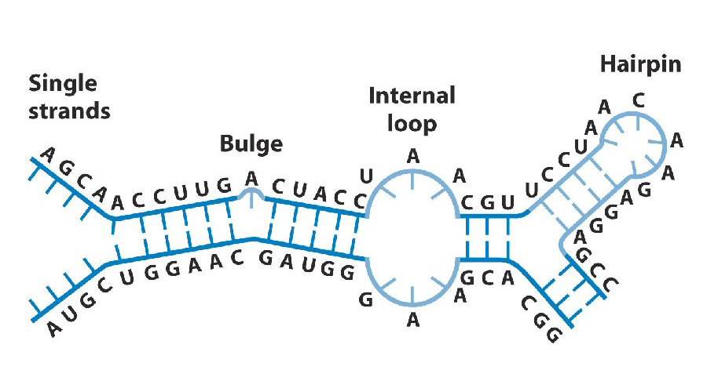
RNA folding
Function of RNA molecules depends on how they fold, based on nucleotide base-pairing

Slide 3
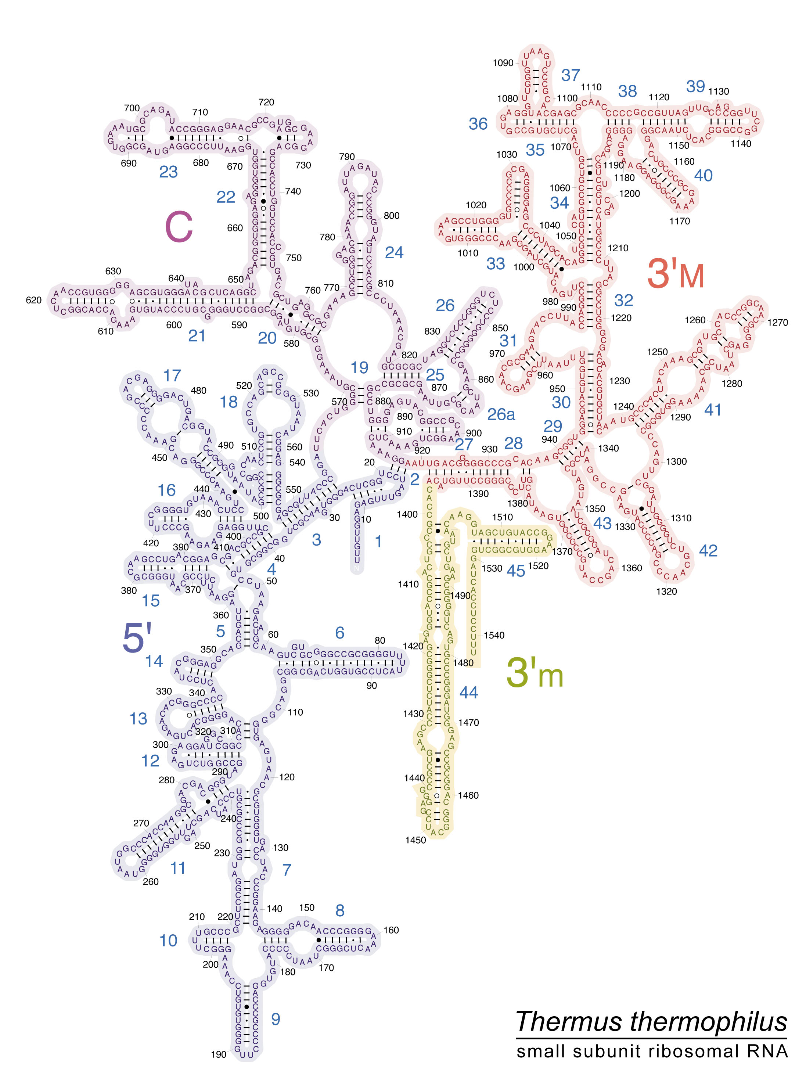

Slide 4
Types of structures
Nested (hairpin)
Pseudo-knots
ACAUGGAUGU
((((..))))
UUCCG--A----
AGGGCAACUCGA
-A-A--UGAGCU
UUCCGAAGCUCAACGGGAAAUGAGCU

Slide 5
RNA folding... not just for RNA
RNA – given the sequence figure out how it folds
Parsing
  Given a grammar
  Parse a string of letters (text,
  program) according to grammar
... example
  Given a C program
  Find whether parentheses, braces, and brackets are matched up correctly
  if not, where are the likely errors (find the smallest number of corrections that would make the progam balanced)
Both can be solved by the same algorithm

Slide 6
From multiple alignment to structure
GCCUUCGGGC
GACAUCGGUC
GGCUUTGGCC
(......)‏
Find columns in the alignment where mutations are correlated
Mutual information - how correlated are the columns?
M_{i,j} = mutual information between columns i and j
f_{xixj} = frequency of each of 16 pairs of nucleotides at columns i and j
f_{xi} = frequency of each of 4 nucleotides at column i
f_{xj} = frequency of each of 4 nucleotides at column j

Slide 7
Mutual information
Ranges from 0 to 2 for a 4-letter alphabet
Correlated columns - mutual information high
Advantages:
  Don't need to know how RNA folds - pseudo-knots should “pop” out of the alignment
Disadvantages:
  Need many sequences in an alignment (to compute frequencies)‏
  The aligned sequences must be sufficiently divergent (conserved columns provide no information)‏

Slide 8
Nussinov's algorithm
Assumes no pseudo-knots
Dynamic programming approach – maximize # of pairings
S – string of nucleotides representing the RNA molecule
Sub-problem – F[i,j] – score of folding just S[i..j]
Initial values: F[i-1,i] = F[i,i] = F[i, i+1] = 0

Slide 9
Nussinov's algorithm
F[i,j] is the maximum of:
i+1
i
j-1
j
III. F[i+1,j-1] + 1
if S[i+1] complementary
to S[j-1]
I. F[i+1,j]
i+1
i
j
S[i] unpaired
S[i] paired with S[j]
II. F[i,j-1]
IV. max_{k}
F[i,k]+F[k+1,j]
i
j-1
j
i
j
k k+1
S[j] unpaired
Branch

Slide 10
Questions
In what order do we fill the dynamic programming table?
How can we ensure that "loops" consist of at least k nucleotides?
Note: related to CYK parsing algorithm for Chomsky Normal Form grammars

Slide 11
F[i+1, j]
F[i, j - 1]
F[i+1, j-1] + 1 (if paired)‏
max_{k}F[i,k] + F[k+1,j]

Slide 12
G G G A A A U C C
G
G
G
A
A
A
U
C
C
0
0
0
0
0
0
1
2
3
GGGAAAUCC
((.(..)))‏
.((..()))‏
0
0
0
0
0
0
1
2
3
0
0
0
0
0
1
2
2
0
0
0
0
1
1
1
0
0
0
1
1
1
0
0
1
1
1
0
0
0
0
0
0
0
0
0

Slide 13
A better objective function
Find the RNA fold that minimizes the Gibbs free energy
Zucker's algorithm keeps track of:
  Stacking energy - f(# of base-pairs in a stem)‏
  Loop energy - f(length of loop)‏
  Bulge energy - f(length of bulge)‏
  Dangle energy - f(length of dangle)‏
Computation is done with an extension of the traditional (Nussinov) dynamic programming approach
One extension: compute sub-optimal folds
  during backtracking, try multiple paths

Slide 14
Question
How do you change Nussinov's algorithm to allow the computation of the stacking energy (score depends on # of next-to-next pairings)?
Hint: think affine gap penalties.

