Slide 1
CMSC423: Bioinformatic Algorithms, Databases and Tools
What you missed

Slide 2
Protein folding

Slide 3
Protein folding
Note: mis-folded proteins may cause disease (e.g. Creutzfeld-Jakob a.k.a. mad cow)‏
Drugs (e.g. antibiotics) often inhibit protein function – knowing structure can help design drugs
Folding@home – lend your computer’s unused cycles to help fold proteins (like SETI@home) (do you believe in evolution or aliens ?)‏

Slide 4
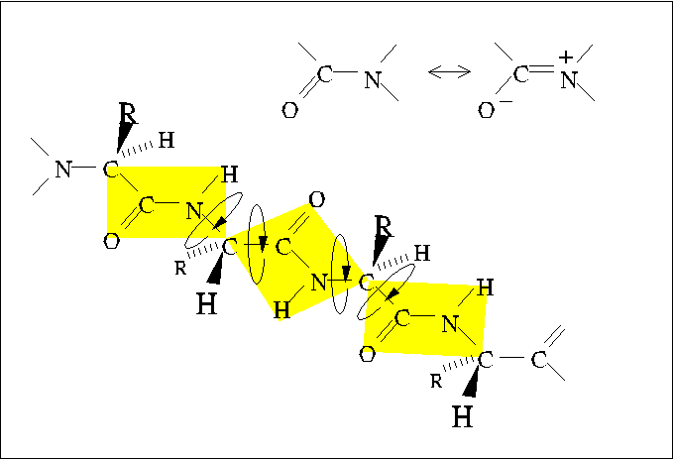
Protein structure
(primary structure = sequence)‏
φ
ψ
http://www.tulane.edu/~biochem/med/second.htm

Slide 5
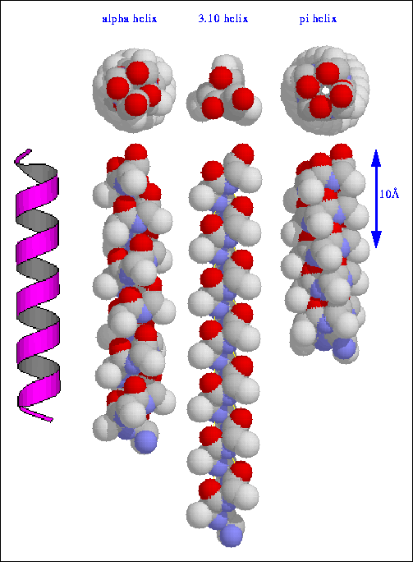
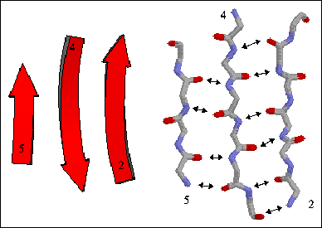

Secondary structure (motifs)‏
helix
sheet
turn
http://alpha2.bmc.uu.se/~kenth/bioinfo/structure/secondary/01.html

Slide 6
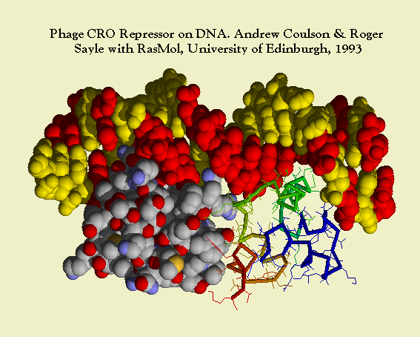
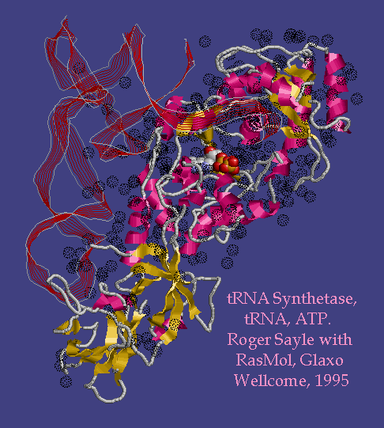
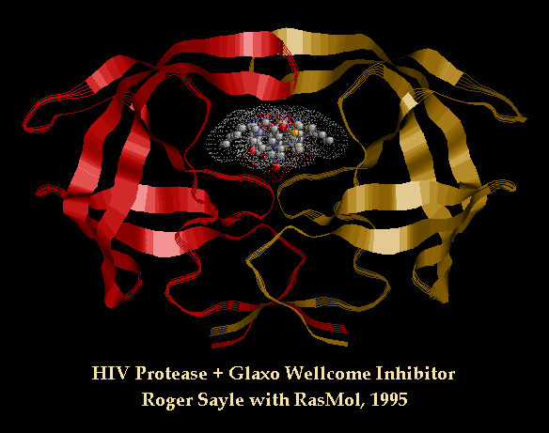
Tertiary structure (3D shape)‏
http://www.umass.edu/microbio/rasmol/sayle1.htm

Slide 7
Folded shape: lowest free energy
Energy components
  electrostatic (~1/D²) (n² terms)‏
  van der Waals (n² terms)‏
  hydrogen bonding (n terms)‏
  “bending” (n terms)‏
  solvent (water/salt) (?? terms)‏
  exclusion principle (no two atoms share same volume)‏
Energy minimzation
  small perturbations & computation: hill climbing, simulated annealing, etc.
Molecular dynamics

Slide 8
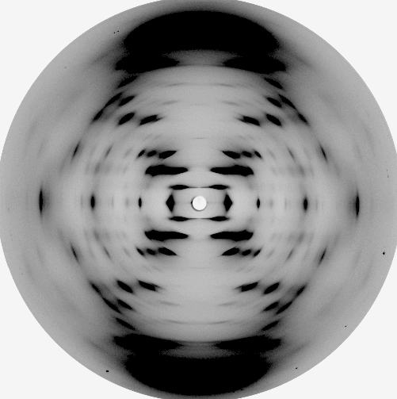
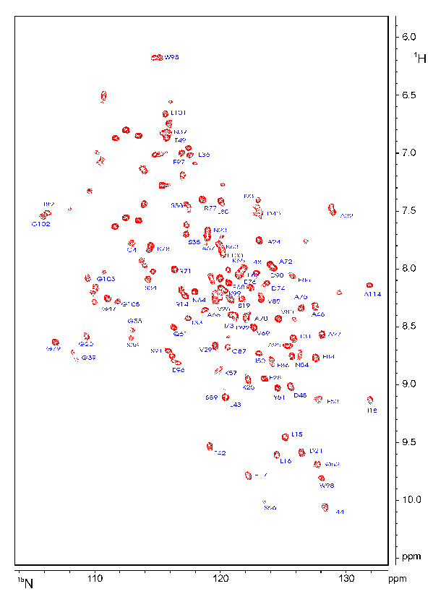
How do we know the truth?
X-ray crystallography
  crystallize protein
  shine X-rays
  examine diffraction patterns
Nuclear Magnetic Resonance (NMR)‏
  no crystallization necessary
  magnetic field “vibrates” hydrogen atoms
  Nobel prize: Kurt Wuethrich
http://www.cryst.bbk.ac.uk/BBS/whatis/cryst_an.html
http://www.cryst.bbk.ac.uk/PPS2/projects/schirra/html/2dnmr.htm

Slide 9
Simpler problems
Secondary structure prediction
Side-chain conformation (assuming fixed backbone)‏
Protein docking (how do proteins interact)‏
Database searches (protein threading)‏
Simpler energy functions
Folding on a lattice (theoretical approximation)‏
Critical Assessment of Fully Automated Structure Prediction – competition on proteins with unpublished 3D structure

Slide 10
Proteomics

Slide 11
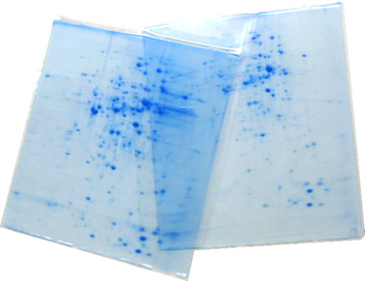
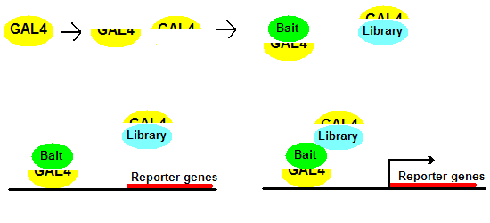
Proteomics
Large-scale analysis of proteins
  protein-protein interactions (e.g. yeast 2-hybrid)‏
  2D gels (mass vs. isoelectric point)‏
  Mass-spectrometry
  Protein microarrays
  etc.

Slide 12
Proteomics
Why proteomics? Are DNA/RNA microarrays not sufficient?
RNA abundance is not necessarily related to protein abundance
Many proteins are modified post-translation
  addition of additional molecules (phosphate, sugars, etc.)
  creation of complexes (hemoglobin is actually 4 molecules)

Slide 13
Mass spectrometry
Technique for measuring the mass-to-charge ratio of ions
Basic idea
  shoot ions into a magnetic field
  deflection depends on mass
Output of a mass-spectrometer
  ions “sorted” by mass
  for each mass bucket - number of ions with that specific mass

Slide 14
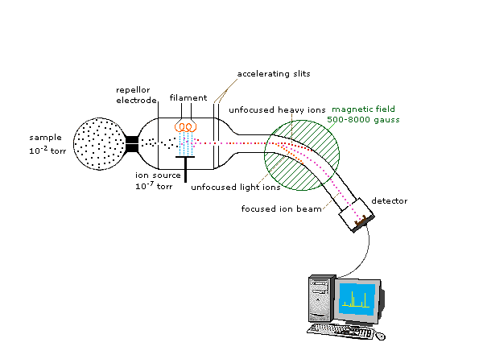
Mass-spectrometry
http://www.cem.msu.edu/~reusch/VirtualText/Spectrpy/MassSpec/masspec1.htm

Slide 15
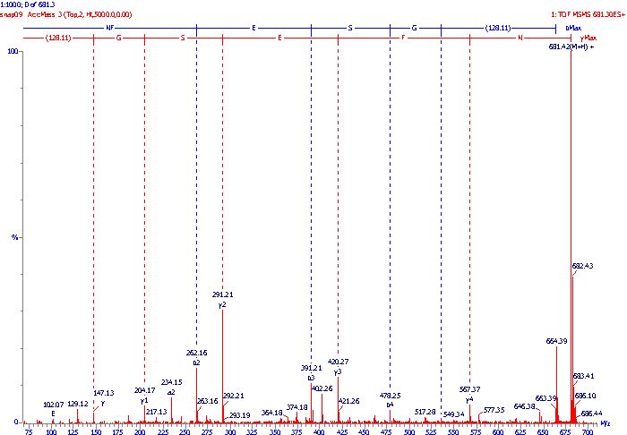
Tandem Mass Spectrometry
First mass-spectrometer “focuses” on a specific protein
Second mass-spectrometer breaks the protein into smaller chunks
Problem: given the chunks, what was the original protein?

Slide 16
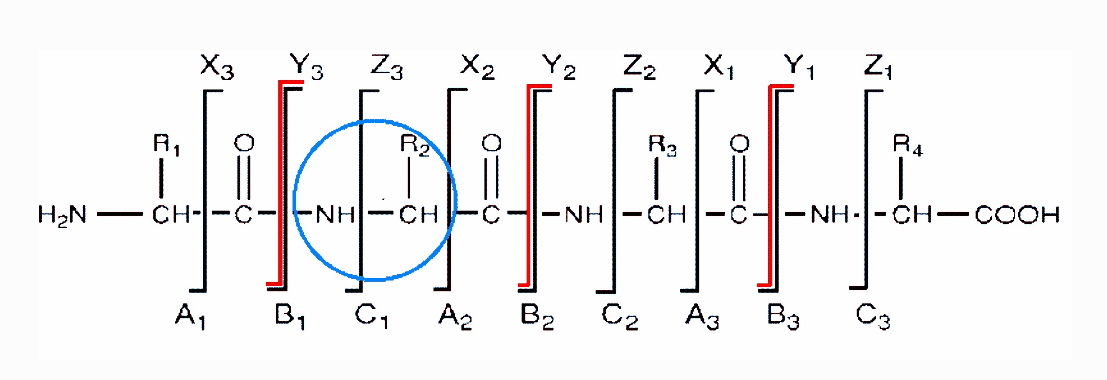
Peptide sequencing
Peptide - a chunk of a protein, usually obtained by enzymatic cleavage of the protein (using trypsin)‏
Problem: Given an MS spectrum (weights of fragments), what was the sequence of the peptide?
Or: find the peptide (of mass m) that best matches the experimental data

Slide 17
Biological networks

Slide 18
Biological networks
Genes/proteins do not exist in isolation
Interactions between genes or proteins can be represented as graphs
Examples:
  metabolic pathways
  regulatory networks
  protein-protein interactions (e.g. yeast 2-hybrid)‏
  genetic interactions (synthetic lethality)‏

Slide 19
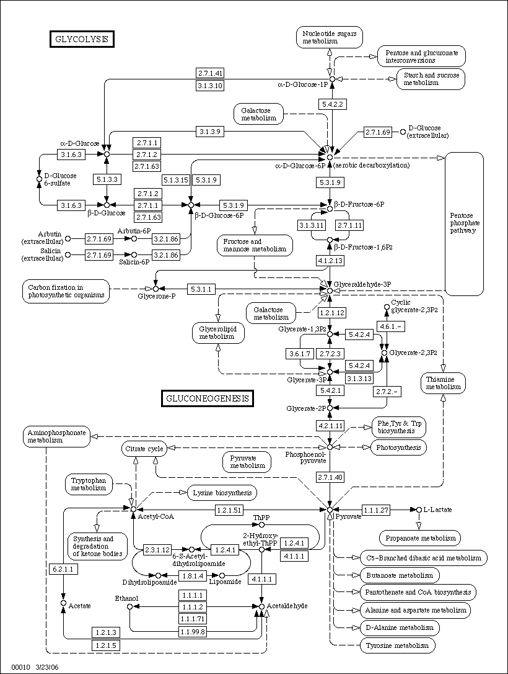

Slide 20
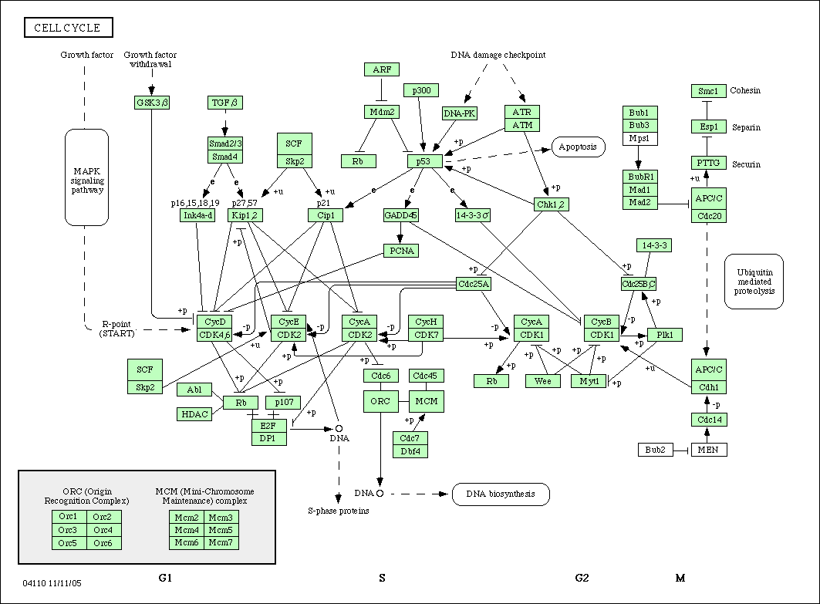

Slide 21
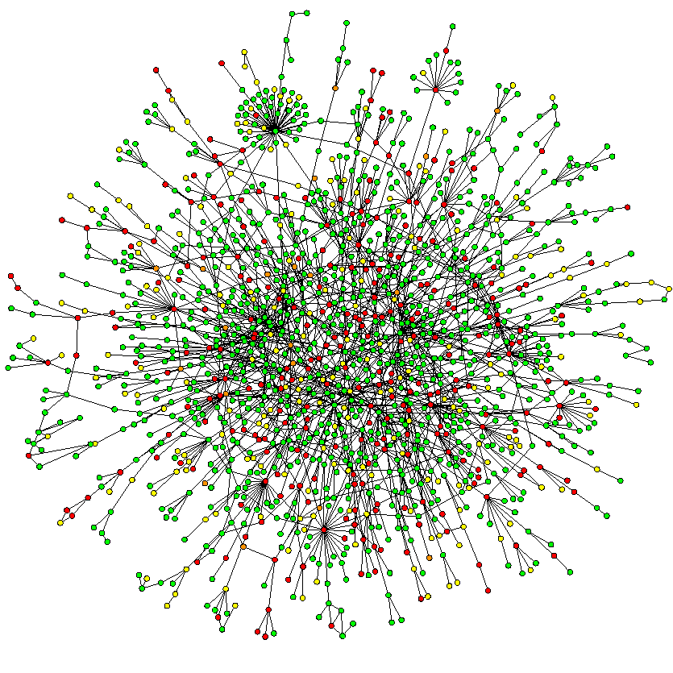

Slide 22
Metagenomics

Slide 23
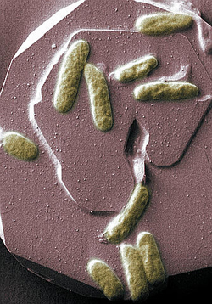
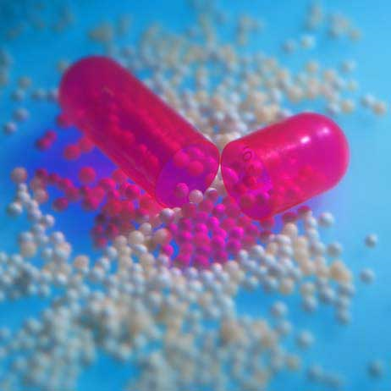
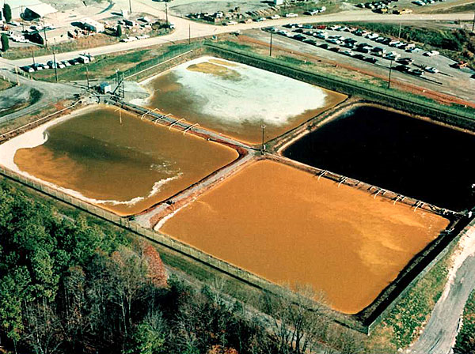
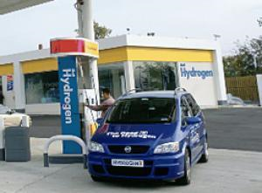
Why do we care?
Bacteria are everywhere in the environment
They are not all evil
Bacteria can be quite useful
Drug development
antibiotics
anti-cancer
Bio-energy
Bio-remediation

Slide 24
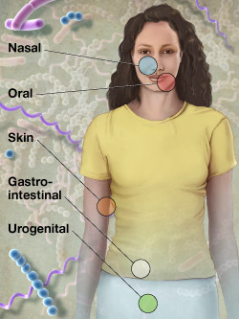
Human microbiome
Human = 1 order of magnitude more bacterial cells than human cells
  critical to infant development (immune system, GI-tract)
  provide essential nutrients (vitamin K, B12, essential amino-acids,....)
  help digest complex molecules – starches, plant material
  imbalances in normal bacterial populations correlate with disease
  (IBD, colon cancer, ...)
Human microbiome project
nihroadmap.nih.gov/hmp/

Slide 25
Some challenges on real data
P1
P2
P3
P4

Slide 26
Spatial genomics

Slide 27
Voxelation
Brown, V.M., et al., High-throughput imaging of brain gene expression. Genome Res, 2002. 12(2): p. 244-54.
http://www.ncbi.nlm.nih.gov/entrez/query.fcgi?cmd=Retrieve&db=PubMed&dopt=Citation&list_uids=11827944
Brown, V.M., et al., Multiplex three-dimensional brain gene expression mapping in a mouse model of Parkinson's disease. Genome Res, 2002. 12(6): p. 868-84.
http://www.ncbi.nlm.nih.gov/entrez/query.fcgi?cmd=Retrieve&db=PubMed&dopt=Citation&list_uids=12045141
Gene expression information in a spatial context
Combines microarray analysis with computer graphics

Slide 28
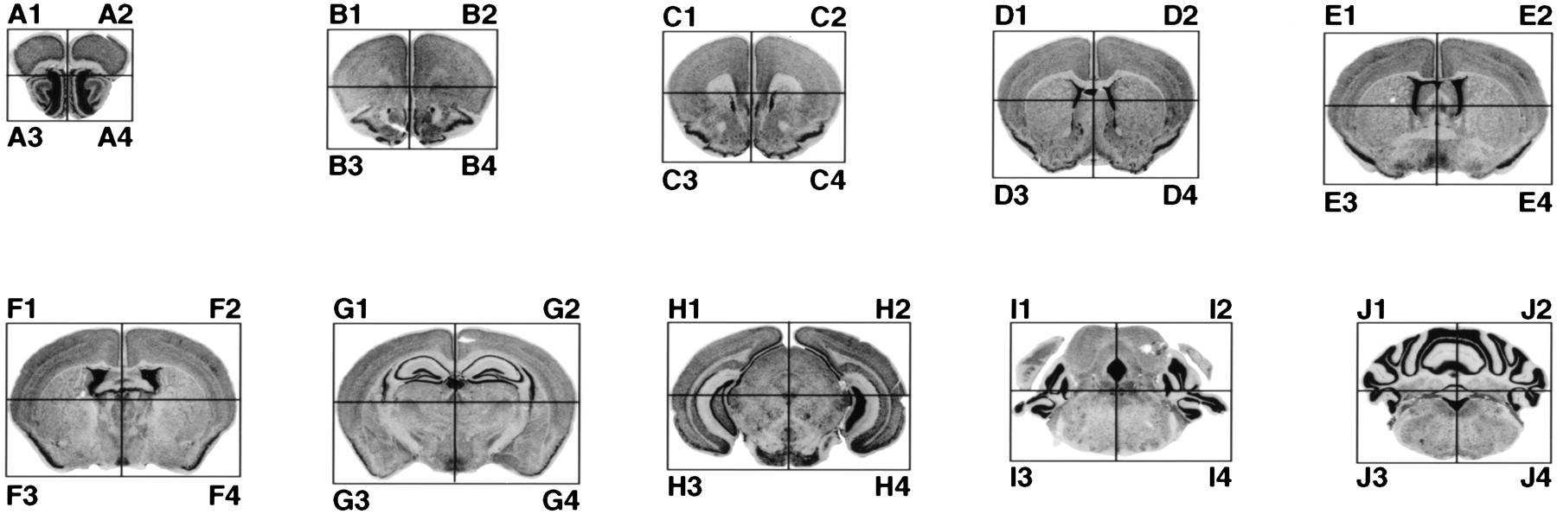

Figure 2 Voxelation scheme
Vanessa M. Brown et al. Genome Res. 2002; 12: 868-884
Mouse brain cut up into voxels
Run a separate microarray experiment on each voxel

Slide 29
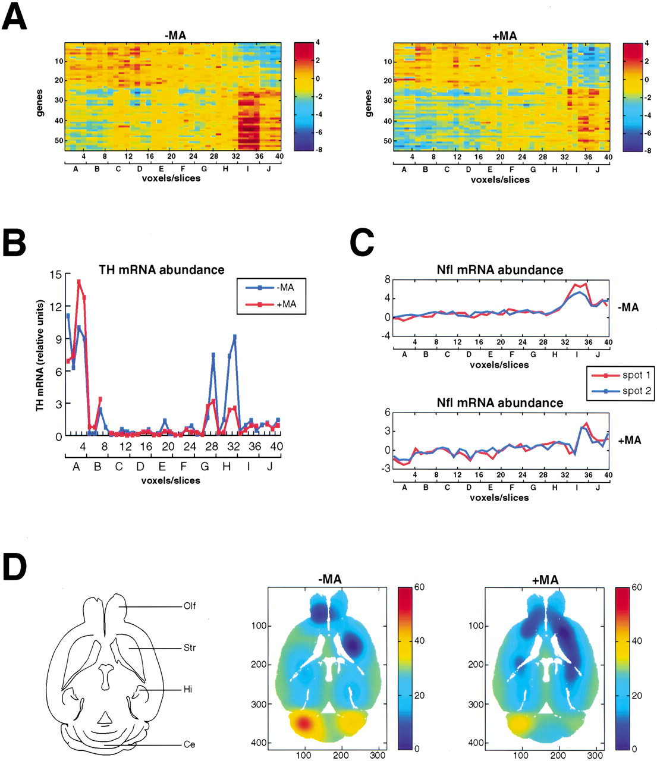
Figure 4 Spatial gene expression patterns for the subset of correlated genes
Vanessa M. Brown et al. Genome Res. 2002; 12: 868-884

Slide 30
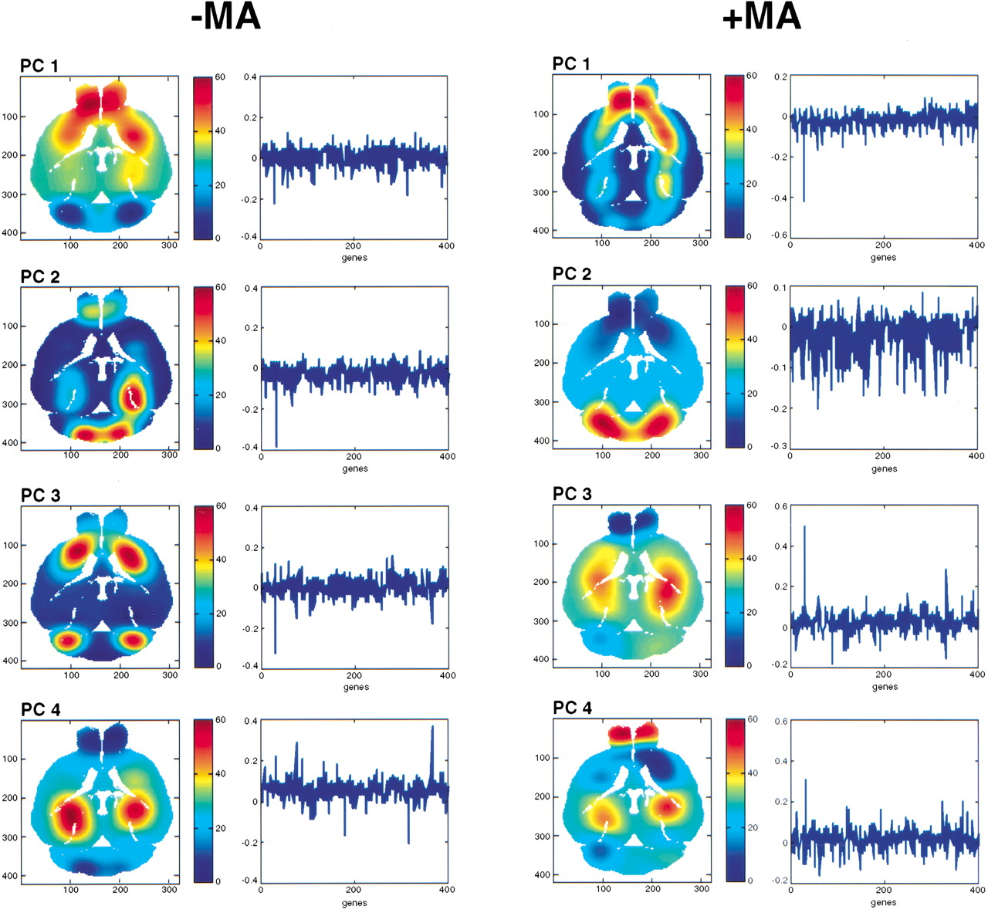
Figure 7 SVD delineates anatomical regions of the brain
Vanessa M. Brown et al. Genome Res. 2002; 12: 868-884

Slide 31
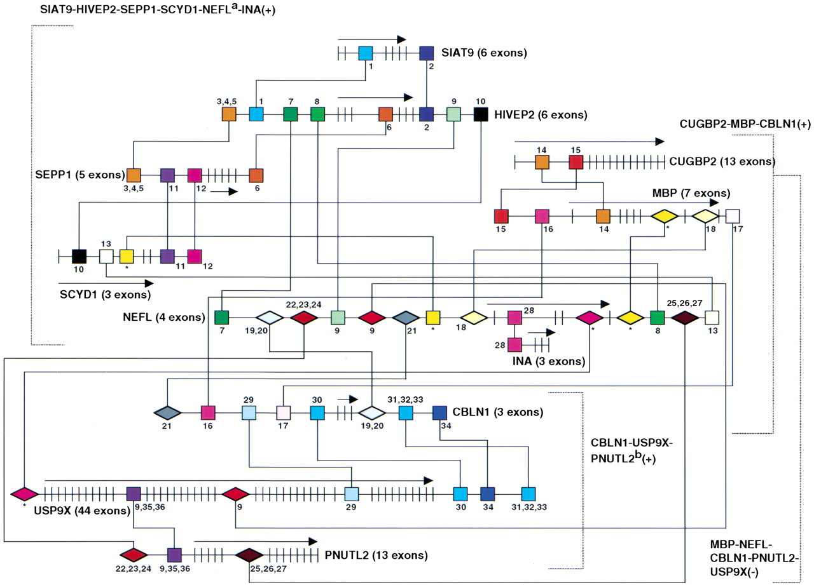
Figure 5 Putative regulatory elements shared between groups of correlated and anticorrelated genes
Vanessa M. Brown et al. Genome Res. 2002; 12: 868-884

