Slide 1
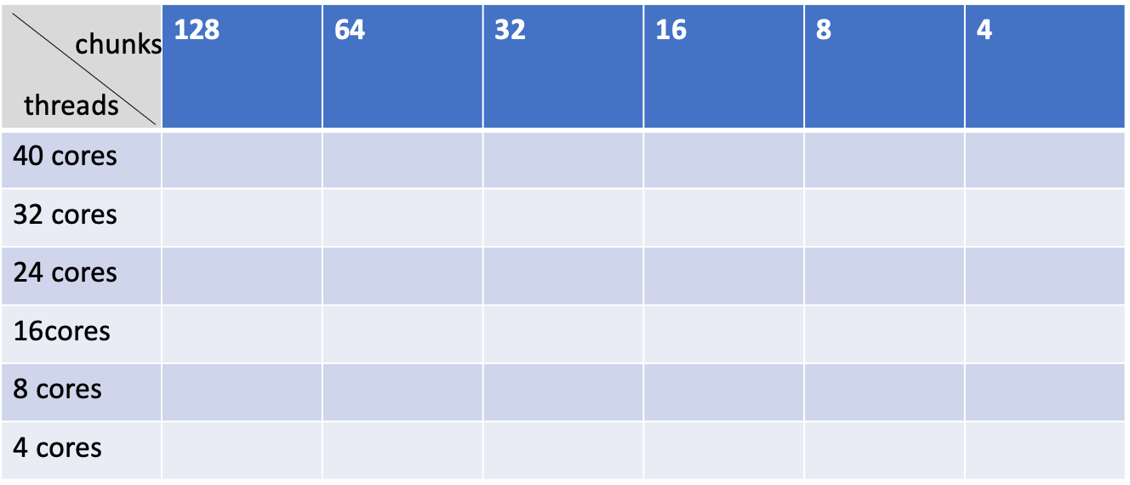
benchmark: new_first = mid/8 (in order to make left and right part uneven)
redo all tests:
original rotate vs. modified rotate
under different number of cores(2,4,8,16,32,40) and varying chunk numbers

Slide 2
modified rotate performance

Slide 3
part1 modified rotate_without_chunksize changing
part2 modified rotate_with_chunksize_changing
1. compare modified(splitecores) rotate with unmodified rotate under same cores number
2. performance of modified(splitcores) rotate with varying chunk numbers under specific cores

Slide 4
part1 modified rotate_without_chunksize changing

Slide 5
part2 modified rotate_with_chunksize_changing
note:
default chunk number of original rotate(light green) and modified rotate all included(rose red)

Slide 6
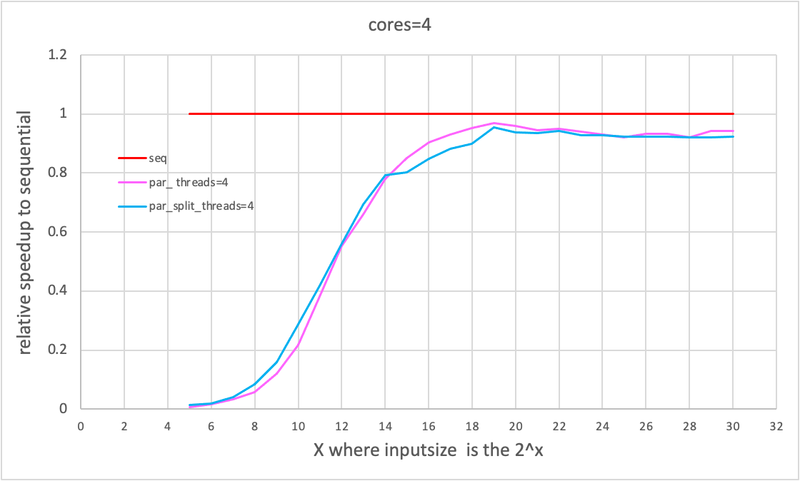
2.1. compare modified(splitecores) rotate with unmodified rotate under same cores number

Slide 12
2.2 performance of modified(splitcores) rotate with varying chunk numbers under specific cores
analyze: improved on the lower end and higher end when chunk number exceed 16

Slide 14
since cores16, chunk128,64,32,24,16 move left than defaultchunk of original-rotate

Slide 18
original_rotate

Slide 25
pick one best performance chunk number from original rotate each core, then compare with the same chunk number from the modified rotate___
a little bit left move

Slide 28
