Slide 2
Writing Maintainable JavaScript Using Backbone, Mustache & Jasmine
Highly Configurable Synchronization

Slide 3
JavaScript Is Risky Business
Dynamically typed language that is interpreted at run time by your browser, aka, very fragile.
Tends to be tightly coupled to the DOM using JQuery
Backbone is essentially client side MVC that lets you create incredibly modular (and testable) components.
DOM
Events
Backbone.View
HTML
Update
Notify
Data
HTML
Backbone.Model
Template

Slide 4

Some Bad JavaScript
/* Imagine there is a webpage with an element with class showMeTheInfo that when you click it must show some data that was passed in from the server on page load. */
$(‘.showMeTheInfo’).click(function(event){
var doctorHtml =
'<div id="' + doctorId + '" class="' + doctorClass + '">' +
(function() {
var paras = '';
for (var i = 0; i < docInfo.length; i++) {
paras += '<h3>' + docInfo [i].Title + '</h3>';
paras += '<p>' + docInfo [i].Info + '</p>';
}
return paras;
})() + '</div>‘;
$(‘.showMeTheInfoWrapper’).append(doctorHtml ) //Psh, I don’t even need semicolons
DoFancyCalculation();
alert(‘Done’);
}

Slide 5

Part 1: A Mustache Template
Mustache provides very basic control flow such as conditionals and loops for traversing objects in a list.
<div id=‘{{DoctorId}}’ class=‘{{DoctorStyles}}’>
{{#DoctorInfo}}
<h3>{{Title}}</h3>
<p>{{Info}}</p>
{{/DoctorInfo}}
</div>

Slide 6
Backbone Models
Models manage data/state and perform CPU intensive operations. Traditionally they are passed into the template to provide the variables in the template.
var Doctor = Backbone.Model.extend({
defaults: {
DoctorId: 1337,
DoctorStyles: ‘doctor-wrapper’,
State: ‘noResult’
}
doFancyCalculation: function () {
// Heavy lifting in progress...
this.set({ state: ‘Done’ });
}
});

Slide 7
Backbone Views
var DoctorView = Backbone.View.extend({
events: {
'click .showMeTheInfo': ‘render‘
},
initialize: function () {
_.bindAll(this, 'render');
this.template = templates['showMeTheInfo'];
this.model.bind('change:state', alert(this.model.get(‘state’));
},
render: function () {
this.$el.append(this.template.render(this.model.toJSON()));
this.model.doFancyCalculation();
return this;
}
});
Cache container, and delegate events to it,
not elements
Bind to changes in the model
Restrict DOM manipulation to the render method

Slide 8
New Code
var docModel = new Doctor({
DoctorId: doctorId,
DoctorClass: doctorClass,
DoctorInfo: docInfo
});
var view = new DoctorView({
el: $(‘.showMeTheInfoWrapper’),
model: docModel
});
This is an incredibly trivial example but show’s the modularity of Views and Models and the performance benefits.

Slide 9
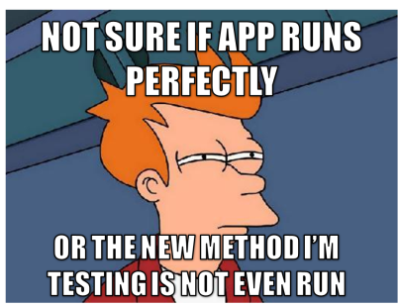
Now What?
So we’ve written some super schweet modular backbone application. Great! Now let’s test it. Why you ask?
How do we know it works correctly in all cases?
How do we stop other people from breaking it accidentally?

Slide 10

Tradition test framework that can assert conditions and mock out function calls.
When testing Backbone, traditionally we test models because they maintain state and perform the computationally intensive tasks.
When the layout is especially important, testing the view is simple using some fun Jasmine plugins. The Jasmine Jquery plugin provides assertions to compare JQuery objects for equality/input state (is this checkbox checked), etc.

Slide 11
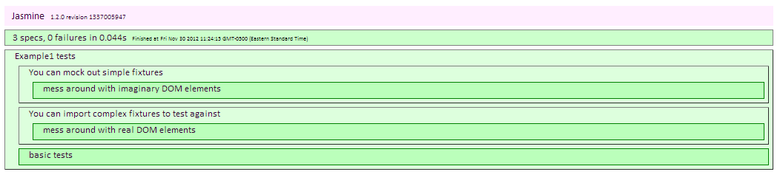


Slide 12
Writing Maintainable JavaScript Using Backbone, Mustache & Jasmine
Highly Configurable Synchronization

Slide 13
Synchronizing Schedules
Doctor’s Computer
ZocDoc
Synchronizer
Availability
PMS

Slide 14

Our initial solution
Key: CreateAvailabilityFromWorkingHours: Value: True
Only on or off per synchronizer
Doctor Private Practice
PMS
ZD Config
Location 1
Location 2
Location-based
Store settings per instance of the PMS

Slide 15
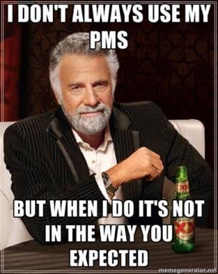
Lessons Learned
Enterprise Clients (> 50 practices / locations / multiple PMS systems)
Multiple practices on one PMS
All doctors manage to use their system differently, even if it’s the same system
Notes:
Use Case #1
Practice
Multiple locations
One scheduling system per location
Multiple doctors at each location
Use Case #2
Practice
1 system
Multiple locations

Slide 16


Lessons Learned
Everyone does it wrong
One-off settings for everyone
People use the same data in different ways
Short term fix => Key value pair of settings per ZD config

Slide 17

New Solution
Create Graph of entity mappings
Prioritize settings based on specificity
Store everything in a key-value based pair
Doctor Private Practice
Settings for Practice
PMS
Location 1
Location 2
Settings for PMS instance
Settings for Location
Settings for Doctor

Slide 18
Example
Key: CreateAvailabilityFromWorkingHours
Doctor Private Practce
True
True
PMS
Location 1
Location 2
False
False
For Practice: True
For Location 2: True
For Location 1: False
For Doctor 2: False

Slide 19

What do we get?
Different values for settings
Adding a new setting is easy
Set values for entire systems through inheritance

