Slide 1
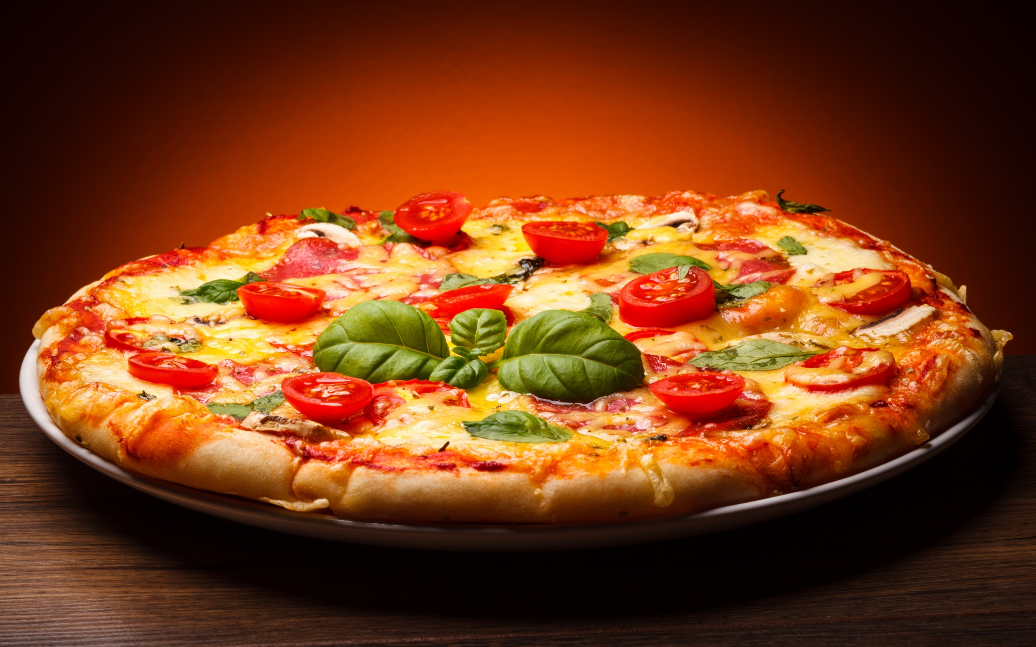
Data 601 Assignment: Project 2
Proffessor :
Mr. Muhhamad Ali Yousuf
Presented By:
Akshansh Mandal
Suraj Chandra Hanumanthapura
Andrew M Ims
Submission Date:
12.04.2022

Slide 2
TABLE OF CONTENT
Which pizza types sell most?
Which ingredients are in
demand?
Are there more (or less)sales of
a certain type of pizza in a
certain month, or day, or time
of the day?
Which pizza sizes are sold more often,
which type, which ingerdients, etc.
Is there a time of the day when there is a
peak sale? If yes, does that depend on the
day of the week, or month?
1)
2)
3)
4)
5)

Slide 3
1. Which pizza types sell most?
 | pizza_name | pizza_category | count
 | The Classic Deluxe Pizza | Classic | 2416
 | The Barbecue Chicken Pizza | Chicken | 2372
 | The Hawaiian Pizza | Classic | 2370
 | The Pepperoni Pizza | Classic | 2369
 | The Thai Chicken Pizza | Chicken | 2315
The classic big_meat_s pizza is the most sold pizza for the year 2015.
The most sold number for the particular pizza is 2416.
The second most sold pizza a The Barbecue Chicken Pizza and the next is The Hawaiian Pizza.

Slide 4
2. Which ingredients are in demand?
 | Pizza_Ingredients Pepperoni, Mushrooms, Red Onions, Red Peppers, Bacon | Count 2416
 | Barbecued Chicken, Red Peppers, Green Peppers, Tomatoes, Red Onions, Barbecue Sauce | 2372
 | Sliced Ham, Pineapple, Mozzarella Cheese | 2370
 | Mozzarella Cheese, Pepperoni | 2369

Slide 5
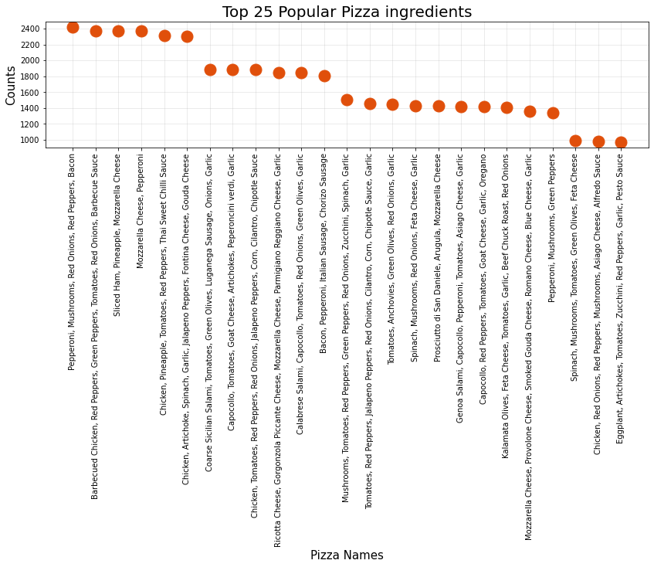

Slide 6
The diagram shows the top 25 highest used ingredients in pizza.
The highest used ingredients are pepperoni, mushrooms, red onions, red peppers and bacon.

Slide 7
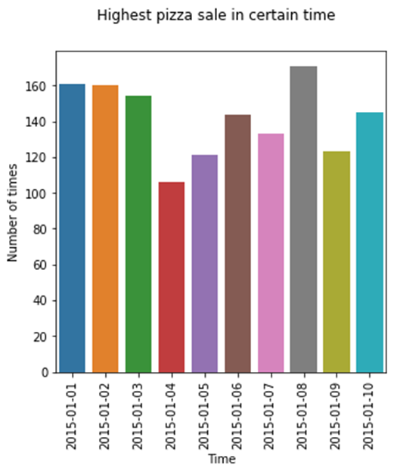
2. Which ingredients are in demand?
Certain date
The highest number of pizza sold is in 2015-11-26 which was Thanksgiving day and second in 2015-11-27 which was black Friday.
The higest number of pizza sold in 2015-11-26 is 261.
Order_date 2015-11-26 | Count 261
2015-11-27 | 259
2015-10-15 | 258
2015-07-04 | 233
2015-07-03 | 207

Slide 8
3. Are there more (or less) sales of a certain type of pizza in a certain month, or day, or time of the day?
Certain pizza in certain date
The highest sold pizza in certain date is The Hawaiian Pizza and in 2015-11-26.
 | Pizza_name The Hawaiian Pizza | Order_date 2015-11-26 | Count 21
 | The Classic Deluxe Pizza | 2015-11-27 | 20
 | The Pepperoni Pizza | 2015-05-15 | 18

Slide 9
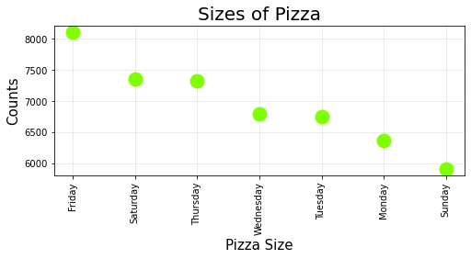
Which day has the maximum sales in a year?
The day for most sales is in Friday which is 8106.
 | Day Friday | Count 8106
 | Saturday | 7355
 | Thursday | 7323
 | Wednesday | 6797
 | Tuesday | 6753
 | Monday | 6369
 | Sunday | 5917

Slide 10
Which pizza is most sold in a certain day?
Friday has the highest number of pizza sales for The Pepperoni Pizza which is 462.
 | Pizza Name The Pepperoni Pizza | Day Friday | Count 462
 | The Classic Deluxe Pizza | Friday | 404
 | The Barbecue Chicken Pizza | Friday | 396
 | The California Chicken Pizza | Friday | 386
 | The Thai Chicken Pizza | Friday | 378

Slide 11
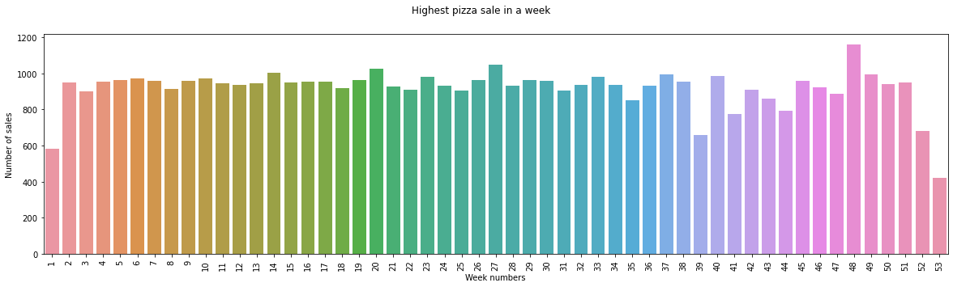
Week for the most sales
The maximum sale is in the week 48 which is 1159.
 | Week 48 | Count 1159
 | 27 | 1048
 | 20 | 1027
 | 14 | 1001
 | 49 | 996

Slide 12
Week for the most sales
The Classic Deluxe Pizza is the higest sold pizza in a week which is in week 48.
 | Pizza Name The Classic Deluxe Pizza | Week 48 | Count 66
 | The Classic Deluxe Pizza | 27 | 65
 | The Pepperoni Pizza | 20 | 63
 | The Barbecue Chicken Pizza | 10 | 62
 | The Sicilian Pizza | 48 | 60

Slide 13
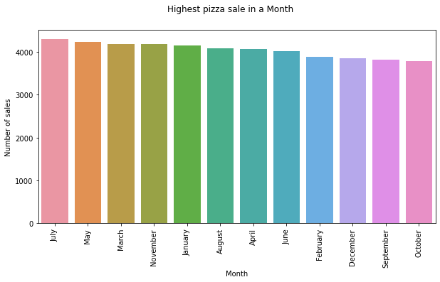
Highest sales for the month.
The highest sales of pizza is in month 7 i.e. July.
The pepperoni pizza is the pizza which is highest sold in a month which is May.
Month July | Count 4301
May | 4239
March | 4186
November | 4185
January | 4156
August | 4094
April | 4067
June | 4025
February | 3892
December | 3859
September | 3819
October | 3797

Slide 14
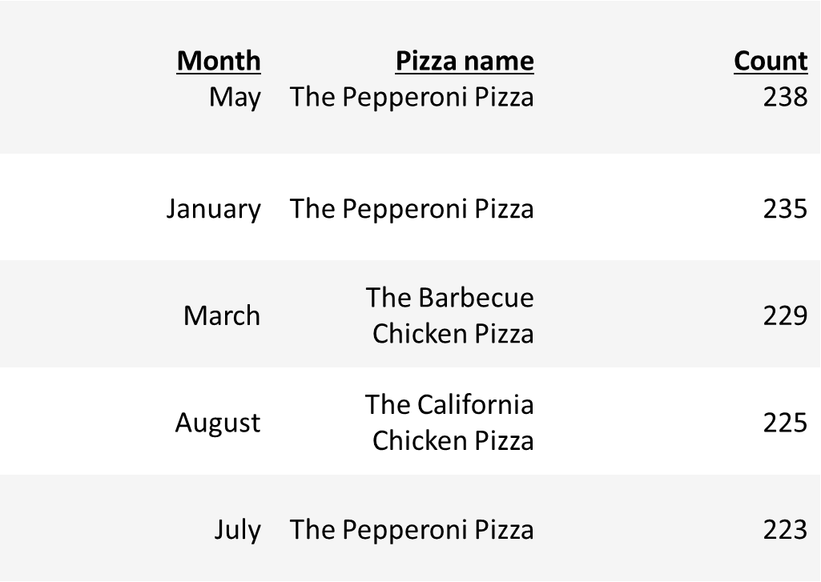
Highest sales for the month.
The pepperoni pizza is the pizza which is highest sold in a month which is May.

Slide 15
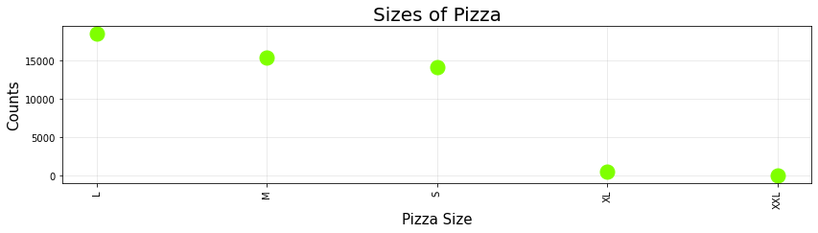
4.Which pizza sizes are sold more often, which type, which ingerdients, etc.?
The highest sold pizza size is large pizza.

Slide 16
Pizza sale with reference to size
The most sold pizza with referecne to size is classis small pizza which is 5975 times.
Pizza_category | pizza_size | count
Classic | S | 5975
Veggie | L | 5263
Chicken | L | 4799
Supreme | L | 4477
Classic | M | 4045
Classic | L | 3987
Supreme | M | 3977
Chicken | M | 3811
Veggie | M | 3552
Supreme | S | 3323
Veggie | S | 2634
Chicken | S | 2205
Classic | XL | 544
Classic | XXL | 28

Slide 17
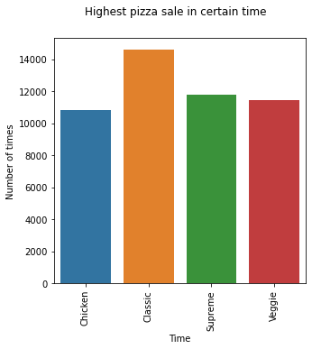
The most used single ingredient in a pizza.
Classic pizza is the most sold pizza.
 | Pizza category Classic | Count 14579
 | Supreme | 11777
 | Veggie | 11449
 | Chicken | 10815

Slide 18
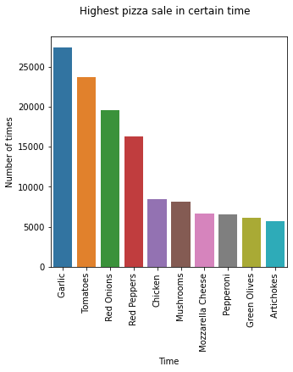
Which ingridents?
The most used ingredient is Garlic and is used 27422 times.
Ingredients Garlic | Count 27422
Tomatoes | 23694
Red Onions | 19547
Red Peppers | 16284
Chicken | 8443

Slide 19
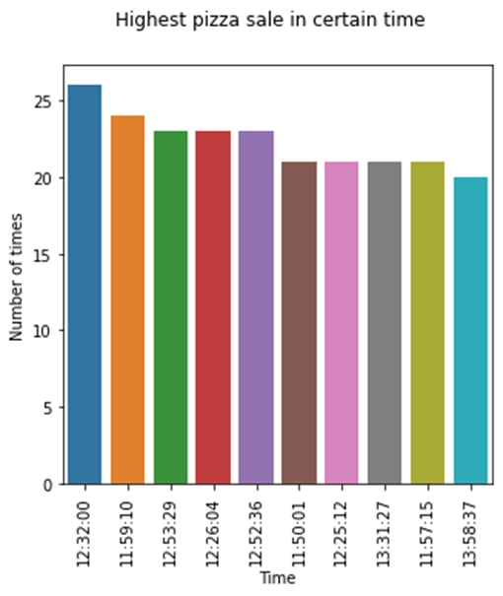
5. 5.Is there a time of the day when there is a peak sale? If yes, does that depend on the day of the week, or month?
The time of the day which has maximum order is 12:32:00 which is 26.
 | Time 12:32:00 | Count 26
 | 11:59:10 | 24
 | 12:53:29 | 23
 | 12:26:04 | 23
 | 12:52:36 | 23

Slide 20
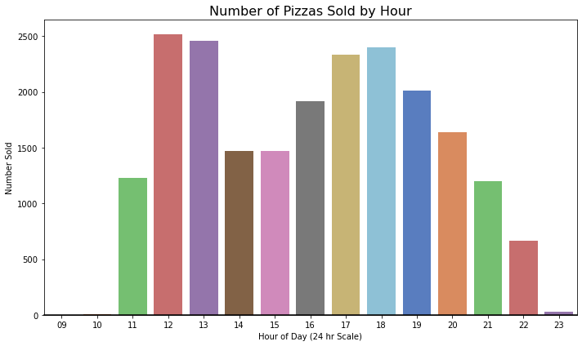
5. Is there a time of the day when there is a peak sale? If yes, does that depend on the day of the week, or month?
The most pizza sales is around 12'o' clock which is mostly lunch time.
Hour 12 | Count 2520
13 | 2455
18 | 2399
17 | 2336
19 | 2009
16 | 1920
20 | 1642
14 | 1472
15 | 1468
11 | 1231
21 | 1198
22 | 663
23 | 28
10 | 8
09 | 1

Slide 21
If yes, does that depend on the day of the week, or month?
The most pizza sales is in around 12'o'clock to 13'o' clock which is mostly lunch time and around 17'o' clock to 18'o'clock which is mostly snacks time.
Therefore the highest sales are around lunch time and snacks time whether it is week or month or day time.
Hour | Day | Count
13 | Thursday | 438
12 | Thursday | 434
12 | Tuesday | 421
12 | Wednesday | 420
12 | Friday | 415
13 | Friday | 413
12 | Monday | 398
18 | Saturday | 388
18 | Friday | 387
13 | Wednesday | 381
Hour | Week | count
17 | 18 | 66
12 | 49 | 64
12 | 9 | 63
17 | 7 | 62
19 | 48 | 62
12 | 51 | 61
12 | 14 | 61
13 | 20 | 61
13 | 46 | 61
19 | 12 | 60
Hour | Month | count
13 | July | 234
18 | July | 233
12 | March | 231
12 | June | 227
12 | December | 225
17 | April | 220
12 | April | 220
18 | June | 218
17 | May | 218
18 | August | 218

Slide 22
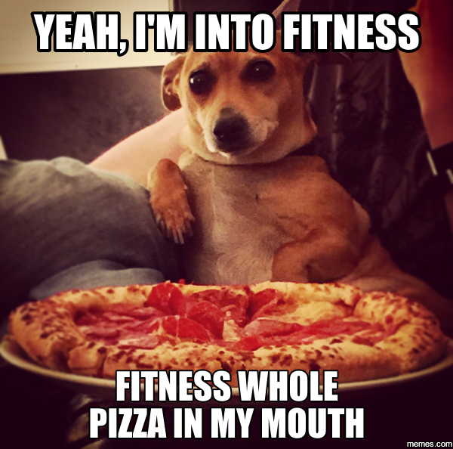

Photo ref:https://www.hungryhowies.com/blog/best-pizza-memes

