Slide 1
Socat 445 smb
Let’s say you want to port forward 3389 on your team server in red space to 192.168.1.100:3389 in blue space. Let’s assume the Beacon SOCKS proxy lives on port 9999. Here’s the syntax to do this:
socat TCP4-LISTEN:3389,fork SOCKS4:127.0.0.1:192.168.1.100:3389,socksport=9999

Slide 2
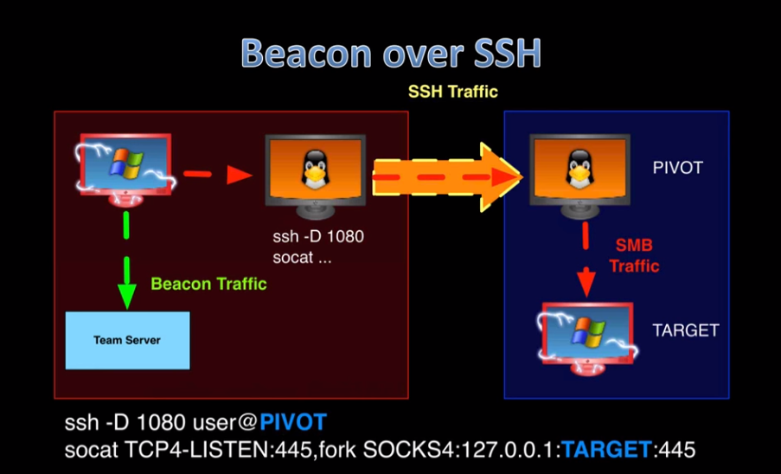

Slide 3
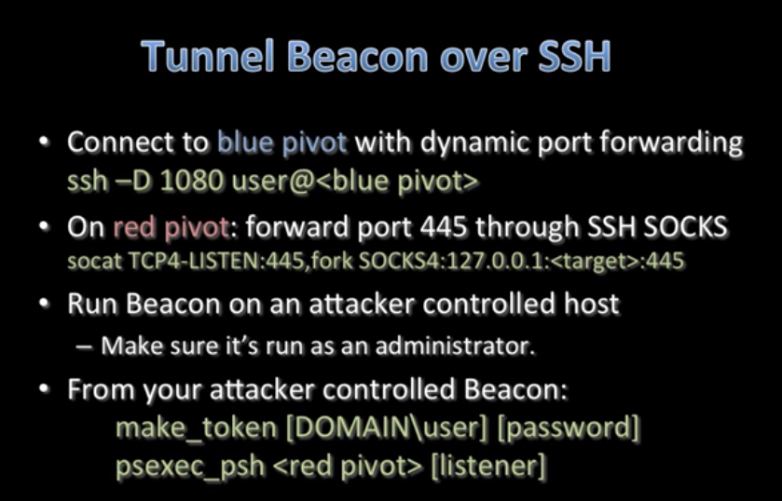

Slide 4
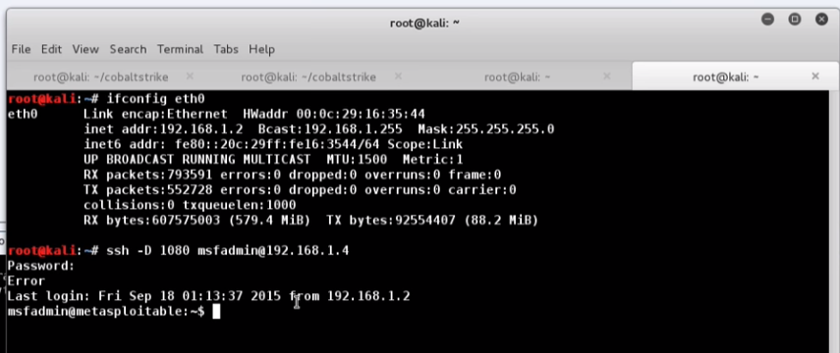

Slide 5
