Slide 1
Lesson 1: Understanding Fair Use, Academic Integrity, Self-Plagiarism, and Computer Basics
CTI110: Introduction to Web, Programming, & Database Foundation

Slide 2
Objectives
Fair Use
Academic Integrity
Self-Plagiarism
Server and Client Architecture
Computer Languages
Computer Basics:
Hardware
Software
Operating Systems
Case Studies and Examples

Slide 3
Tips to Achieve Better Learning Outcome
There are a lot of coding examples in the lesson.
You are not just expected to READ through the slides one by one.
Instead, you are required to PRACTICE all the examples shown on the slides.
You only achieve the goal of understanding the topics by practicing and understanding the examples.

Slide 4
Introduction
Overview of the topics to be covered in the lecture.
Importance of fair use, academic integrity, and avoiding self-plagiarism in academic and professional settings.
Understand How Blackboard Works:
https://blackboard.waketech.edu
Know Other Students in Class
Introduced yourself to each other
Communicate via classroom, email, discussion forum on BlackBoard, etc.
Describe the requirements of the Course
Know Where to Find Instructor Information
On BlackBoard, find Faculty Information menu
Understand and Apply Computer File Management Skills
File path
Copy and paste
Word processing

Slide 5
Fair Use
Define fair use as a legal doctrine that allows for the use of copyrighted material without permission from the copyright owner.
Explain the factors considered in fair use, such as the nature, amount, purpose, and effect on the market.
Provide examples of fair use scenarios, such as criticism, comment, news reporting, teaching, and research.
Discuss the limitations of fair use and the need to exercise caution when using copyrighted material.

Slide 6
Academic Integrity
Define academic integrity as the commitment to honesty, responsibility, and accountability in academic work.
Explain the importance of citing sources, giving proper credit, and avoiding plagiarism.
Discuss the consequences of academic integrity violations, including disciplinary actions, academic penalties, and damage to one's reputation.
Highlight the benefits of upholding academic integrity, such as fostering a culture of trust, promoting originality, and ensuring academic fairness.

Slide 7
Self-Plagiarism
Define self-plagiarism as the act of reusing one's own previously published or submitted work without proper citation.
Explain the reasons why self-plagiarism is considered unethical, such as misrepresenting the originality of work and potentially misleading readers.
Discuss the potential consequences of self-plagiarism, including academic sanctions, loss of credibility, and hindrance to the development of new ideas.
Provide strategies to avoid self-plagiarism, such as properly citing and referencing one's own previous work and seeking permission when necessary.

Slide 8
Server and Client Architecture
Client-side programming (front-end). Client-side refers to the software that runs on a user's web browser or user agent. Client-side web development is about interactivity and displaying data.
HTML, CSS and JavaScript are front-end languages. Support for these languages is found on the client (browser application). Source code for front-end languages can generally be found by right-clicking on the web page and is not secure.
Server-side programming (back-end). Server-side means the systems that are on the server. Server-side is about working behind the scenes to manage data.
Python, PHP, Ruby, Java, C# and JavaScript are examples of back-end languages. Support for these languages is found on the server. Source code for back-end languages is hidden from the user since it only resides on the server and is secure.
Web/Full-Stack Development. Full Stack Development is combining front-end and back-end skills.

Slide 9
Programming Languages
Computers can understand only machine instructions given by programmers. Programming languages are broadly categorized into three types:
Machine level language
consists of a set of instructions that are in the binary form 0 or 1
not easy for the programmers to write the program in machine instructions.
Assembly level language
The language instructions are written in English words like mov, add, sub, so it is easier to write and understand.
requires a translator that converts the assembly code into machine code. The translator used for translating the code is known as an assembler.
assembly code is not portable
High-level language
Computer programming - PHP, Java, JavaScript, Python, C++, C#, R, etc.
Database programming - SQL and NoSQL

Slide 10
Programming Languages (continued)
When you build a dynamic web site, you will use one of the computer programming languages in the backend of application development. It has been very common display dynamic web page (HTML page) to use PHP or Python as a programming language, MySQL or MS Access as a database language.
What about JavaScript? This language works at both the client and server side.
We do not cover JavaScript in this course
Towards the end of semester, we will work with PHP or Python, a backend programming language, to pull everything together (Programming, Web and Database).

Slide 11
Computer Basics
The following concepts should be addressed before we move on:
What is Hardware?
What is Software?
What is Operation Systems?
Windows Operation Systems
Unix-bases Operation Systems

Slide 12
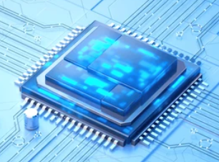
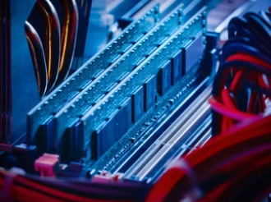
Hardware
Hardware as the physical components that make up a computer system.
Main hardware components:
Central Processing Unit (CPU):
Role: the "brain" of the computer, responsible for executing instructions.
Memory (RAM):
Function: temporarily storing data and program instructions.

Slide 13
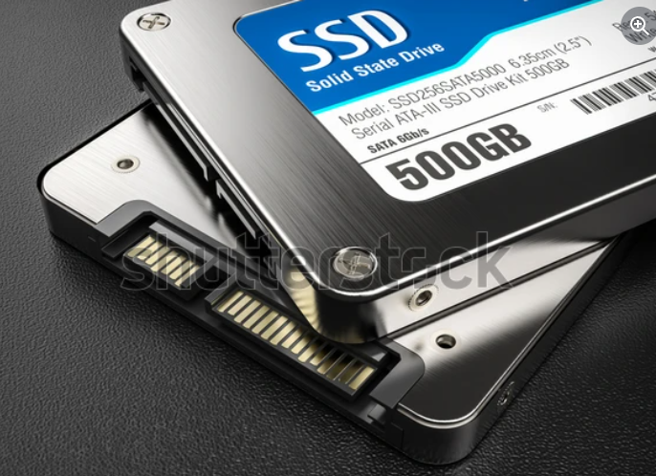
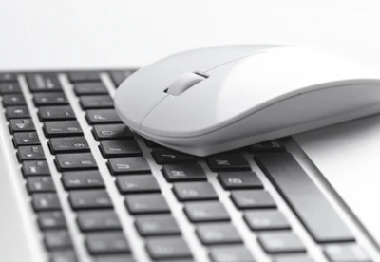
Hardware (continued)
Storage Devices:
different storage options:
hard disk drives (HDDs)
solid-state drives (SSDs)
Input and Output Devices:
Accessories to facilitate the interaction of the following with the computer
Mouse
Keyboard
Monitor
Printer

Slide 14
Software
Software is a set of programs or applications to give instructions to give hardware.
Software types:
System software:
managing the computer’s resources, including the operating system.
Operating System (OS):
managing memory, controlling hardware, and providing a user interface.
Application Software
used for specific tasks, such as:
word processors (MS Word, Notepad++)
web browsers (MS Edge, Chrome)
graphic design tools (Adobe PhotoShop, Lightroom)
Statistical software (SPSS, JMP)

Slide 15
Operating Systems: Windows and Unix-based
Difference between Windows and Unix-based operating systems
Windows:
user-friendly interface, and compatibility with a wide range of software and hardware.
Example:
MS Windows
MacOS
Unix-based Operating Systems:
Unix-like family, not user-friendly as Windows OS but powerful.
known for their stability, security, and command-line interface
Example:
Linux
MacOS terminal
Capable of running all kinds of applications
Web server (Apache)
Python, Java, R, C++, PHP
SQL (Oracle, MySQL/MariaDB and NoSQL (MongoDB)

Slide 16
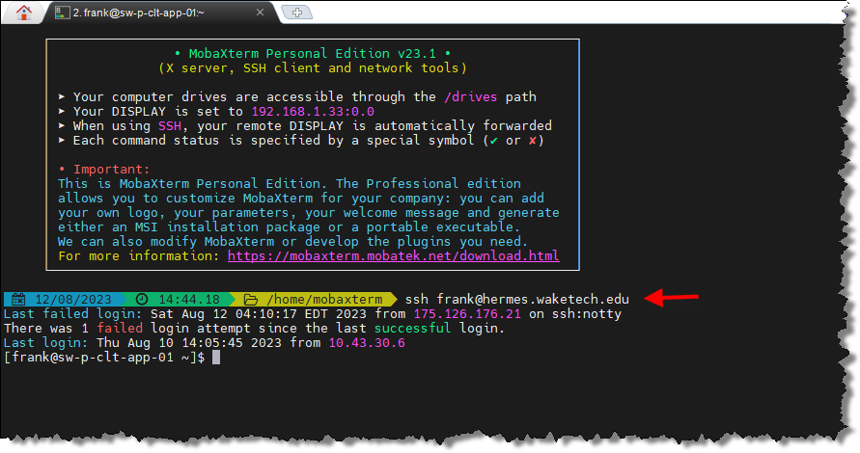
Example of Accessing our Linux Server
With a username, password, and a client tool (e.g. MobaXTerm, FileZilla, PowerShell, MacOS terminal), you can access Linux server (e.g. hermes).
Each student will have an account access to hermes web server to run web pages

Slide 17
Case Studies and Examples
Present real-life case studies or examples related to fair use, academic integrity, and self-plagiarism.
Discussing these cases and asking for their perspectives on ethical decision-making.

Slide 18
Q&A Session
Questions? Instructors will provide clarifications on any topic discussed in the lecture.
Any concerns or queries?
Remember:
You goal is to get education. Therefore, academic integrity is mostly self-defeating.

Slide 19
Summary
Key points covered in the lecture:
fair use, academic integrity, and self-plagiarism.
Server and Client Architecture
Programming languages
Computer basics
Importance of respecting copyright laws, practicing academic integrity, and avoiding self-plagiarism.
Students should apply the knowledge gained in their academic and professional pursuits.

