Slide 1
Lesson 8: Advanced CSS, HTML Tables, and Forms
CTI110: Introduction to Web, Programming,
& Database Foundation

Slide 2
Objectives
In this lesson, students will learn the following:
Create and build a HTML tables
Create simple HTML forms that include text boxes, drop down lists and submit button
Design multiple web pages with a consistent design
Apply box model when designing web pages
Apply positioning properties display, float and clear

Slide 3
Tips to Achieve Better Learning Outcome
There are a lot of coding examples in the lesson.
You are not just expected to READ through the slides one by one.
Instead, you are required to PRACTICE all the examples shown on the slides.
You only achieve the goal of understanding the topics by practicing and understanding the examples.

Slide 4
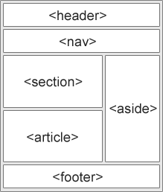
Review of Semantic and Non-Semantic Elements
Non-semantic elements – tells nothing about its content
Examples: <div> and <span>
Semantic elements – clearly defines its content
Examples: <form>, <table>, and <article>
For more detail, check: https://www.w3schools.com/html/html5_semantic_elements.asp

Slide 5
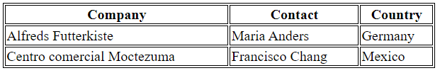

When Do We Use a Table?
The HTML tables allow web authors to arrange data like text, images, links, other tables, etc. into rows and columns of cells.
You can also use tables to layout your web page, but it is not considered to be semantic.
Just as in Excel, when you create a table using HTML, you do not have borders to separate the data.
A good web design uses CSS for styling and layout the tables.

Slide 6
HTML Table Tags
<table> </table>
Indicate the beginning and end of a table.
<caption> </caption>
Define the title of a table.
<caption> must be inserted immediately after the <table> tag.
<th> </th>
Indicate the start and end of a column heading within a row.
<tr> </tr>
Indicate the start and end of a row.
<td> </td>
Indicate the start and end of a column within a row (td stands for table data).
Is a child of the <tr> element. <td> should be nested within a <tr>

Slide 7
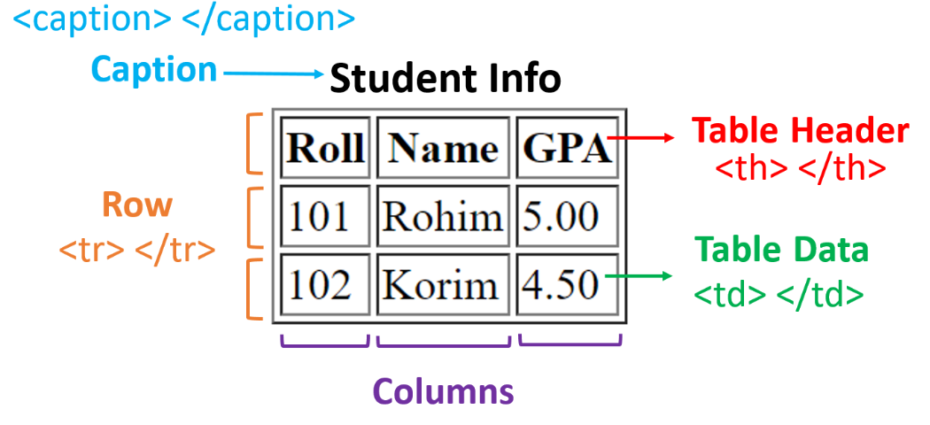
HTML Table Tags (Cont.)

Slide 8
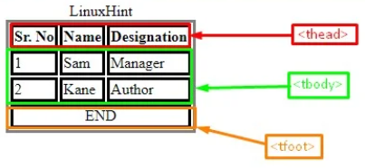
Additional Semantic Table Tags
<thead></thead>
Is usually the first row containing the column headings.
You can have multiple rows where there are headers but style them differently.
<tbody></tbody>
Is used to group the body content in an HTML table.
It must have one or more <tr> tags inside.
<tfoot>
It wraps table rows that indicate the footer of the table, semantically indicating these are not data rows but ancillary information.
It might be a final row with items in the previous rows summed.
The browser will render it at the bottom of the table no matter where it is coded.

Slide 9
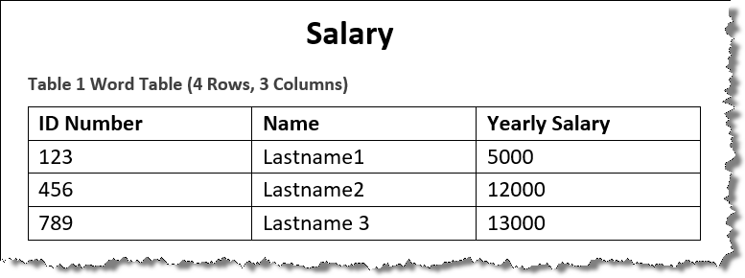
Creating a Simple Table
The title of the table is Salary
The first row consists of the table heads, which are ID Number, Name, and Yearly Salary
Rows 2 – 4 consists of the table data items/cells of data

Slide 10
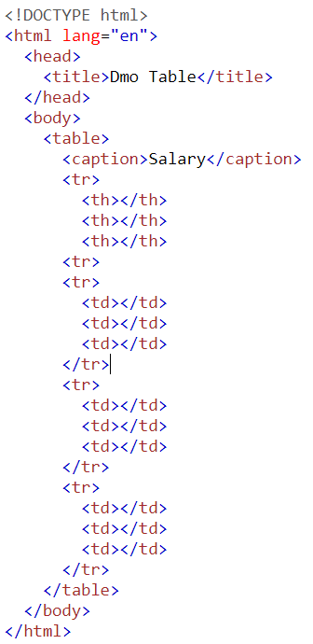
Creating a Simple Table (cont.)
Step 1: We need 4 rows and 3 columns.
Columns are represented by the <td> tag.
Rows are represented by the <tr> tag.
When the <td> is a heading, it uses the <th> instead of <td> tag
Step 2: Create placeholders by stubbing out the structure.
It helps to focus on the structure before adding the content.
Code Example A, available at (View Page Source to get the code) https://hermes.waketech.edu/~frank/cti110/lesson05/tablea.html

Slide 11
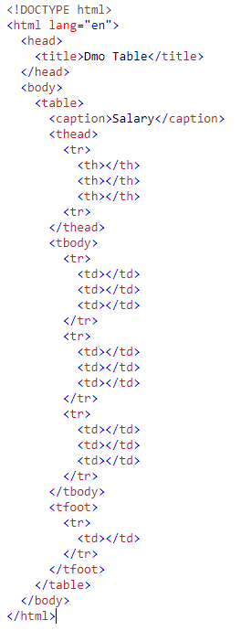
Creating a Simple Table (cont.)
Step 3: We can add the <thead>, <tbody> and <tfoot> tags giving even more meaning and context.
When you use <thead>, there must be no <tr> that is a direct child of <table>.
All rows must be within either the <thead>, <tbody>, or <tfoot>.
In addition, these additional semantic tags for tables are very useful for CSS styling.
Code Example B, available at (View Page Source to get the code) https://hermes.waketech.edu/~frank/cti110/lesson05/tableb.html

Slide 12
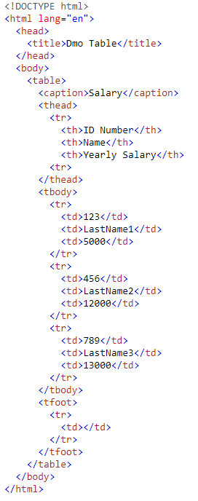
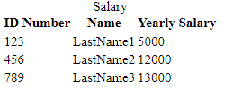
Creating a Simple Table (cont.)
Step 4: Since the structure is already created, then we can focus on the content. Insert the Table content for <th> and<td>.
Code Example C, available at (View Page Source to get the code) https://hermes.waketech.edu/~frank/cti110/lesson05/tablec.html

Slide 13
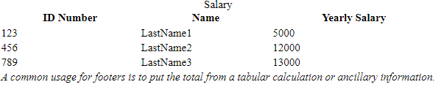
Merging Columns and Rows
Using <tfoot>
You can include the table footer right at the bottom of the table as you'd expect, or just below the table header (the browser will still render it at the bottom of the table).
Adding <td> colspan attributes to span multiple rows and columns
<td colspan="3">something</td> would span 3 columns of the table.
<tfoot>
<tr>
<td colspan = "3">
<em> A common usage for footers is to put the total from a tabular calculation or ancillary information.</em>
</td>
</tr>
</tfoot>
Code Example D, available at (View Page Source to get the code) https://hermes.waketech.edu/~frank/cti110/lesson05/tabled.html

Slide 14
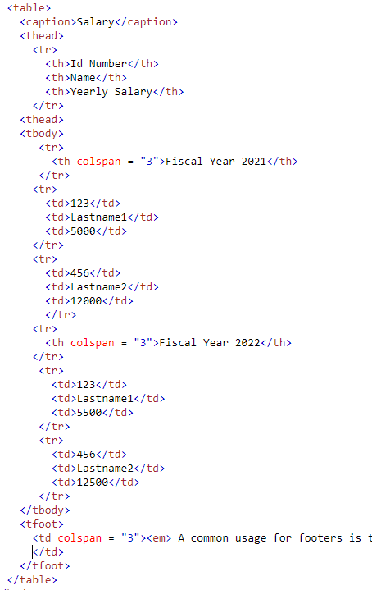
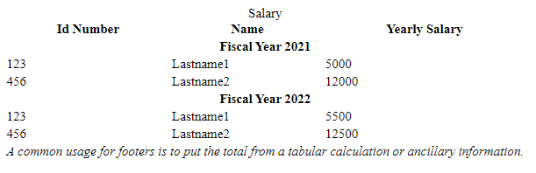
Multiple Headings with a Primary Heading
Using <thead>
It is usually the first row containing the column headings.
You can add additional headings within the <tbody> which will not affect the headings in the <thead>
Code Example E, available at (View Page Source to get the code) https://hermes.waketech.edu/~frank/cti110/lesson05/tablee.html

Slide 15
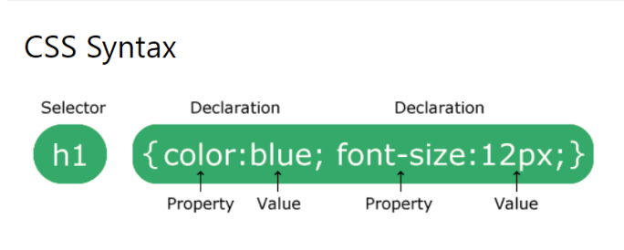
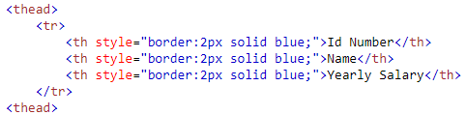
Using Inline CSS in HTML Table
Although there are 3 types of CSS styles, Inline CSS has the highest priority.
Example F uses the Inline CSS
Code Example F, available at (View Page Source to get the code) https://hermes.waketech.edu/~frank/cti110/lesson05/tablef.html

Slide 16
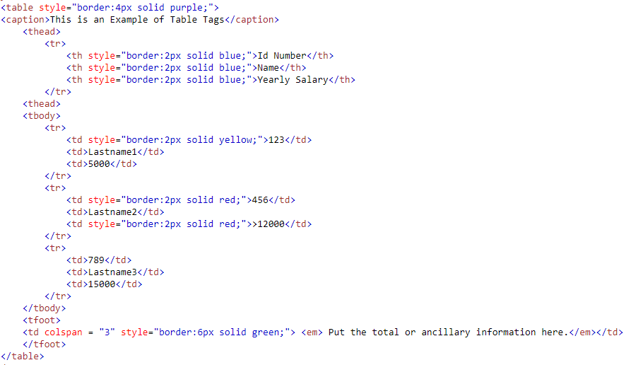
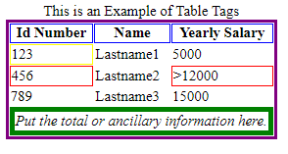
Using Inline CSS with HTML Table (Cont.)

Slide 17
Using Internal CSS for HTML Table
Place style rules inside the opening and closing <style> tags inside the <head> element.
Simple Selectors (select elements based on element name, id, class)
/* Element Selector */
p {
text-align:center;
color: red;
}
/* id selector */
#para1 {
text-align:center;
color:red;
}
/* class selector */
.center {
text-align:center;
color: red;
}

Slide 18
Using Internal CSS for HTML Table (Cont.)
A combinator is something that explains the relationship between the selectors.
descendant selector (space)
Child selector (>)
adjacent sibling selector (+)
general sibling selector (~)
/* List items that are children of the "my-things" list */
ul.my-things > li {
margin:em;
}
/* syntax for child combinator */
selector1 > selector2 {style properties}
/*example for child combinator within a table…only the <th> and <tr> that fall within the <thead> will be styled. Your tables assignment will need this
thead>tr>th {background-color:blue;color:white:}

Slide 19
Using Internal CSS for HTML Table (Cont.)
The grouping selector selects all the HTML elements with the same style definitions.
It would be better to group the selectors to minimize the code.
To group selectors (on the right) separate each selector with a comma (,):
h1,h2,p
{
text-align:center;
color:red;
}

Slide 20
Using Internal CSS for HTML Table (Cont.)
The following are the commonly used CSS properties and values
color: defines the text color for an HTML element
text-align: specifies the horizontal alignment of text in an element.
background-color: sets the background color of an element
list-style: specifies the type of list item marker.
font-size: sets the size of the text.
font-family: specifies the font for an element.
border: specifies what kind of border to display.
font-weight: sets how thick or thin characters in text should be displayed.
padding: create space around an element's content, inside of any defined borders.
In summary, let’s put things together by demonstrating the display with an example.
Code Example J, available at (View Page Source to get the code) https://hermes.waketech.edu/~frank/cti110/lesson05/tablej.html

Slide 21
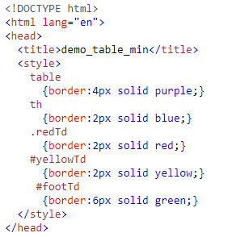
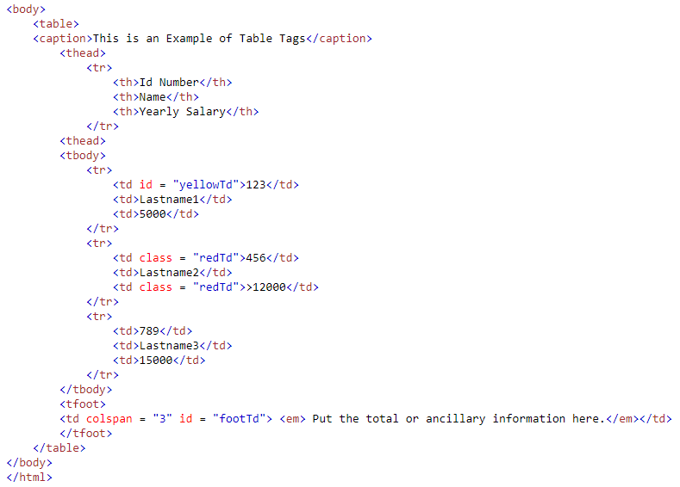
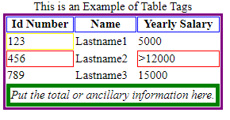
Using Internal CSS for HTML Table (Cont.)

Slide 22
Overview of HTML Forms
An HTML form is used to collect user input. The user input is most often sent to a server for processing.
We use the <form> element to create forms, use attributes action, method and id to determine where to and how to send the input.
The <form> element is a container for different types of input elements, such as:
single or multi-line text fields
dropdown boxes
buttons
checkboxes
radio buttons

Slide 23
HTML <form> Tag
Used to create an HTML form for user input.
As a minimum both the action and method attributes should be used.
https://www.w3schools.com/tags/tag_form.asp
If the submit button is outside of the form tags, then you must have an id as well. If not, then an id is not needed.
<form action="#" method="post">
<!-- # is used a placeholder -->
<button type="submit">Sign-Up</button>
</form>
<!-- Button INSIDE of <form> tag -->
<form id="form" action="#" method="post">
. . .
</form>
<button type="submit" form="form">Sign-Up</button>
<!-- Button OUTSIDE of <form> tag -->

Slide 24

HTML <label> Tag
Defines a label for several elements.
The for attribute of <label> must be equal to the id attribute of the related element to bind them together (in this case <input>).
A label can also be bound to an element by placing the element inside the <label> element.
https://www.w3schools.com/tags/tag_label.asp
<input type="radio" id="html" name="fav_language" value="HTML">
<label for="html">HTML</label><br>
<input type="radio" id="css" name="fav_language" value="CSS">
<label for="css">CSS</label>

Slide 25
HTML <input> Tag
Specifies an input field where the user can enter data.
Can be displayed in several ways, depending on the type attribute.
The name attribute is needed to reference the input data after the form is submitted (if you omit the name attribute, no data from the form will be submitted).
https://www.w3schools.com/tags/tag_input.asp
<input type="email" id="email" name="email">
Value | Description | Example
email | Field for an e-mail address | <input type="email" id="email" name="email">
number | Field for entering a number. We can use a min/max value for validation | <input type="number" id="minMax" name="number" min="5" max="10">
radio | Defines a radio button | <input type="radio" id="child" name="child" value="child">
submit | Defines a submit button | <button type="submit" form="form"> Sign-Up</button>
text | Default. Defines a single-line text field | <input type="text" id="name" name="name">
select | Using the <select> element for input | <select name="ticketType" id="ticketType"> <option value="Adult">Adult</option>

Slide 26
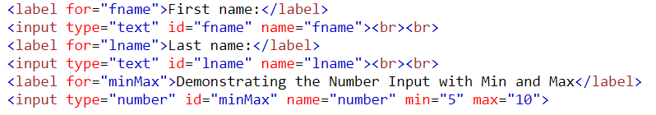
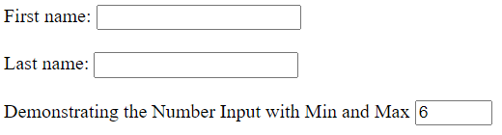
HTML <input> Tag (cont.)
Should always add the <label> tag for each <input> for best accessibility practices!
The type attribute “text” defines a single-line text field. The default width of the text field is 20 characters.
The type attribute “number” defines a field for entering a number. This input type includes built-in validation to reject non-numerical entries.
max - specifies the maximum value allowed
min - specifies the minimum value allowed

Slide 27
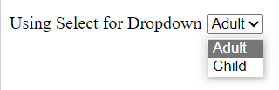
HTML <select> Tag
Used to create a drop-down list.
The id attribute is needed to associate the drop-down list with a label.
The <option> tags inside the <select> element define the available options in the drop-down list.
https://www.w3schools.com/tags/tag_select.asp
<label for="ticketType">Using Select for Dropdown</label>
<select name="ticketType" id="ticketType">
<option value="Adult">Adult</option>
<option value="Child">Child</option>
</select>

Slide 28
HTML <fieldset> and <legend> Tag
Used to group related elements in a form.
Draws a box around the related elements.
Using only the <fieldset> and <legend> tags create a horizontal input form.
https://www.w3schools.com/tags/tag_fieldset.asp
<form> action="#" method="post">
<fieldset>
<legend class="labels">User</legend>
<label>Entering Text</label>
<input type="text" id="name" name="name">
<label for="email">Entering Email</label>
<input type="email" id="email" name="email">
</fieldset>
</form>

Slide 29


HTML <button> Tag
Two ways to defines a clickable button.
Tag <button>
Tag <input>
Always specify the type attribute to tell browsers what type of button it is.
https://www.w3schools.com/tags/tag_button.asp

Slide 30
Client-Side Validation
Before submitting data to the server, it is important to ensure all required form controls are filled out, in the correct format.
Client-side validation is an initial check and an important feature of good user experience; by catching invalid data on the client-side, the user can fix it straight away.
If it gets to the server and is then rejected, a noticeable delay is caused by a round trip to the server and then back to the client-side to tell the user to fix their data.

Slide 31
Tag Attributes Used for Client-Side Validation
required: Specifies whether a form field needs to be filled in before the form can be submitted.
minlength and maxlength: Specifies the minimum and maximum length of textual data (strings)
min and max: Specifies the minimum and maximum values of numerical input types
type: Specifies whether the data needs to be a number, an email address, or some other specific preset type.
pattern: Specifies a regular expression that defines a pattern the entered data needs to follow.

Slide 32
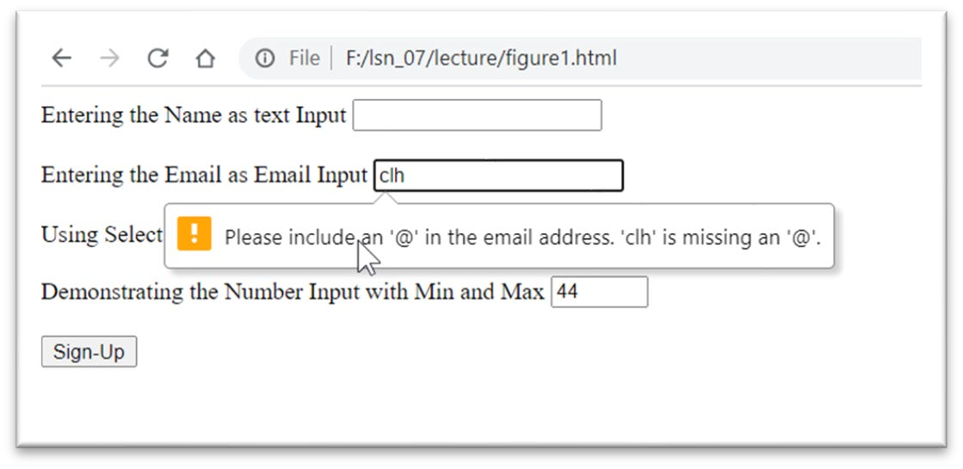
Client-Side Validation Examples
Email
<input type="email" id="email" name="email">

Slide 33
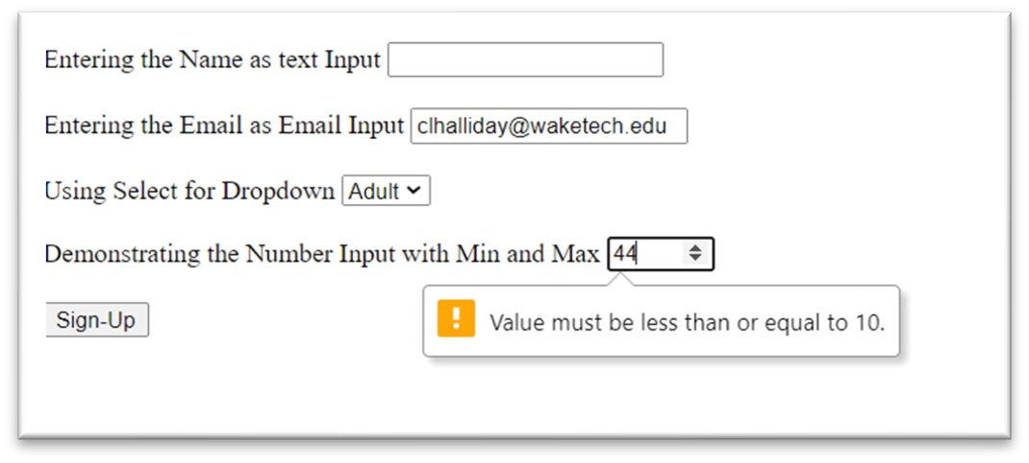
Client-Side Validation Examples (cont.)
Range of number
<input type="number" id="minMax" name="number" min="5" max="10">

Slide 34
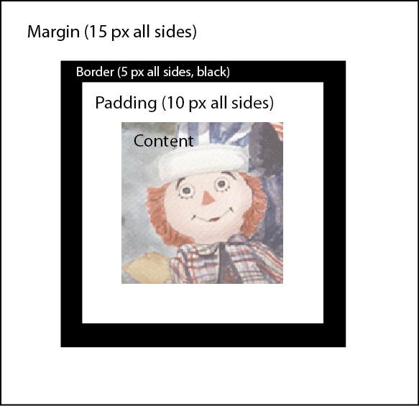
The box Model
All HTML elements are essentially boxes
The CSS box model describes the layout of these boxes on the page
Box model properties
padding - area around the HTML content
border - area around padding and HTML content
margin - area around the border, padding, and HTML content

Slide 35
The padding Property
The padding property
The spacing between the content and the border
Is a shorthand for specifying the padding on all sides of a box
Start at the top and move clockwise (top right bottom left)
Can be replaced with side-specific properties
padding-top
padding-right
padding-bottom
div {
padding: 10px 20px 10px 20px;
}

Slide 36
The border Property
The border property
Is a shorthand for specifying the border on all sides of a box
Defines several border properties
border-width - sets the width of the border area
border-color - defines the border color
border-style - defines border type
div {
border: 2px dotted black;
}
Note: Each border property can be defined for each side of a box and there are many more border properties. See http://www.w3schools.com/css/css_border.asp for more details.

Slide 37
The margin Property
The margin property
The spacing between the border and the element's parent
Is a shorthand for specifying the margin on all sides of a box
Start at the top and move clockwise (top right bottom left)
Can be replaced with side-specific properties
margin-top
margin-right
margin-bottom
margin: 10px 20px 10px 20px;
div {
margin: 10px 20px 10px 20px;
}

Slide 38
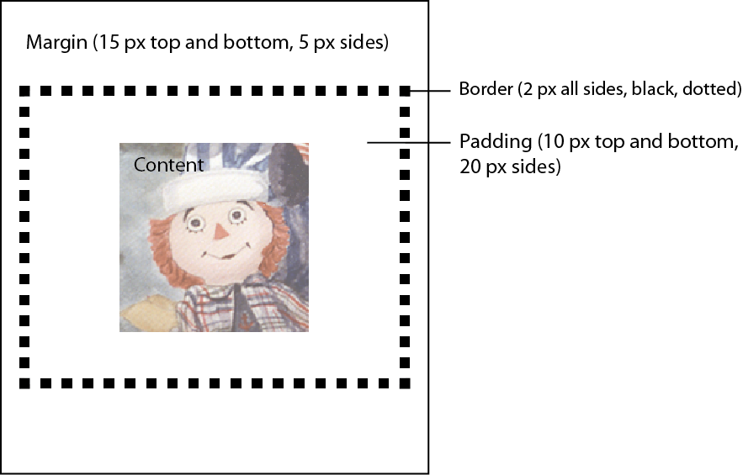
Styling with the Box Model
div {
padding: 10px;
border: 5px solid black;
margin: 15px;
}
div {
padding: 10px 20px 10px 20px;
border: 2px dotted black;
margin: 15px 5px 15px 5px;
}

Slide 39
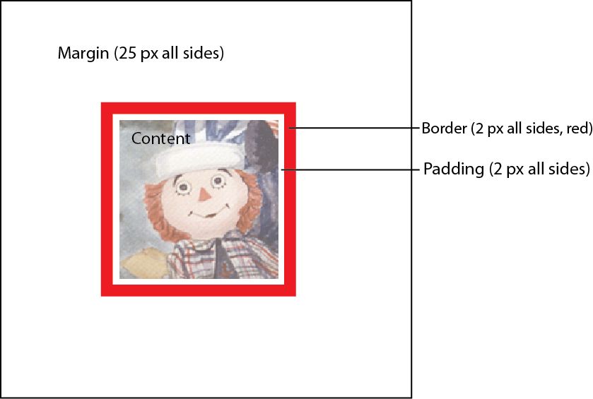
Styling with the Box Model (cont.)
div {
padding: 2px;
border: 2px solid red;
margin: 25px;
}

Slide 40
Defining Element Dimensions
Set height and width properties to specify box size
Values can be defined as
Lengths (px, em, etc.)
Percentages
auto - default setting that sizes boxes to fit all of its content
Note: You can read more about CSS units here: http://www.w3schools.com/cssref/css_units.asp

Slide 41
Adjusting the Position of HTML Elements
Flow of elements
A browser renders the elements of an HTML document that has no CSS from left to right, top to bottom, in the same order as they exist in the document.
CSS also includes properties that can change how a browser positions elements. These properties specify where an element is located on a page.
There are five properties for adjusting the position of HTML elements in the browser
position
display
z-index
float
Clear

Slide 42
display Property
The default display can be changed using one of three values:
inline
The default display for some tags, such as <em>, <strong>, and <a>, is called inline.
Inline elements have a box that wraps tightly around their content, only taking up the amount of space necessary to display their content and not requiring a new line after each element.
The CSS display property provides the ability to make any element an inline element. This includes elements that are not inline by default such as paragraphs, divs, and headings.
The CSS in the example below will change the display of all <h1> elements to inline. The browser will render <h1> elements on the same line as other inline elements immediately before or after them (if there are any).
h1 {
display: inline;
}

Slide 43
display Property (cont.)
block display
Elements that are block-level by default include all levels of heading elements (<h1> through <h6>), <p>, <div> and <footer>.
inline-block
inline-block display combines features of both inline and block elements. Inline-block elements can appear next to each other, and we can specify their dimensions using the width and height properties.
Images are the best example of default inline-block elements.

Slide 44
float Property
You can simply move an element as far left or as far right as possible on the page, with float property.
You can put sections side by side with this. Whether they are tables or different <div>’s or <section> etc. You may have to adjust the margins and widths to get a good fit.
The float property can be set to one of two values:
left - this value will move, or float, elements as far left as possible.
right - this value will move elements as far right as possible.
table {
width:35%
float:left;
margin:25px;
}

Slide 45
clear Property
The clear property specifies how elements should behave when they bump into each other on the page. It can take on one of the following values:
left — the left side of the element will not touch any other element within the same containing element.
right — the right side of the element will not touch any other element within the same containing element.
both — neither side of the element will touch any other element within the same containing element.
none — the element can touch either side.

Slide 46
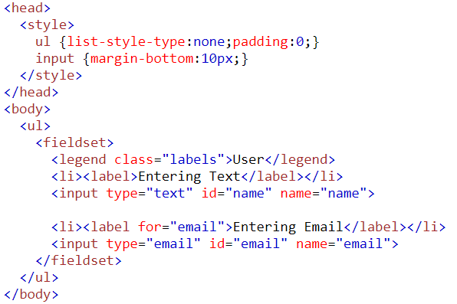
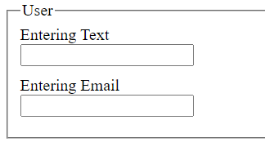
Use <ul> Tag Within <forms>
Use both the <ul> and <fieldset> in combination to get both the widgets and vertical input.
CSS removed bullets and created spacing
Example: https://hermes.waketech.edu/~frank/cti110/lesson06/form01.html

Slide 47
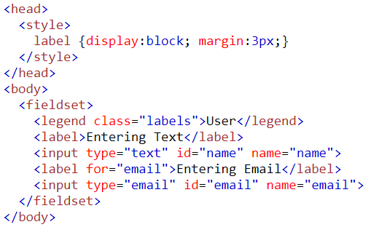
Tags Used Within <forms> (continued 8)
Vertical Presentation can also be done using the CSS property/value: display:block without UL
Example: https://hermes.waketech.edu/~frank/cti110/lesson06/form02.html

