Slide 1

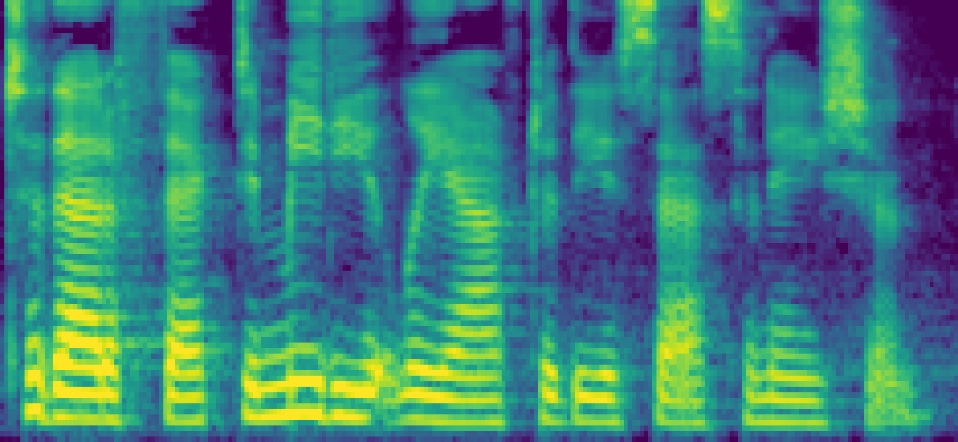

Mel bins
Candidate pairs
Block index
…
80
60
0
1
2
…
i
Payload bit j
0/1
60
60
Watermark
Embedding Area
20
0
20
20
Time

