Slide 1


那些甜食與他們的產地
DocuXml Editor
史萊姆 國王
Advisor: Prof. Hsiang, Jieh @RCDH & CSIE, NTU
Student: Huang, Chih-Yang @CS, Utaipei

Slide 2
Editor Function

Slide 3
Editor Function
New Tag
Edit Content
Content (Un)Tagging
Tagging with RefId
Search Term on CBDB TWGIS TGAZ
Search and Tag through
New/Modify Metadata
Upload to DocuSky

Slide 4
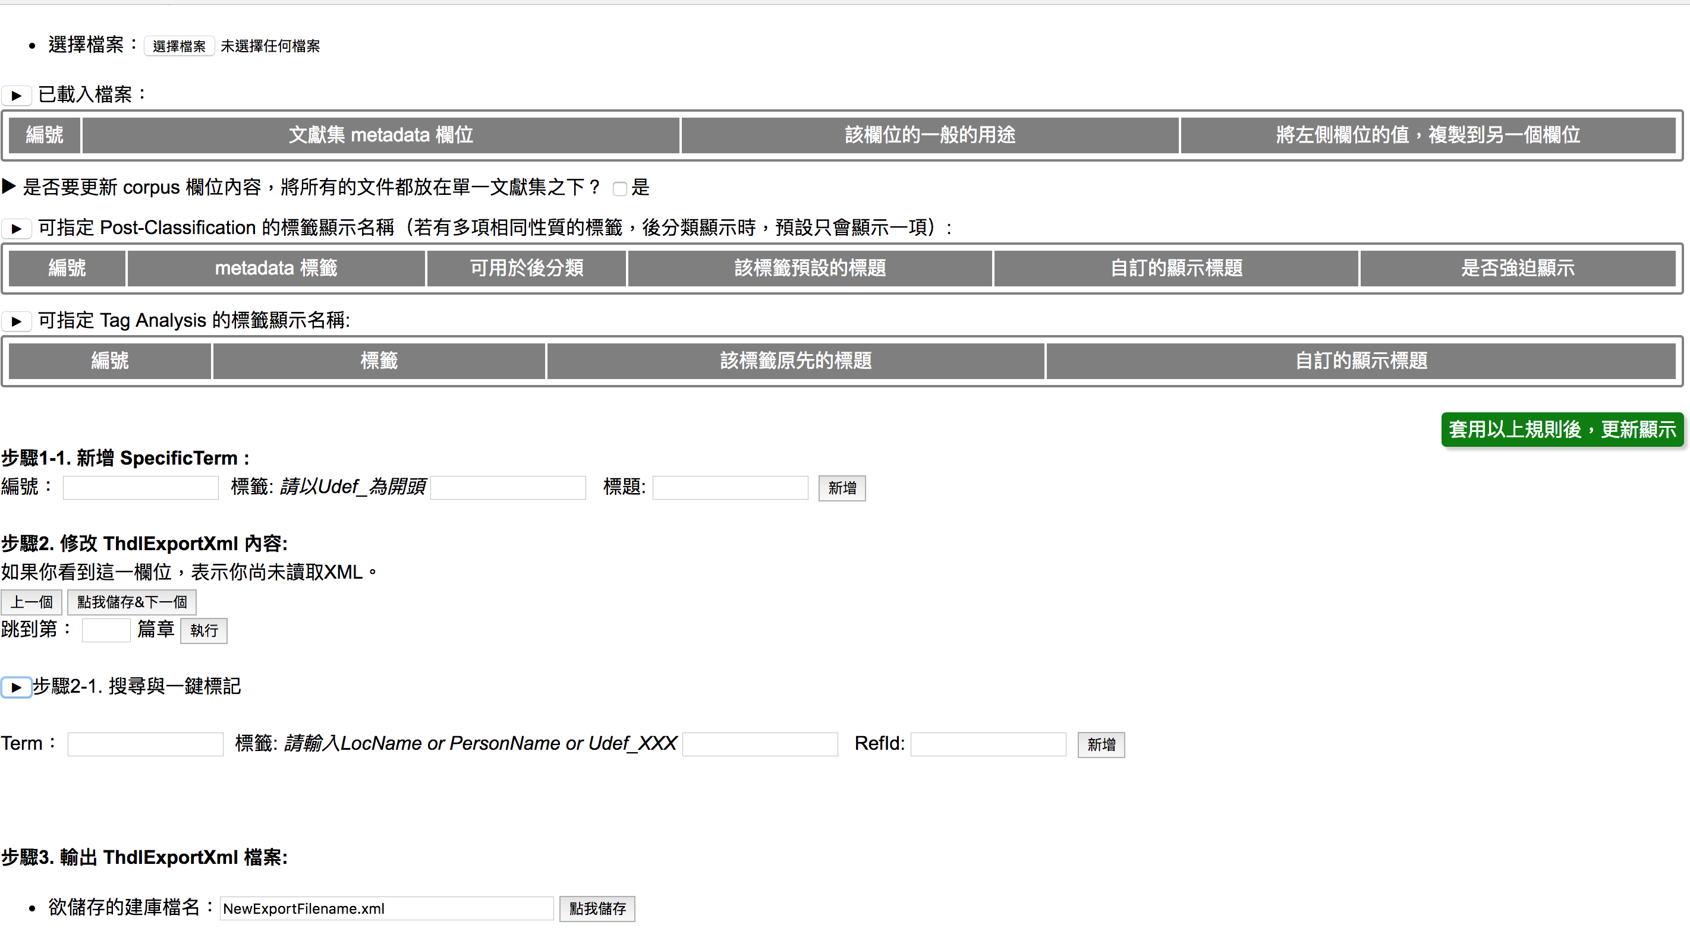
Based on 建庫檔彙整工具(管理Metadata欄位)

Slide 5
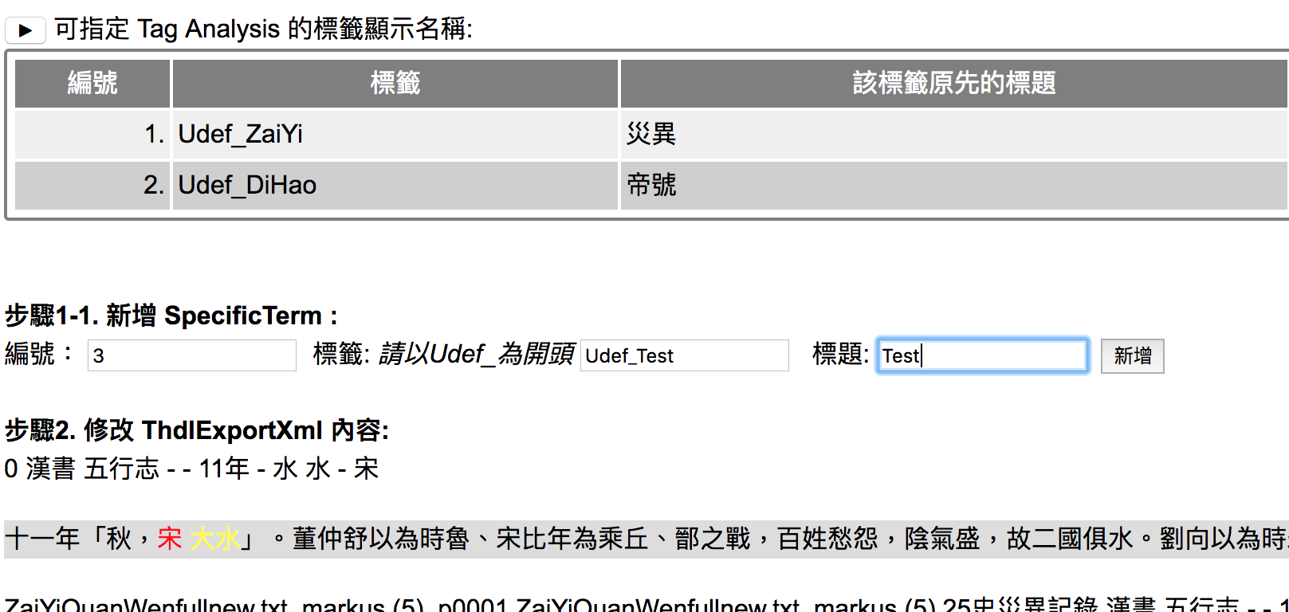
New Tag

Slide 6
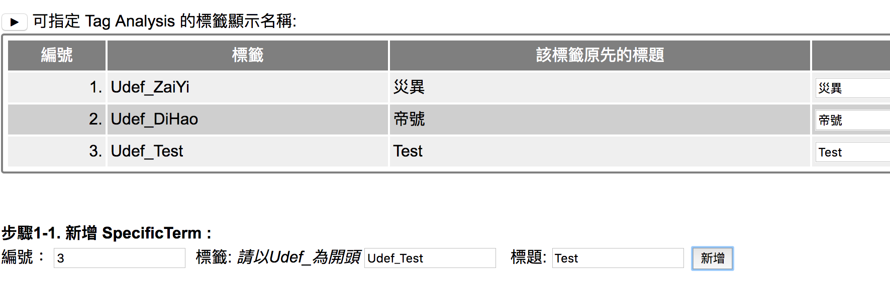
New Tag

Slide 7
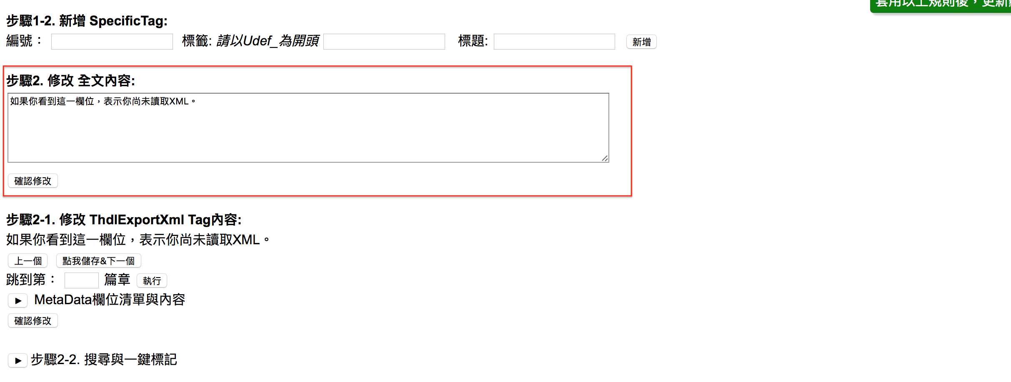
Edit Content

Slide 8
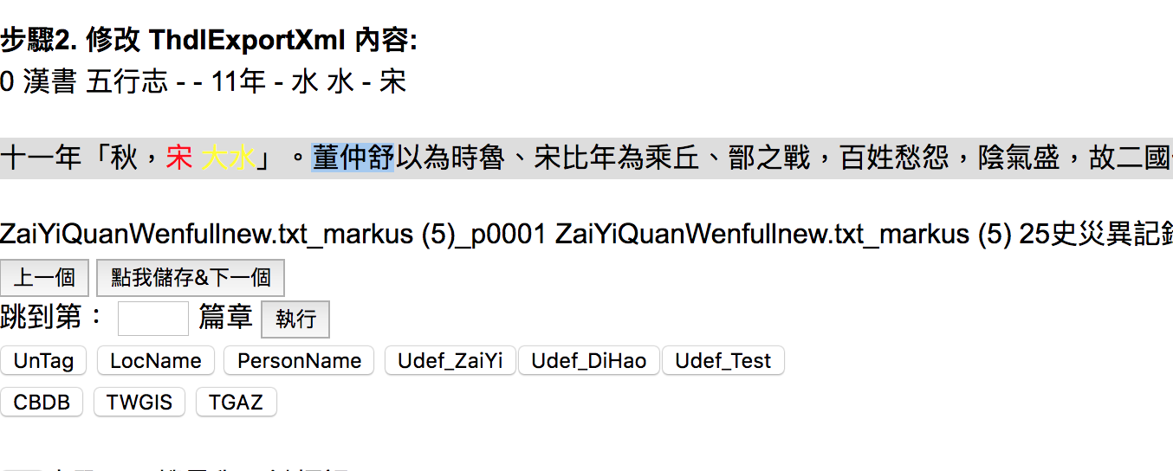
Content (Un)Tagging

Slide 9
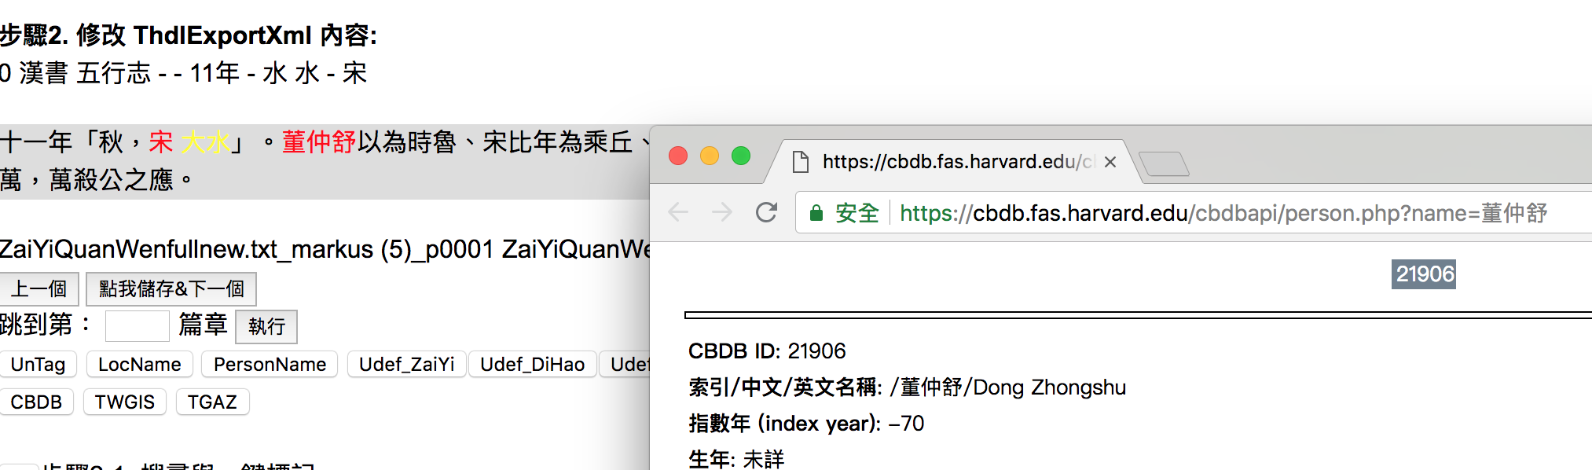
Search Term on CBDB TWGIS TGAZ
3
1
2

Slide 10
Tagging with RefId

Slide 11
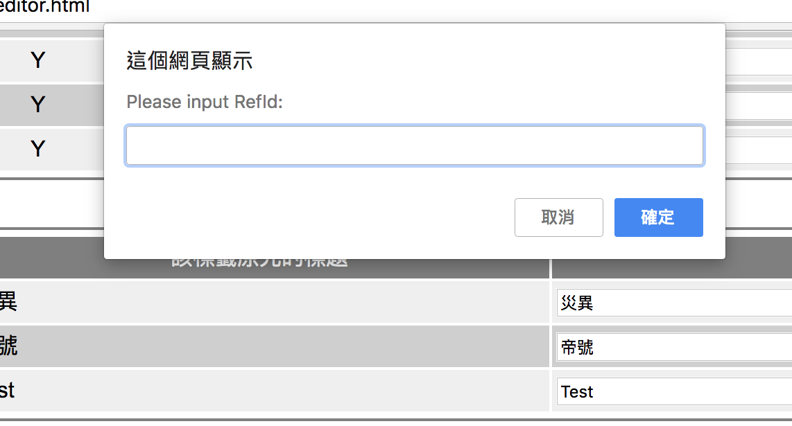
Tagging with RefId

Slide 12
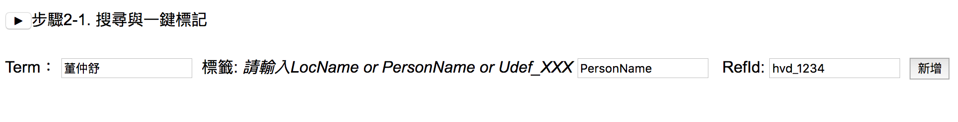
Search and Tag through
1
2
3 (optional)

Slide 13
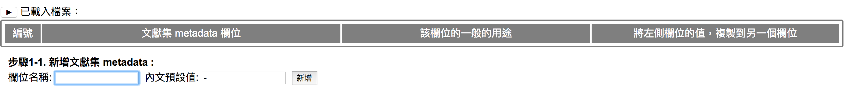
New Metadata

Slide 14
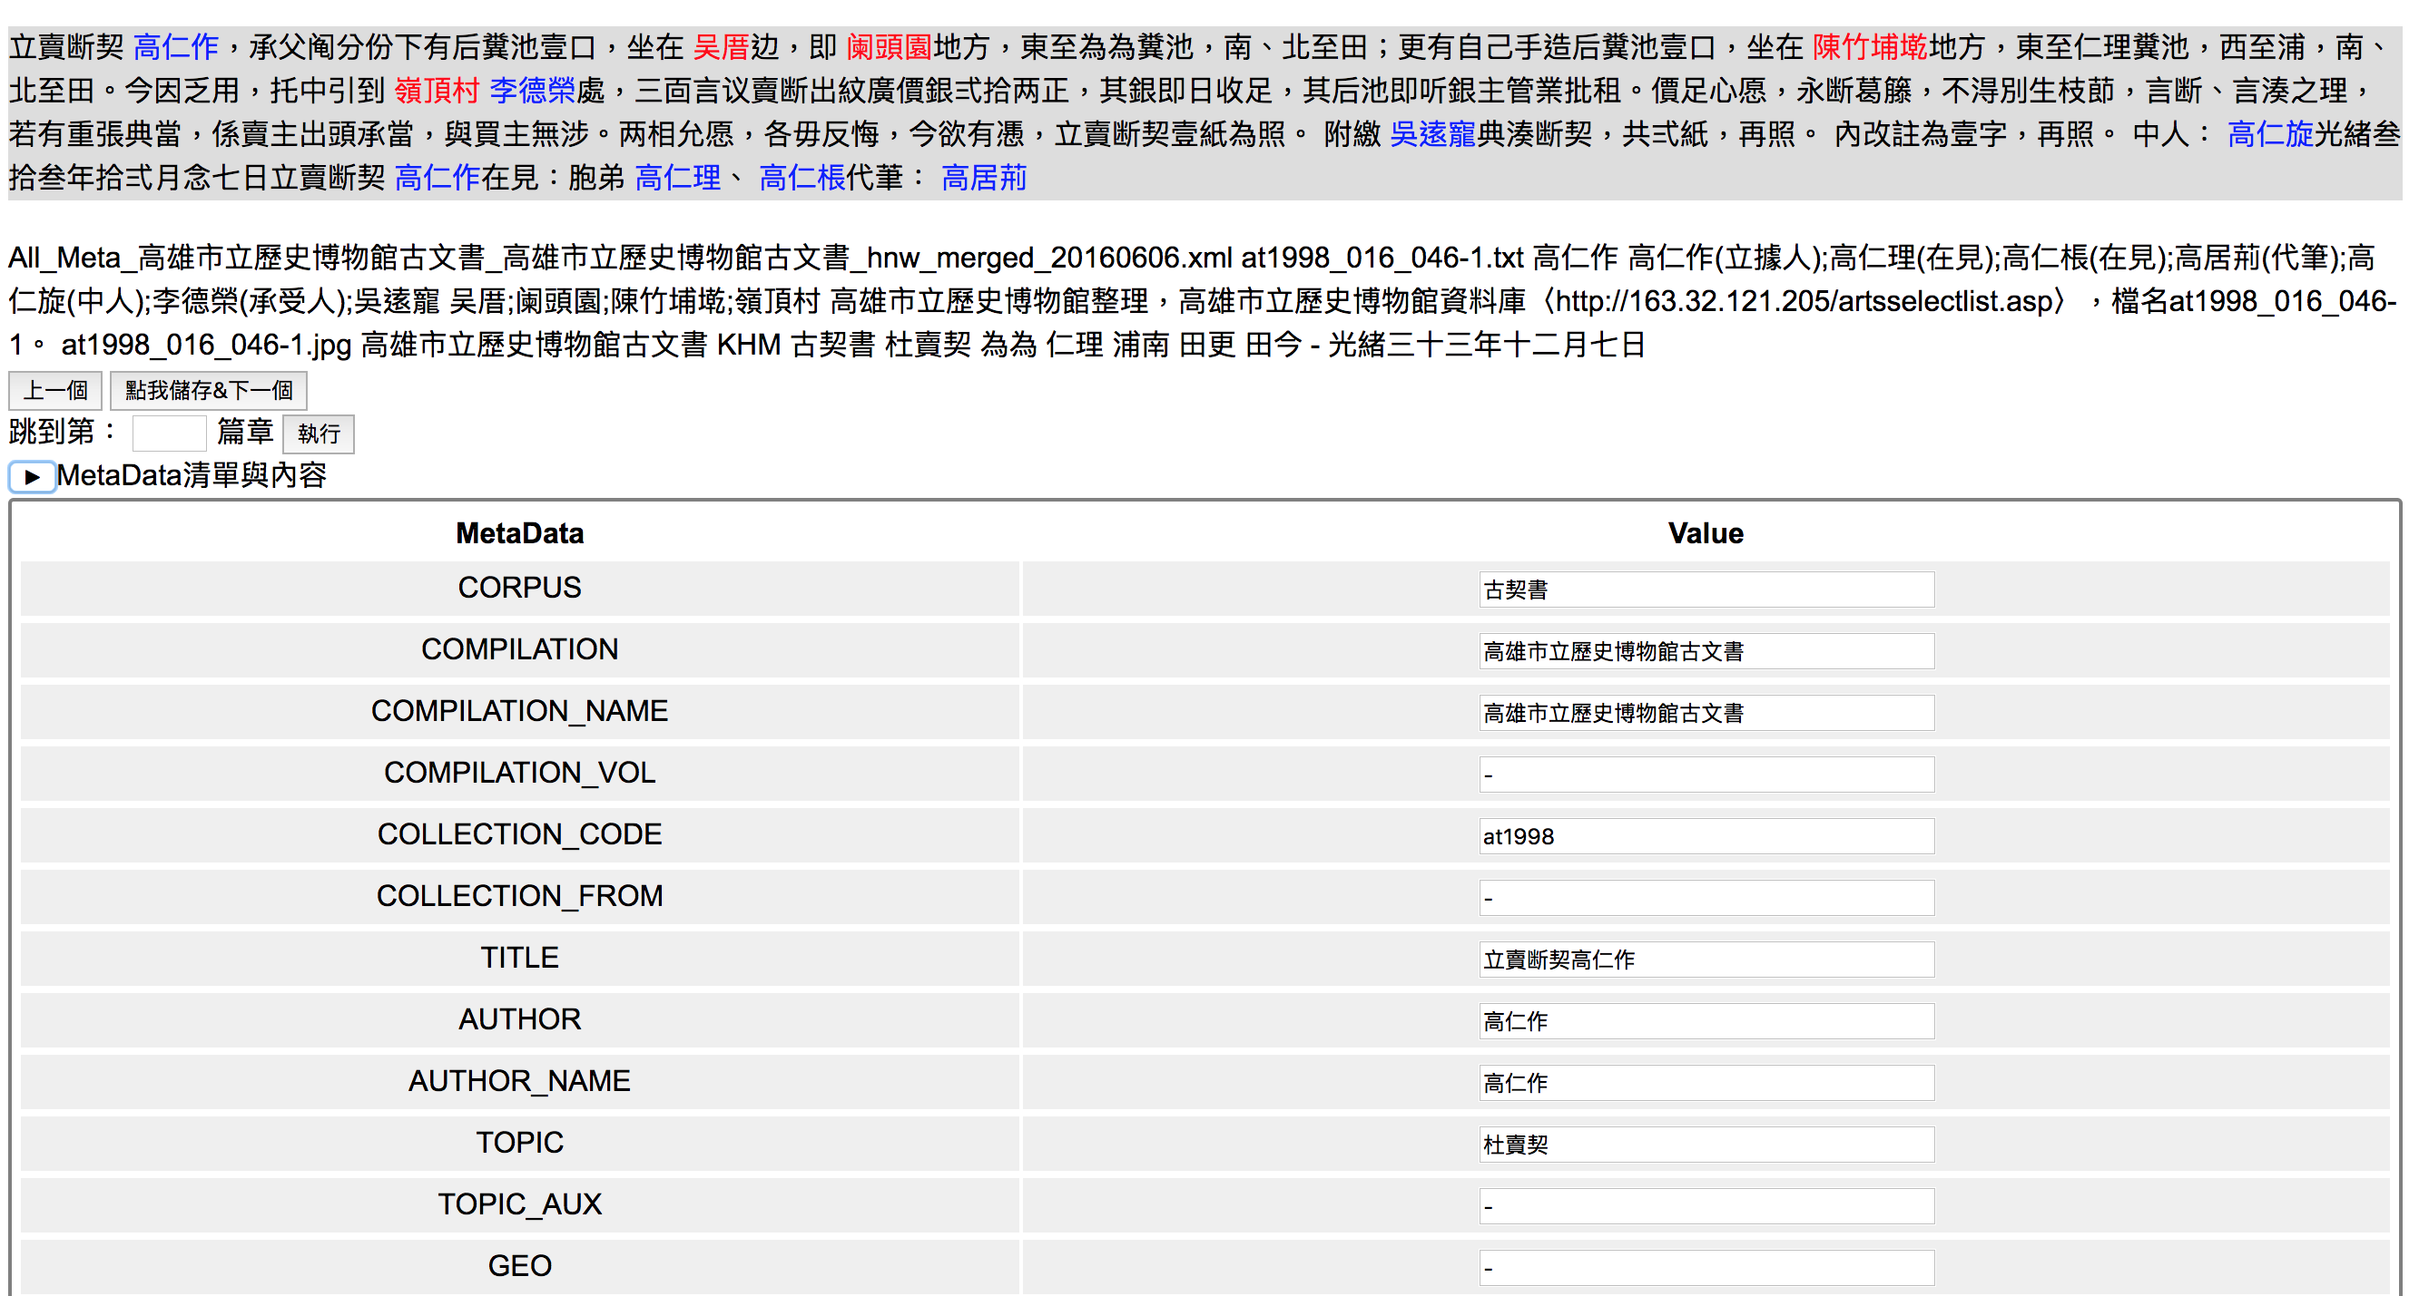
Modify Metadata

Slide 15
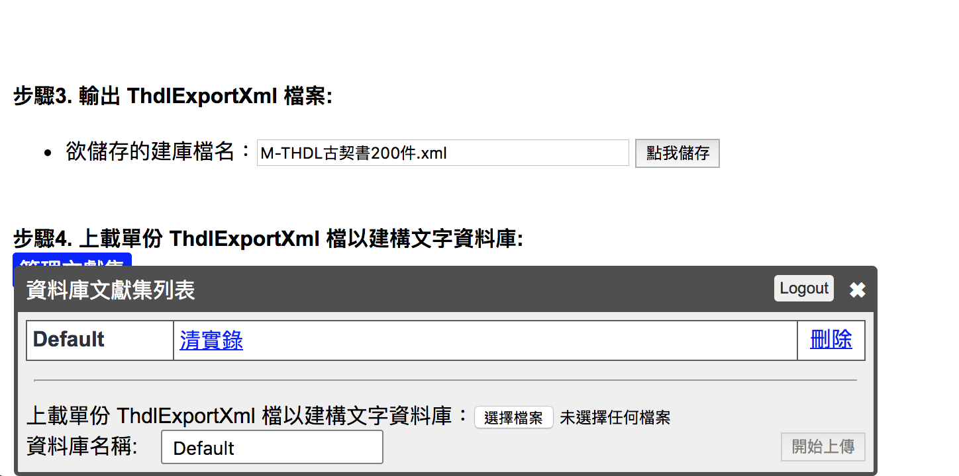
Upload to DocuSky

Slide 16
Thank you

