Slide 1


那些甜食與他們的產地
DocuXml Editor
史萊姆 國王
Advisor: Prof. Hsiang, Jieh @RCDH & CSIE, NTU
Student: Huang, Chih-Yang @CS, Utaipei

Slide 2
Editor Function
More Issue
Future Work

Slide 3
Editor Function
New Tag
Content (Un)Tagging
Tagging with RefId
Search Term on CBDB TWGIS TGAZ
Search and Tag through
New/Modify Metadata
Upload to DocuSky

Slide 4
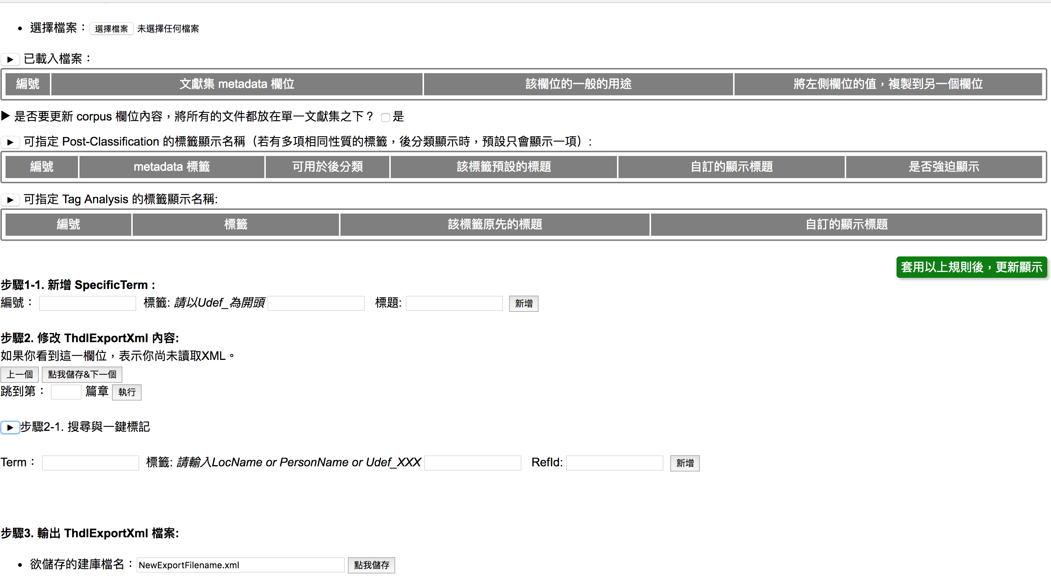
Based on 建庫檔彙整工具(管理Metadata欄位)

Slide 5
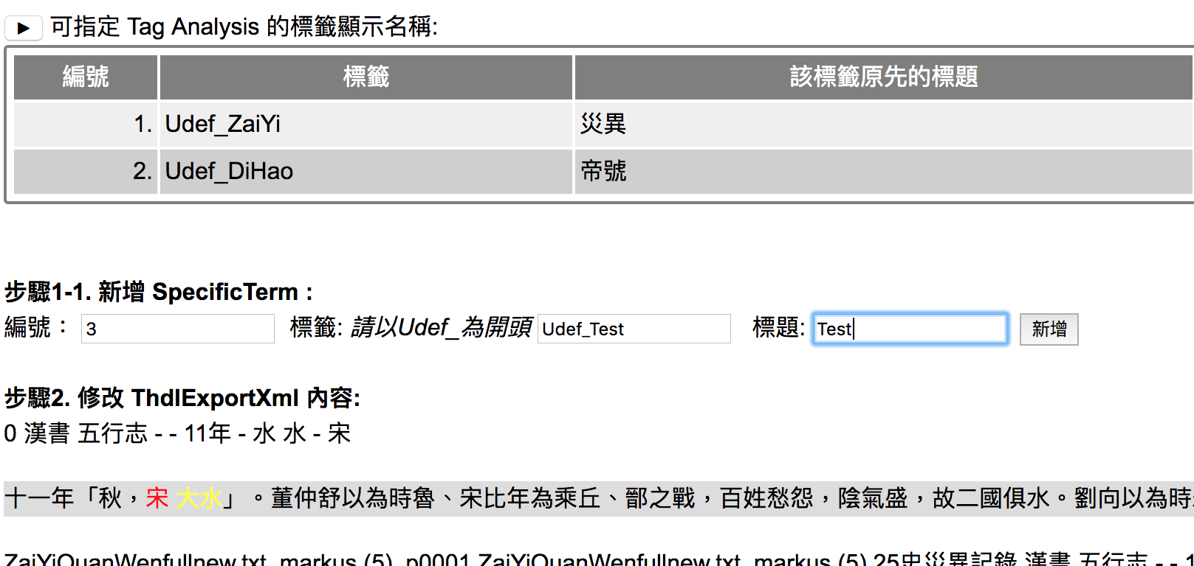
New Tag

Slide 6
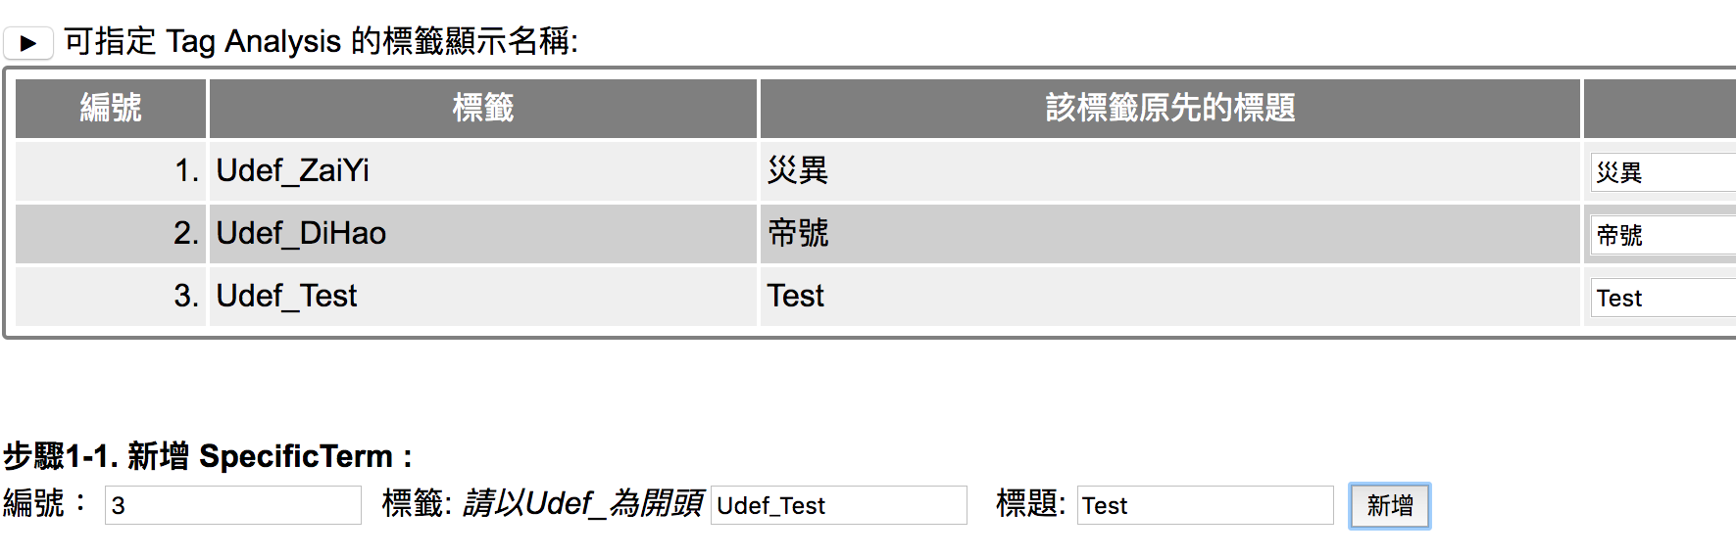
New Tag

Slide 7
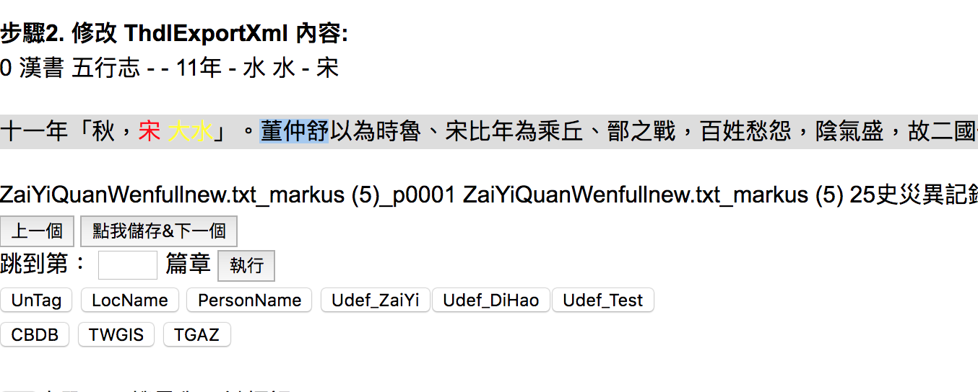
Content (Un)Tagging

Slide 8
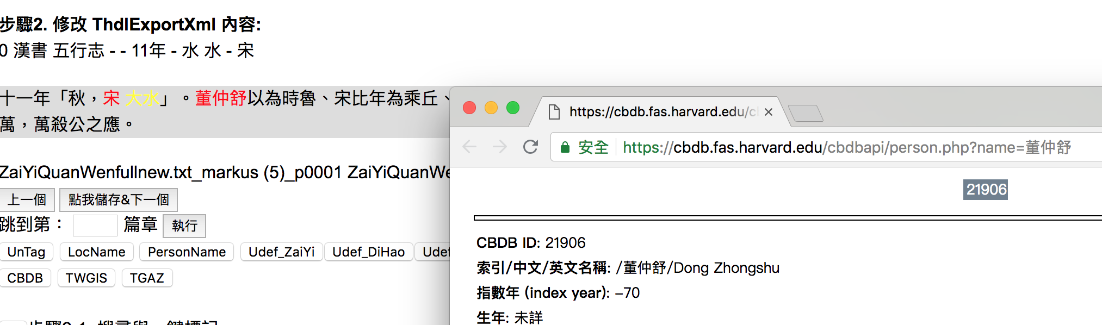
Search Term on CBDB TWGIS TGAZ
3
1
2

Slide 9
Tagging with RefId

Slide 10
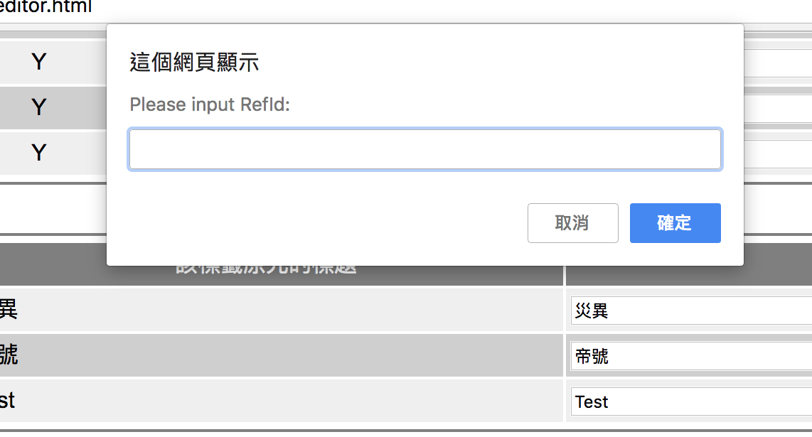
Tagging with RefId

Slide 11
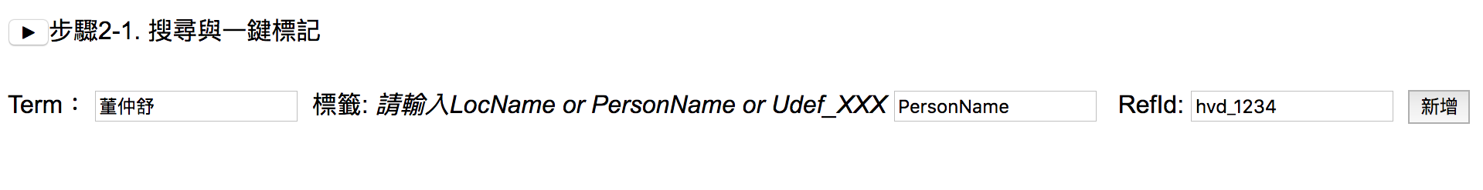
Search and Tag through
1
2
3 (optional)

Slide 12
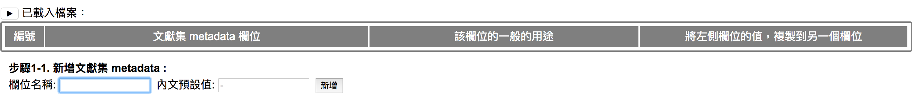
New Metadata

Slide 13
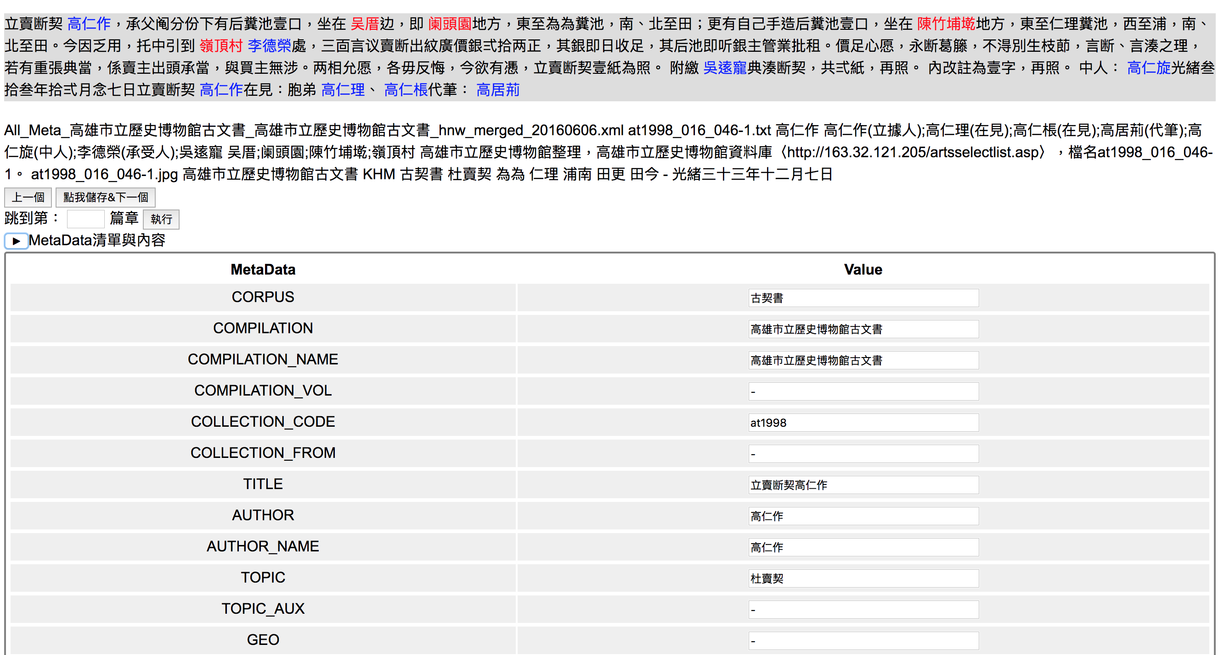
Modify Metadata

Slide 14
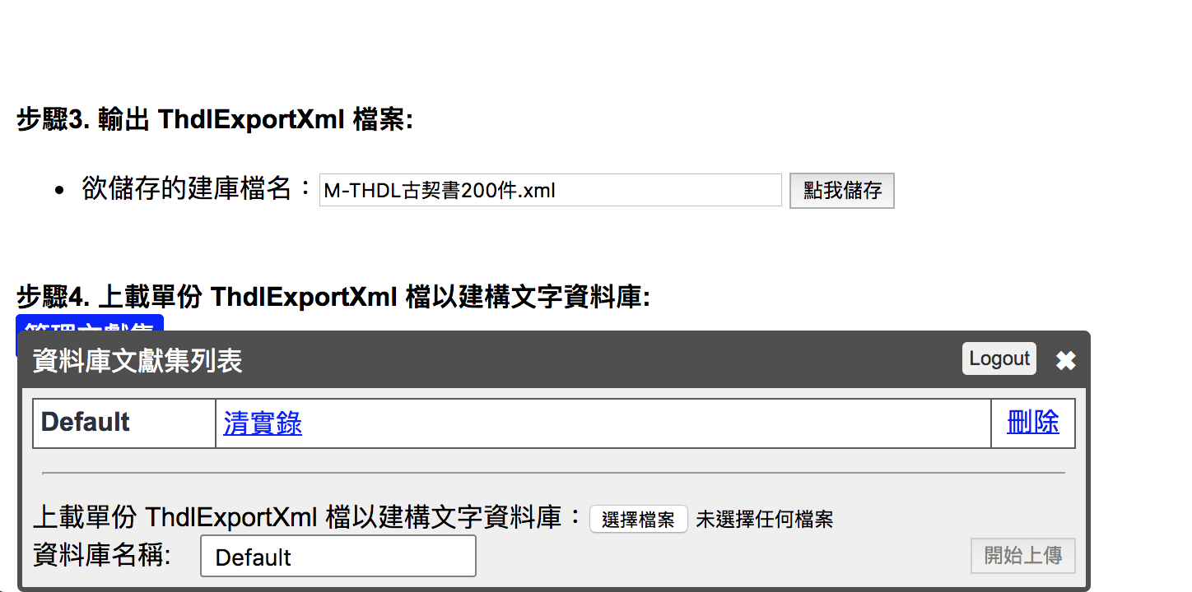
Upload to DocuSky

Slide 15
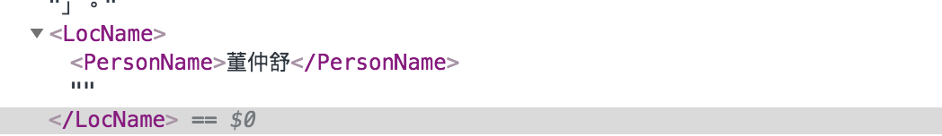
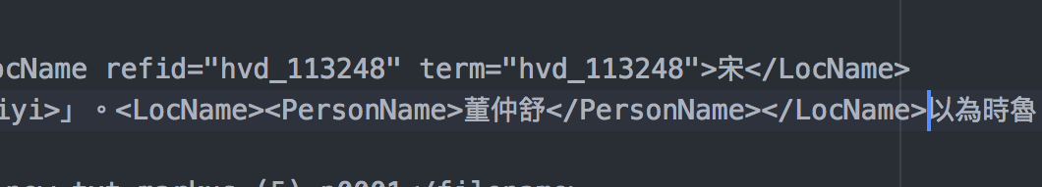
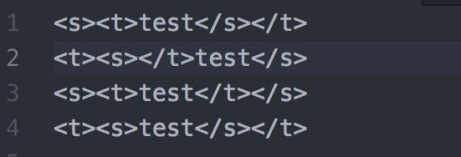
More Issue-Double Tag
⁇

Slide 16
More Issue- upper/lower Case in Xml

Slide 17
More Issue- Multi-Value in Xml

Slide 18
Future Work in August 2018
Convert 淡新檔案 to DocuXml

Slide 19
Thank you

