Slide 1
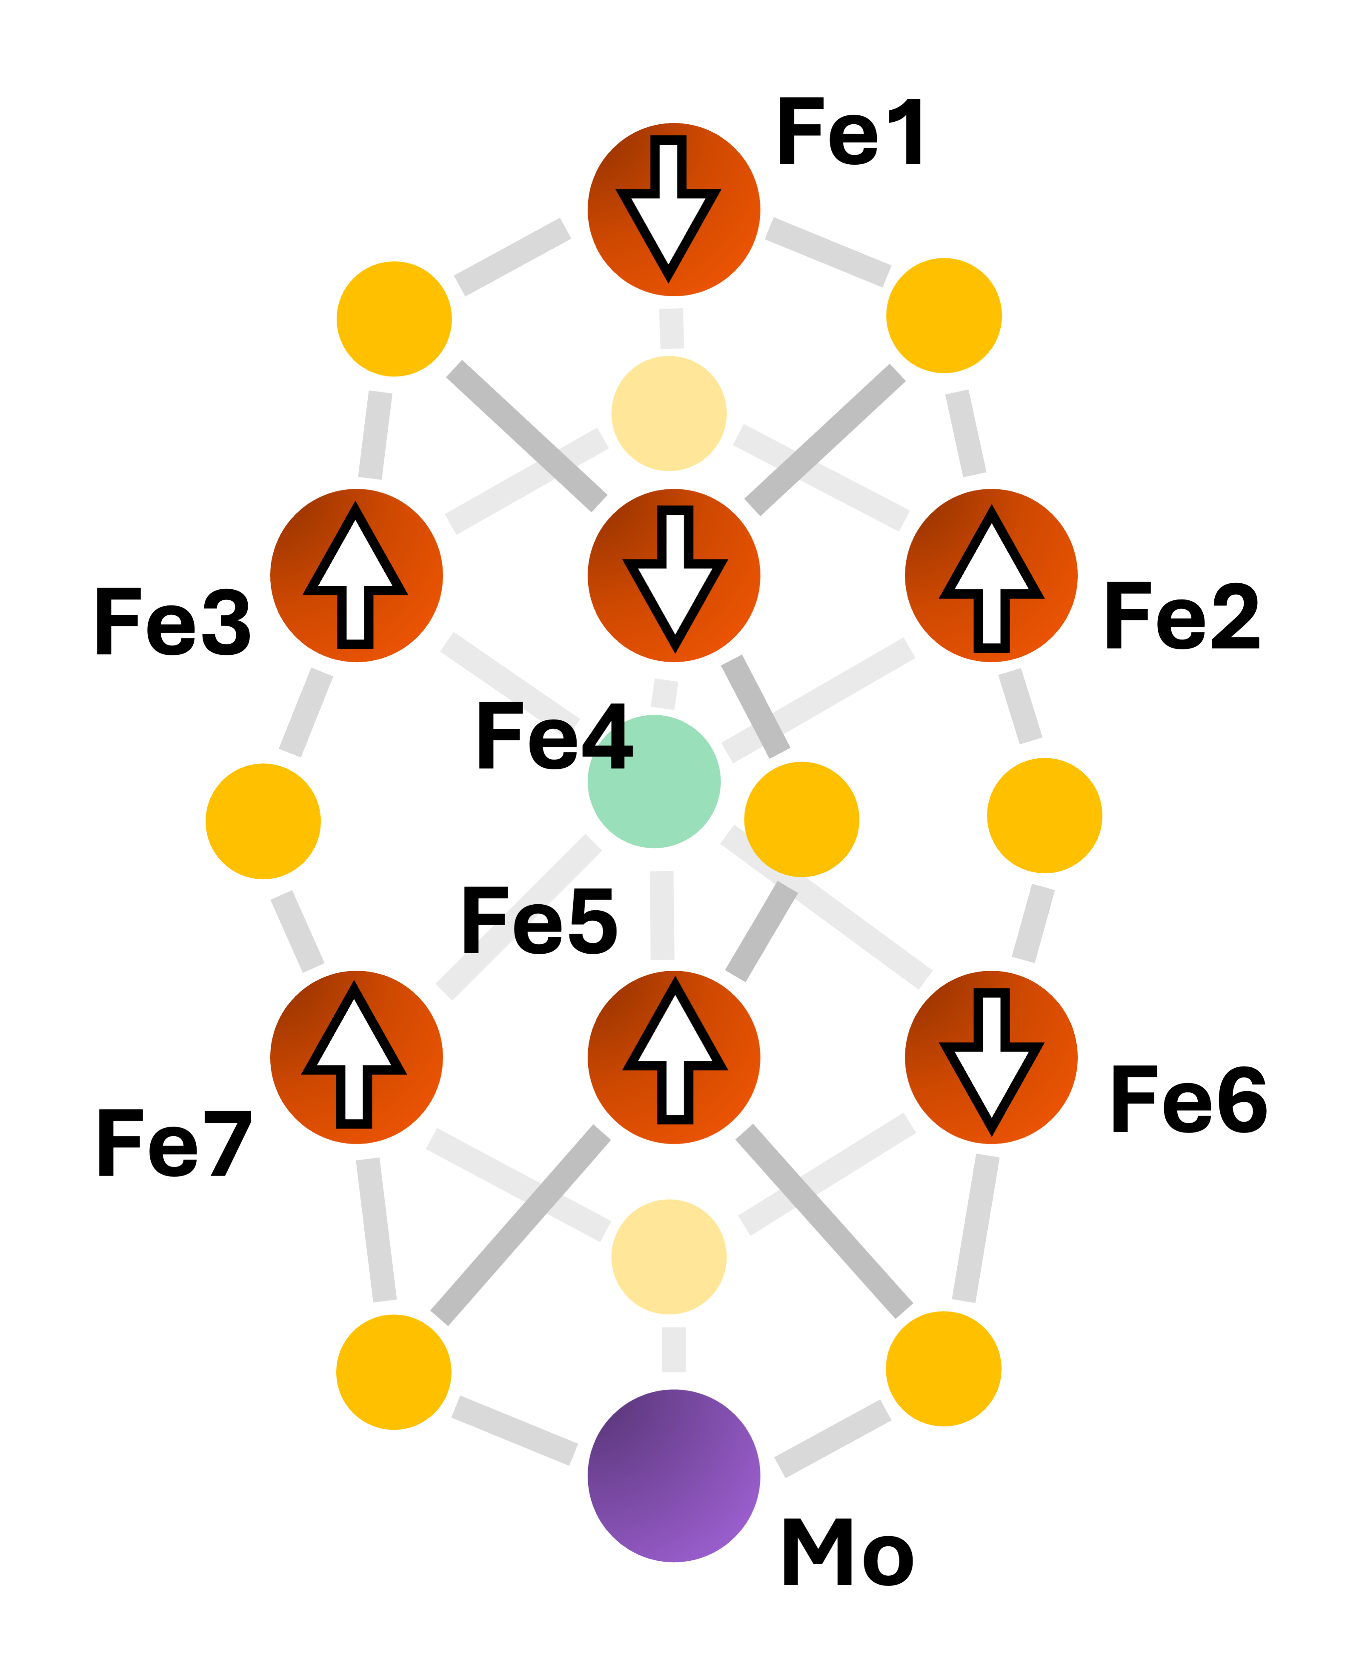


broken symmetry spin isomers
BS10-146
many low lying
electronic
configurations
pure spin isomer tower
tower of states S=1/2, 3/2, 5/2 …
superexchange scale
BS7-346
pure spin isomer tower
double exchange scale
tower of states S=1/2, 3/2, 5/2 …
< 1 kcal/mol
pure spin isomer tower
BS8-237
tower of states S=1/2, 3/2, 5/2 …

