Slide 1
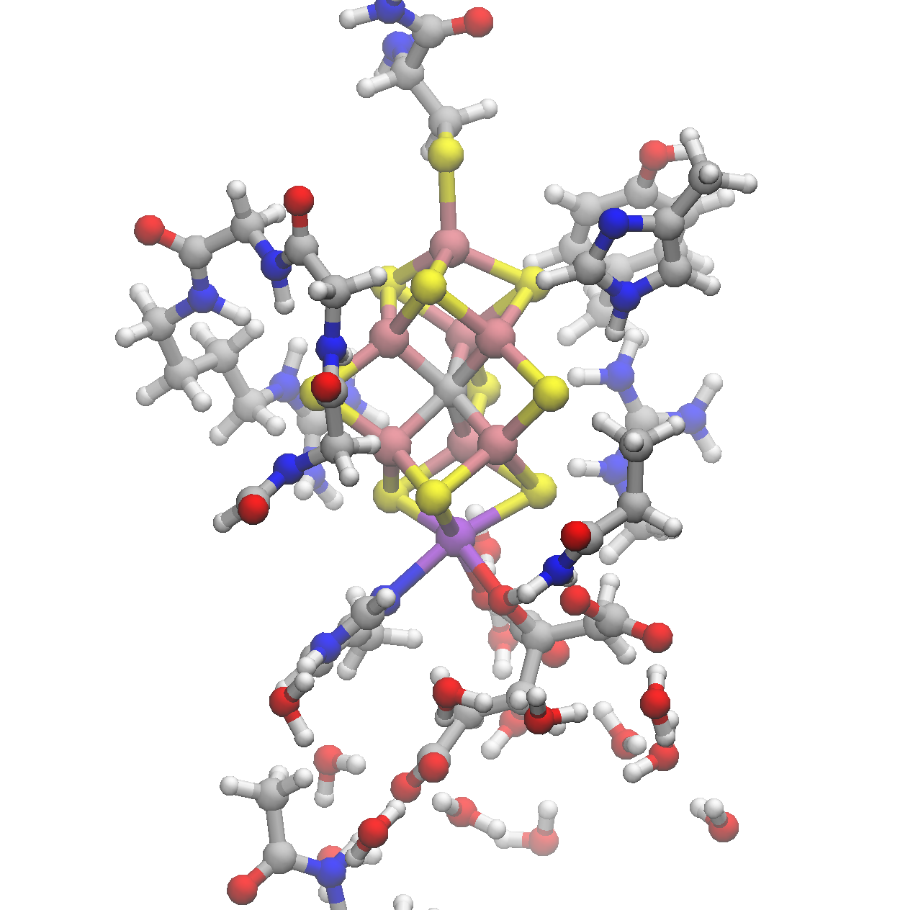
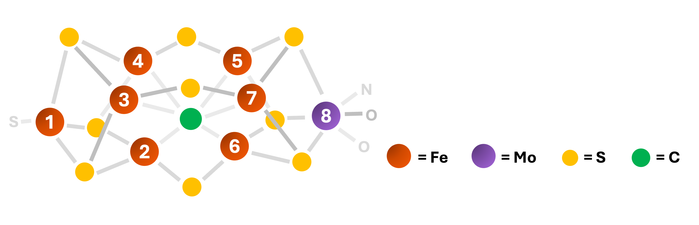
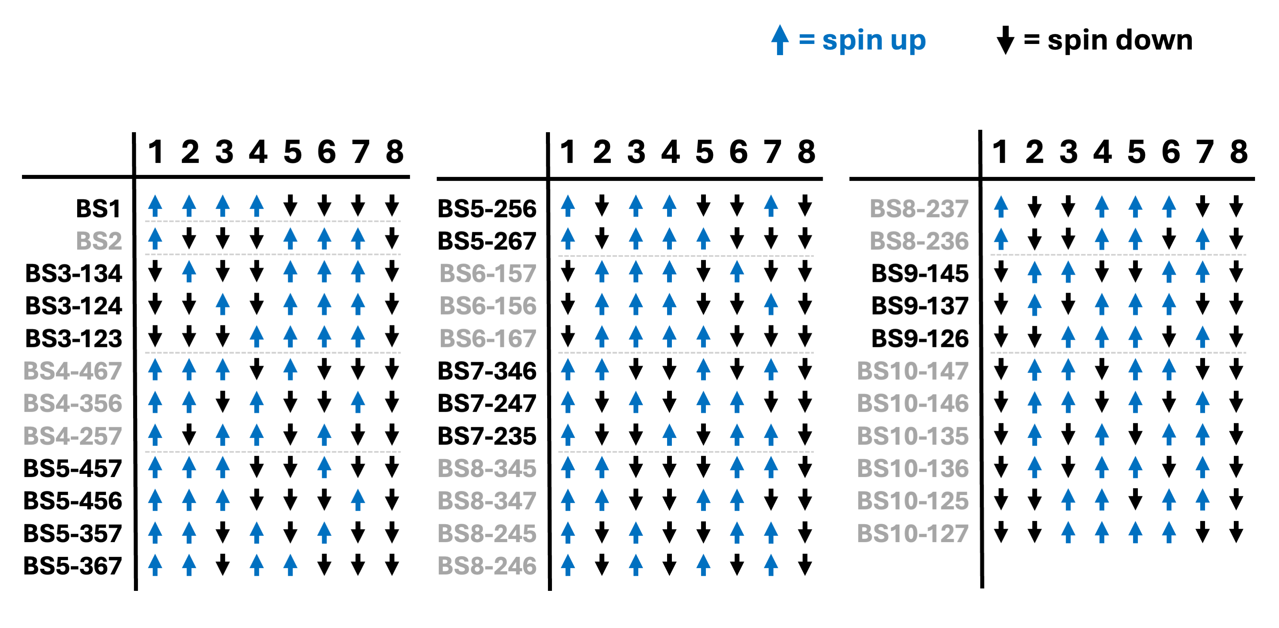
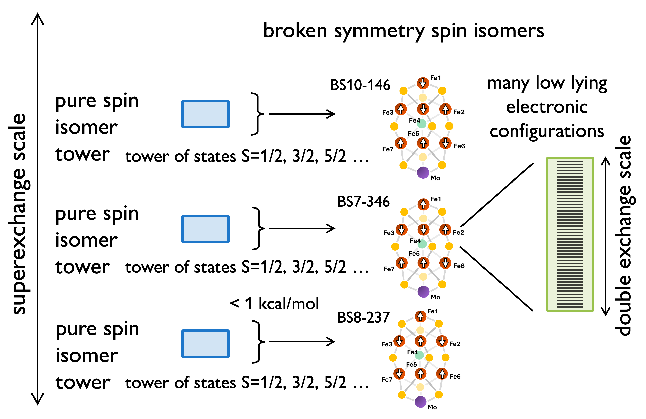
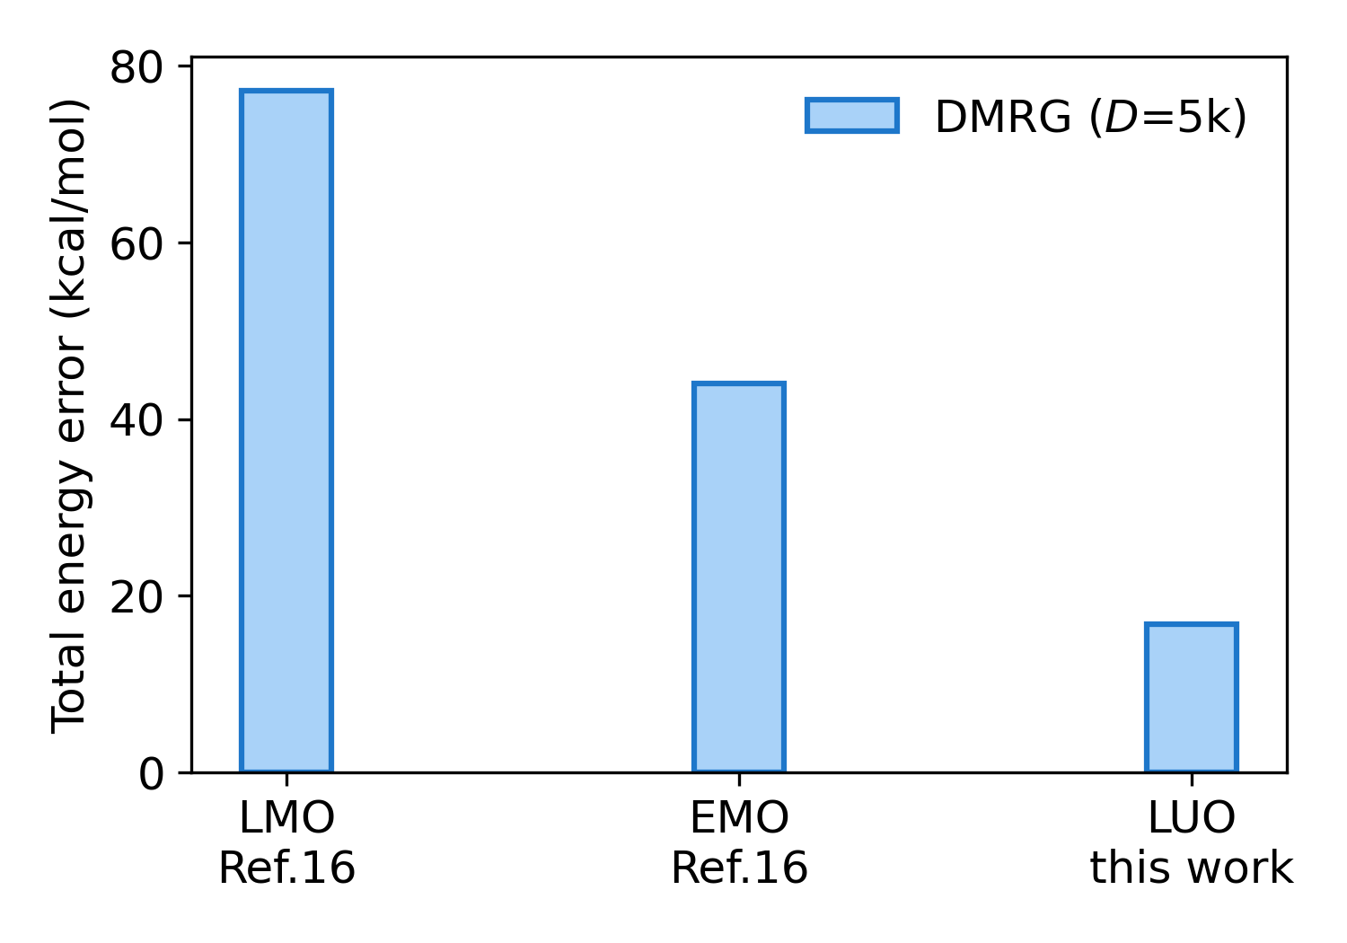
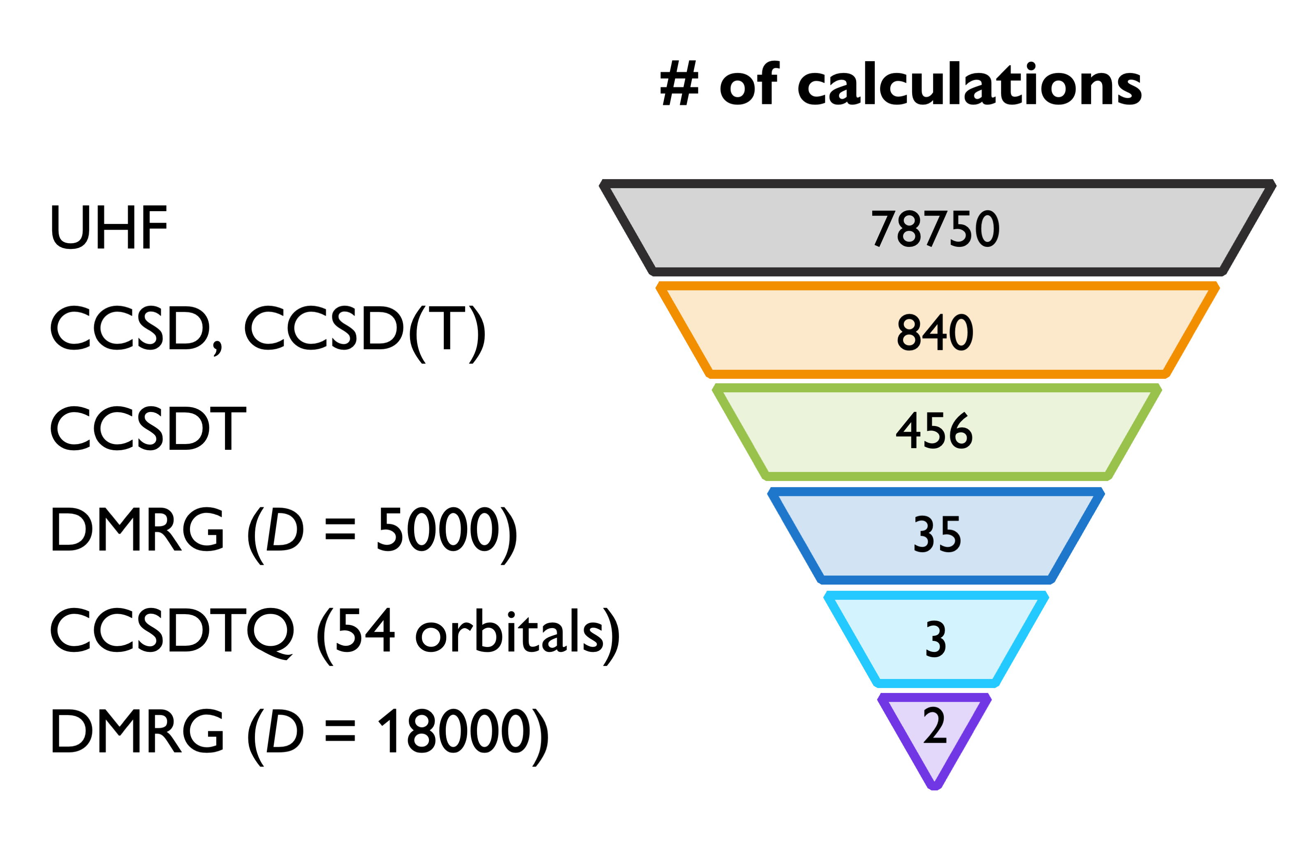
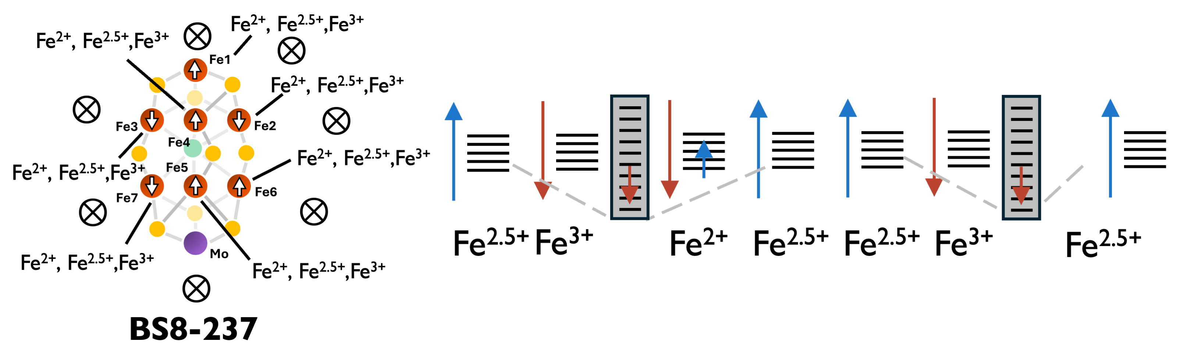
A
B
Cys 275
(113e, 76o) active space model
charge = −1 spin = 3/2
Leu 358
Fe₇MoS₉C
Gly 357
Tyr 229
His 195
broken symmetry initial guesses
from 35 spin couplings
Arg 359
Arg 96
C
Gly 356
Gln 191
His 442
Homocitrate
Gly 424
D
F
E
G

