Slide 1
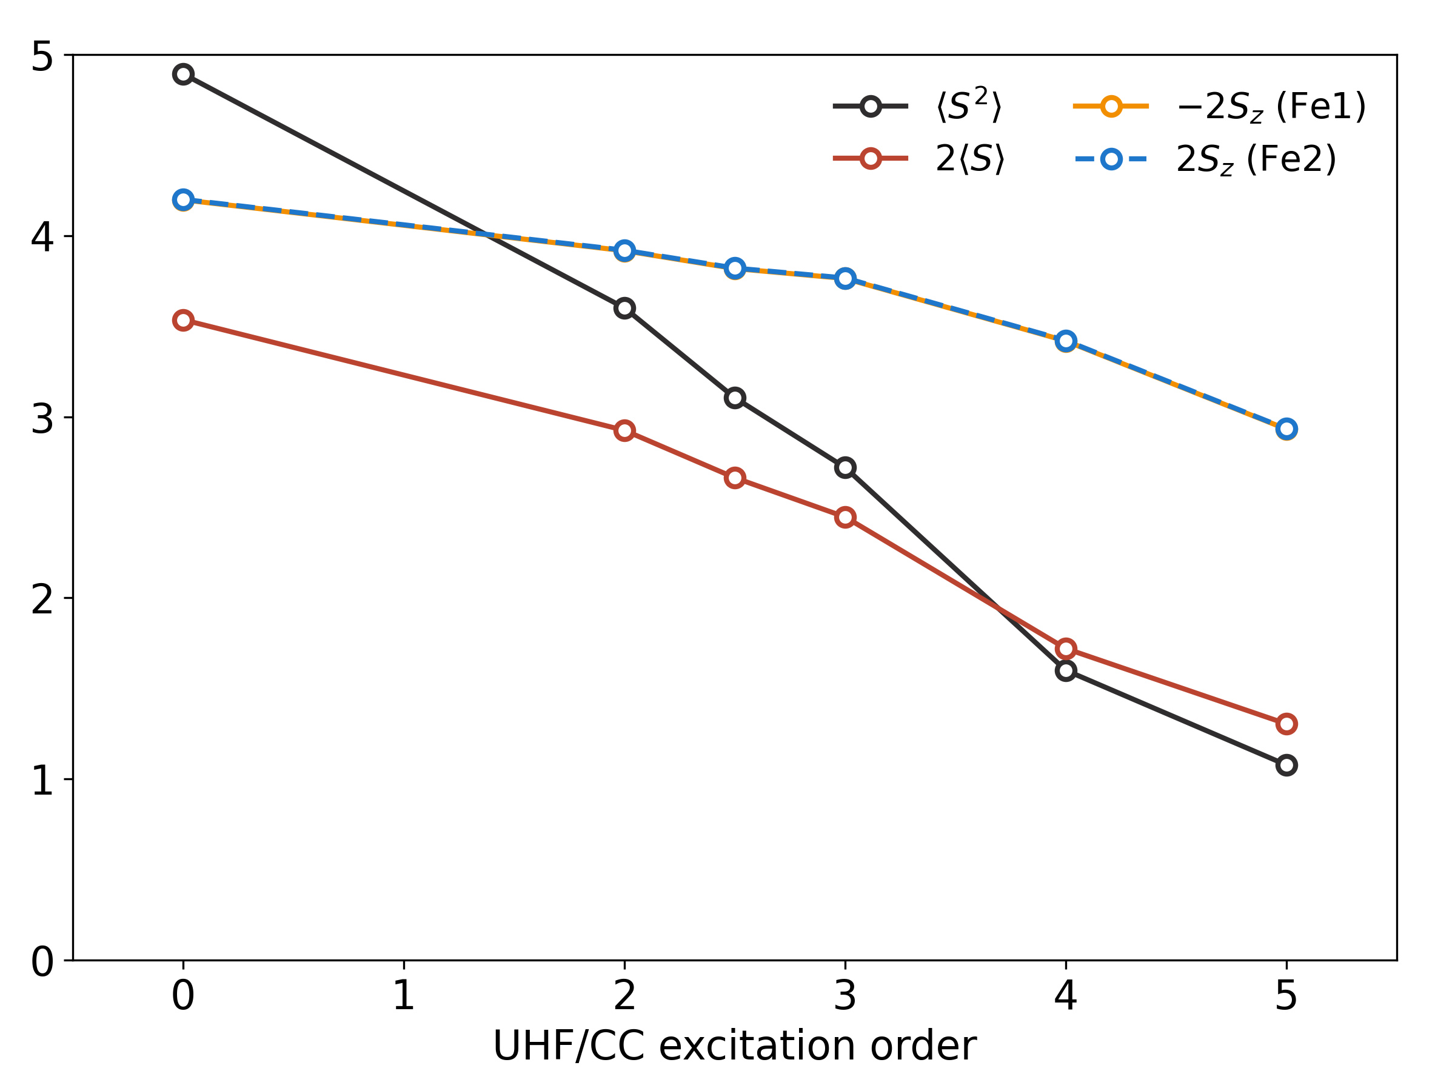
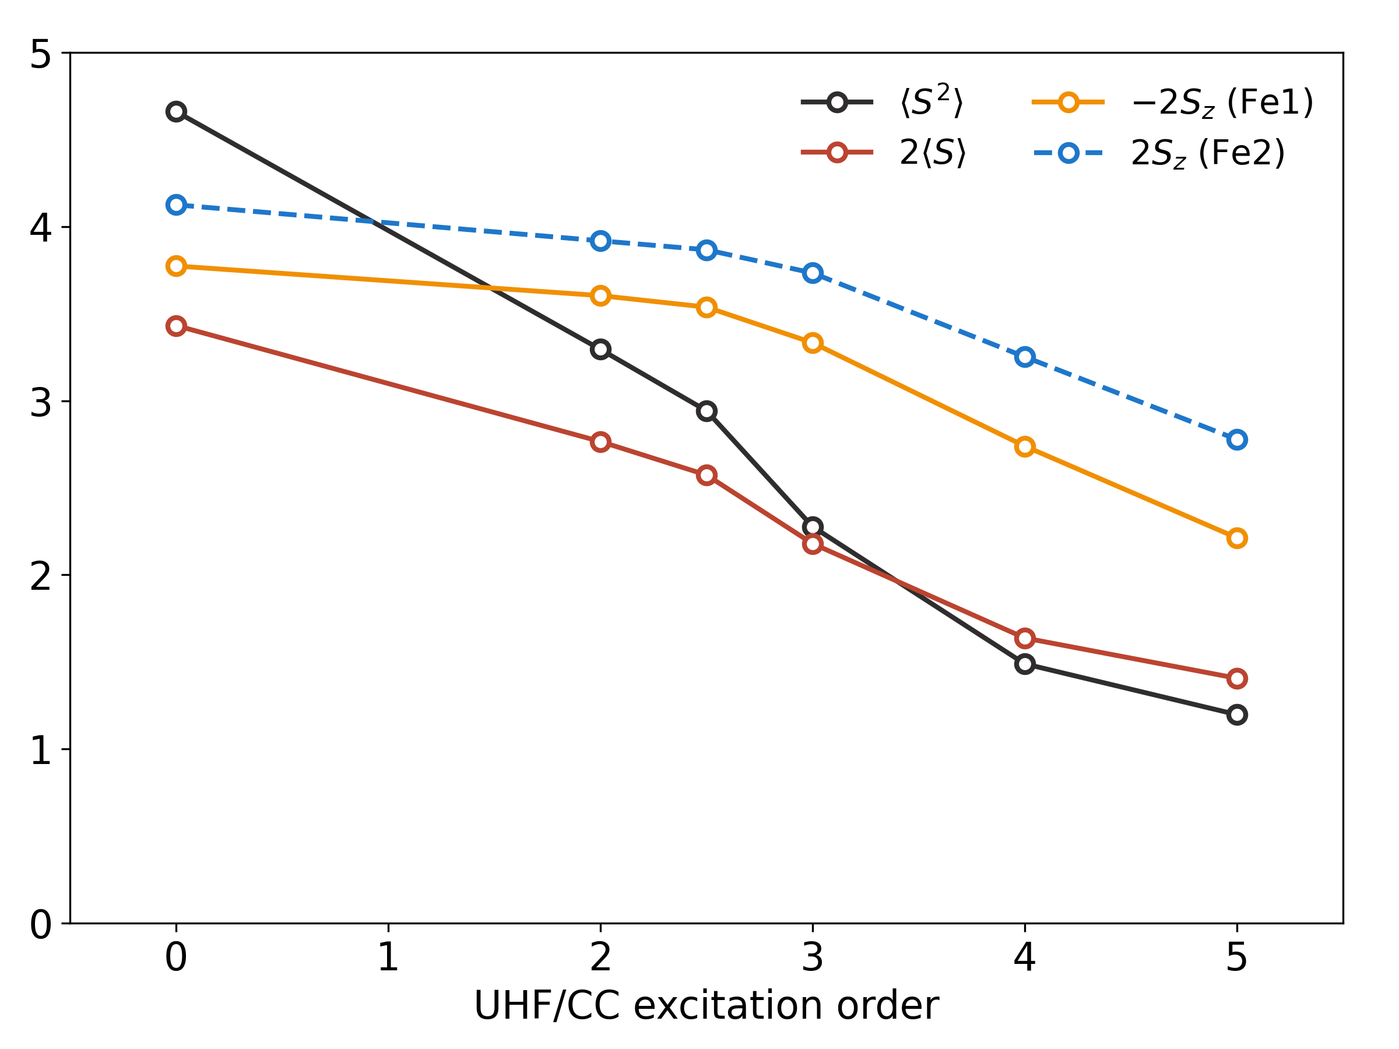
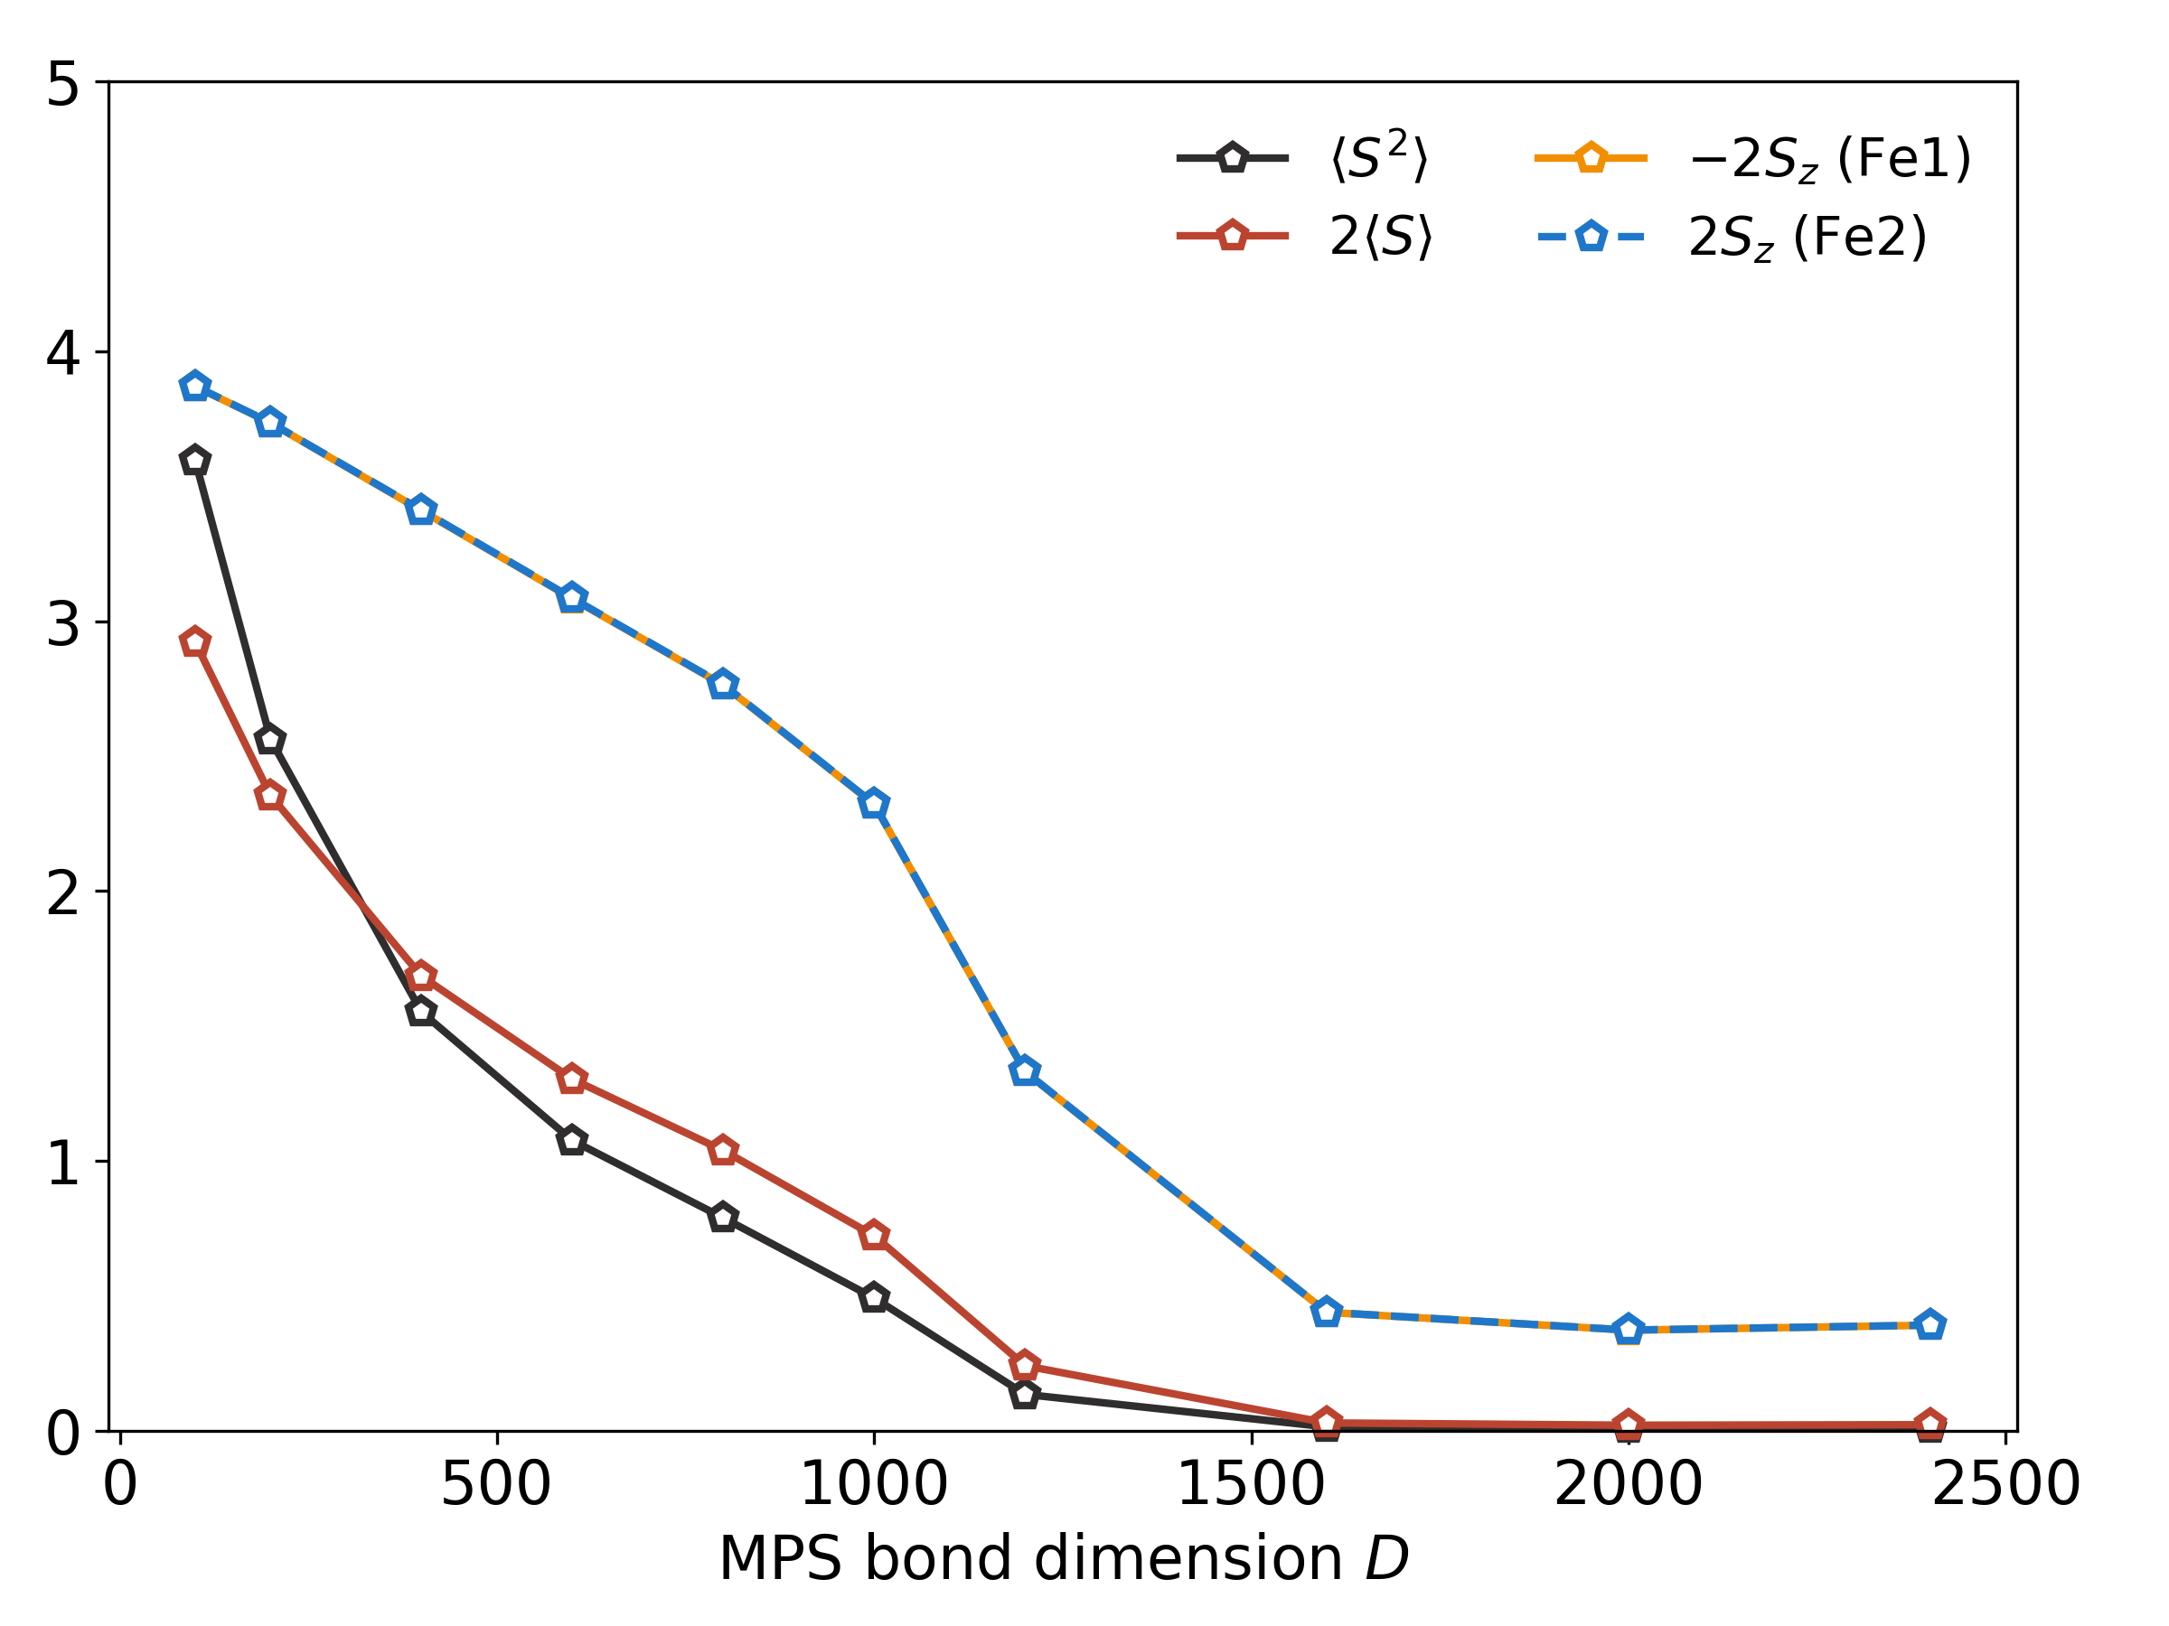
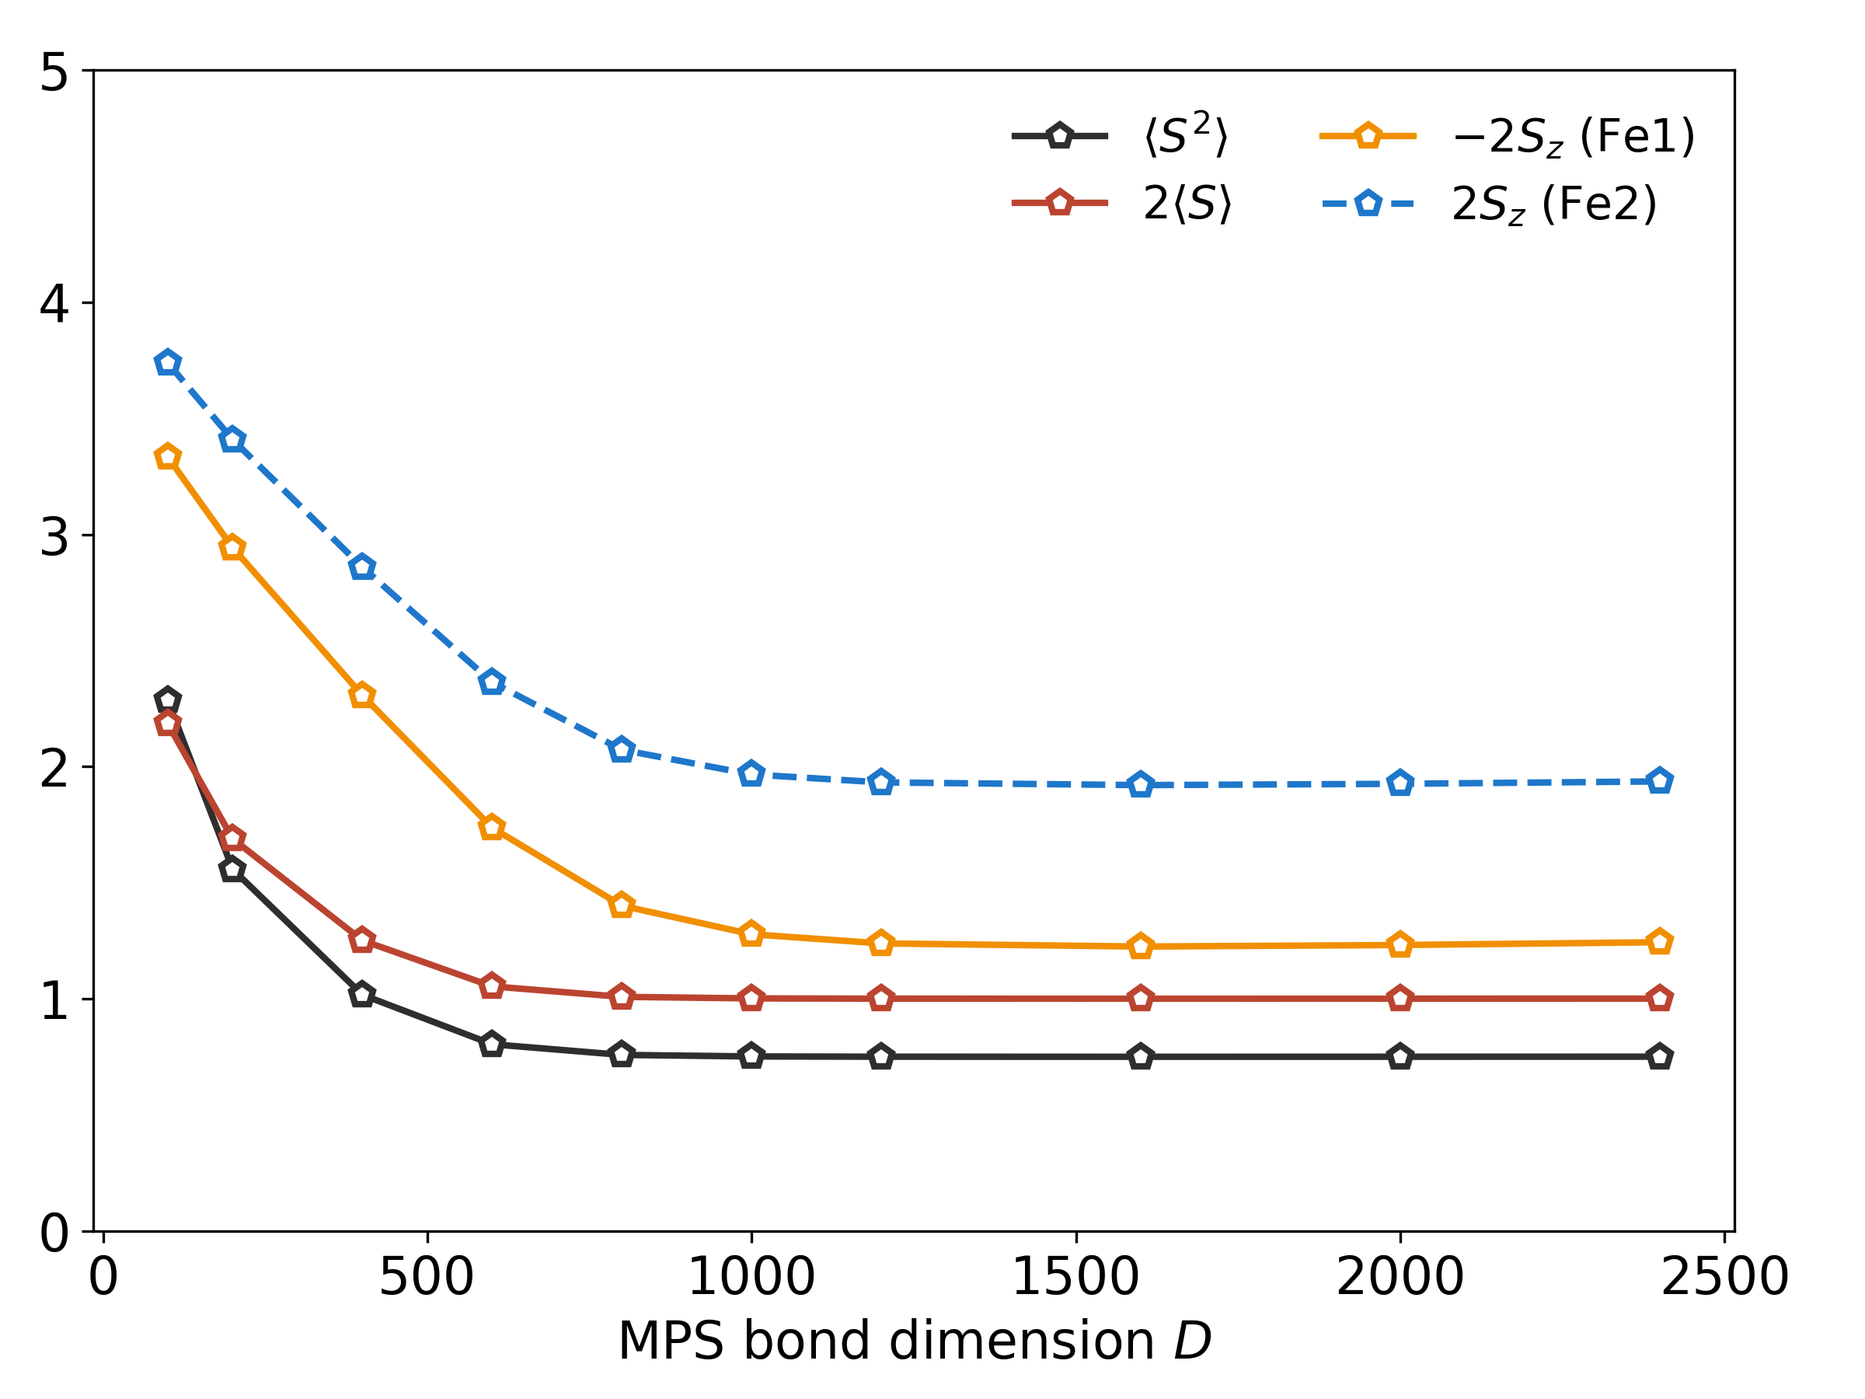
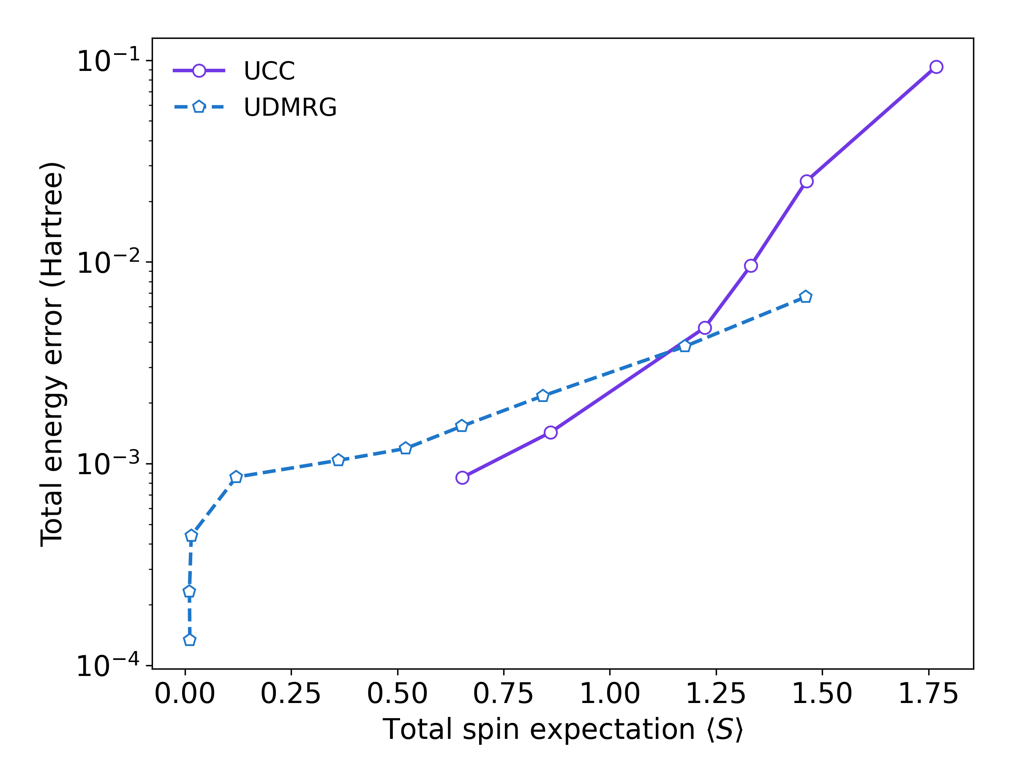
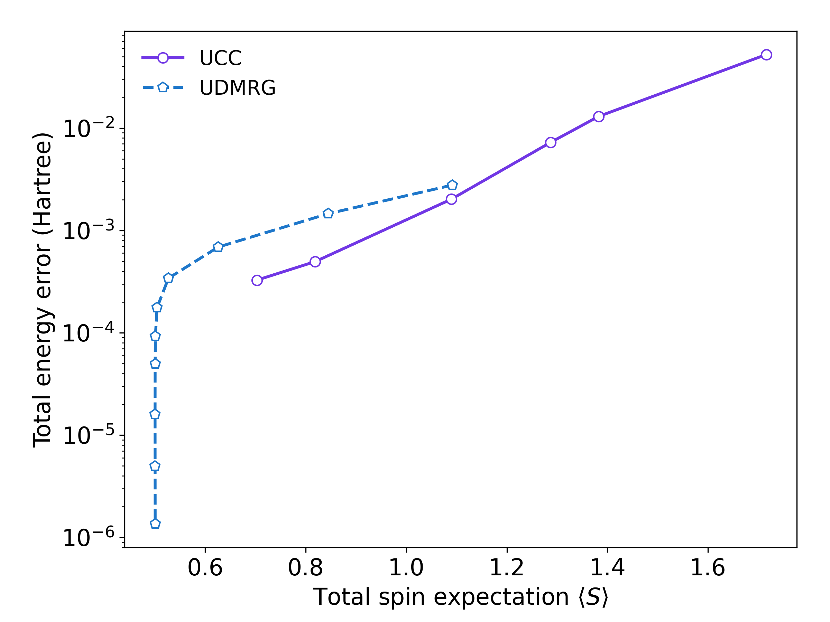
A
B
(20o, 30e) FeIII-FeIII UCC
(20o, 31e) FeIII-FeII UCC
C
D
(20o, 30e) FeIII-FeIII UDMRG
(20o, 31e) FeIII-FeII UDMRG
E
F
(20o, 30e) FeIII-FeIII
(20o, 31e) FeIII-FeII

