Slide 1
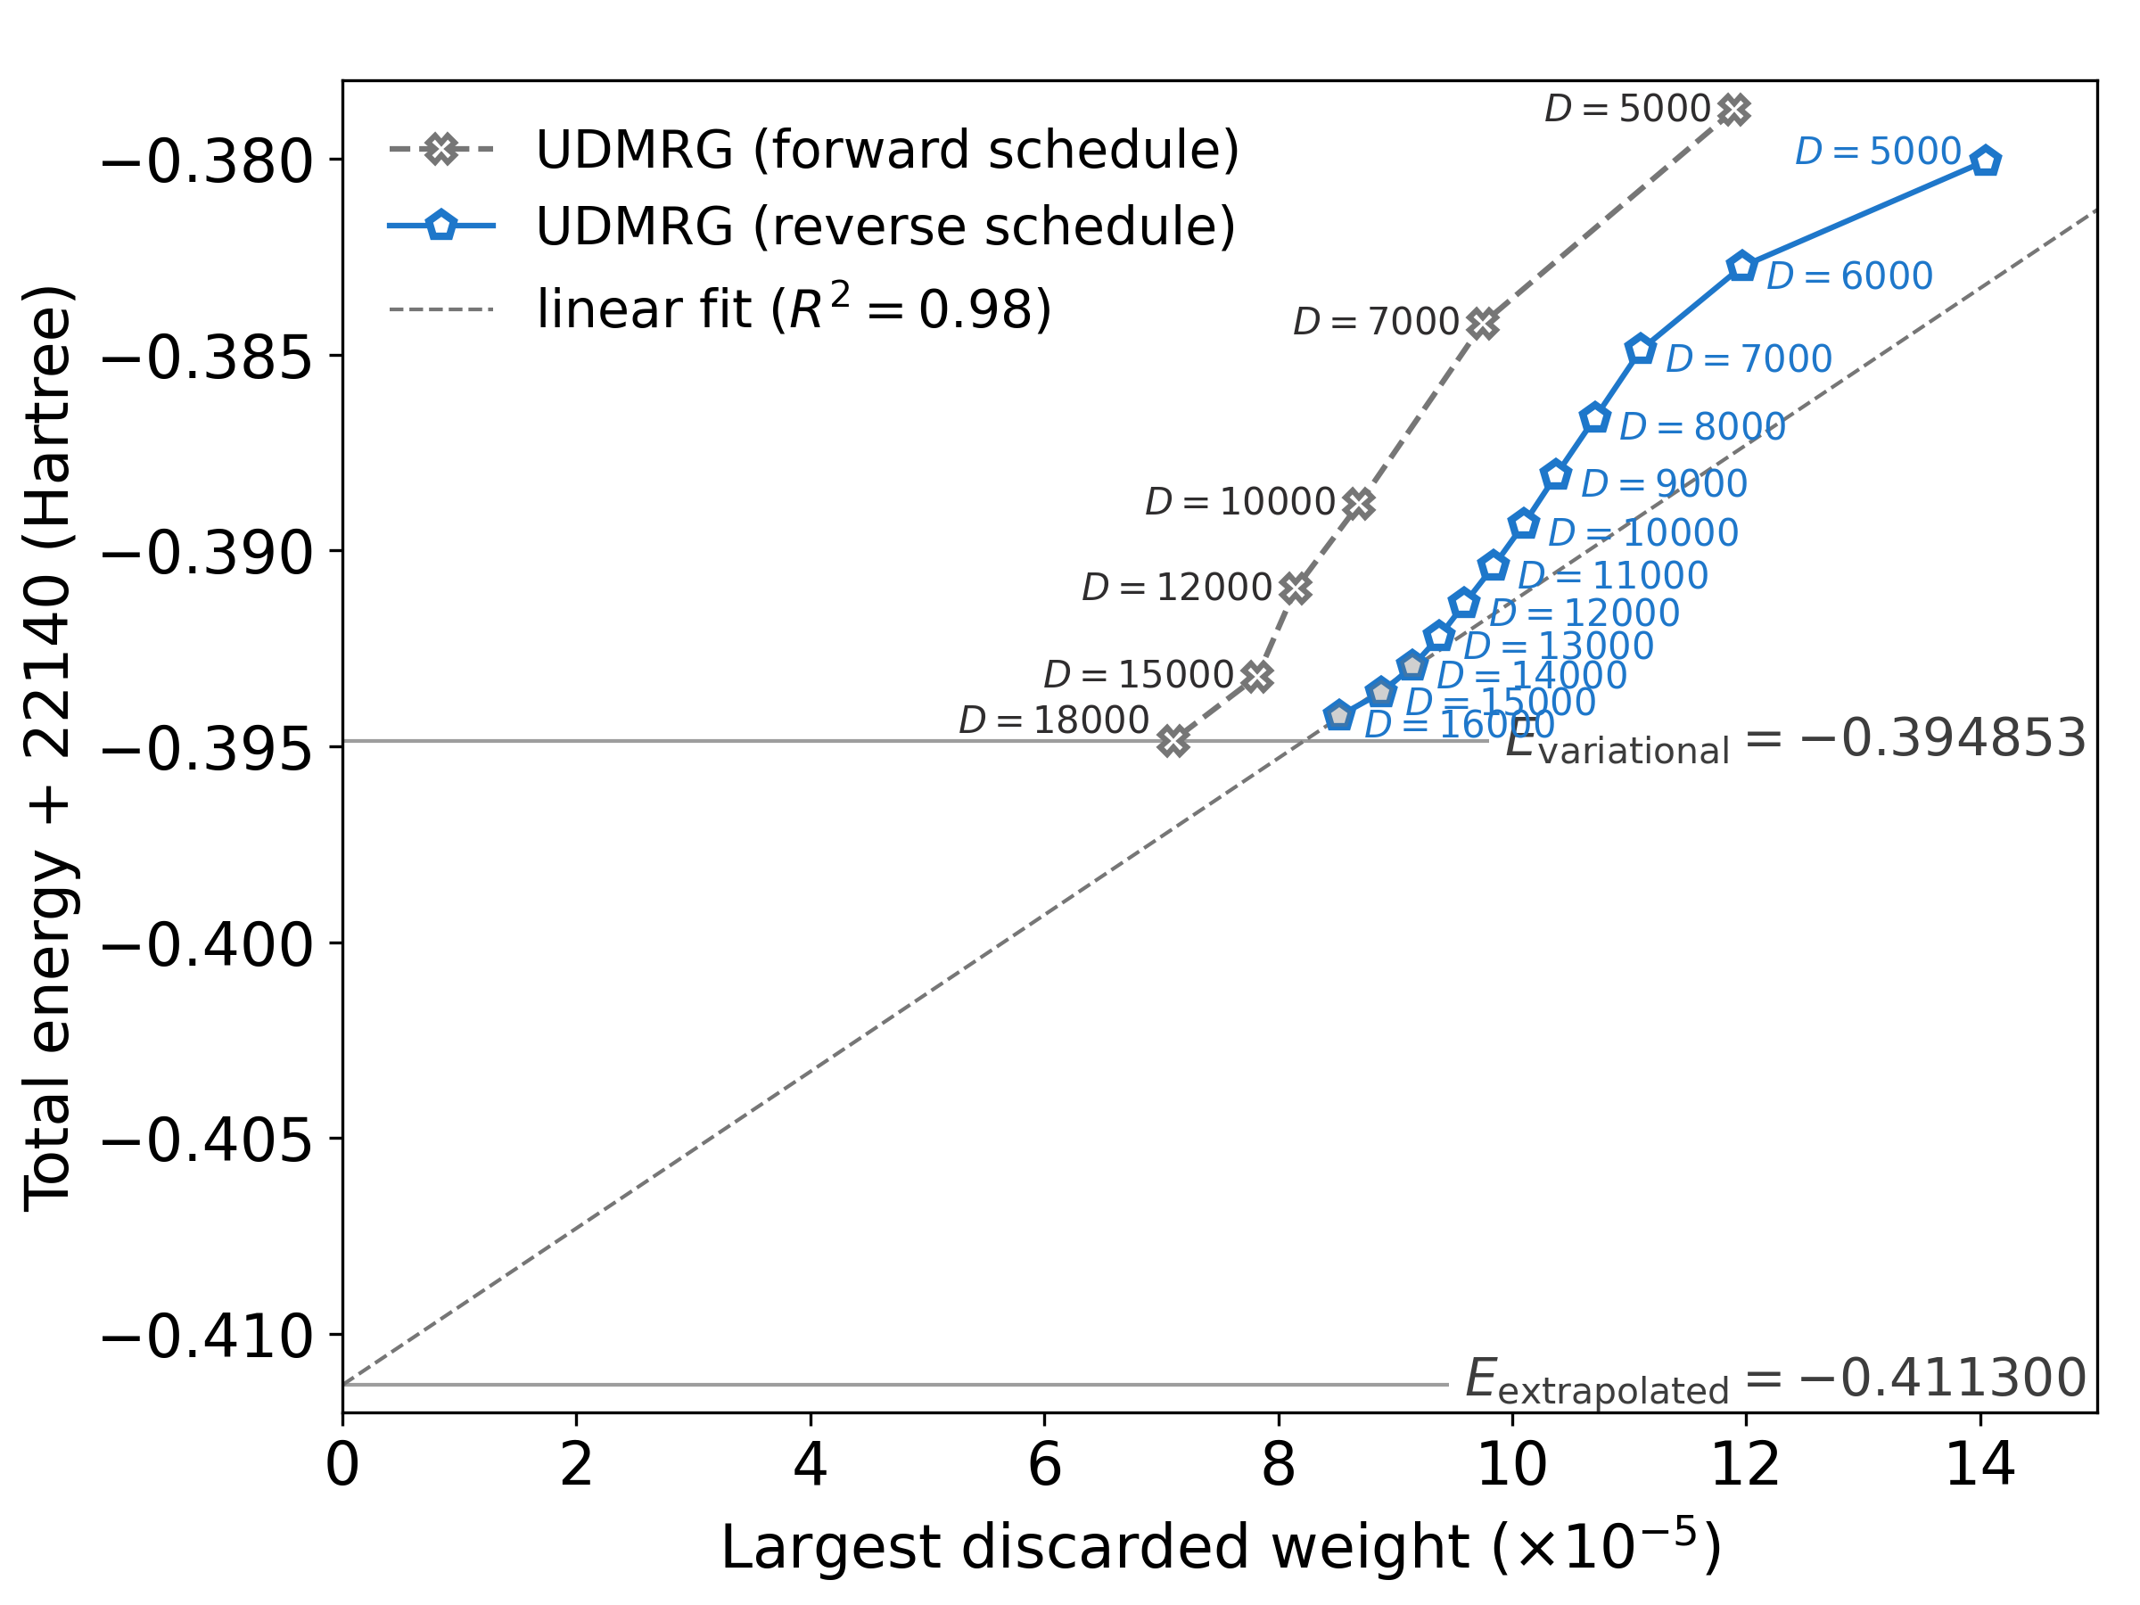
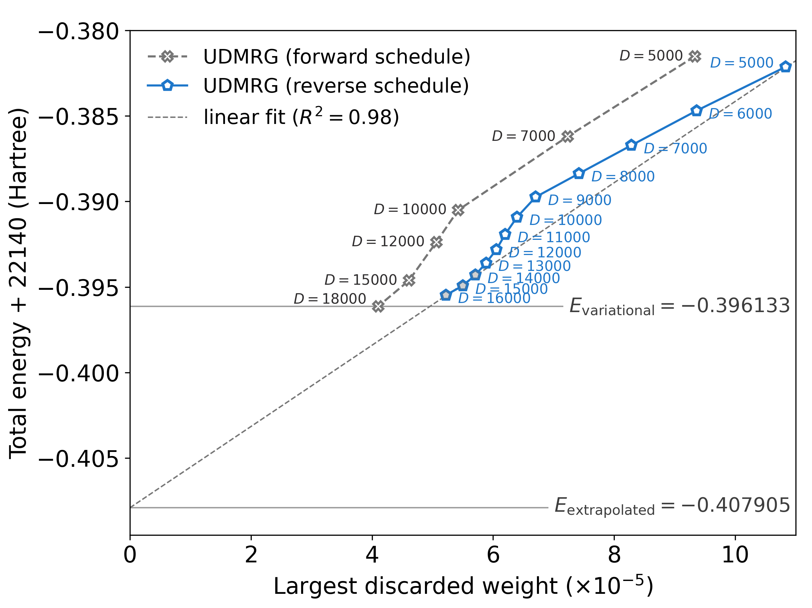
A
B
BS7-C (235)
BS8-E (237)

