Slide 1
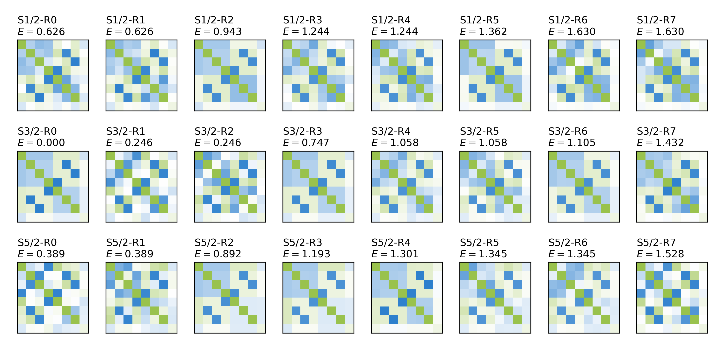
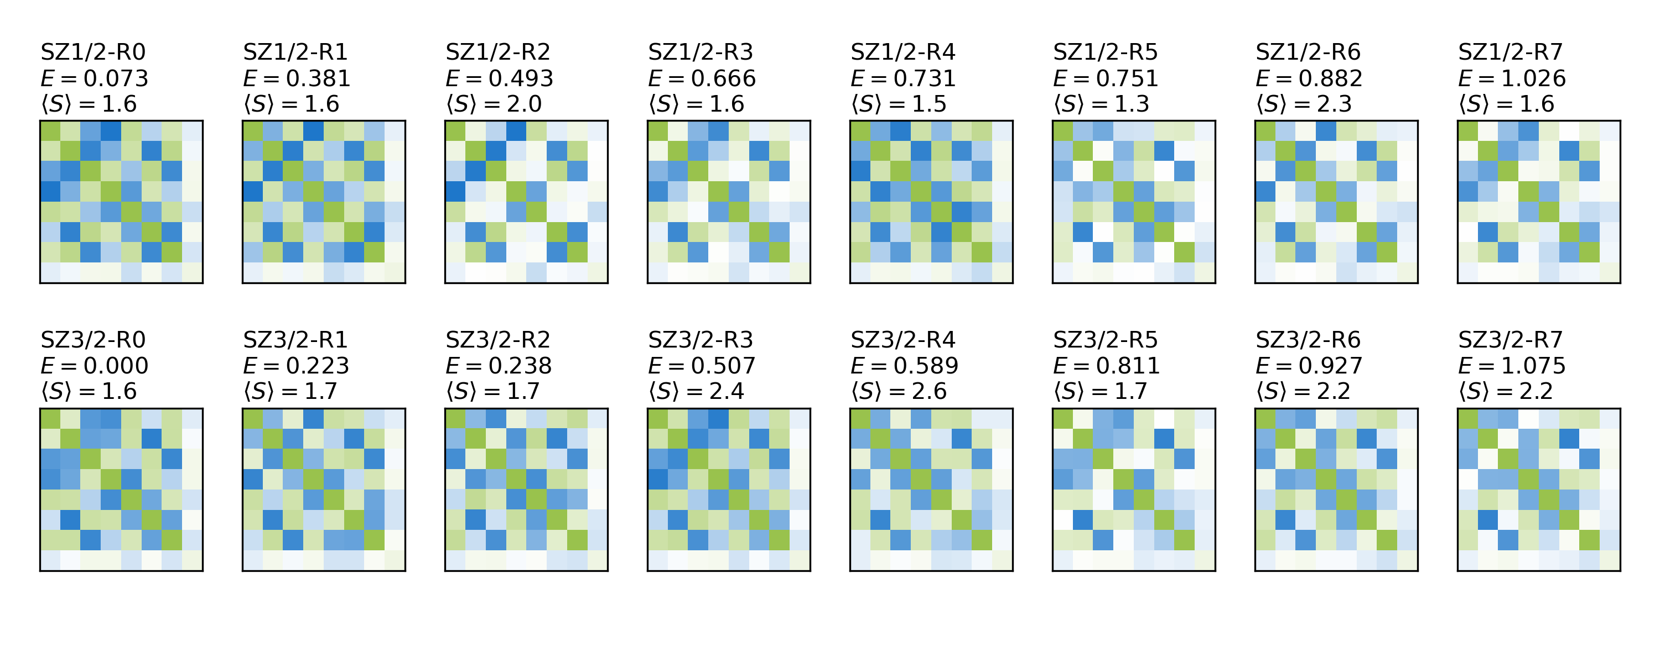
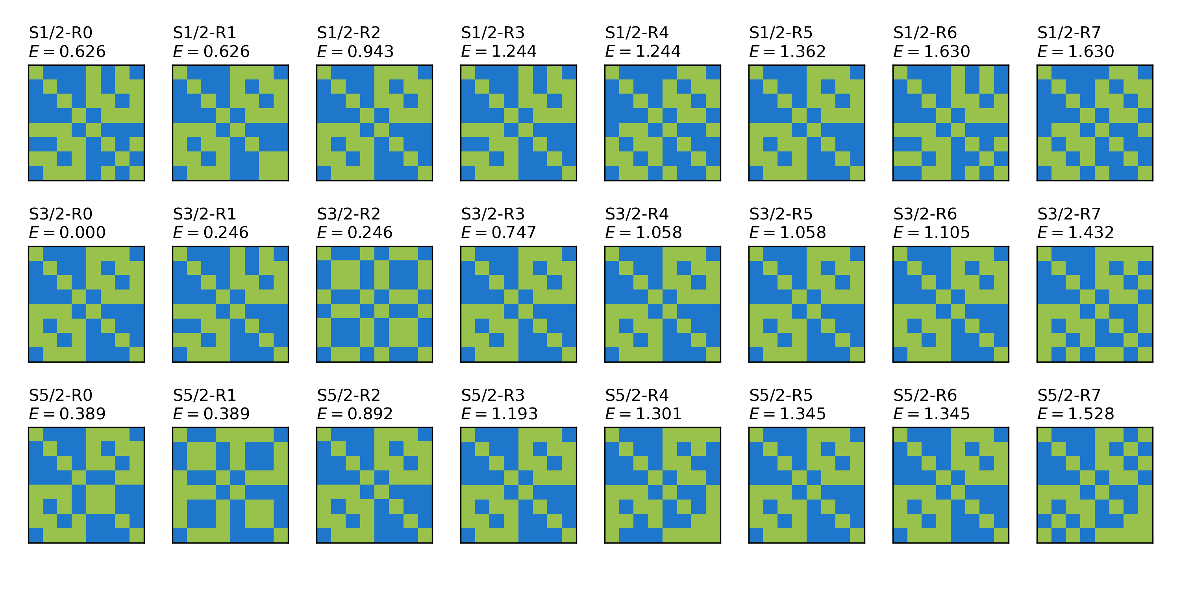
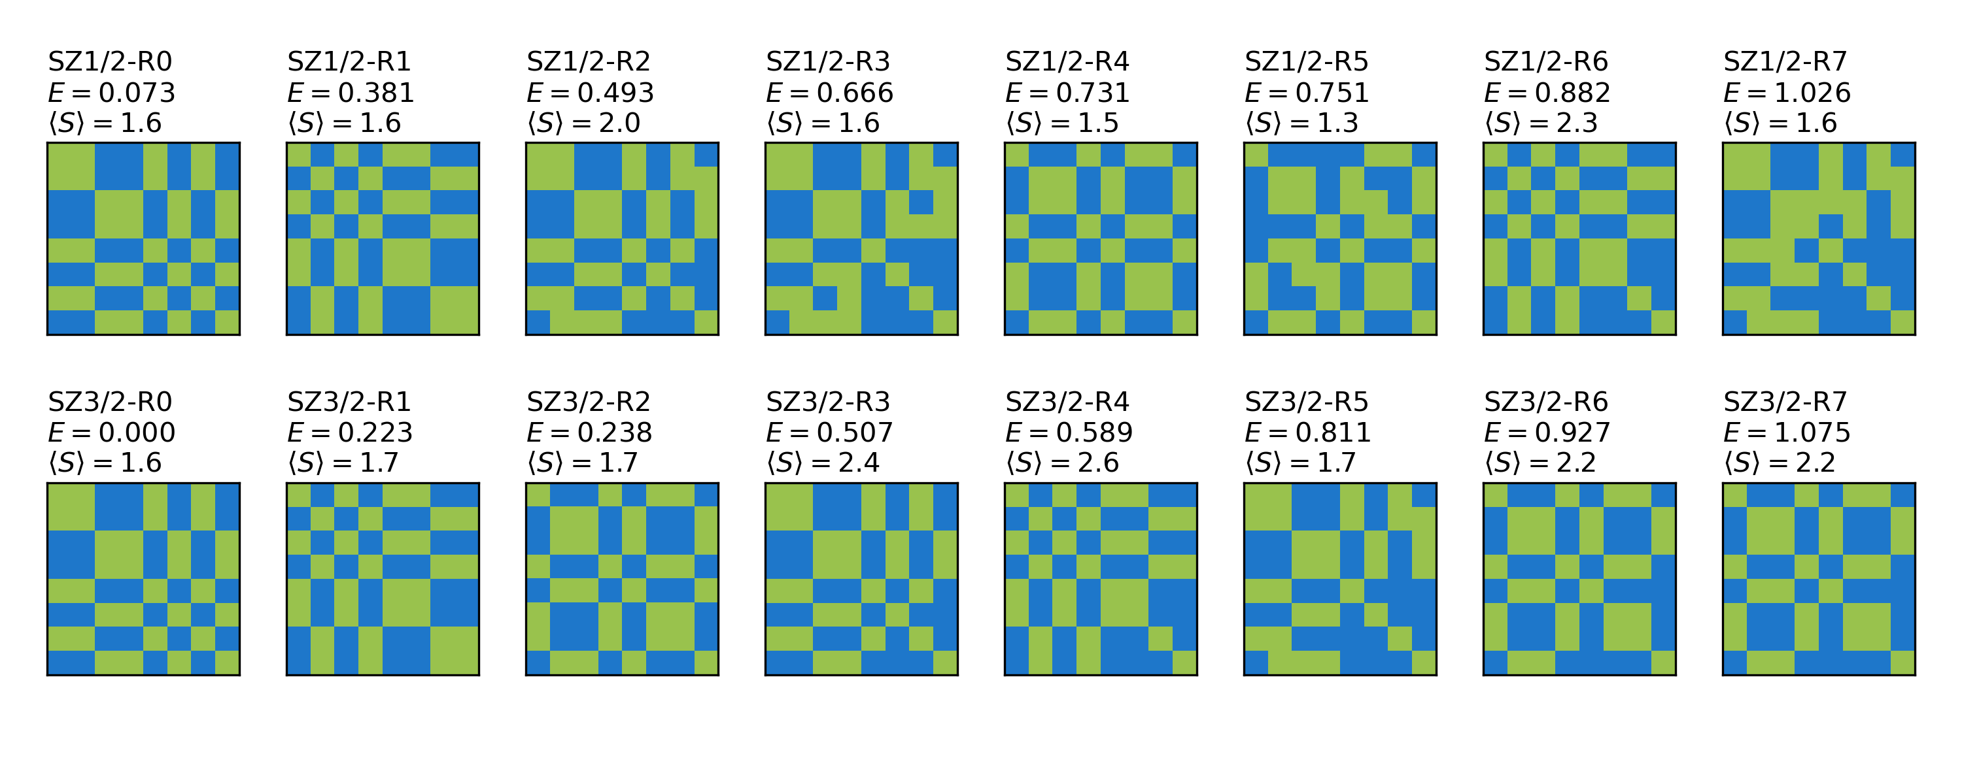
1 4 3 2 5 7 6
BS8-D (246)
1 4 3 2 5 7 6
BS8-A (345)
1 4 3 2 5 7 6
BS8-E (237)
Exact spin-adapted DMRG
S=1/2, 3/2, 5/2, …
Approximate
non-spin-adapted DMRG
with Sz = 3/2
Broken-symmetry
spin isomers

