Slide 1
初階影像處理、嵌入式機器人視覺 及人機互動 Homework 2
TA:
林超：423838819@qq.com
黃梅琇 : illya50947@gmail.com
尹心忠 : yinagfa081922@yahoo.com.tw
吳中銓 : f74012227@gmail.com
Office Hour: 15:00~17:00, Tue.

Slide 2
注意事項一
嚴禁抄襲!! 發現兩份一樣則兩份都以零分計算
若批改時不能執行，一週內自行來實驗室demo，否則以零分計算!!!
Deadline => 12 / 23 (五) 23:59
-遲交最晚收到 12 / 26 (一) 23:59，並且分數打七折，超過補交期限一律0分
作業上傳位置 => 140.116.154.1 -> Upload/Homework/OpenCv_Hw2
-帳號:OpenCv 密碼: OpenCv
繳交格式
-檔名：Hw2_學號_名字_版本.rar
Ex: Hw2_F71234567_林小明_v1.rar
-內容：整個專案(含圖片和影片) (但是不要把Debug資料夾也裝進來這樣檔案很大)

Slide 3
Notices (2/2):
OpenCV 2.4.7 is on ftp
Visual Studio 2012 is on http://www.cc.ncku.edu.tw/download/

Slide 4
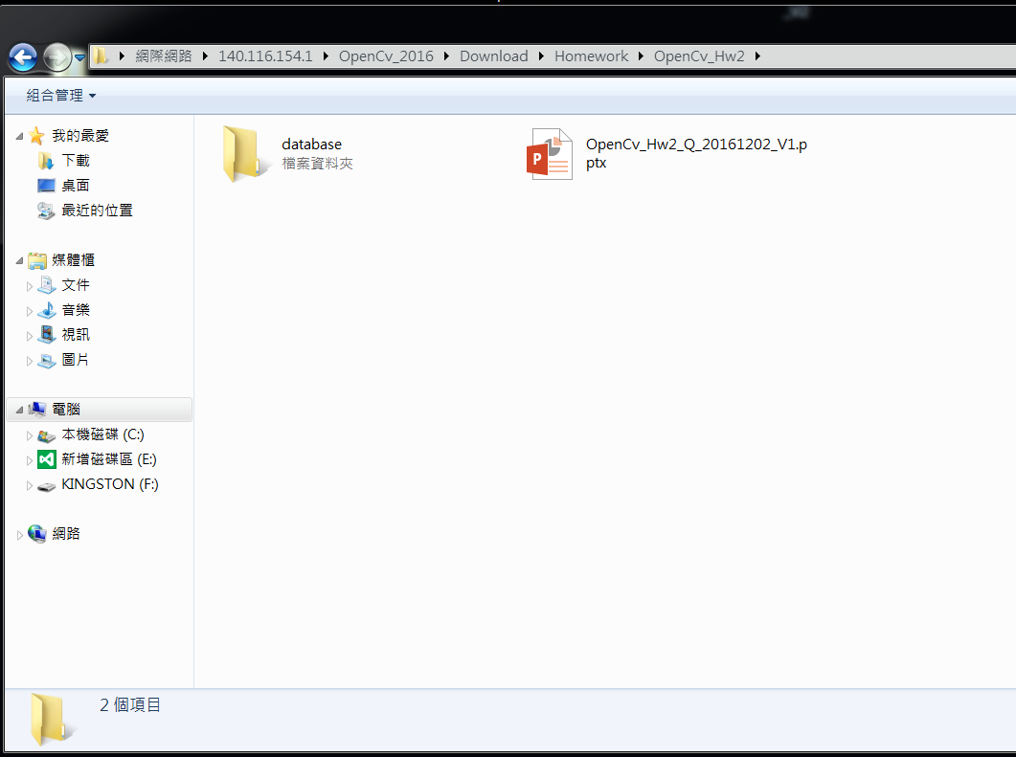
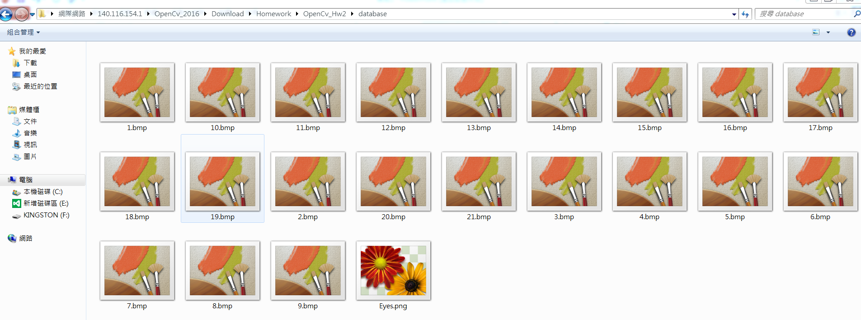
Homework Resources
Folder “Database”: includes image files 1.bmp ~ 21.bmp, and Eyes.png
Folder “hw2”
Folder “database”

Slide 5
Grading:
1. (10%) Homework Format
2. (40%) Camera Calibration
2.1 Corner detection (10%)
2.2 Find the intrinsic matrix (10%)
2.3 Find the extrinsic matrix (10%)
2.4 Find the distortion matrix (10%)
3. (20%) AR
4. (30%) 瞳孔偵測 4.1 Median Smooth 去除圖片的雜訊 (10%)
4.2 Canny 邊緣偵測 (10%)
4.3 HoughCircle + cvCircle 找出圓並將瞳孔標示出來 (10%)

Slide 6
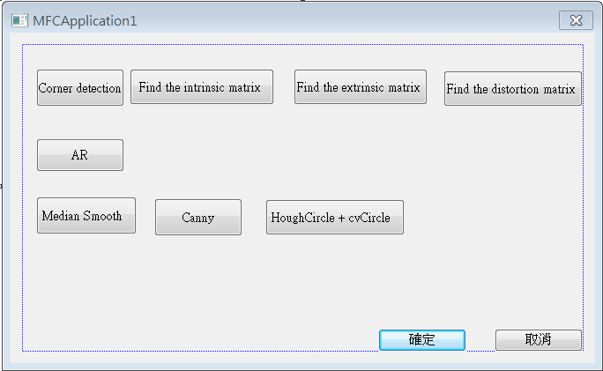
1. (10%) Homework Format
使用 MFC 實作下方介面

Slide 7
2. (40%) Camera Calibration
2.1 Corner detection (10%)
2.2 Find the intrinsic matrix (10%)
2.3 Find the extrinsic matrix (10%)
2.4 Find the distortion matrix (10%)

Slide 8
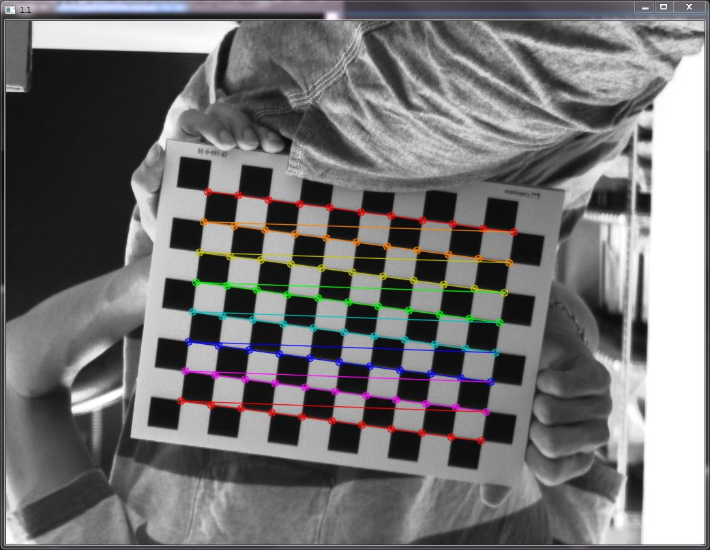
2.1 Corner detection (10%)
Find the corners on the chessboard (1.bmp) and draw them.
Click button “1.1” and then show the result.
Hint :
OpenCV Textbook Chapter 11 (p. 398 ~ p. 399)
cvShowImage(…);
EX:

Slide 9
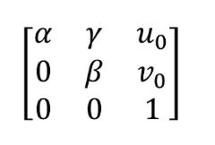

2.2 Find the intrinsic matrix (10%)
Find the intrinsic matrix:
Click button “1.2” and then show the result on the console window.
Output format:
Hint:
OpenCV Textbook Chapter 11 (P.398 ~ p.400)

Slide 10
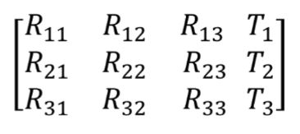

2.3 Find the extrinsic matrix (10%)
Find the extrinsic matrix of the chessboard (1.bmp):
Click button “1.3” and then show the result on the console window.
Output format:
Hint:
OpenCV Textbook Chapter 11

Slide 11

2.4 Find the distortion matrix (10%)
Find the distortion matrix:
Click button “1.4” and then show the result on the console window.
Output format:
Hint:
OpenCV Textbook Chapter 11 (P.398 ~ p.400)

Slide 12
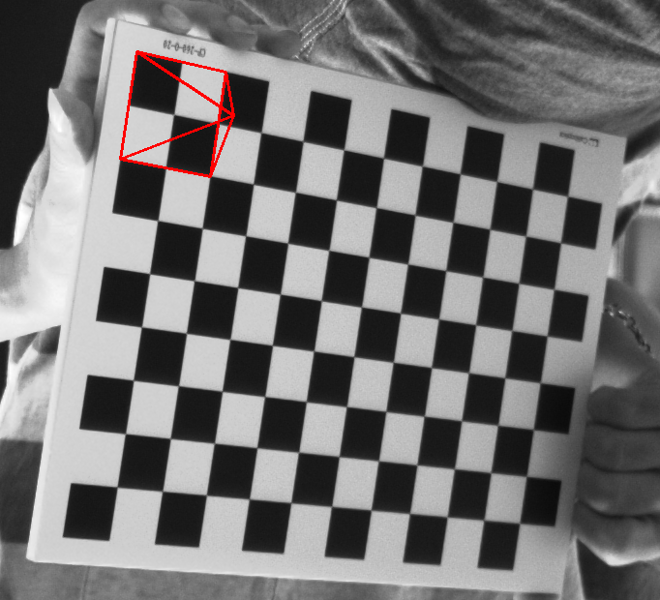
3. (20%) AR
1. Draw pyramid on the chessboards images(1.bmp to 5.bmp)
2. Click the button ”2” 開始播放畫上金字塔的圖，每格0.5秒顯示下一張(共顯示五張)
Hint :
Textbook Chapter 10、11
cvLine(…)
3D Object coordinates:
Vertex (0, 0, -2)
Corners(1, 1, 0)(1, -1, 0)(-1, -1, 0)(-1, 1, 0)
(0,0,0)
(0, 0, -2)
(示意影片: 見 FTP 資料夾 hw2 的範例影片 Hw2_Demo.mp4 )
(-1, -1, 0)
(1, -1, 0)
(-1, 1, 0)
(1, 1, 0)

Slide 13
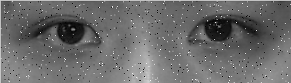
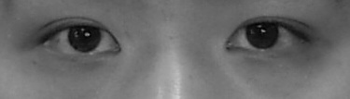
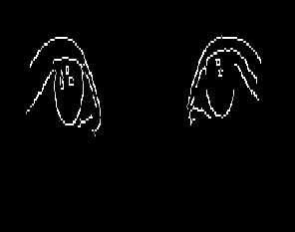
4.(30%)瞳孔偵測
Median Smooth 去除圖片的雜訊並顯示出來 10%
2) Canny 邊緣偵測並顯示出來 10%
3) HoughCircle + cvCircle 找出圓並將瞳孔標示出來 10%

