Slide 1
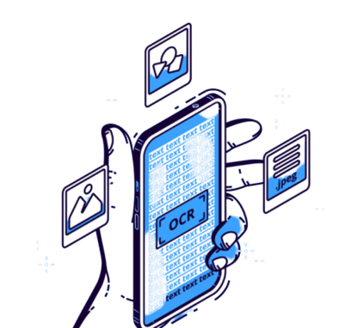
OCR COMPUTER VISION

Slide 2
WHAT ARE WE WORKING ON
Creating an Application that can do below
Upload a document using a UI based WebApp
Have a backend engine that will accept/validate and process the document
Extract contents of the document after processing
Display the list of documents in UI along with status
Have a side by side UI to display both document and extracted content of the document in a Form.
Upload multiple documents with similar/repeated content
Have a search option, which can take “Text Data” as input and list down all the documents in which that searched text is found.

Slide 3
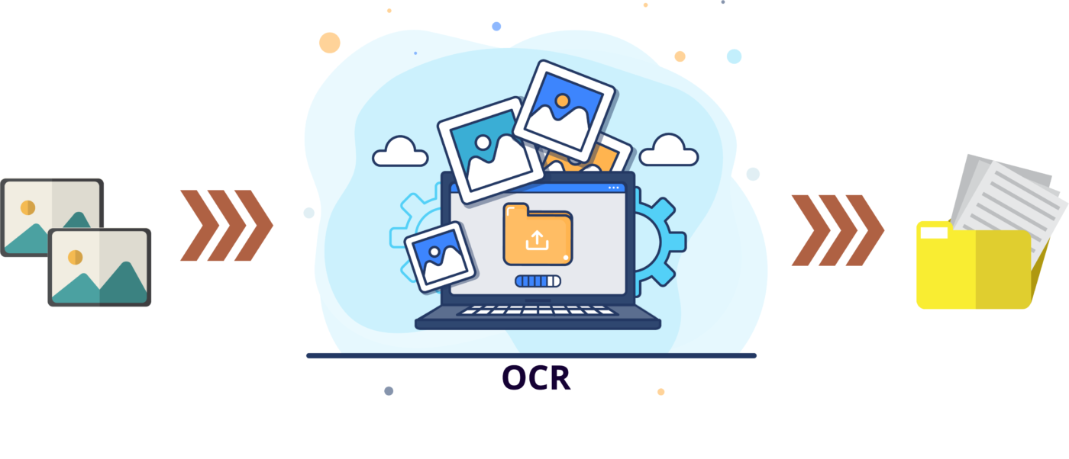
WHAT IS COMPUTER VISION
Computer vision is the field of computer science that focuses on creating digital systems that can process, analyze, and make sense of visual data
The concept of computer vision is based on teaching computers to process an image at a pixel level and understand it.

Slide 4
WHAT IS OCR
Optical Character Recognition is the use of technology to distinguish and convert text embedded in scanned documents, images, or videos into a format that is easily editable and searchable.
It requires a combination of computer vision (CV) modules, recognition (ML) modules, and text modules to extract the text into a readily useable structured form.

Slide 5
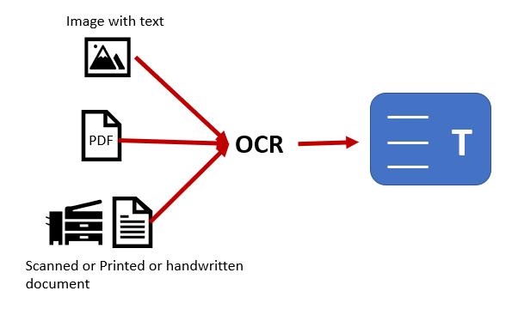

Slide 6
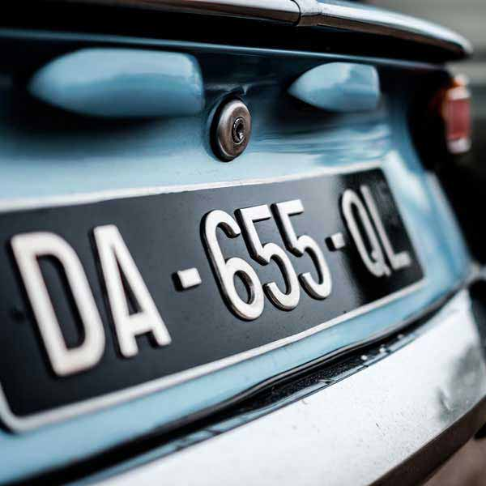
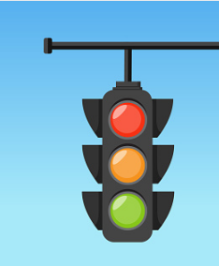
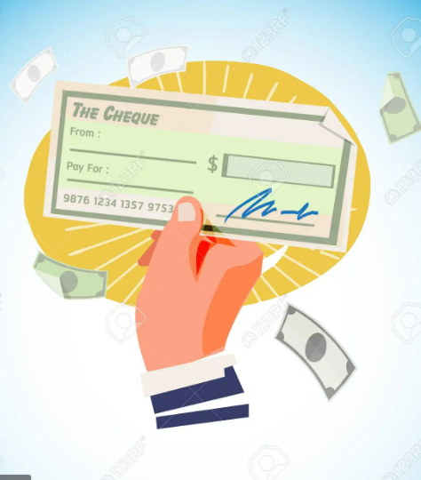

Where is OCR used
Automatic
number
plate
recognition
Traffic
sign recognition
Word processing
Bank
Statement

Slide 7
WORKING

Slide 8
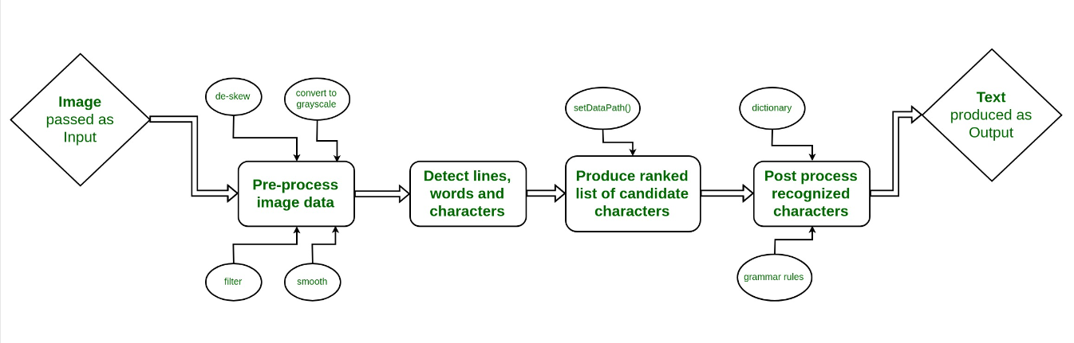
General working of OCR

Slide 9

Tesseract — is an optical character recognition engine with open-source code, this is the most popular and qualitative OCR-library.
Tesseract is finding templates in pixels, letters, words and sentences. It uses two-step approach that calls adaptive recognition.

Slide 10

Flask is a micro web framework written in Python. It is classified as a microframework because it does not require particular tools or libraries.
This web application can be some web pages, a blog, a wiki or go as big as a web-based calendar application or a commercial website.

Slide 11
Working of the project
The user selects a file which should be in the pdf format
Now this pdf file is transformed into images separately in order to analyze the text present
A library named PDF2Image is used for the same
Now the text is analyzed from the generated images by the tesseract library .
Finally we obtain a text file containing the data of the pdf chosen.

Slide 12
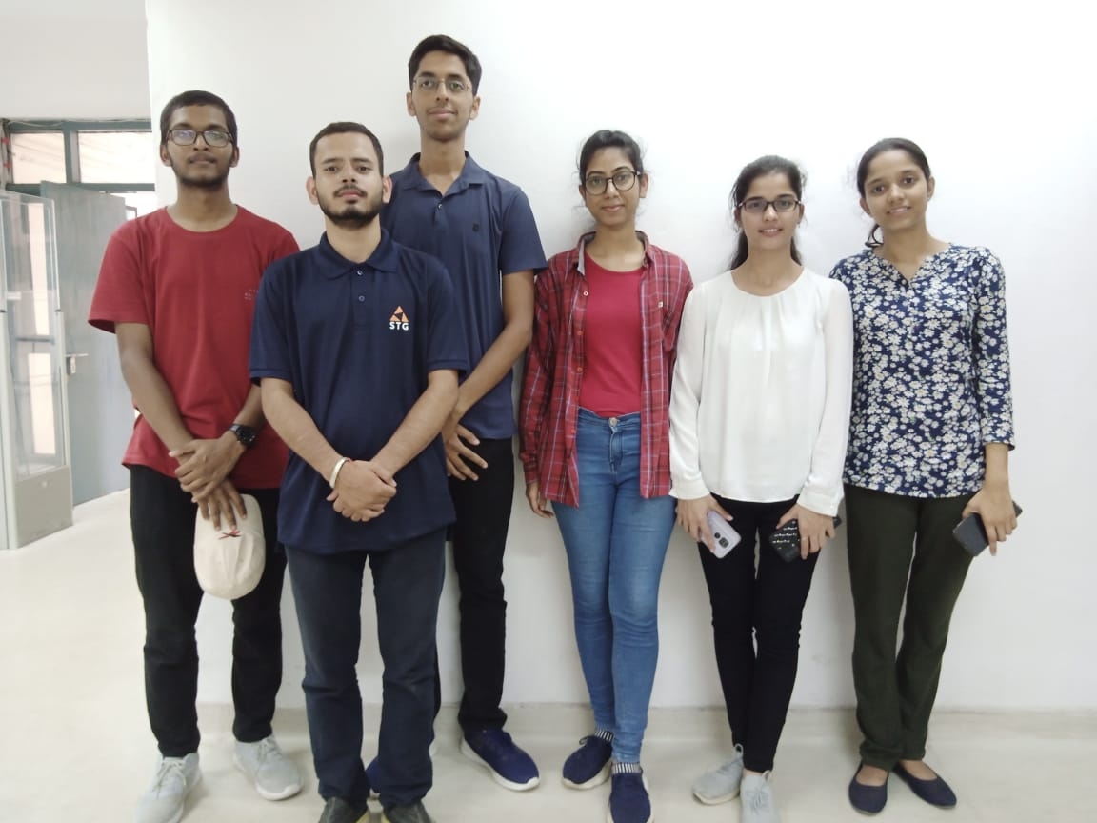
Team names from left to right:
Himanshu Saha CSE CO20322 himanshusaha02@gmail.com
Lalit Kumar CSE CO20328 lakshyabijarnia@gmail.com
Harshit Dubey CSE CO20321 dubeyharshit663@gmail.com
Smriti Kumari CSE CO20356 ksmritie@gmail.com
Anju Devi ECE CO21515 goyatdevi1105@gmail.com
Shreya Pandey CSE CO20351 shreya20011002@gmail.com

Slide 13
Working of the project
The user selects a file which should be in the pdf format
Now this pdf file is transformed into images separately in order to analyze the text present
A library named PDF2Image is used for the same
Now the text is analyzed from the generated images by the tesseract library .
Finally we obtain a text file containing the data of the pdf chosen.

