Slide 1

HEALTHHACK
A Virtual Friend caring about your health

Slide 2
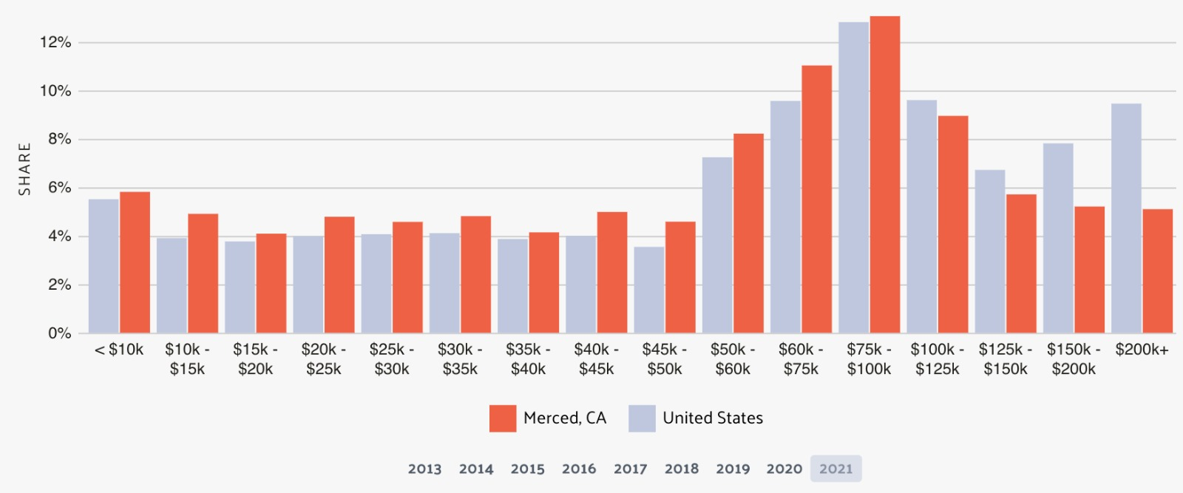
Why??
POVERTY
Taking Merced location , This graph here gives the minimum income percentages and average people fall into 50-60K.
Low Income people need affordable healthcare.

Slide 3
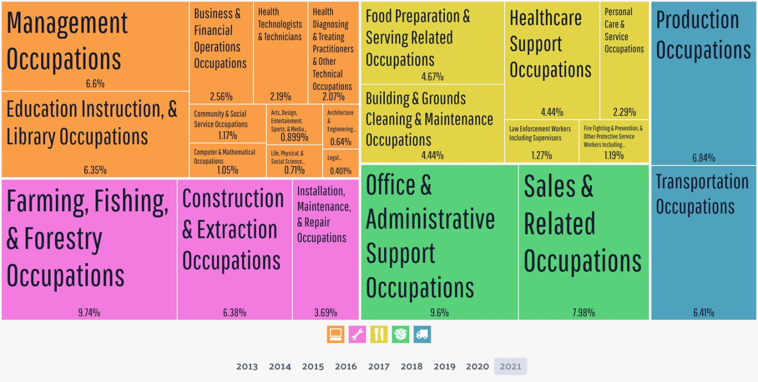
GEOGRAPHY Only 4.4% of people in Merced are Healthcare support Health technologists – 2.5% People in such places need products that educate them on the available service (CalFresh) to maintain their health.

Slide 4

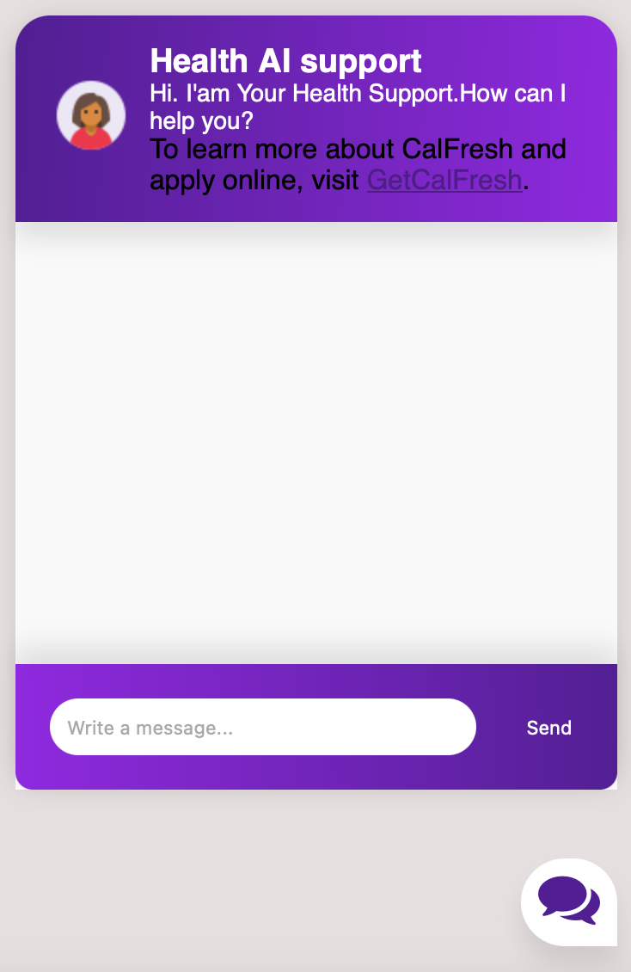
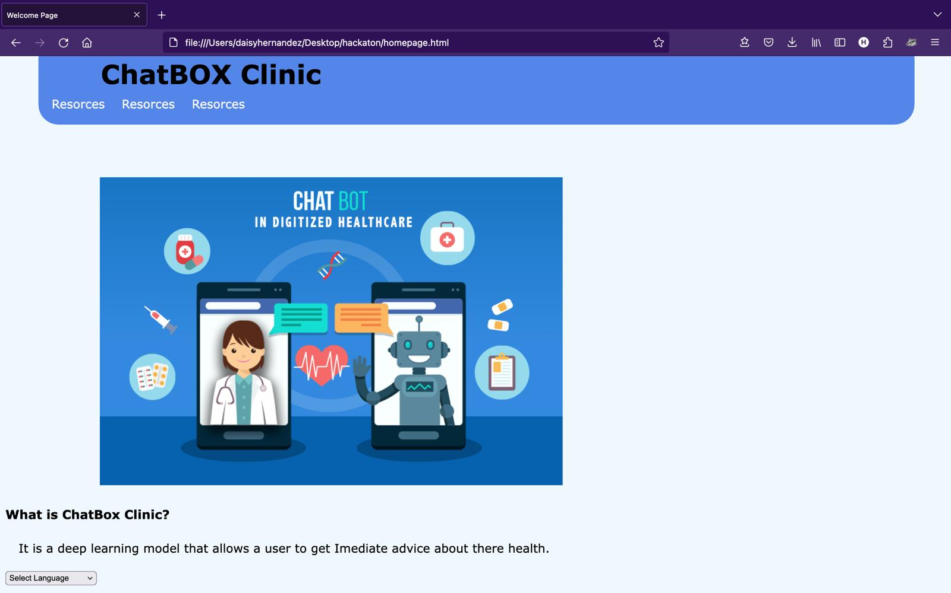
How It is Built
Back-end
Front-End

Slide 5

Challenges we ran into
Not able to integrate the Model with the front-end
Extracting complex large amount of text data.

Slide 6
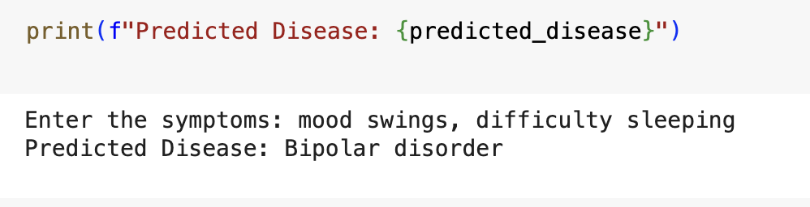
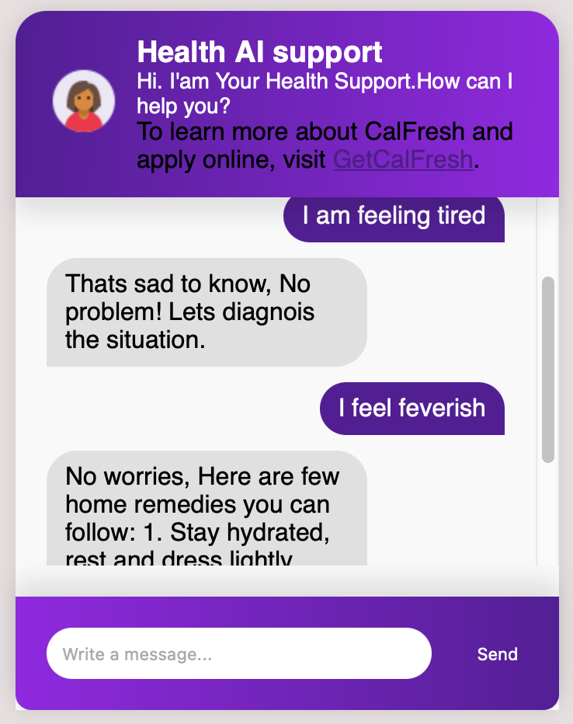
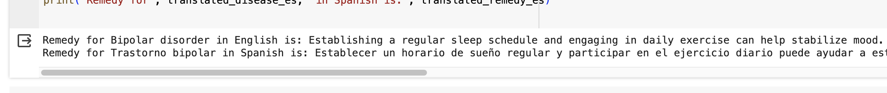
Accomplishments that we're proud of
We were able to predict the type of disease, and also provide the remedies using the LLM Model.
We were able to project the results in multiple languages taking users language factor into consideration.
We finally built a prototype of our Chatbot with sample data inputs and output.
We were able to create the login pages of the website using HTML/CSS.

Slide 7

What's next for HealthHack
We plan to integrate the chatbot with the backend LLM model.
We plan to get the google maps api and embed it to our model so that it can actually recommend users the nearest hospitals available.
We plan to include the resources like Calfresh, California Association of Food Banks, School Meals etc into our chatbot which will give users knowledge on the vital services they can use to stay healthy.

Slide 8

Thank you
Any Queries: Connect with us :
https://www.linkedin.com/in/purnima14b/
https://www.linkedin.com/in/janipasha-mohammed/
https://github.com/hdaisy21

