Slide 1
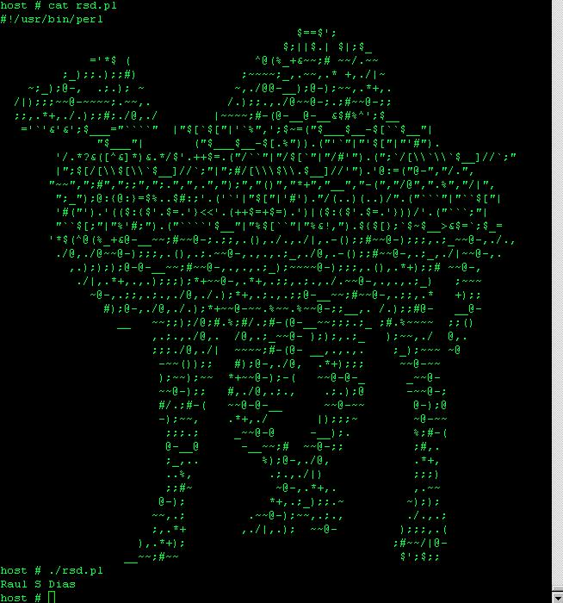
Matrix Reloaded

Slide 2
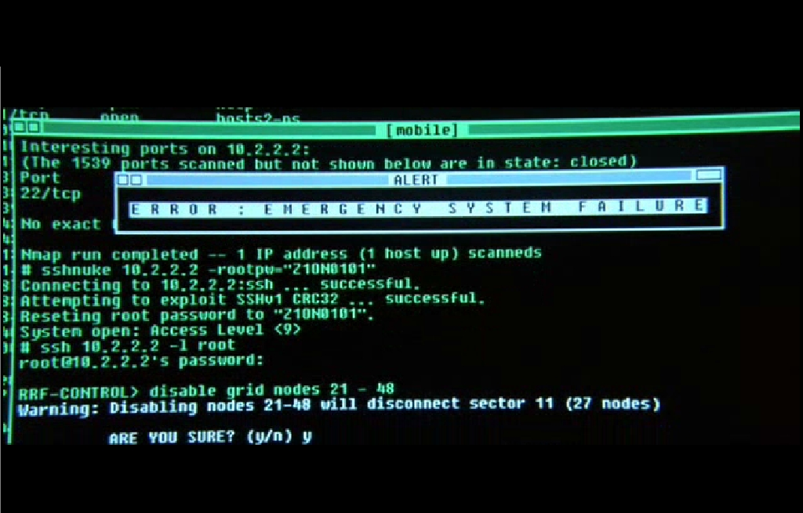

Slide 3
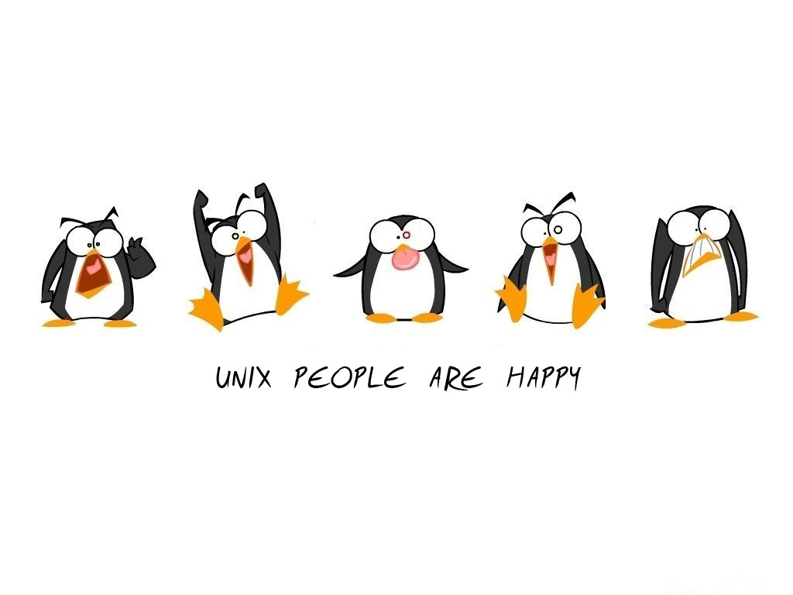

Slide 4
UNIX @ CSE – Lecture 1
  Pat O'Keefe

Slide 5
What will we cover?
Operating system overview
UNIX commands, shell & process mgt.
Scripting languages
Programming tools
Various text editors
X11 & KDE windows env
Basic C/C++ programming and other applications (emacs, gcc-g++, gzip, tar, …)

Slide 6
Schedule
Lectures Mon, Wed 1:25-2:15
801 Lab 2:30 – 3:20
802 Lab 3:35 – 4:25
Quizzes taken during lab
Final: In lab September 27th.
Project due Friday September 24th.

Slide 7
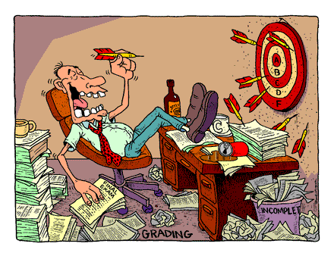
Who cares, how do I get an A?
Assignments: 35%
Project: 15%
quizzes: 30%
Final: 20%

Slide 8
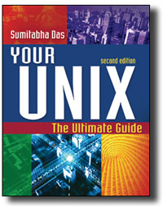
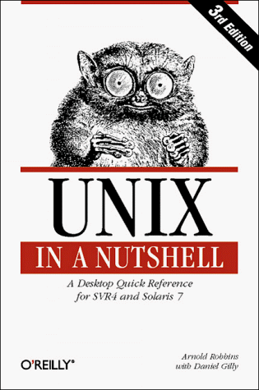
Books
USC Bookstore

Slide 9
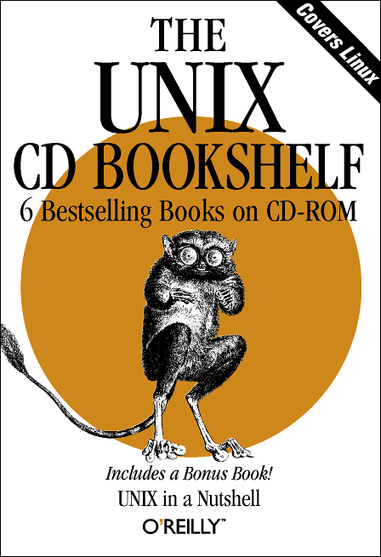


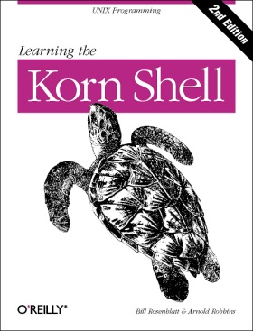
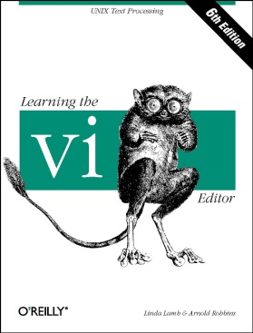
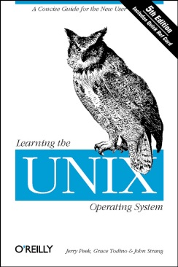
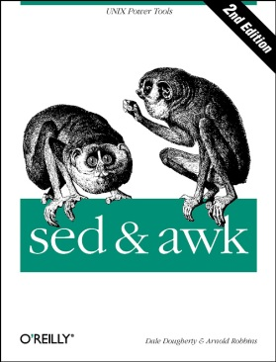
Other helpful resources
http://safari.oreilly.com

Slide 10
Administrivia
Make sure you have a CSE account
Sign up for the mailing list
Check the website/dropbox regularly:
CSE homepage -> Academics ->Current Class Web Pages -> CSCE215-xxx
http://www.cse.sc.edu/~okeefe/unix-linux/8[0,5]1
Office hours: In lab or by appt.
TAs: none.
Assignment 1 is due Tomorrow.

Slide 11

Cheating
Don’t

Slide 12
Cheating
Don’t
Seriously, don’t

Slide 13
Individual Effort
Assignments and quizzes are open book, open notes, open computer/internet!
This is a hands on course designed to familiarize YOU with the unix/linux environment.
You will need these skills in future classes.
Cheat and pay the price later.
Why not learn this stuff now?

Slide 14

Our Heroes
Ken Thompson
Dennis Ritchie

Slide 15
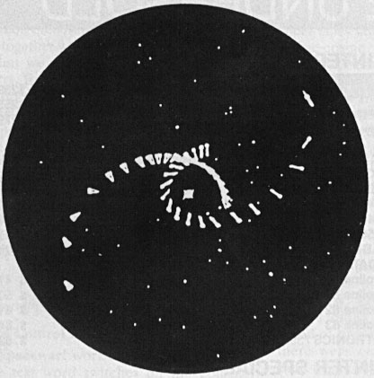
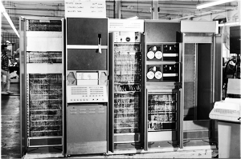
Video Games Spark Innovation
PDP-7
Space Pilot
Notes:
Operating systems needed because without them there is inefficient use of resources.
CTSS was one of the first OSes, and MULTIC was to be a second generation OS.
MULTICS: Multi User file system from MIT/GE/Bell Labs, on expensive GE-645.
Introduced hierarchical file system
MULTICS died, but Thompson/Ritchie still wanted to play Space Pilot.
In order to do so, they decided to create a simplified version that would work on a PDP-7 that was laying around.

Slide 16
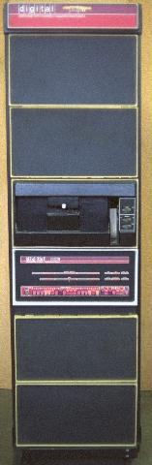
In the Beginning
UNICS: 1969 – PDP-7 minicomputer
PDP-7 goes away, rewritten on PDP-11 to “help patent lawyers”
V1: 1971
V3: 1973 (pipes, C language)
V6: 1976 (rewritten in C, base for BSD)
V7: 1979 (Licensed, portable)
PDP-11
Notes:
PDP7: 72K, 18 Bit, 120 made. The OS that came with it was terrible.
PDP11: 1970, $10K, 16 bit, 600K+ made
C: Also a 3rd generation system: BCPL (similar to fortran) -> B (simplified) -> C (cleaned up, more powerful)

Slide 17
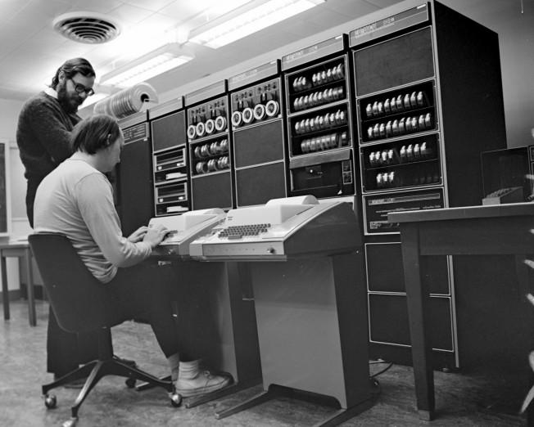

Slide 18
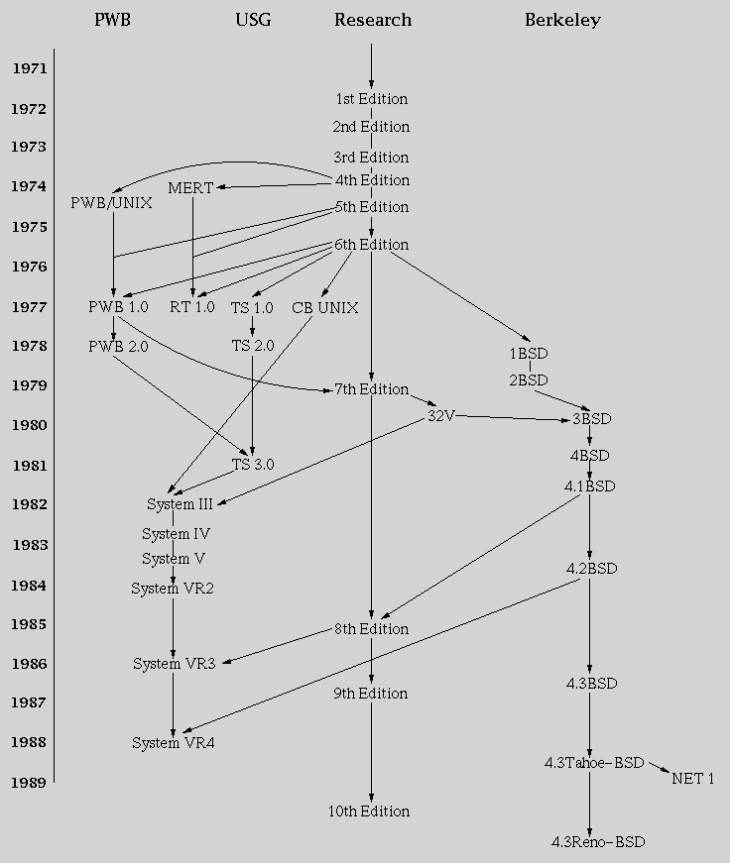
Derivative Systems
PWB, MERT
BSD: Adds many important features (networking, job control).
AT&T enters the computer business with System III, V
Notes:
By the time V7 was released, there were plenty of derivative systems, most starting after V3.
PWB: Programmers Work Bench: Good development tools
MERT: Realtime features, used for switches. Introduced shared memory, IPC, early example of microkernel
BSD: Started when Ken thompson does sabbatical at Berkeley in 1975-6. Grad student Bill Joy continues development. Added vi, tcp/ip, etc.
V7: Also branched into a commercial non-research variant.
Sys V: 1983, year of breakup. Large motivation was to get into UNIX business.

Slide 19





Commercial Success
AIX
SunOS, Solaris
Ultrix, Digital Unix
HP-UX
Irix
UnixWare -> Novell -> SCO -> Caldera ->SCO
Xenix: -> SCO
Standardization (Posix, X/Open)
Notes:
Early eighties: lots of commercial spinoffs.
XENIX: Port for microcomputers by microsoft, but inadequate. Sold to SCO after switch to QDOS (quick and dirty)
SUN: Bill Joy’s startup launched in 1982
SCO: One of the first (1978)
UnixWare: AT&T’s.

Slide 20
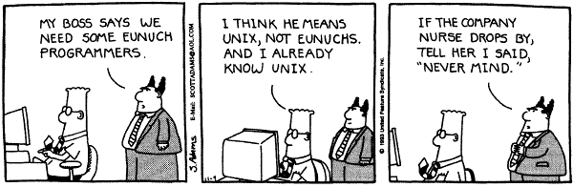
Popular Success!
Notes:
Cartoon from 1993

Slide 21
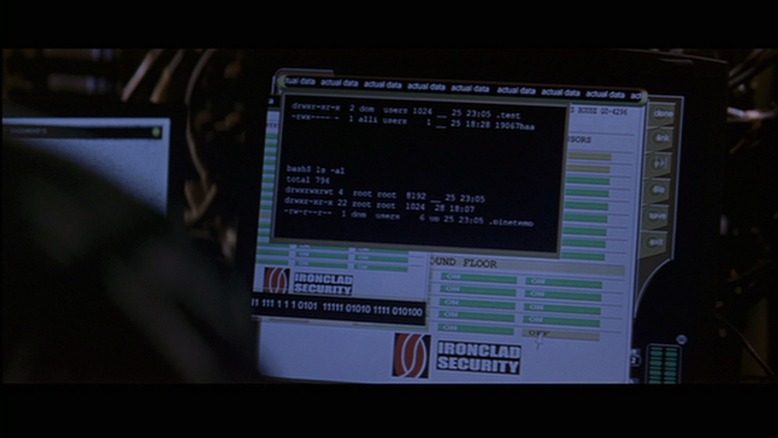
The Score

Slide 22
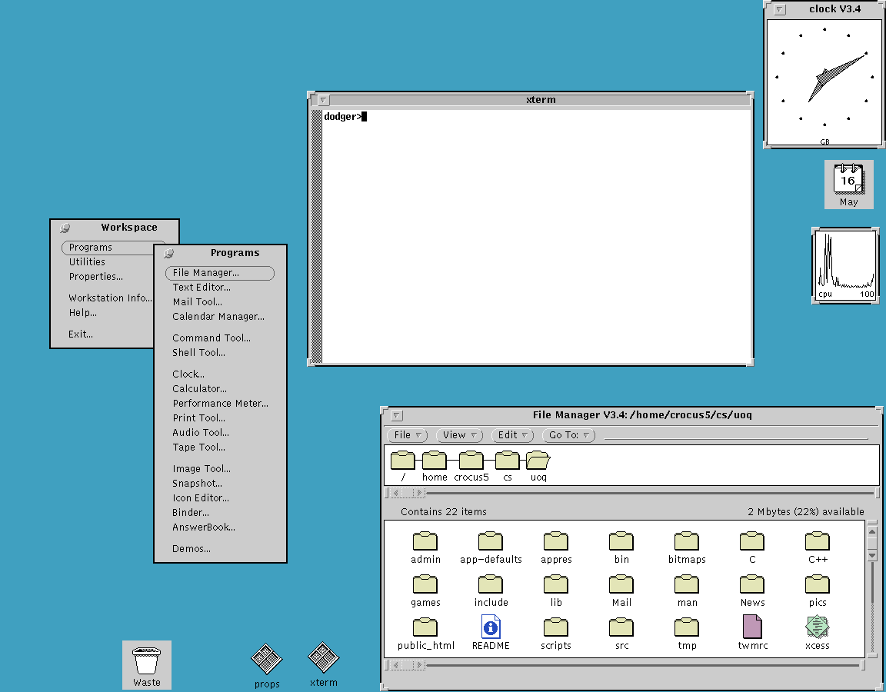
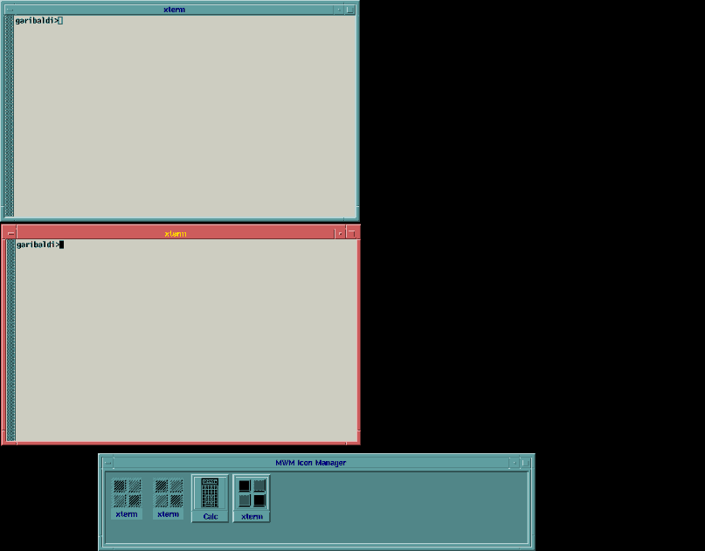
Standards and Wars
1998: POSIX Standard
Unix International vs. Open Software Foundation (to compete with desktop PCs)
Battle of the Window Managers
Openlook
Motif
Threat of Windows NT resolves battle with CDE
Notes:
Early 90s

Slide 23

Commercial Backlash
Not everyone was happy with proprietary UNIX
1983: GNU Project starts
  No UNIX code
  (GNU's Not UNIX)
  Initial focus on utilities
  Later compiler, shell, kernel

Slide 24

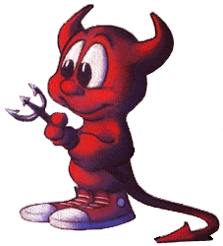
Send in the Clones
Linux
  Written in 1991 by Linus Torvalds
  Most popular UNIX variant
  Free with GNU license
BSD Lite
  FreeBSD (1993, focus on PCs)
  NetBSD (1993, focus on portability)
  OpenBSD (1996, focus on security)
  Free with BSD license
  Development less centralized
Notes:
GNU and BSD licenses have major differences.

Slide 25

Darwin
Apple abandoned old Mac OS for UNIX
  Purchased NeXT in December 1996
  Unveiled in 2000
  Based on 4.4BSD-Lite
  Aqua UI written over Darwin
  Open Source

Slide 26
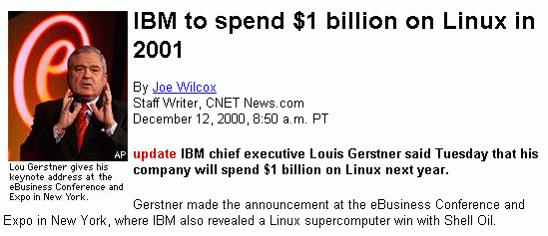
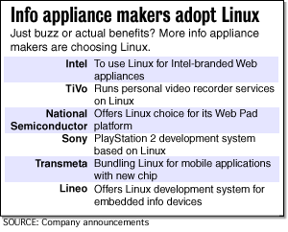

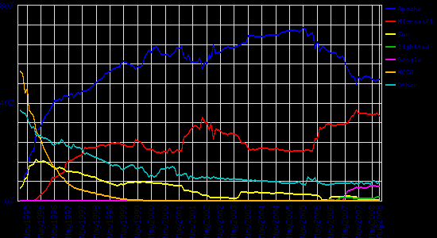
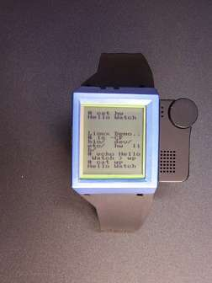
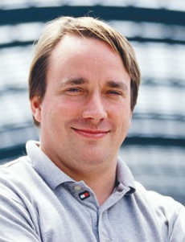
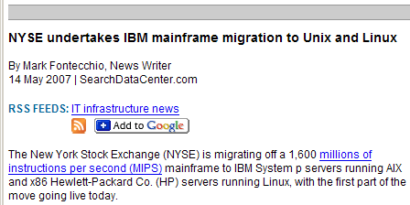
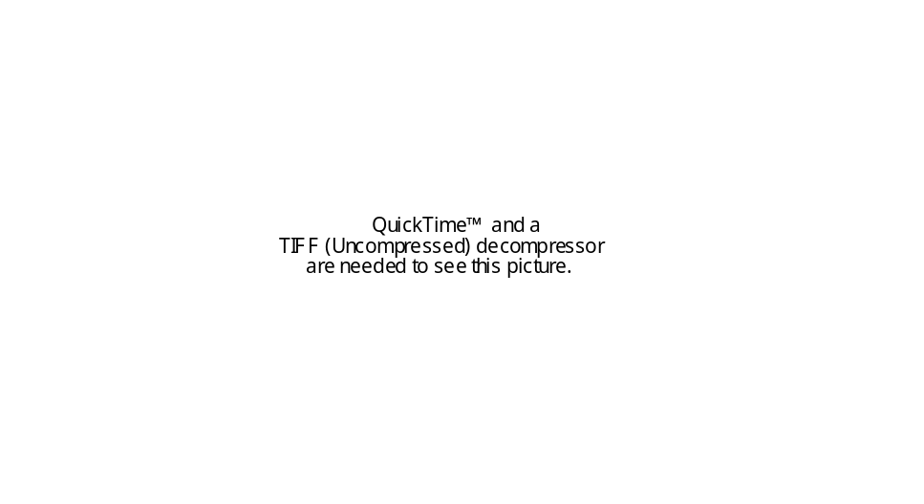
Linux Success
Notes:
Over 70% of all web servers run UNIX variants.
Other uses: FAA, Mars Pathfinder,

Slide 27
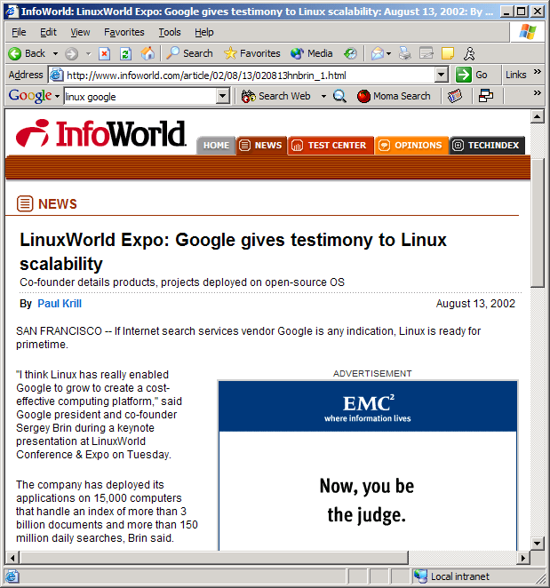
Linux at Google

Slide 28
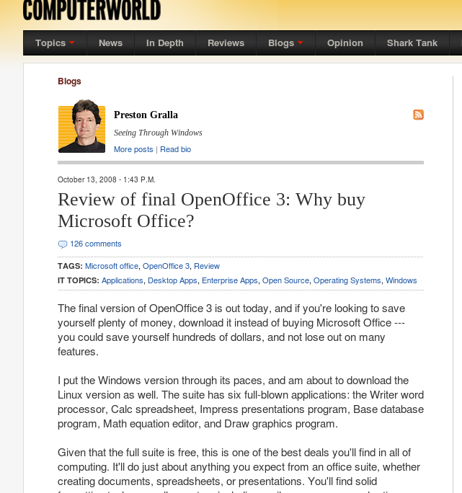
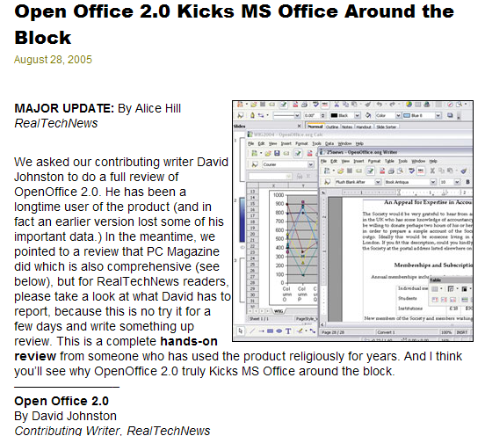
Some Desktop Success

Slide 29
Why did UNIX succeed?
Technical strengths!
Research, not commercial
PDP-11 was popular with an unusable OS
AT&T’s legal concerns
  Not allowed to enter computer business but needed to write software to help with switches
  Licensed cheaply or free
Notes:
Breakup: 1983

Slide 30

The Open Source Movement
Has fueled much growth in UNIX
  Keeps up with pace of change
  More users, developers
    More platforms, better
    performance, better code
Many vendors switching to Linux

Slide 31
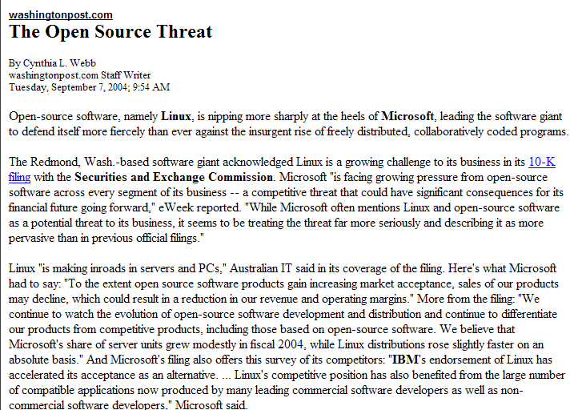

Slide 32
SCO vs. Linux
Jan 2002: SCO releases Ancient Unix : BSD style licensing of V5/V6/V7/32V/System III
March 2003: SCO sues IBM for $3 billion. Alleges contributions to Linux come from proprietary licensed code
  AIX is based on System V r4, now owned by SCO
Aug 2003: IBM Countersuit: patent and GPL violations
Aug 2003: Evidence released
  Code traced to Ancient UNIX
  Isn’t in 90% of all running Linux distributions
  Already dropped from Linux in July
* Aug 2005: Linux Kernel Code May Have Been in SCO
* Aug 2007: About that UnixWare purchase…
* Sept 2007: SCO files chapter 11

Slide 33
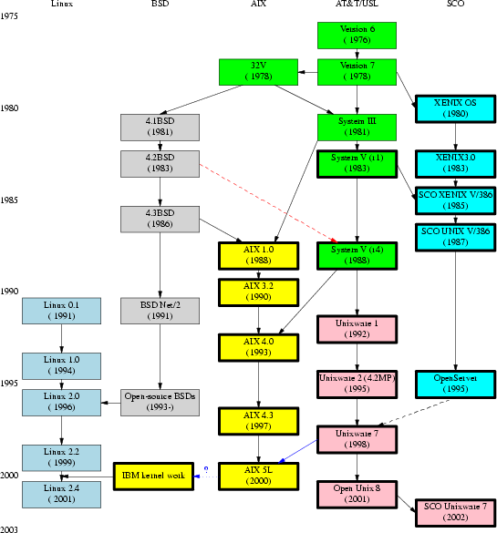
UNIX vs. Linux

Slide 34


In the 90’s, Thompson/Ritchie developed Plan 9 which applied UNIX ideas to distributed systems
Plan 9 evolved into Inferno, used for set top boxes
Lucent had problems, many people left
Thompson retired, now at startup
Ritchie still at Lucent

Slide 35

The UNIX Philosophy
Small is beautiful
  Easy to understand
  Easy to maintain
  More efficient
  Better for reuse
Make each program do one thing well
  More complex functionality by combining programs
  Make every program a filter
Notes:
Core Idea: #1
#2 is an example of #1

Slide 36
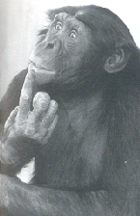
The UNIX Philosophy
..continued
Portability over efficiency
  Most efficient implementation is rarely portable
  Portability better for rapidly changing hardware
Use flat ASCII files
  Common, simple file format (yesterday’s XML)
  Example of portability over efficiency
Reusable code
  Good programmers write good code;
  great programmers borrow good code
Notes:
Example: Failure of ATARI 2600 move to ATARI 800 (hard (8K) so highly non portable)

Slide 37
The UNIX Philosophy
..continued
Scripting increases leverage and portability
print $(who | awk '{print $1}' | sort | uniq) | sed 's/ /,/g'
List the logins of a system’s users on a single line.
who
755
awk
3,412
sort
2,614
Build prototypes quickly (high level interpreted languages)
uniq
302
sed
2,093
9,176 lines

Slide 38
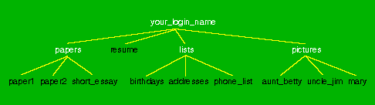
The UNIX Philosophy
..continued
Avoid captive interfaces
  The user of a program isn’t always human
  Look nice, but code is big and ugly
  Problems with scale
Silence is golden
  Only report if something is wrong
Think hierarchically

Slide 39
UNIX Highlights / Contributions
Portability (variety of hardware; C implementation)
Hierarchical file system; the file abstraction
Multitasking and multiuser capability for minicomputer
Inter-process communication
  Pipes: output of one programmed fed into input of another
Software tools
Development tools
Scripting languages
TCP/IP

Slide 40
Operating System Structure
programs
operating system
hardware

Slide 41
The Operating System
The government of your computer
Kernel: Performs critical system functions and interacts with the hardware
Systems utilities: Programs and libraries that provide various functions through systems calls to the kernel

Slide 42
Unix System Structure
user
c programs
scripts
ls
ksh
gcc
find
shell and utilities
open()
fork()
exec()
kernel
hardware
Notes:
We will see soon that “Unix Tools” is a study of the green layer.

Slide 43
Kernel Basics
The kernel is …
  a program loaded into memory during the boot process, and always stays in physical memory.
  responsible for managing CPU and memory for processes, managing file systems, and interacting with devices.

Slide 44
The Kernel
Manage resources
  Storage
  Memory
  CPU
  Display
  Network
Sharing
  Users
  Tasks
Communication
user
shell and utilities
kernel
hardware

Slide 45
Kernel Subsystems
File system
  Directory hierarchy, regular files, peripherals
  Multiple file systems
  Input/Output
    How processes access files, terminal I/O
Process management
  How processes share CPU, memory and signals
  Scheduling
  Interprocess Communication
  Memory management
UNIX variants have different implementations of different subsystems.

Slide 46
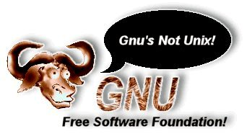
Shell & Utilities
The rest of the operating system
Focus of this course
Cause of debate in Linux community
user
shell and utilities
kernel
hardware

Slide 47
Logging In
Need an account and password first
  Enter at login: prompt
  Password not echoed
  After successful login, you will see a shell prompt
Entering commands
  At the shell prompt, type in commands
    Typical format: command options arguments
    Examples: who, date, ls, cat myfile, ls –l
  Case sensitive
exit to log out

Slide 48
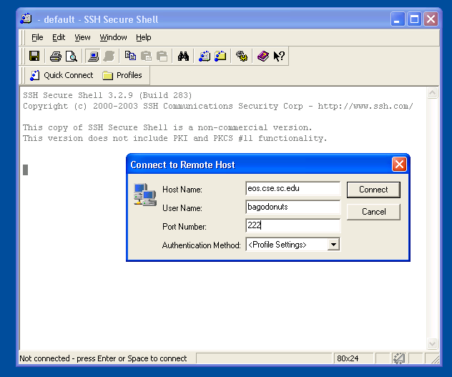
Remote Login
Use Secure Shell (SSH)
Windows
  SSH Secure Shell Client
UNIX-like OS
  ssh -p 222 <userid>@eos.cse.sc.edu
http://www.cse.sc.edu/~okeefe/unix-linux/assignments/linux.html

Slide 49
UNIX on Windows
Two recommended UNIX emulation environments:
UWIN (AT&T)
  http://www.research.att.com/sw/tools/uwin
Cygwin (GPL)
- http://sources.redhat.com/cygwin
VMWare
- http://www.vmware.com/download/player/

Slide 50

Assignment 1
Get an account
Log in and run a program
Join the mailing list
Submit a text file

Slide 51
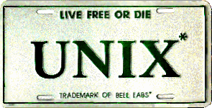
Next Time
Basic UNIX concepts
Introduction to the shell
Introduction to basic commands

Slide 52
LINUX Tutorials
http://www.linux-tutorial.info/modules.php?name=Tutorial&pageid=224
http://www.tldp.org/LDP/intro-linux/html/index.html
http://www.slackbook.org/html/index.html

Slide 53
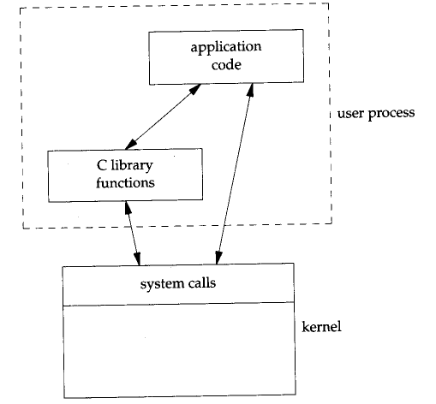
System Calls
The kernel implements a set of special routines
A user program invokes a routine in the kernel by issuing a hardware TRAP
The trap switches the CPU into a privileged mode and the kernel executes the system call
The CPU goes back to user mode
A C language API exists for all system calls

Slide 54
SCO: Line by Line Copying
System V Code Linux Kernel Code
/*
* Allocate 'size' units from the given map.
* Return the base of the allocated space.
* In a map, the addresses are increasing and the
* list is terminated by a 0 size.
* The swap map unit is 512 bytes.
* Algorithm is first-fit.
*
∗ Ασ παρτ οφ τηε κερνελ εϖολυτιον τοωαρδ μοδυλαρ ναμινγ, τηε
∗ φυνχτιονσ μαλλοχ ανδ μφρεε αρε βεινγ ρεναμεδ το ρμαλλοχ ανδ ρμφρεε.
∗ Χομπατιβιλιτψ ωιλλ βε μαινταινεδ βψ τηε φολλοωινγ ασσεμβλερ χοδε:
∗ (αλσο σεε μφρεε/ρμφρεε βελοω)
∗/
…
/*
* Allocate 'size' units from the given map.
* Return the base of the allocated space.
* In a map, the addresses are increasing and the
* list is terminated by a 0 size.
* Algorithm is first-fit.
*/
ulong_t
atealloc(
struct map *mp,
size_t size)
{
register unsigned int a;
register struct map *bp;
register unsigned long s;
…

