Slide 1
Lecture 2
The UNIX Filesystem

Slide 2
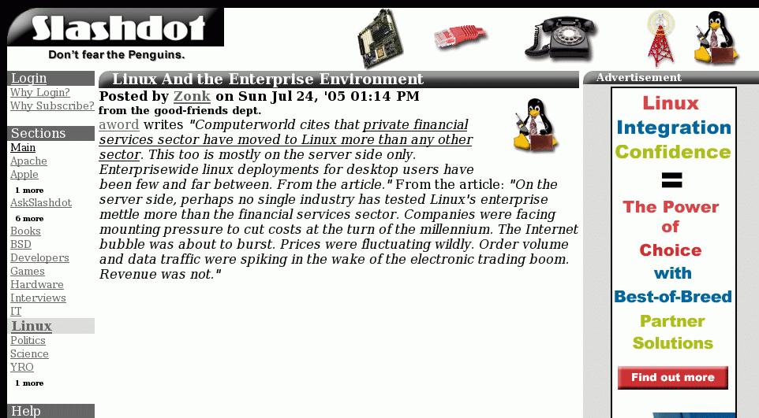

Slide 3
On the last episode of UNIX Tools…
Course Info
History of UNIX
Highlights of UNIX
The UNIX Philosophy
System organization

Slide 4
Unix System Structure
user
c programs
scripts
ls
ksh
gcc
find
shell and utilities
open()
fork()
exec()
kernel
hardware

Slide 5
Kernel Subsystems
File system
  Deals with all input and output
    Includes files and terminals
    Integration of storage devices
Process management
  Deals with programs and program interaction
    How processes share CPU, memory and signals
    Scheduling
    Interprocess Communication
    Memory management
UNIX variants have different implementations of different subsystems.

Slide 6
Kernel Data Structures
Information about each process.
Process table: contains an entry for every process in the system.
Open-file table: contains at least one entry for every open file in the system.
User Space
Code
Code
Code
Data
Data
Data
Process Info
Process Info
Process Info
Open File Table
Process Table
Kernel Space

Slide 7
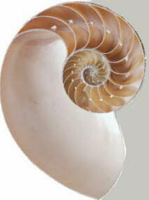
What is a shell?
The user interface to the operating system
Functionality:
  Execute other programs
  Manage files
  Manage processes
A program like any other
Executed when you log on

Slide 8
Most Commonly Used Shells
  /bin/sh The Bourne Shell / POSIX shell
  /bin/csh C shell
  /bin/tcsh Enhanced C Shell
  /bin/ksh Korn shell
  /bin/bash Free ksh clone
Basic form of shell:
while (read command) {
parse command
execute command
}

Slide 9
Shell Interactive Use
When you log in, you interactively use the shell:
  Command history
  Command line editing
  File expansion (tab completion)
  Command expansion
  Key bindings
  Spelling correction
  Job control

Slide 10

Shell Scripting
A set of shell commands that constitute an executable program
A shell script is a regular text file that contains shell or UNIX commands
Before running it, it must have execute permissions
Very useful for automating repetitive task and administrative tools and for storing commands for later execution

Slide 11
Simple Commands
simple command: sequence of non blanks arguments separated by blanks or tabs.
1st argument (numbered zero) usually specifies the name of the command to be executed.
Any remaining arguments:
  Are passed as arguments to that command.
  Arguments may be filenames, pathnames, directories or special options
  Special characters are interpreted by shell

Slide 12
A simple example
$ ls –l /bin
-rwxr-xr-x 1 root sys 43234 Sep 26 2001 date
$
prompt
command
arguments
Execute a basic command
Parsing into command in arguments is called splitting

Slide 13
Types of Arguments
$ tar –c –v –f archive.tar main.c main.h
Options/Flags
  Convention: -X or --longname
Parameters
  May be files, may be strings
  Depends on command

Slide 14
Quoting
The shell interprets special characters (e.g. many punctuation characters). To avoid, use quotes:
$ ls ; date
$ ls ";" date
$ ls 'file with spaces'

Slide 15
Getting Help on UNIX
man: display entries from UNIX online documentation
whatis, apropos
Manual entries organization:
  1. Commands
  2. System calls
  3. Subroutines
  4. Special files
  5. File format and conventions
  6. Games

Slide 16
Example Man Page
ls ( 1 )
USER COMMANDS
ls ( 1 )
NAME
ls - list files and/or directories
SYNOPSIS
ls [ options ] [ file ... ]
DESCRIPTION
For each directory argument ls lists the contents; for each file argument the name and requested information are listed. The
current directory is listed if no file arguments appear. The listing is sorted by file name by default, except that file arguments
are listed before directories.
.
OPTIONS
-a, --all
List entries starting with .; turns off --almost-all.
-F, --classify
Append a character for typing each entry.
-l, --long|verbose
Use a long listing format.
-r, --reverse
Reverse order while sorting.
-R, --recursive
List subdirectories recursively.
SEE ALSO
chmod(1), find(1), getconf(1), tw(1)

Slide 17
Today
Discuss several commands relating to:
  Security
  File system

Slide 18



Fundamentals of Security
UNIX systems have one or more users, identified with a number and name.
A set of users can form a group. A user can be a member of multiple groups.
    A special user (id 0, name root) has
    complete control.
    Each user has a primary (default)
    group.

Slide 19
How are Users & Groups used?
Used to determine if file or process operations can be performed:
  Can a given file be read? written to?
  Can this program be run?
  Can I use this piece of hardware?
  Can I stop a particular process that’s running?

Slide 20
A simple example
$ ls –l /bin
-rwxr-xr-x 1 root sys 43234 Sep 26 2001 date
$
read
write
execute

Slide 21
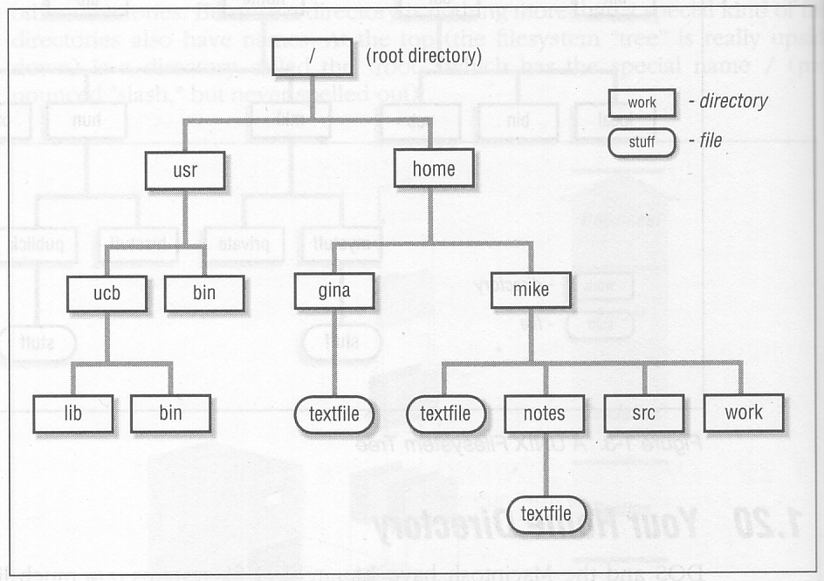
The UNIX File Hierarchy

Slide 22
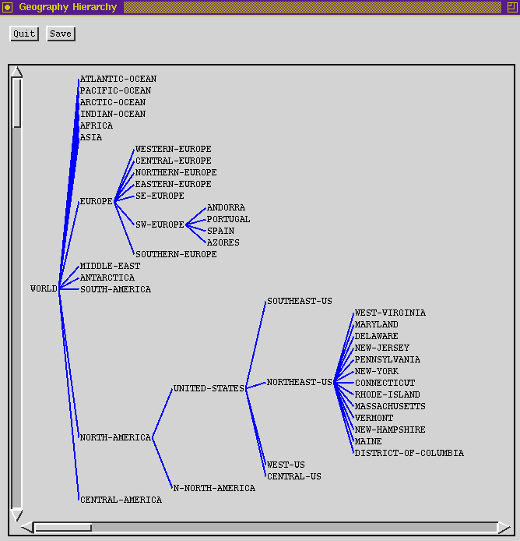
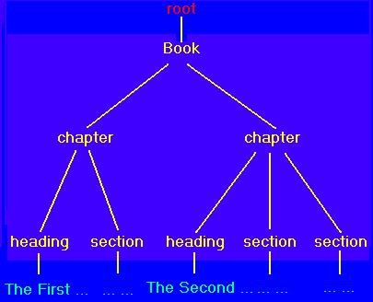
Hierarchies are Ubiquitous

Slide 23
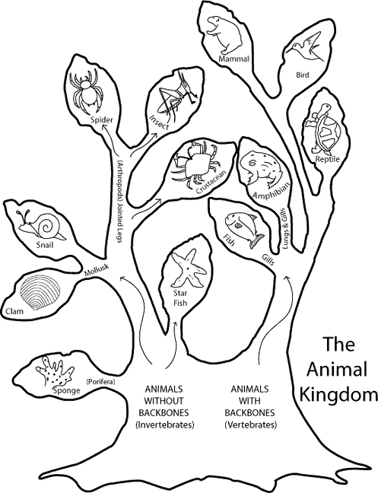
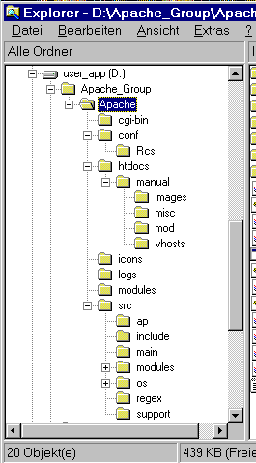
Hierarchies are Ubiquitous

Slide 24
Definition: Filename
A sequence of characters other than slash. Case sensitive.
/
usr
tmp
etc
bin
foo
who
date
dmr
wm4
foo
who
date
.profile
.profile

Slide 25
Definition: Directory
Holds a set of files or other directories.
Case sensitive.
/
usr
tmp
etc
bin
foo
who
date
dmr
wm4
etc
usr
dmr
bin
.profile

Slide 26
Definition: Pathname
A sequence of directory names followed by a simple filename, each separated from the previous one by a /
/
acct
tmp
etc
bin
foo
who
date
staff
s1
<user>
/acct/s1/<user>/.profile
.profile

Slide 27
Definition: Working Directory
A directory that file names refer to by default.
One per process.
/
acct
tmp
etc
bin
foo
who
date
f1
s1
<user>
.profile

Slide 28
Definition: Relative Pathname
A pathname relative to the working directory (as opposed to absolute pathname)
/
acct
tmp
etc
bin
foo
who
date
guest
s1
.. refers to parent directory
. refers to current directory
<user>
.profile
./.profile
../<user>/.profile
.profile

Slide 29
Files and Directories
Files are just a sequence of bytes
  Number of file types (data vs. executable)
  No sections
  Example of UNIX philosophy
Directories are a list of files and status of the files:
  Creation date
  Attributes
  etc.

Slide 30
Tilde Expansion
Each user has a home directory
Some shells (ksh, csh) support ~ operator:
  ~ expands to my home directory
    ~/myfile → /acct/s1/<user>/myfile
  ~user expands to user’s home directory
    ~<user>/CSCE215/file2 /acct/s1/<user>/CSCE215/file2
Useful because home directory locations vary by machine

Slide 31
Mounting File Systems
When UNIX is started, the directory hierarchy corresponds to the file system located on a single disk called the root device.
Mounting allows root to splice the root directory of a file system into the existing directory hierarchy.
File systems created on other devices can be attached to the original directory hierarchy using the mount mechanism.
Commands mount and umount manage

Slide 32
Mounting File Systems
root device
external device
/
/
a
a
b
b
/
Device
Mount Point
a
/
b
/a/b
a
Mount table
b

Slide 33
Printing File Contents
The cat command copies the contents of a file to the terminal. When invoked with a list of file names, it concatenates them.
Some options:
  -n number output lines (starting from 1)
  -v display control-characters in visible form (e.g. ^C)
Interactive commands more and less show a page at a time

Slide 34
Common Utilities for Managing files and directories
pwd print process current dir
ed, vi, emacs… create/edit files
ls list contents of directory
rm remove file
mv rename file
cp copy a file
touch create an empty file
mkdir and rmdir create and remove dir
wc counts the words in a file
file determine file type

Slide 35
File Permissions
UNIX also provides a way to protect files based on users and groups.
Three types of permissions:
    read, process may read contents of file
    write, process may write contents of file
    execute, process may execute file
Three sets of permissions:
    permissions for owner
    permissions for group
    permissions for other

Slide 36
Directory permissions
Same types and sets of permissions as for files
  read: process may a read the directory contents (i.e., list files)
  write: process may add/remove files in the directory
  execute: process may open files in directory or subdirectories

Slide 37
Utilities for Manipulating file attributes
chmod change file permissions
chown change file owner
chgrp change file group
only owner or super-user can change file attributes
upon creation, default permissions given to file modified by process umask value

Slide 38
Chmod command
Symbolic access modes
    example: chmod +r file
Octal access modes
octal read write execute
0 no no no
1 no no yes
2 no yes no
3 no yes yes
4 yes no no
5 yes no yes
6 yes yes no
7 yes yes yes

Slide 39
File System Internals
Notes:
Demo 2:
chmod 000, og+x, 755
umask 000, 777, 022
cp /bin/ls .
./ls (works)
chmod -x ls
./ls (doesn't work)

Slide 40
The Open File Table
I/O operations are done on files by first opening them, reading/writing/etc., then closing them.
The kernel maintains a global table containing information about each open file.
Inode
Mode
Count
Position
1023
read
1
0
1331
read/write
2
50
…

Slide 41
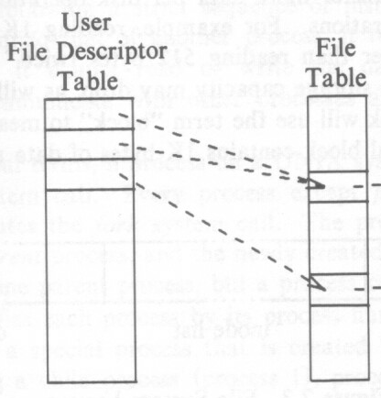
The File Descriptor Table
Each process contains a table of files it has opened.
Each open file is associated with a number or handle, called file descriptor, (fd).
Each entry of this table points to an entry in the open file table.
Starts at 0

Slide 42

Standard in/out/err
The first three entries in the file descriptor table are preset:
Entry 0 is for input
Entry 1 is for output
Entry 2 is for error messages
By default all go to terminal (/dev/tty)
ls

Slide 43
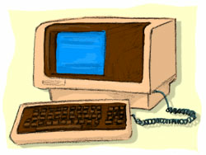
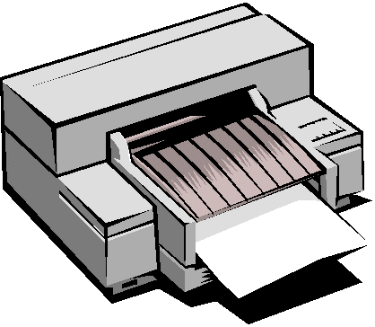
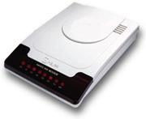
Devices
Besides files, input and output can go from/to various hardware devices
UNIX innovation: Treat these just like files!
  /dev/tty, /dev/lpr, /dev/modem

Slide 44


Redirection
Before a command is executed, the input and output can be changed from the default (terminal) to a file
  Shell modifies file descriptors in child process
  The child program knows nothing about this
ls
ls

Slide 45
Redirection of input/ouput
Redirection of output: >
  example:$ ls > my_files
Redirection of input: <
  example: $ cat <input.data
Append output: >>
  example: $ date >> logfile
Bourne Shell derivatives: fd>
  example: $ ls 2> error_log

Slide 46
Using Devices
Redirection works with devices (just like files)
Special files in /dev directory
  Example: /dev/tty
  Example: /dev/lp
  Example: /dev/null
    cat big_file > /dev/lp
    cat big_file > /dev/null

Slide 47
Questions?
Notes:
Demo 3:
redirection examples:
date
date > output
readline
readline < output
date >> output
cat output
ls -R
ls -R > myfiles
wc -l myfiles

Slide 48

Links
Directories are a list of files and directories.
  Each directory entry links to a file on the disk
  Two different directory entries can link to the same file
    In same directory or across different directories
  Moving a file does not actually move any data around.
    Creates link in new location
    Deletes link in old location
ln command

Slide 49
Symbolic links
Symbolic links are different than regular links (often called hard links). Created with ln -s
Can be thought of as a file that contains the name of another file.
Does not change link count for file
  When original deleted, symbolic link remains
They exist because:
  Hard links don’t work across file systems
  Hard links only work for regular files, not directories
dirent
file
symlink
dirent
file
dirent
Hard link
Symbolic Link

Slide 50
Example
usr tmp etc bin
foo
f1 s1
who date
<user>
etc
.profile

Slide 51
Hard Link
usr tmp etc bin
foo
f1 s1
who date
<user>
etc
.profile

Slide 52
Symbolic Link
acct tmp etc bin
foo
f1 s1
who date
<user>
etc
.profile

Slide 53
Tree Walking
How can do we find a set of files in the hierarchy?
One possibility:
  ls –l –R /
What about:
  All files below a given directory in the hierarchy?
  All files since Jan 1, 2001?
  All files larger than 10K?

Slide 54
find utility
find pathlist expression
find recursively descends through pathlist and applies expression to every file.
expression can be:
  -name pattern
    true if file name matches pattern. Pattern may include shell patterns such as *, must be in quotes to suppress shell interpretation.
  Eg: find / -name '*.c'

Slide 55
find utility (continued)
-perm [+-]mode
  Find files with given access mode, mode must be in octal. Eg: find . 755
-type ch
  Find files of type ch (c=character, b=block, f for plain file, etc..). Eg: find /home –type f
-user userid/username
  Find by owner userid or username
-group groupid/groupname
  Find by group groupid or groupname
-size size
  File size is at least size
many more…

Slide 56
find: logical operations
! expression returns the logical negation of expression
op1 -a op2 matches both patterns
op1 and op2
op1 -o op2 matches either op1 or op2
( ) group expressions together

Slide 57
find: actions
-print prints out the name of the current file (default)
-exec cmd
  Executes cmd, where cmd must be terminated by an escaped semicolon (\; or ';').
  If you specify {} as a command line argument, it is replaced by the name of the current file just found.
  exec executes cmd once per file.
  Example:
    find -name "*.o" -exec rm "{}" ";"

Slide 58
find Examples
Find all files beneath home directory beginning with f
  find ~ -name 'f*' -print
Find all files beneath home directory modified in last day
  find ~ -mtime 1 -print
Find all files beneath home directory larger than 10K
  find ~ -size 10k -print
Count words in files under home directory
  find ~ -exec wc -w {} \; -print
Remove core files
  find / -name core –exec rm {} \;

Slide 59
diff: comparing two files
diff: compares two files and outputs a description of their differences
  Usage: diff [options] file1 file2
  -i: ignore case
apples
oranges
walnuts
apples
oranges
grapes
$ diff test1 test2
3c3
< walnuts
---
> grapes

Slide 60
Other file comparison utilities
cmp
  Tests two files for equality
  If equal, nothing returned. If different, location of first differing byte returned
  Faster than diff for checking equality
comm
  Reads two files and outputs three columns:
    Lines in first file only
    Lines in second file only
    Lines in both files
  Must be sorted
  Options: fields to suppress ( [-123] )

Slide 61

There is only one way to prevent this:
Put in time at the terminal in the environment. Read, try, re-read, try again, understand what you are doing. Don’t shoot in the dark.

Slide 62
Next Time
Processes
Pipes
Filters
Notes:
Demo 4:
find, diff, cmp, comm
find . -name '*.csv' -print
find . -name '*.csv' -a -name 'p*' -print
find . -name '*.csv' -a ! -name 'p*' -print
find . -size +3000k -print
find . -size +3000k -exec ls -l \{} \;
find . -mtime -10
find . -perm 755
find . -perm 755 -type f -print
cp README README2
make changes to README2
diff
cmp ls /bin/ls
ls -R > files1
make changes to some files
ls -R > files2
comm -3 files1 files2

Slide 63
The only way to prevent this:
Notes:
Demo 4:
find, diff, cmp, comm
find . -name '*.csv' -print
find . -name '*.csv' -a -name 'p*' -print
find . -name '*.csv' -a ! -name 'p*' -print
find . -size +3000k -print
find . -size +3000k -exec ls -l \{} \;
find . -mtime -10
find . -perm 755
find . -perm 755 -type f -print
cp README README2
make changes to README2
diff
cmp ls /bin/ls
ls -R > files1
make changes to some files
ls -R > files2
comm -3 files1 files2

