Slide 1
Lecture 3
Processes and Filters

Slide 2
Kernel Data Structures
Information about each process.
Process table: contains an entry for every process in the system.
Open-file table: contains at least one entry for every open file in the system.
User Space
Code
Code
Code
Data
Data
Data
Process Info
Process Info
Process Info
Open File Table
Process Table
Kernel Space

Slide 3
Unix Processes
Process: An entity of execution
Definitions
  program: collection of bytes stored in a file that can be run
  image: computer execution environment of program
  process: execution of an image
Unix can execute many processes simultaneously.

Slide 4
Background Jobs
By default, executing a command in the shell will wait for it to exit before printing out the next prompt
Trailing a command with & allows the shell and command to run simultaneously
$ /bin/sleep 10 &
[1] 3424
$

Slide 5
Process Creation
Interesting trait of UNIX
fork system call clones the current process
exec system call replaces current process
A fork is typically followed by an exec
A
A
A
A
B

Slide 6
Process Setup
All of the per process information is copied with the fork operation
  Working directory
  Open files
Copy-on-write makes this efficient
Before exec, these values can be modified

Slide 7
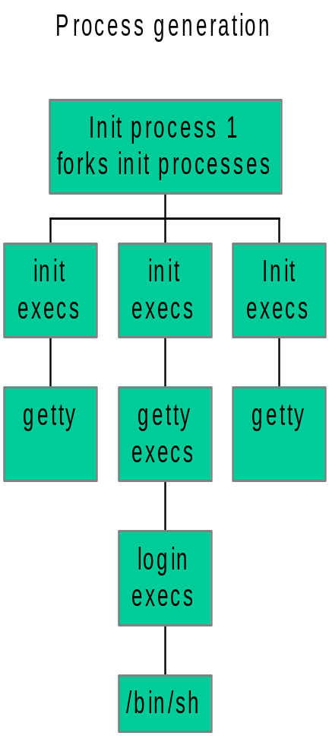
Unix process genealogy

Slide 8
Program Arguments
When a process is started, it is sent a list of strings
  argv, argc respectively give the number and value of the program's command-line arguments.
The process can use this list however it wants to

Slide 9
Ending a process
When a process ends, there is a return code associated with the process
This is a positive integer
  0 means success
  >0 represent various kinds of failure, up to process

Slide 10
Process Information Maintained
Working directory
File descriptor table
Process id
  number used to identify process
Process group id
  number used to identify set of processes
Parent process id
  process id of the process that created the process

Slide 11
Process Information Maintained
Umask
  Default file permissions for new file
Effective user and group id
  The user and group this process is running with permissions as
Real user and group id
  The user and group that invoked the process
Environment variables
We haven’t talked about these yet:

Slide 12
Setuid and Setgid Mechanisms
The kernel can set the effective user and group ids of a process to something different than the real user and group
  Files executed with a setuid or setgid flag set cause the these values to change
Make it possible to do privileged tasks:
  Change your password
Open up a can of worms for security if buggy

Slide 13

Environment of a Process
A set of name-value pairs associated with a process
Keys and values are strings
Passed to children processes
Cannot be passed back up
Common examples:
  PATH: Where to search for programs
  TERM: Terminal type

Slide 14

The PATH environment variable
Colon-separated list of directories.
Non-absolute pathnames of executables are only executed if found in the list.
  Searched left to right
Example:
$ myprogram
sh: myprogram not found
$ PATH=/bin:/usr/bin:/acct/s1/bagodonuts/bin
$ myprogram
hello!

Slide 15
Having . In Your Path
$ ls
foo
$ foo
sh: foo: not found
$ ./foo
Hello, foo.
What not to do:
$ PATH=.:/bin
$ ls
foo
$ cd /usr/badguy
$ ls –l
-rwxr-xr-x 1 imbad student 254 2006-08-30 15:56 ls
$ ls
Congratulations, your files have been removed and you have just sent email to Dr. Buell challenging him to a duel.

Slide 16
Shell Variables
Shells have several mechanisms for creating variables. A variable is a name representing a string value. Example: PATH
  Shell variables can save time and reduce typing errors, variables
Allow you to store and manipulate information
  Eg: ls $DIR > $FILE
Two types: local and environmental
  local are set by the user of by the shell itself
  environmental come from the operating system and are passed to children

Slide 17
Variables (con’t)
Syntax varies by shell
  name=value # sh, ksh
  set name = value # csh
To access the value: $var
Turn local variable into environment:
export variable

Slide 18
Environmental Variables
NAME MEANING
$HOME Absolute pathname of your home directory
$PATH A list of directories to search for
$MAIL Absolute pathname to mailbox
$USER Your user id
$SHELL Absolute pathname of login shell
$TERM Type of your terminal
$PS1 Prompt

Slide 19
Inter-process Communication
Ways in which processes communicate:
Passing arguments, environment
Read/write regular files
Exit values
Signals
Pipes

Slide 20

Signals
Signal: A message a process can send to a process or process group, if it has appropriate permissions.
Message type represented by a symbolic name
For each signal, the receiving process can:
  Explicitly ignore signal
  Specify action to be taken upron receipt (signal handler)
  Otherwise, default action takes place (usually process is killed)
Common signals:
  SIGKILL, SIGTERM, SIGINT
  SIGSTOP, SIGCONT
  SIGSEGV, SIGBUS

Slide 21

An Example of Signals
When a child exists, it sends a SIGCHLD signal to its parent.
If a parent wants to wait for a child to exit, it tells the system it wants to catch the SIGCHLD signal
When a parent does not issue a wait, it ignores the SIGCHLD signal

Slide 22
Process Subsystem utilities
ps monitors status of processes
kill send a signal to a pid
wait parent process wait for one of its children to terminate
nohup makes a command immune to the hangup and terminate signal
sleep sleep in seconds
nice run processes at low priority

Slide 23

Pipes
One of the cornerstones of UNIX

Slide 24
Pipes
General idea: The input of one program is the output of the other, and vice versa
Both programs run at the same time
A
B

Slide 25
Pipes (2)
Often, only one end of the pipe is used
Could this be done with files?
standard out
standard in
A
B

Slide 26
File Approach
Run first program, save output into file
Run second program, using file as input
Unnecessary use of the disk
  Slower
  Can take up a lot of space (eg: ls -R followed by wc)
Makes no use of multi-tasking
process 1
process 2

Slide 27
More about pipes
What if a process tries to read data but nothing is available?
  UNIX puts the reader to sleep until data available
What if a process can’t keep up reading from the process that’s writing?
  UNIX keeps a buffer of unread data
    This is referred to as the pipe size.
  If the pipe fills up, UNIX puts the writer to sleep until the reader frees up space (by doing a read)
Multiple readers and writers possible with pipes.

Slide 28
More about Pipes
Pipes are often chained together
  Called filters
standard out
standard in
A
B
C

Slide 29

Interprocess Communication
For Unrelated Processes
FIFO (named pipes)
  A special file that when opened represents pipe
System V IPC
  message queues
  semaphores
  shared memory
Sockets (client/server model)
p1
p2

Slide 30
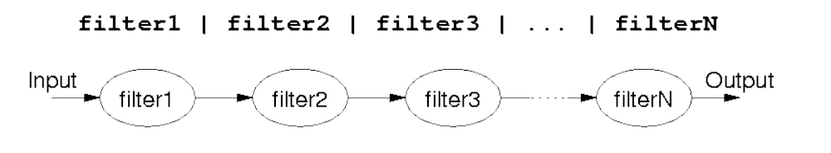
Shell Pipelines
Output of one program becomes input to another
  Uses concept of UNIX pipes
Example: $ who | wc -l
  counts the number of users logged in
Pipelines can be long

Slide 31
What’s the difference?
Both of these commands send input to command from a file instead of the terminal:
$ cat file | command
vs.
$ command < file

Slide 32
An Extra Process
$ cat file | command
cat
command
$ command < file
command

Slide 33
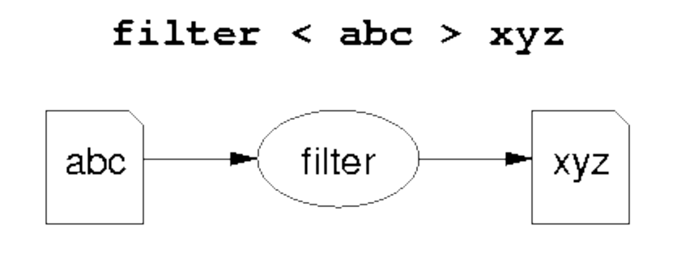
Introduction to Filters
A class of Unix tools called filters.
  Utilities that read from standard input, transform the file, and write to standard out
Using filters can be thought of as data oriented programming.
  Each step of the computation transforms data stream.

Slide 34
Examples of Filters
Sort
  Input: lines from a file
  Output: lines from the file sorted
Grep
  Input: lines from a file
  Output: lines that match the argument
Awk
  Programmable filter

Slide 35
cat: The simplest filter
The cat command copies its input to output unchanged (identity filter). When supplied a list of file names, it concatenates them onto stdout.
Some options:
  -n number output lines (starting from 1)
  -v display control-characters in visible form (e.g. ^C)
cat file*
ls | cat -n

Slide 36
head
Display the first few lines of a specified file
Syntax: head [-n] [filename...]
  -n - number of lines to display, default is 10
  filename... - list of filenames to display
When more than one filename is specified, the start of each files listing displays
==>filename<==

Slide 37
tail
Displays the last part of a file
Syntax: tail +|-number [lbc] [f] [filename]
or: tail +|-number [l] [rf] [filename]
  +number - begins copying at distance number from beginning of file, if number isn’t given, defaults to 10
  -number - begins from end of file
  l,b,c - number is in units of lines/block/characters
  r - print in reverse order (lines only)
  f - if input is not a pipe, do not terminate after end of file has been copied but loop. This is useful to monitor a file being written by another process

Slide 38
head and tail examples
head /etc/passwd
head *.c
tail +20 /etc/passwd
ls -lt | tail -3
head –100 /etc/passwd | tail -5
tail –f /usr/local/httpd/access_log

Slide 39
tee
Unix Command
Standard output
file-list
Copy standard input to standard output and one or more files
  Captures intermediate results from a filter in the pipeline

Slide 40
tee con’t
Syntax: tee [ -ai ] file-list
  -a - append to output file rather than overwrite, default is to overwrite (replace) the output file
  -i - ignore interrupts
  file-list - one or more file names for capturing output
Examples
ls | head –10 | tee first_10 | tail –5
who | tee user_list | wc

Slide 41
Unix Text Files: Delimited Data
Tab Separated
Pipe-separated
John 99
Anne 75
Andrew 50
Tim 95
Arun 33
Sowmya 76
COMP1011|2252424|Abbot, Andrew John |3727|1|M
COMP2011|2211222|Abdurjh, Saeed |3640|2|M
COMP1011|2250631|Accent, Aac-Ek-Murhg |3640|1|M
COMP1021|2250127|Addison, Blair |3971|1|F
COMP4012|2190705|Allen, David Peter |3645|4|M
COMP4910|2190705|Allen, David Pater |3645|4|M
Colon-separated
root:ZHolHAHZw8As2:0:0:root:/root:/bin/ksh jas:nJz3ru5a/44Ko:100:100:John Shepherd:/home/jas:/bin/ksh cs1021:iZ3sO90O5eZY6:101:101:COMP1021:/home/cs1021:/bin/bash cs2041:rX9KwSSPqkLyA:102:102:COMP2041:/home/cs2041:/bin/csh cs3311:mLRiCIvmtI9O2:103:103:COMP3311:/home/cs3311:/bin/sh

Slide 42
cut: select columns
The cut command prints selected parts of input lines.
  can select columns (assumes tab-separated input)
  can select a range of character positions
Some options:
  -f listOfCols: print only the specified columns (tab-separated) on output
  -c listOfPos: print only chars in the specified positions
  -d c: use character c as the column separator
Lists are specified as ranges (e.g. 1-5) or comma-separated (e.g. 2,4,5).

Slide 43
cut examples
cut -f 1 < data
cut -f 1-3 < data
cut -f 1,4 < data
cut -f 4- < data
cut -d'|' -f 1-3 < data
cut -c 1-4 < data
Unfortunately, there's no way to refer to "last column" without counting the columns.

Slide 44
paste: join columns
The paste command displays several text files "in parallel" on output.
If the inputs are files a, b, c
  the first line of output is composed
  of the first lines of a, b, c
  the second line of output is composed
  of the second lines of a, b, c
Lines from each file are separated by a tab character.
If files are different lengths, output has all lines from longest file, with empty strings for missing lines.
1
2
3
4
5
6
1 3 5
2 4 6

Slide 45
paste example
cut -f 1 < data > data1
cut -f 2 < data > data2
cut -f 3 < data > data3
paste data1 data3 data2 > newdata

Slide 46
sort: Sort lines of a file
The sort command copies input to output but ensures that the output is arranged in ascending order of lines.
  By default, sorting is based on ASCII comparisons of the whole line.
Other features of sort:
  understands text data that occurs in columns.
  (can also sort on a column other than the first)
  can distinguish numbers and sort appropriately
  can sort files "in place" as well as behaving like a filter
  capable of sorting very large files

Slide 47
sort: Options
Syntax: sort [-dftnr] [-o filename] [filename(s)]
-d Dictionary order, only letters, digits, and whitespace are significant in determining sort order
-f Ignore case (fold into lower case)
-t Specify delimiter
-n Numeric order, sort by arithmetic value instead of first digit
-r Sort in reverse order
-o filename - write output to filename, filename can be the same as one of the input files
Lots of more options…
Notes:
Following is normally true for sort
1) uppercase is sorted separately from lowercase but alphabetically within group
2) Numbers are sorted according to first digit
3) Punctuation/symbols are not grouped
Bottom line, it is an ASCII sort
sort is a filter and so can use redirection and in pipes, it can also specify input and output files as part of command
sort starts with the first character of the line and keeps going until it resolves all conflicts in order

Slide 48
sort: Specifying fields
Delimiter : -td
Old way:
  +f[.c][options] [-f[.c][options]
    +2.1 –3 +0 –2 +3n
  Exclusive
  Start from 0 (unlike cut, which starts at 1)
New way:
  -k f[.c][options][,f[.c][options]]
    -k2.1 –k0,1 –k3n
  Inclusive
  Start from 1

Slide 49
sort Examples
sort +2nr < data
sort –k2nr data
sort -t: +4 /etc/passwd
sort -o mydata mydata

Slide 50
uniq: list UNIQue items
Remove or report adjacent duplicate lines
Syntax: uniq [ -cdu] [input-file] [ output-file]
-c Supersede the -u and -d options and generate an output report with each line preceded by an occurrence count
-d Write only the duplicated lines
-u Write only those lines which are not duplicated
  The default output is the union (combination) of -d and -u

Slide 51
wc: Counting results
The word count utility, wc, counts the number of lines, characters or words
Options:
-l Count lines
-w Count words
-c Count characters
Default: count lines, words and chars

Slide 52
wc and uniq Examples
who | sort | uniq –d
wc my_essay
who | wc
sort file | uniq | wc –l
sort file | uniq –d | wc –l
sort file | uniq –u | wc -l

Slide 53
Next Time
Regular Expressions
  Allow you to search for text in files
  grep command
Utilities that let you write high level programs for stream manipulation:
  sed, awk
We will soon learn how to write scripts that use this utilities in interesting ways.

