Slide 1
Lecture 6
Shell Part II:
sh, bash, ksh

Slide 2
Parsing and Quoting

Slide 3
How the Shell Parses
Part 1: Read the command:
  Read one or more lines a needed
  Separate into tokens using space/tabs
  Form commands based on token types
Part 2: Evaluate a command:
  Expand word tokens (command substitution, parameter expansion)
  Split words into fields
  Setup redirections, environment
  Run command with arguments

Slide 4
Useful Program for Testing
/ftproot/okeefe/215/showargs.c
#include <stdio.h>
int main(int argc, char *argv[])
{
int i;
for (i=0; i < argc; i++) {
printf("Arg %d: %s\n", i, argv[i]);
}
return(0);
}

Slide 5
Shell Comments
Comments begin with an unquoted #
Comments end at the end of the line
Comments can begin whenever a token begins
Examples
# This is a comment
# and so is this
grep foo bar # this is a comment
grep foo bar# this is not a comment

Slide 6
Special Characters
The shell processes the following characters specially unless quoted:
| & ( ) < > ; " ' $ ` space tab newline
The following are special whenever patterns are processed:
* ? [ ] (turn off with set -o noglob)
The following are special at the beginning of a word:
# ~
The following are special when processing assignments:
= [ ]

Slide 7
Token Types
The shell uses spaces and tabs to split the line or lines into the following types of tokens:
  Control operators (|, ||)
  Redirection operators (<, >, >>)
  Reserved words (while, if)
  Assignment tokens (foo=bar)
  Word tokens (everything else)

Slide 8
Operator Tokens
Operator tokens are recognized everywhere unless quoted. Spaces are optional before and after operator tokens.
I/O Redirection Operators:
> >> >| >& < << <<- <&
  Each I/O operator can be immediately preceded by a single digit
Control Operators:
| & ; ( ) || && ;;

Slide 9
Shell Quoting
Quoting causes characters to loose special meaning.
\ Unless quoted, \ causes next character to be quoted. In front of new-line causes lines to be joined.
'…' Literal quotes. Cannot contain '
"…" Removes special meaning of all characters except $, ", \ and `. The \ is only special before one of these characters and new-line.

Slide 10
Quoting Examples
$ cat file*
a
b
$ cat "file*"
cat: file* not found
$ cat file1 > /dev/null
$ cat file1 ">" /dev/null
a
cat: >: cannot open
FILES="file1 file2"
$ cat "$FILES"
cat: file1 file2 not found

Slide 11
Simple Commands
A simple command consists of three types of tokens:
  Assignments (must come first)
  Command word tokens (name and args)
  Redirections: redirection-op + word-op
  The first token must not be a reserved word
  Command terminated by new-line or ;
Example:
  foo=bar z=`date`
  print $HOME
  x=foobar > q$$ $xyz z=3

Slide 12
Word Splitting
After parameter expansion, command substitution, and arithmetic expansion, the characters that are generated as a result of these expansions (if not inside double quotes) are checked for split characters
Default split character is space or tab
Split characters are defined by the value of the IFS variable (IFS="" disables)

Slide 13
Word Splitting Examples
FILES="file1 file2"
cat $FILES
a
b
IFS=
cat $FILES
cat: file1 file2: cannot open
IFS=x v=exit
print exit $v "$v"
exit e it exit

Slide 14
Pathname Expansion
After word splitting, each field that contains pattern characters is replaced by the pathnames that match
Quoting prevents expansion
set –o noglob disables
  Not in original Bourne shell, but in POSIX

Slide 15
Parsing Example
DATE=`date` echo $foo > \
/dev/null
DATE=`date` echo $foo > /dev/null
assignment
word
param
redirection
echo hello there
/dev/null
/bin/echo hello there
/dev/null
PATH expansion
split by IFS

Slide 16
The eval built-in
eval arg …
  Causes all the tokenizing and expansions to be performed again

Slide 18
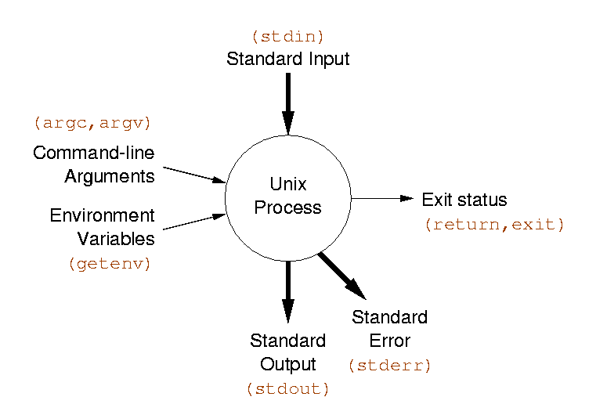
Input/Output Shell Features
Standard input, output, error
  Redirection
  Here documents
  Pipelines
  Command substitution
Exit status
  $?
  &&, ||, if, while
Environment
  export, variables
Arguments
  Command substitution
  Variables
  Wildcards

Slide 19
Power of the Shell
The shell is a language that lets you use programs as you would use procedures in other languages
  Called with command line arguments
  If used in if, while statements programs behave like functions returning a boolean value
    /bin/true: Program that just does exit(0)
    /bin/false: Program that just does exit(1)
  If used in command substitution, programs behave like functions returning a string
  Environment behaves like global variables

Slide 20
test Summary
String based tests
-z string Length of string is 0
-n string Length of string is not 0
string1 = string2 Strings are identical
string1 != string2 Strings differ
string String is not NULL
Numeric tests
int1 –eq int2 First int equal to second
int1 –ne int2 First int not equal to second
-gt, -ge, -lt, -le greater, greater/equal, less, less/equal
File tests
-r file File exists and is readable
-w file File exists and is writable
-f file File is regular file
-d file File is directory
-s file file exists and is not empty
Logic
! Negate result of expression
-a, -o and operator, or operator
( expr ) groups an expression

Slide 21
Example
#!/bin/sh
if test -f /tmp/stuff && \
[ `wc –l < /tmp/stuff` -gt 10 ]
then
echo "The file has more than 10 lines"
else
echo "The file is nonexistent or small"
fi

Slide 22
Arithmetic
No arithmetic built in to /bin/sh
Use external command /bin/expr
expr expression
  Evaluates expression and sends the result to standard output
  Yields a numeric or string result
expr 4 "*" 12
expr \( 4 + 3 \) \* 2

Slide 23
for loops
Different than C:
for var in list
do
command
done
Typically used with positional params or a list of files:
sum=0
for var in "$@"
do
sum=`expr $sum + $var`
done
for file in *.c ; do echo "We have $file"
done

Slide 24
Case statement
Like a C switch statement for strings:
  case $var in
  opt1) command1
  command2
  ;;
  opt2) command
  ;;
  *) command
  ;;
  esac
* is a catch all condition

Slide 25
Case Example
#!/bin/sh
echo "Say something."
while true
do
read INPUT_STRING
case $INPUT_STRING in
hello)
echo "Hello there."
;;
bye)
echo "See ya later."
;;
*)
echo "I'm sorry?"
;;
esac
done
echo "Take care."

Slide 26
Case Options
opt can be a shell pattern, or a list of shell patterns delimited by |
Example:
case $name in
*[0-9]*)
echo "That doesn't seem like a name."
;;
J*|K*)
echo "Your name starts with J or K, cool."
;;
*)
echo "You're not special."
;;
esac

Slide 27
Types of Commands
All behave the same way
Programs
  Most that are part of the OS in /bin
Built-in commands
Functions
Aliases

Slide 28
Built-in Commands
Built-in commands are internal to the shell and do not create a separate process. Commands are built-in because:
  They are intrinsic to the language (exit)
  They produce side effects on the process (cd)
  They perform much better
    No fork/exec

Slide 29
Important Built-in Commands
exec : replaces shell with program
cd : change working directory
shift : rearrange positional parameters
(un)set : set positional parameters
wait : wait for background proc. to exit
umask : change default file permissions
exit : quit the shell
eval : parse and execute string
time : run command and print times
export : put variable into environment
trap : set signal handlers

Slide 30
Important Built-in Commands
continue : continue in loop
break : break in loop
return : return from function
: : true
. : read file of commands into
current shell; like #include

Slide 31
Reading Lines
read is used to read a line from a file and to store the result into shell variables
  read –r prevents special processing
  Uses IFS to split into words
  If no variable specified, uses REPLY
read
read –r NAME
read FIRSTNAME LASTNAME

Slide 32
trap command
trap specifies command that should be executed when the shell receives a signal of a particular value.
trap [ [command] {signal}+]
  If command is omitted, signals are ignored
Especially useful for cleaning up temporary files
trap 'echo "please, dont interrupt!"' SIGINT
trap 'rm /tmp/tmpfile' EXIT

Slide 33
Functions
Functions are similar to scripts and other commands except that they can produce side effects in the callers script. The positional parameters are saved and restored when invoking a function. Variables are shared between caller and callee.
Syntax:
name ()
{
commands
}

Slide 34
Aliases
Like macros (#define in C)
Shorter to define than functions, but more limited
Not recommended for scripts
Example:
alias rm='rm –i'

Slide 35
Search Rules
Special built-ins
Functions
  command bypasses search for functions
Built-ins not associated with PATH
PATH search
Built-ins associated with PATH
Executable images

Slide 36
Script Examples
Rename files to lower case
Strip CR from files
Emit HTML for directory contents

Slide 37
Rename files
#!/bin/sh
for file in *
do
lfile=`echo $file | tr A-Z a-z`
if [ $file != $lfile ]
then
mv $file $lfile
fi
done

Slide 38
Remove DOS Carriage Returns
#!/bin/sh
TMPFILE=/tmp/file$$
if [ "$1" = "" ]
then
tr -d '\r'
exit 0
fi
trap 'rm -f $TMPFILE' EXIT
for file in "$@"
do
if tr -d '\r' < $file > $TMPFILE
then
mv $TMPFILE $file
fi
done

Slide 39
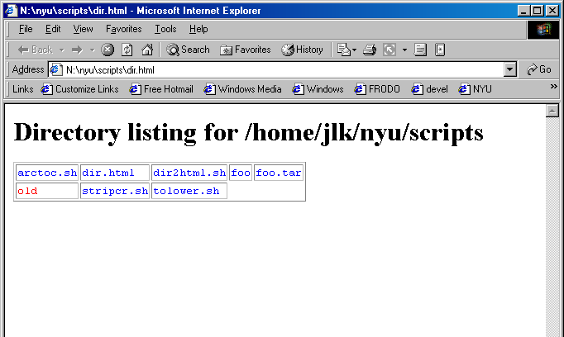
Generate HTML
$ dir2html.sh > dir.html

Slide 40
The Script
#!/bin/sh
if test –n "$1"
then
cd "$1"
fi
cat <<HUP
<html>
<h1> Directory listing for $PWD </h1>
<table border=1>
<tr>
HUP
num=0 # global variable counting file number
for file in *
do
genhtml $file # this function is on next page
done
cat <<HUP
</tr>
</table>
</html>
HUP

Slide 41
Funciton genhtml
genhtml()
{
file=$1
echo "<td><tt>"
if [ -f $file ]
then echo "<font color=blue>$file</font>"
elif [ -d $file ]
then echo "<font color=red>$file</font>"
else echo "$file"
fi
echo "</tt></td>"
# Check if this is the end of the row
num=`expr $num + 1`
if [ $num -gt 4 ]
then
echo "</tr><tr>"
num=0
fi
}

Slide 42
Korn Shell / bash Features

Slide 43
Command Substitution Syntax
Better syntax with $(command)
  Allows nesting
  x=$(cat $(generate_file_list))
Backward compatible with ` … ` notation

Slide 44
Expressions
Expressions are built-in with the [[ ]] operator
if [[ $var = "" ]] …
Gets around parsing issues when using /bin/test, allows checking strings against patterns
Operations:
  string == pattern
  string != pattern
  string1 < string2
  file1 –nt file2
  file1 –ot file2
  file1 –ef file2
  &&, ||
Patterns:
  Can be used to do string matching
if [[ $foo = *a* ]]
if [[ $foo = [abc]* ]]

Slide 45
Additonal Parameter Expansion
${#param} – Length of param
${param#pattern} – Left strip min pattern
${param##pattern} – Left strip max pattern
${param%pattern} – Right strip min pattern
${param%%pattern} – Right strip max pattern
${param-value} – Default value if param not set

Slide 46
Variables
Variables can be arrays
  foo[3]=test
  echo ${foo[3]}
Indexed by number
${#arr} is length of the array
Multiple array elements can be set at once:
  set –A foo a b c d
  echo ${foo[1]}
Set command can also be used for positional params: set a b c d; print $2

Slide 47
Functions
Alternative function syntax:
function name {
commands
}
Allows for local variables (with typeset)
$0 is set to the name of the function

Slide 48
Additional Features
Built-in arithmetic: Using $((expression ))
  e.g., print $(( 1 + 1 * 8 / x ))
Tilde file expansion
~ $HOME
~user home directory of user
~+ $PWD
~- $OLDPWD

Slide 49
Printing (ksh only)
Built-in print command to replace echo
Not subject to variations in echo
Much faster
Allows options:
-u# print to specific file descriptor

Slide 50
KornShell 93

Slide 51
Variable Attributes
By default attributes hold strings of unlimited length
Attributes can be set with typeset:
  readonly (-r) – cannot be changed
  export (-x) – value will be exported to env
  upper (-u) – letters will be converted to upper case
  lower (-l) – letters will be converted to lower case
  ljust (-L width) – left justify to given width
  rjust (-R width) – right justify to given width
  zfill (-Z width) – justify, fill with leading zeros
  integer (-I [base]) – value stored as integer
  float (-E [prec]) – value stored as C double
  nameref (-n) – a name reference

Slide 52
Name References
A name reference is a type of variable that references another variable.
nameref is an alias for typeset -n
  Example:
user1="jeff"
user2="adam"
typeset –n name="user1"
print $name
jeff

Slide 53
New Parameter Expansion
${param/pattern/str} – Replace first pattern with str
${param//pattern/str} – Replace all patterns with str
${param:offset:len} – Substring

Slide 54
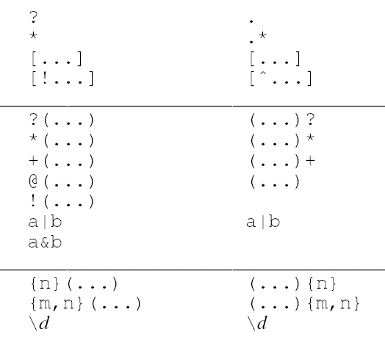
Patterns Extended
Patterns
Regular Expressions
Additional pattern types so that shell patterns are equally expressive as regular expressions
Used for:
  file expansion
  [[ ]]
  case statements
  parameter expansion

Slide 55
ANSI C Quoting
$'…' Uses C escape sequences
$'\t' $'Hello\nthere'
printf added that supports C like printing:
printf "You have %d apples" $x
Extensions
  %b – ANSI escape sequences
  %q – Quote argument for reinput
  \E – Escape character (033)
  %P – convert ERE to shell pattern
  %H – convert using HTML conventions
  %T – date conversions using date formats

Slide 56
Associative Arrays
Arrays can be indexed by string, like awk
Declared with typeset –A
Set: name["foo"]="bar"
Reference ${name["foo"]}
Subscripts: ${!name[@]}

Slide 57
Coprocesses
|& operator supports a simple form of concurrent processing
cmd |&
cmd runs as a background process whose standard input and output channels are connected to the original parent shell via a two way pipe.
Can read and write from process with
  read –p
  print –p
Note that echo couldn’t be used. Why?

Slide 58
C Expressions
We have already seen built-in expressions with the [[ ]] operator:
  [[ $var = *foo* ]] && print "contains foo"
New operator (( )) for C-like numeric expressions:
  (( x > 10 )) && print "x=$x, greater than 10"
  (( x ++ ))
  Note variables don't have to be used with $ inside parens
Value of (( )) expression can be used
with $(( ))
  y=$(( x + 1 ))
  print $(( x * y - sin(y) ))

Slide 59
Compound Variables
Variables can contain subfields (like structures or classes)
Syntax: variable name containing .
Example:
cust=(name=Jeff zip=10003)
cust.state=NY
print ${cust.name}
print ${!cust.*}

Slide 60
New for loop syntax
Regular syntax:
for var in list
do
…
done
Additional syntax like C:
for (( initialization; condition; increment ))
do
…
done
Example: for (( i=0; i < $VAR; i++))

Slide 61
Example: Word Count
#!/home/unixtool/bin/ksh
integer l=0 w=0 c=0
while read –r LINE
do
(( l++ ))
set -- $LINE
(( w += $# ))
(( c += ${#LINE}+1 ))
done < $1
print "$l lines, $w words, $c characters"

Slide 62
Example: Word Count
integer l=0 w=0 c=0
while read –r LINE
do
(( l++ ))
set -- $LINE
(( w += $# ))
(( c += ${#LINE}+1 ))
done < $1
print "$l lines, $w words, $c characters"
integer tag indicates variables will be used as integers
while loop is a command, so redirection works

Slide 63
Example: Word Count
integer l=0 w=0 c=0
while read –r LINE
do
(( l++ ))
set -- $LINE
(( w += $# ))
(( c += ${#LINE}+1 ))
done < $1
print "$l lines, $w words, $c characters"
set -- $LINE turns LINE into positional parameters ($1, …), splitting up the value with IFS
$# is the number of positional parameters

Slide 64
Example: Word Count
integer l=0 w=0 c=0
while read –r LINE
do
(( l++ ))
set -- $LINE
(( w += $# ))
(( c += ${#LINE}+1 ))
done < $1
print "$l lines, $w words, $c characters"
${#LINE} returns the length of the value of LINE
We add 1 because the newline character is not part of LINE

Slide 65
Example: Spell a Phone Number
Given a number, finds possible words that the number spells on a telephone.
Example:
$ phonespell 8643
void

Slide 66
Algorithm
Create function combo that prints all combinations of words. Check those against the dictionary.
function combo is recursive:
  Pass in part of number, part of word spelled
combo 8643 ""
combo 643 t
combo 643 u
combo 643 v
combo 43 vm
combo 43 vn
combo 43 vo
…
combo "" void

Slide 67
Example: Spell a Phone Number
function combo
{
typeset num=$1 word=$2
if [[ $num = '' ]]
then print $word
else typeset -L1 digit=$num
for letter in ${get_letter[digit]}
do combo "${num#?}" "$word$letter"
done
fi
}
functions defined in ksh take arguments as positional parameters, like commands
typeset makes a variable local

Slide 68
Example: Spell a Phone Number
function combo
{
typeset num=$1 word=$2
if [[ $num = '' ]]
then print $word
else typeset -L1 digit=$num
for letter in ${get_letter[digit]}
do combo "${num#?}" "$word$letter"
done
fi
}
End of recursion: If number is empty, just print the given word. Should end up happening for every combination

Slide 69
Example: Spell a Phone Number
function combo
{
typeset num=$1 word=$2
if [[ $num = '' ]]
then print $word
else typeset -L1 digit=$num
for letter in ${get_letter[digit]}
do combo "${num#?}" "$word$letter"
done
fi
}
Extract leftmost digit from num

Slide 70
Example: Spell a Phone Number
function combo
{
typeset num=$1 word=$2
if [[ $num = '' ]]
then print $word
else typeset -L1 digit=$num
for letter in ${get_letter[digit]}
do combo "${num#?}" "$word$letter"
done
fi
}
for loop goes through all letters that correspond to the number (stored in get_letter array, shown next slide)
Recursively calls itself for each letter, taking off one character from the left (using the # operator with pattern ?)

Slide 71
Spell a Phone Number (cont’)
set -A get_letter o i "a b c" "d e f" "g h i" "j k l" \
"m n o" "p r s" "t u v" "w x y"
# method 1
combo $1 | comm -12 /usr/dict/words -
# method 2
trap 'rm -f /tmp/full$$' EXIT
combo $1 > /tmp/full$$
spell < /tmp/full$$ | comm -13 - /tmp/full$$
set –A arrayname value value ...
  sets elements of an array all at once

Slide 72
Spell a Phone Number (cont’)
set -A get_letter o i "a b c" "d e f" "g h i" "j k l" \
"m n o" "p r s" "t u v" "w x y"
# method 1
combo $1 | comm -12 /usr/dict/words -
# method 2
trap 'rm -f /tmp/full$$' EXIT
combo $1 > /tmp/full$$
spell < /tmp/full$$ | comm -13 - /tmp/full$$
Call function combo with first argument, pipe to comm
  suppress fields 1 and 2 (show only matching lines)
  combo emits sorted lines, and dictionary is sorted so comm works well

Slide 73
Spell a Phone Number (cont’)
set -A get_letter o i "a b c" "d e f" "g h i" "j k l" \
"m n o" "p r s" "t u v" "w x y"
# method 1
combo $1 | comm -12 /usr/dict/words -
# method 2
trap 'rm -f /tmp/full$$' EXIT
combo $1 > /tmp/full$$
spell < /tmp/full$$ | comm -13 - /tmp/full$$
Another method: use spell command
  Create temporary file storing combos
  Run through spell, generating list of misspelled words
  Pipe to comm, suppressing fields 1 and 3 (show correct words)

Slide 74
Example: Mortgage Calculator
float rate=$1 principle=$2 payment
integer months years=$3
[[ $1 ]] || read -r 'rate?rate in per cent: '
[[ $2 ]] || read -r 'principle?principle: '
[[ $3 ]] || read -r 'years?years to amoritization: '
print "\n\n\tprinciple\t$principle"
print "\trate\t\t$rate"
print "\tamortization\t$years"
(( months = years*12 ))
(( rate /= 1200. ))
(( payment = (principle*rate)/(1.-pow(1.+rate,-months)) ))
Declare variables
Read in unspecified inputs

Slide 75
Example: Mortgage Calculator
float rate=$1 principle=$2 payment
integer months years=$3
[[ $1 ]] || read -r 'rate?rate in per cent: '
[[ $2 ]] || read -r 'principle?principle: '
[[ $3 ]] || read -r 'years?years to amortization: '
print "\n\n\tprinciple\t$principle"
print "\trate\t\t$rate"
print "\tamortization\t$years"
(( months = years*12 ))
(( rate /= 1200. ))
(( payment = (principle*rate)/(1.-pow(1.+rate,-months)) ))
Initialize values
Uses built-in arithmetic (pow, floating point /)

Slide 76
Example: Mortgage Calculator
printf "\tmonthly payment\t%8.2f\n\n" "$payment"
print '\tYears Balance'
print '\t====== ======='
for (( months=0; principle > 0; months++))
do (( principle *= (1.+rate) ))
(( principle -= payment ))
if (( ((months+1)%12) == 0 ))
then printf "\t%d\t%8.2f\n" months/12 "$principle"
fi
done
Print table header
  Uses printf to format floating point number

Slide 77
Example: Mortgage Calculator
printf "\tmonthly payment\t%8.2f\n\n" "$payment"
print '\tYears Balance'
print '\t====== ======='
for (( months=0; principle > 0; months++))
do (( principle *= (1.+rate) ))
(( principle -= payment ))
if (( ((months+1)%12) == 0 ))
then printf "\t%d\t%8.2f\n" months/12 "$principle"
fi
done
C-style for loop with numerical calculations

Slide 78
Documentation
Web version of Learning the KornShell documents ksh93. Good for learning ksh.
Glass documents ksh88 and bash
UNIX in a Nutshell has a chapter that is a great ksh93 reference. Documents:
  Bourne shell compatible features
  ksh88 compatible features
  ksh93 features

