Slide 1
Lecture 7
Networking, HTTP, CGI

Slide 2
Network Application
Client application and server application communicate via a network protocol
A protocol is a set of rules on how the client and server communicate
web client
HTTP
web server

Slide 3
Internet Protocol Suite
user
application layer
client
server
TCP
transport layer
TCP
kernel
IP
network layer
IP
hardware
hardware
datalink and physical layer
(ethernet)

Slide 4
Network Packet
Ethernet header
IP header
TCP header
Your data

Slide 5
TCP/IP
TCP and IP were developed as a standard networking protocol to connect a diverse set of networks
Two layers:
  IP – determines routing of packets of data from sender to receiver. Uses 32-bit addresses (e.g. 128.122.20.15)
  TCP – connection-oriented protocol for reliable delivery of data. Acknowledgements, sequencing, retransmission, timeouts

Slide 6
Ports
With TCP/IP, each machine has a number of ports that can be contacted from a client.
A machine has to serve a port by listening for connections to it.
Ports for popular services are fixed:
  ssh: 22/222, telnet: 23, www: 80
  1-1023 are reserved (well-known)
  1024-49151 are user level
  49152-65535 are private to the machine
Clients use ephemeral ports

Slide 7
Naming
In addition to addresses, nodes on the network can have associated names
Names are translated into addresses by a server called a nameserver
Local name address mappings stored in /etc/hosts

Slide 8
Sockets
Sockets provide access to TCP/IP on UNIX systems
Invented in Berkeley UNIX
Allows a network connection to be opened as a file (returns a file descriptor)
machine 1
machine 2

Slide 9
Major Network Services
Telnet
  Provides a virtual terminal for a remote user
  Port 23
  telnet program can be used to connect to other ports
FTP: File Transfer Protocol
  A service that allows files to be transferred from one machine to another.
  Uses port 20 for data, 21 for control
SSH
  Like telnet but encrypts data. Port 22/222

Slide 10
Major Network Services (cont.)
SMTP
  Host-to-host mail transport
  Port 25
IMAP
  Email access
  Port 143 (993 for SSL)
HTTP
  “… protocol for distributed, collaborative, hypermedia information systems”
  Port 80

Slide 11
Ksh93: /dev/tcp
Files in the form /dev/tcp/hostname/port result in a socket connection to the given service:
exec 3<>/dev/tcp/smtp.cse.sc.edu/25 #SMTP
print –u3 ”EHLO cse.sc.edu"
print –u3 ”QUIT"
while IFS= read –u3
do
print –r "$REPLY"
done

Slide 12
HTTP
The Hyper Text Transfer Protocol: Port 80
Language used to communicate between browsers (IE, Mozilla) and web servers (Apache, IIS)
Browsers make requests:
  Request a URL
  Also includes info such as the browser type, formats accepted, etc.
Web servers reply with two parts
  Header information describing the data
  The actual data (e.g. HTML document)

Slide 13
GET /index.html HTTP/1.0
Connection: Keep-Alive
User-Agent: Mozilla/5.0 (Linux i686)
Host: www.cs.nyu.edu
Accept: image/gif, image/x-bitmap, image/jpeg, */*
request
HTTP/1.0 200 Document follows
Date: Tue, 05 Nov 2002 12:03:23 EST
Server: Apache 1.1
Last-modified: Mon, 04 Nov 2002 03:34:43 EST
Content-type: text/html
Content-length: 2493
<H1> This is a test </H1>
response

Slide 14
Sample HTTP session
% telnet www.cse.sc.edu 80
Trying 128.122.81.68...
Connected to cse.sc.edu.
Escape character is '^]'.
GET / HTTP/1.1
Host: www.cse.sc.edu
HTTP/1.1 200 OK
Date: Tue, 19 Oct 2004 05:12:27 GMT
Server: Apache/2.0.49 (Unix) mod_perl/1.99_14 …
Last-Modified: Thu, 12 Sep 2002 17:09:03 GMT
…
Content-Type: text/html; charset=ISO-8859-1
<!DOCTYPE HTML PUBLIC "-//IETF//DTD HTML//EN">
<html>
<head>
<title></title>
<meta HTTP-EQUIV="Refresh" CONTENT="0; URL=csweb/index.html">
<body>
</body>
</html>

Slide 15
URLs
Uniform Resource Locator
http://www.cse.sc.edu:80/acadinfo/classpage.html
protocol
host
port
resource
Connect to port 80 on machine www.cse.sc.edu
GET /acadinfo/classpage.html

Slide 16
HTML
Hyper-Text Markup Language
A text document with formatting information
  Tags are embedded in the text
  Common tags: <P>, <B>...</B>, <UL>, <PRE>, <H1>
Browsers turn HTML into visual presentation

Slide 17
HTML
HTML is a file format that describes a web page.
These files can be made by hand, or generated by a program
A good way to generate an HTML file is by writing a shell script

Slide 18
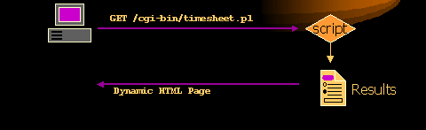
CGI Overview
Web servers allow HTML documents to be generated on the fly through the CGI standard.
A request is made for a web page, your program is called by the web server to generate the HTML, the HTML is rendered in the browser
  Your program outputs HTML to standard output
There are ways to get input to your script
  Through standard input and/or environment variables

Slide 19
HTML Forms
An HTML form provides a way to collect user input
  Text Areas
  Buttons
  Menus
  Checkboxes
Browser send data via HTTP request
Invokes a URL of a CGI script to process data when submitted

Slide 20
Forms and CGI
HTTP defines how form variables are sent to the web server
Two methods:
  GET
    Form variables encoded into an environment variable
  POST
    Form variables encoded into standard input as the content of the HTTP request

Slide 21
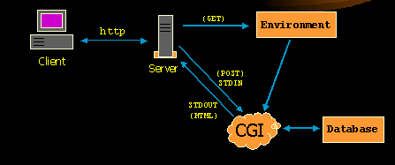

Slide 22
Sending form variables
Browser sends form variables as name-value pairs:
name1=value1&name2=value2&name3=value3
Names are defined in form elements
<INPUT TYPE=“checkbox” NAME=“send_payment” Value=“yes”>
Values are specified by user
  Encoded into special format: special characters replaced with %## (2-digit hex number), spaces replaced with +
    Avoids parsing problems
    e.g. “10/20 Wed” encoded as “10%2F20+Wed”

Slide 23
Submitting forms
POST
POST /cgi-bin/sample.cgi HTTP/1.1
Host: www.cs.nyu.edu
Content-Length: 50
Content-Type: application/x-www-form-urlencoded
name1=value1&name2=value2
GET
GET /cgi-bin/sample.cgi?name1=value1&name2=value2 HTTP/1.1
Host: www.cs.nyu.edu

Slide 24
Reading form inputs
Forms specify whether to use GET or POST style HTTP request
<FORM ACTION=“/cgi-bin/sample.cgi METHOD=POST>
…
</FORM>
GET: input encoded into QUERY_STRING
POST: standard input (body of the request)
Most scripts parse the input into an associative array
  You can parse these yourself
  But most people use libraries for this

Slide 25
CGI Environment Variables
DOCUMENT_ROOT
HTTP_HOST
HTTP_REFERER
HTTP_USER_AGENT
HTTP_COOKIE
REMOTE_ADDR
REMOTE_HOST
REMOTE_USER
REQUEST_METHOD
SERVER_NAME
SERVER_PORT

Slide 26
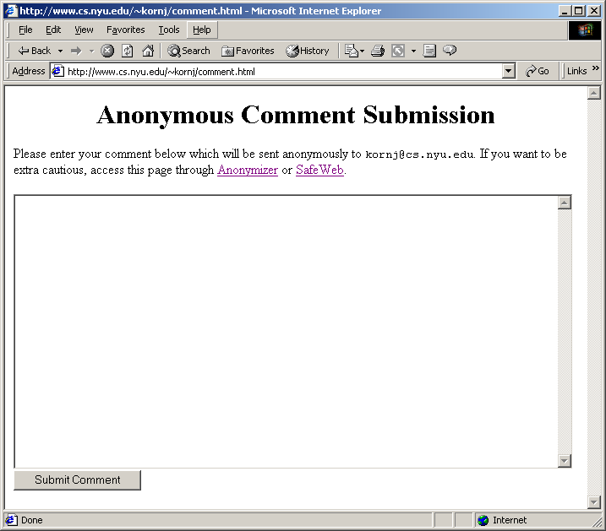
CGI Script: Example

Slide 27
Part 1: HTML Form
<html>
<center>
<H1>Anonymous Comment Submission</H1>
</center>
Please enter your comment below which will
be sent anon. to <tt>okeefe@cse.sc.edu</tt>.
If you want to be extra cautious, access this
page through <a href="http://www.anonymizer.com">Anonymizer</a>.
<p>
<form action=cgi-bin/comment.cgi method=post>
<textarea name=comment rows=20 cols=80>
</textarea>
<input type=submit value="Submit Comment">
</form>
</html>

Slide 28
Part 2: CGI Script (ksh)
#!/home/unixtool/bin/ksh
. cgi-lib.ksh # Read special functions to help parse
ReadParse
PrintHeader
print -r -- "${Cgi.comment}" | /bin/mailx -s "COMMENT" kornj
print "<H2>You submitted the comment</H2>"
print "<pre>"
print -r -- "${Cgi.comment}"
print "</pre>"

Slide 29
Debugging
Debugging can be tricky, since error messages don't always print well as HTML
One method: run interactively
$ QUERY_STRING='birthday=10/15/03'
$ ./birthday.cgi
Content-type: text/html
<html>
Your birthday is <tt>10/15/02</tt>.
</html>

Slide 30
How to get your script run
This can vary by web server type
http://www.cims.nyu.edu/systems/resources/webhosting/index.html
Typically, you give your script a name that ends with .cgi
Give the script execute permission
Specify the location of that script in the URL

Slide 31
CGI Security Risks
Often CGI scripts are run as the author
  setuid
Be careful of security holes
Never trust the input
Clean up (don't leave sensitive data around)

Slide 32
CGI Benefits
Simple
Language independent
UNIX tools are good for this because
  Work well with text
  Integrate programs well
  Easy to prototype
  No compilation (CGI scripts)

Slide 33
Example: Dump Some Info
#!/home/unixtool/bin/ksh
. ./cgi-lib.ksh
PrintHeader
ReadParse
print "<h1> Date </h1>"
print "<pre>"
date
print "</pre>"
print "<h1> Form Variables </h1>"
print "<pre>"
set -s -- ${!Cgi.*}
for var
do
nameref r=$var
print "${var#Cgi.} = $r"
unset r
done
print "</pre>"
print "<h1> Environment </h1>"
print "<pre>"
env | sort
print "</pre>"

Slide 34
Example: Find words in Dictionary
<form action=dict.cgi>
Regular expression: <input type=entry name=re value=".*">
<input type=submit>
</form>

Slide 35
Example: Find words in Dictionary
#!/home/unixtool/bin/ksh
PATH=$PATH:.
. cgi-lib.ksh
ReadParse
PrintHeader
print "<H1> Words matching <tt>${Cgi.re}</tt> in the dictionary </H1>\n";
print "<OL>"
grep "${Cgi.re}" /usr/dict/words | while read word
do
print "<LI> $word"
done
print "</OL>"

