Slide 1
Logseq Project Executive Report
Repository: logseq/db-test
Generated: November 25, 2025

Slide 2
Executive Dashboard
609
174
435
Total Issues
Open Issues
Closed Issues
71.4%
3 days
76
Resolution Rate
Avg Close Time
Contributors

Slide 3
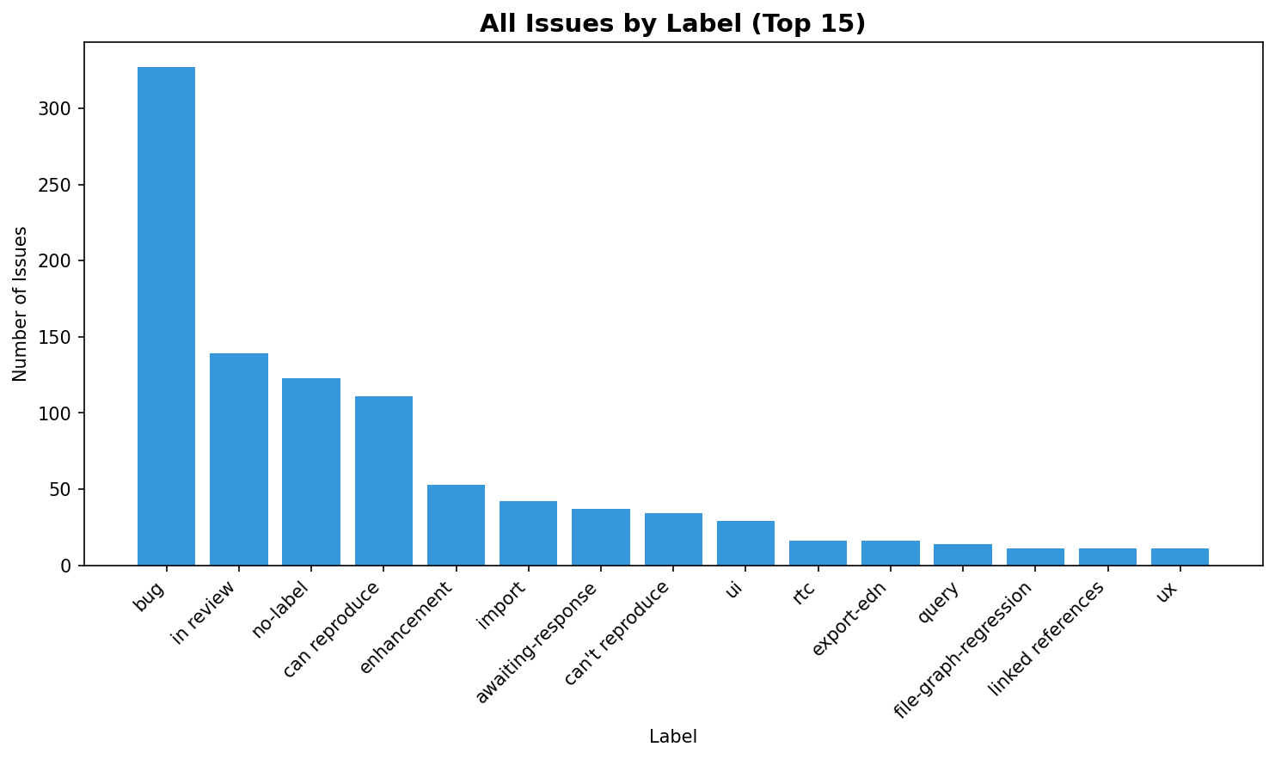
All Issues by Label

Slide 4
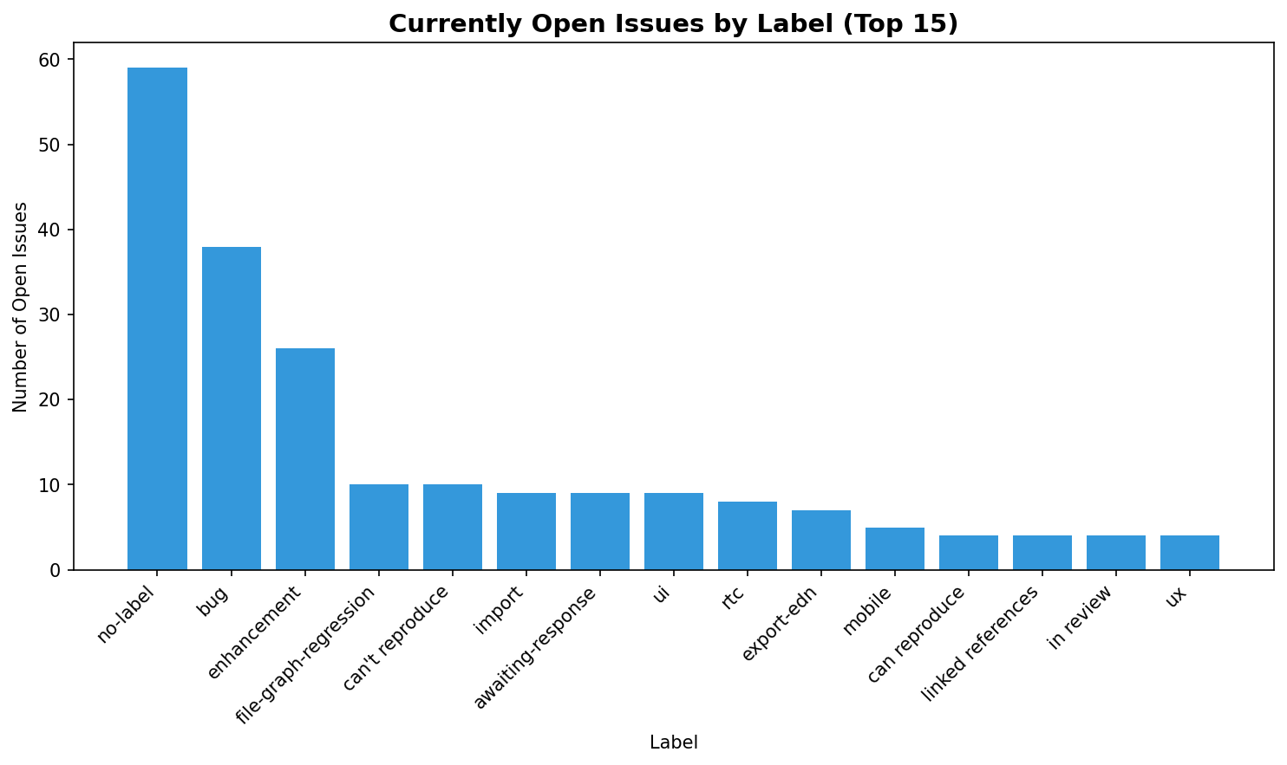
Currently Open Issues by Label

Slide 5
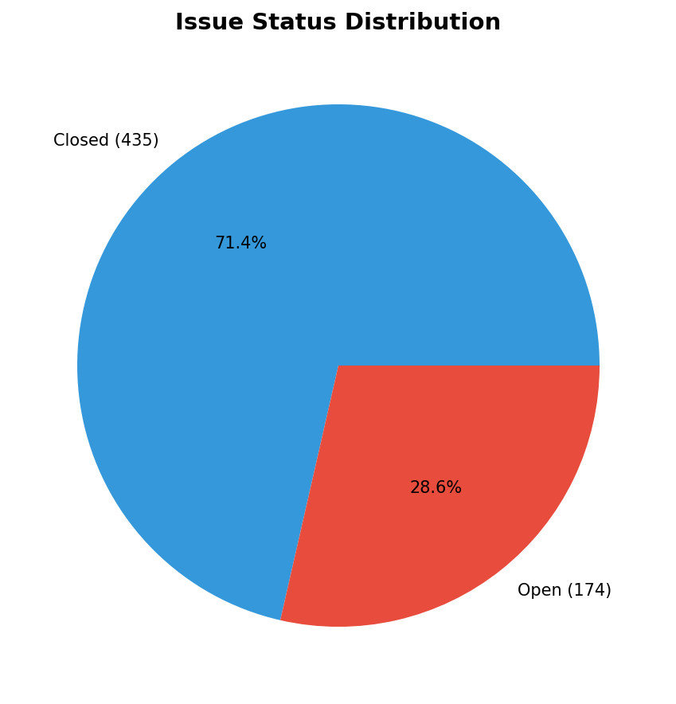
Issue Status Summary
Resolution Rate: 71.4% | Median Time to Close: 3 days

Slide 6
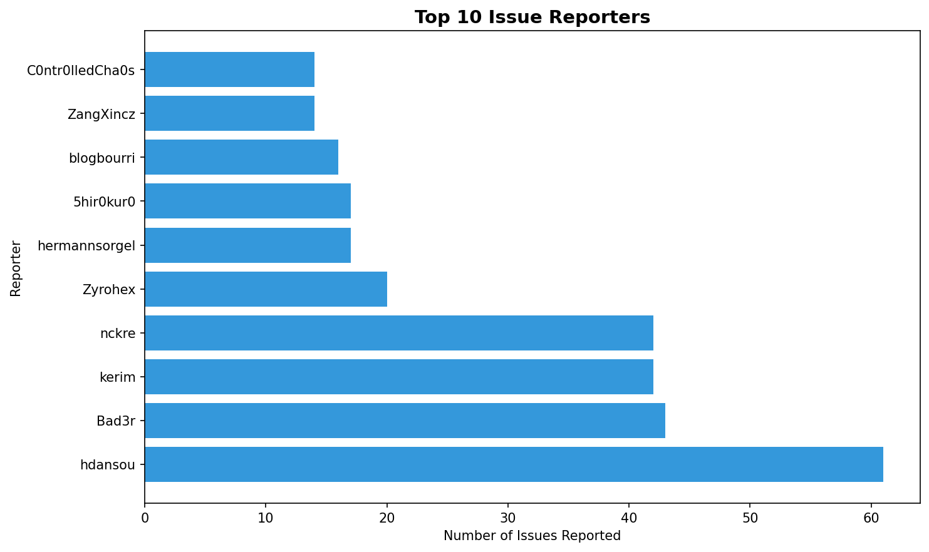
Top Issue Reporters

Slide 7
Top Problem Areas
#111: Page names with page references
Age: 432 days | Comments: 7 | Labels: bug, minor
#113: `/` is not visible for page references starting with `/`
Age: 431 days | Comments: 3 | Labels: bug, can reproduce, minor
#98: Tags as properties not showing as edges in graph
Age: 435 days | Comments: 1 | Labels: graph-view
#187: No blank entry for today in Journals view with latest feat/db (non-db mode)
Age: 346 days | Comments: 5 | Labels: can't reproduce

Slide 8
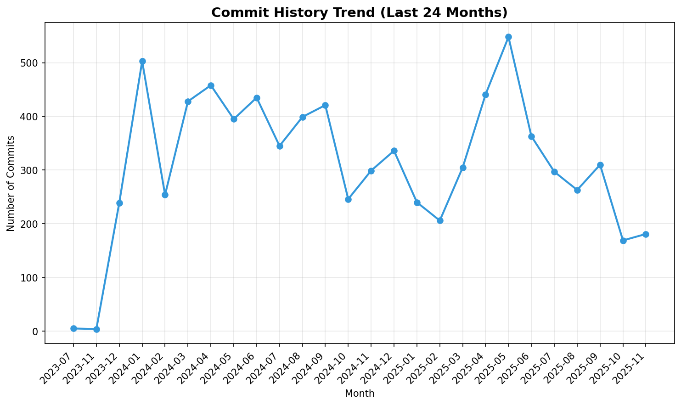
Commit Activity Trend

Slide 9
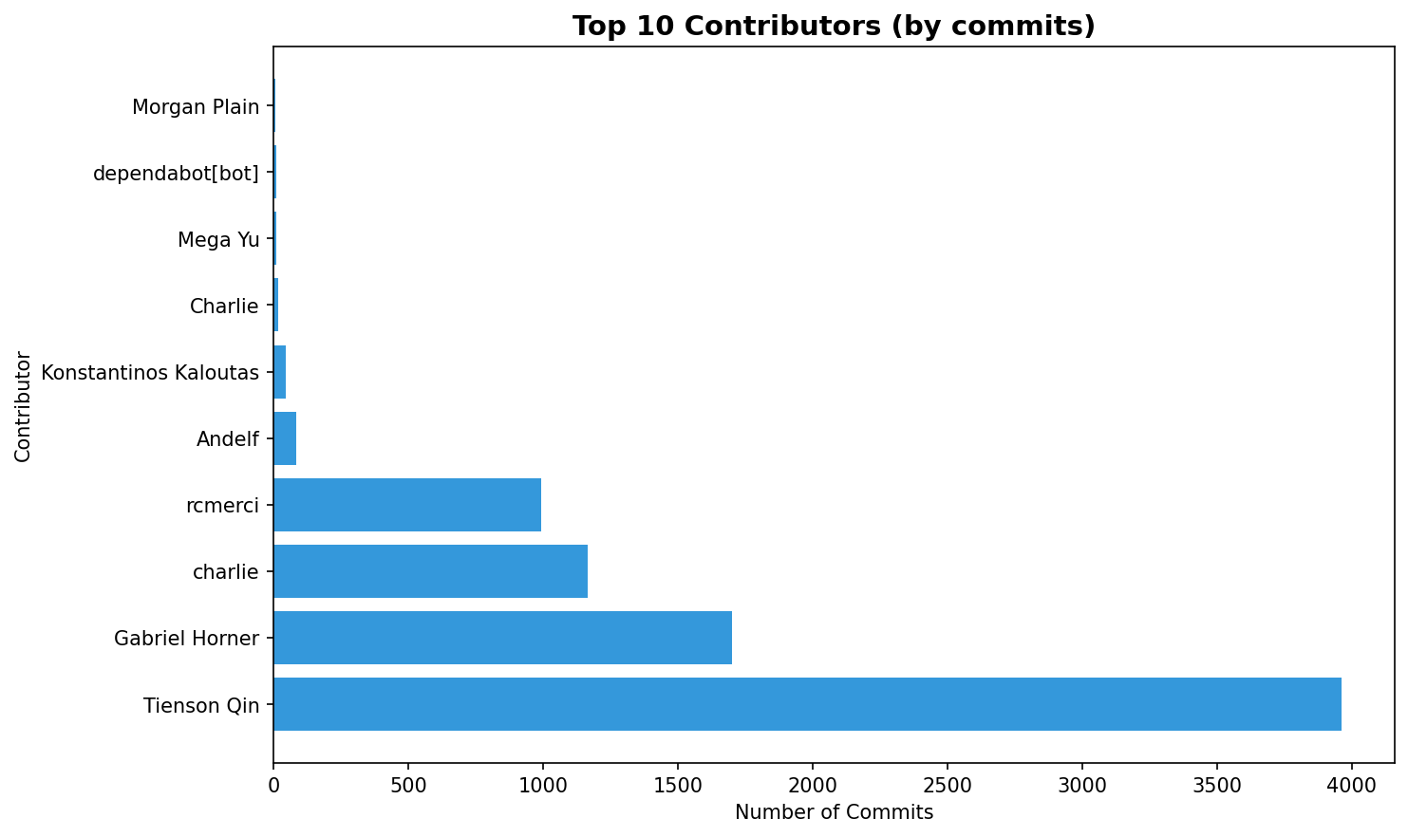
Top Code Contributors

Slide 10
Project Health Assessment
Issue Resolution Rate
71.4%
High
Monthly Commit Velocity
337 commits/month
High
Active Contributors
76 total
High
Avg Contributors/Month
7.7
Medium

Slide 11
Strategic Recommendations
1
Address High-Priority Issues: Focus on resolving the oldest open issues with high engagement to improve user satisfaction
2
Improve Issue Triage: Implement better labeling and prioritization for incoming issues to reduce resolution time
3
Expand Contributor Base: Actively recruit and onboard new contributors to reduce dependency on core team members
4
Establish Response SLAs: Set target response times for different issue types to improve community engagement
5
Regular Health Reviews: Schedule monthly reviews of project health metrics to identify trends early
6
Documentation Focus: Address documentation-related issues to reduce support burden and improve onboarding

