Slide 1
Chapter 19 OpenMP
Speaker: Lung-Sheng Chien
Reference: [1] OpenMP C and C++ Application Program Interface v2.0
[2] OpenMP C and C++ Application Program Interface v3.0
[3] OpenMP forum, http://www.openmp.org/forum/
[4] OpenMP tutorial: https://computing.llnl.gov/tutorials/openMP/
[5] Getting Started with OpenMP:
http://rac.uits.iu.edu/hpc/openmp_tutorial/C/

Slide 2
OutLine
OpenMP introduction
- shared memory architecture
- multi-thread
Example 1: hello world
Example 2: vector addition
enable openmp in vc2005
Example 3: vector addition + Qtime
Example 4: matrix multiplication
Example 5: matrix multiplication (block version)

Slide 3
What is OpenMP
http://en.wikipedia.org/wiki/OpenMP
The OpenMP (Open Multi-Processing) is an application programming interface (API) that supports multi-platform shared memory multiprocessing programming in C/C++ and Fortran on many architectures, including Unix and Microsoft Windows platforms. It consists of a set of compiler directives, library routines, and environment variables that influence run-time behavior.
OpenMP is a portable, scalable model that gives programmers a simple and flexible interface for developing parallel applications for platforms ranging from the desktop to the supercomputer.
An application built with the hybrid model of parallel programming can run on a computer cluster using both OpenMP and Message Passing Interface (MPI).
OpenMP: shared memory
MPI: distributed memory

Slide 4
History of OpenMP
The OpenMP Architecture Review Board (ARB) published its first API specifications, OpenMP for Fortran 1.0, in October 1997. October the following year they released the C/C++ standard.
2000 saw version 2.0 of the Fortran specifications with version 2.0 of the C/C++ specifications being released in 2002.
Version 2.5 is a combined C/C++/Fortran specification that was released in 2005.
Version 3.0, released in May, 2008, is the current version of the API specifications. Included in the new features in 3.0 is the concept of tasks and the task construct. These new features are summarized in Appendix F of the OpenMP 3.0 specifications.

Slide 5
Goals of OpenMP
Standardization:
Provide a standard among a variety of shared memory architectures/platforms.
Lean and Mean:
establish a simple and limited set of directives for programming shared memory machines. Significant parallelism can be implemented by using just 3 or 4 directives.
Ease of Use:
-Provide capability to incrementally parallelize a serial program,
unlike message-passing libraries which typically require an all or
nothing approach
-Provide the capability to implement both coarse-grain and fine-grain
parallelism
Portability:
-Supports Fortran (77, 90, and 95), C, and C++
-Public forum for API and membership

Slide 6



Website: http://openmp.org/wp/

Slide 7

OpenMP forum: http://www.openmp.org/forum/
Please register in this forum and browse articles in “General” item

Slide 8
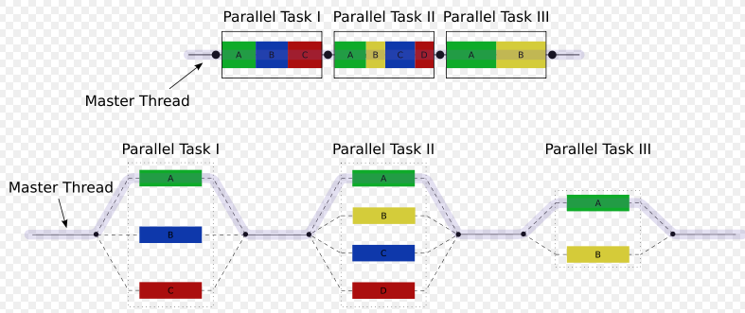
Multithread (多執行緒)
OpenMP is an implementation of multithreading, a method of parallelization whereby the master "thread" (a series of instructions executed consecutively) "forks" a specified number of slave "threads" and a task is divided among them. The threads then run concurrently, with the runtime environment allocating threads to different processors.
The runtime environment allocates threads to processors depending on usage, machine load and other factors. The number of threads can be assigned by the runtime environment based on environment variables or in code using functions. The OpenMP functions are included in a header file labelled "omp.h" in C/C++

Slide 9
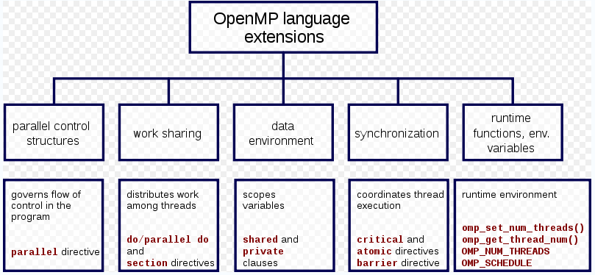

Core elements
A compiler directive in C/C++ is called a pragma (pragmatic information). It is a preprocessor directive, thus it is declared with a hash (#). Compiler directives specific to OpenMP in C/C++ are written in codes as follows:

Slide 10
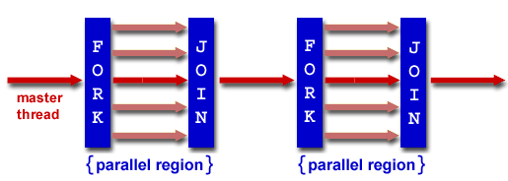
OpenMP programming model [1]
Shared Memory, Thread Based Parallelism:
OpenMP is based upon the existence of multiple threads in the shared memory programming paradigm. A shared memory process consists of multiple threads.
Explicit Parallelism:
OpenMP is an explicit (not automatic) programming model, offering the programmer full control over parallelization.
Fork - Join Model:
- OpenMP uses the fork-join model of parallel execution
- All OpenMP programs begin as a single process: the master thread. The
master thread executes sequentially until the first parallel region construct
is encountered
- FORK: the master thread then creates a team of parallel threads
- The statements in the program that are enclosed by the parallel region construct are
then executed in parallel among the various team threads
- JOIN: When the team threads complete the statements in the parallel
region construct, they synchronize and terminate, leaving only the master
thread

Slide 11
OpenMP programming model [2]
Compiler Directive Based:
OpenMP parallelism is specified through the use of compiler directives.
Nested Parallelism Support:
- The API provides for the placement of parallel constructs inside of other parallel
constructs
- Implementations may or may not support this feature.
Dynamic Threads:
-The API provides for dynamically altering the number of threads which may used to
execute different parallel regions
- Implementations may or may not support this feature.
I/O:
-OpenMP specifies nothing about parallel I/O. This is particularly important if multiple
threads attempt to write/read from the same file.
-If every thread conducts I/O to a different file, the issues are not as significant.
-It is entirely up to the programmer to insure that I/O is conducted correctly within the context of a multi-threaded program.
FLUSH Often?:
-OpenMP provides a "relaxed-consistency" and "temporary" view of thread memory
(in their words). In other words, threads can "cache" their data and are not required
to maintain exact consistency with real memory all of the time.
-When it is critical that all threads view a shared variable identically, the programmer
is responsible for insuring that the variable is FLUSHed by all threads as needed.

Slide 12
OutLine
OpenMP introduction
Example 1: hello world
- parallel construct
Example 2: vector addition
enable openmp in vc2005
Example 3: vector addition + Qtime
Example 4: matrix multiplication
Example 5: matrix multiplication (block version)

Slide 13
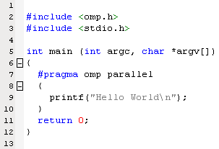

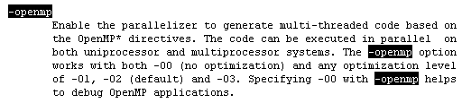
Example 1: hello world [1]
hello.c
Makefile
header file “omp.h” is necessary for OpenMP programming
MSDN library 2005
The #pragma directives offer a way for each compiler to offer machine- and operating system-specific features while retaining overall compatibility with the C and C++ languages. Pragmas are machine- or operating system-specific by definition, and are usually different for every compiler.
If the compiler finds a pragma it does not recognize, it issues a warning, but compilation continues.
man icpc

Slide 14
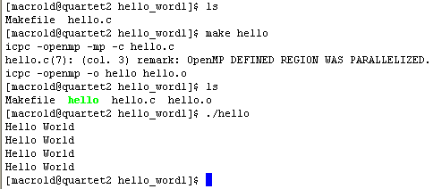
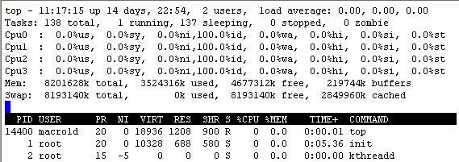

Example 1: hello world [2]
hello.c
Machine quartet2 has 4 cores

Slide 15
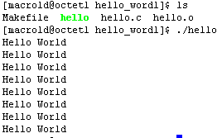
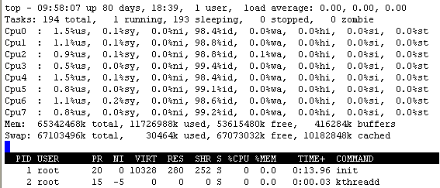


Example 1: hello world [3]
octet1
Machine octet1 has 8 cores (two quad-core)
hello.c
Question 1: How to impose number of threads in code?
environment variable OMP_NUM_THREADS

Slide 16
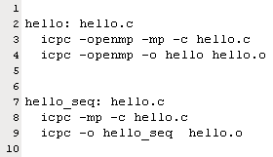
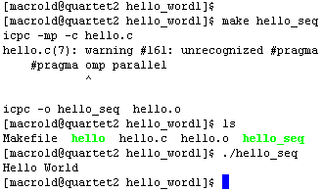

Example 1: hello world [4]
Question 2: How can we run the same code in sequential mode?
hello.c
Makefile
sequential version
quartet2
octet1
only one core executes

Slide 17
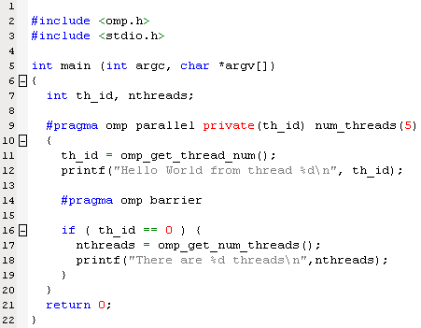
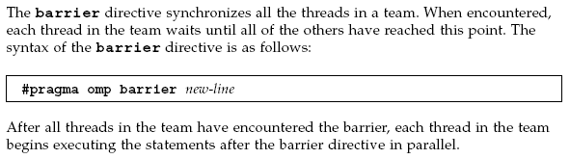
Example 1: hello world [5]
Question 3: How can we issue number of threads explicitly in code?
hello.c
every thread has its own copy
use 5 threads (explicit) to execute concurrently
synchronization
wait until all 5 threads execute “printf” statement.

Slide 18
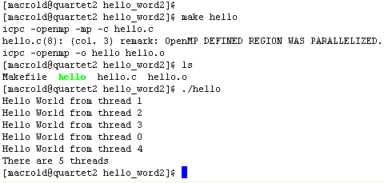
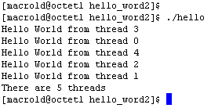

Example 1: hello world [6]
quartet2
octet1
core 0
core 1
core 2
core 3
core 4
th_id
th_id
th_id
th_id
th_id

Slide 19

Directive Format
The syntax of an OpenMP directive is formally specified by the grammar
Each directive starts with #pragma omp, to reduce the potential for conflict with other (non-OpenMP or vendor extensions to OpenMP) pragma directives with the same names. White space can be used before and after the #, and sometimes white space must be used to separate the words in a directive. Preprocessing tokens following the #pragma omp are subject to macro replacement.
PARALLEL construct
for Directive
sections Directive
Work-sharing construct
workshare Directive
single Directive
Conditional compilation

Slide 20
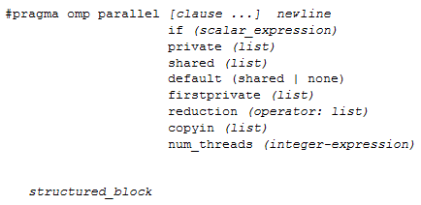
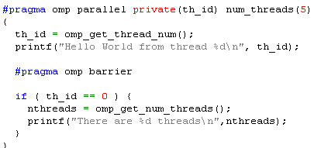
Parallel construct
The number of physical processors hosting the threads is implementation-defined. Once created, the number of threads in the team remains constant for the duration of that parallel region.
When a thread reaches a PARALLEL directive, it creates a team of threads and becomes the master of the team. The master is a member of that team and has thread number 0 within that team.
Starting from the beginning of this parallel region, the code is duplicated and all threads will execute that code.
There is an implied barrier at the end of a parallel region. Only the master thread of the team continues execution at the end of a parallel region.

Slide 21
How many threads
The number of threads in a parallel region is determined by the following factors, in order of precedence:
- evaluation of the IF clause
- setting of the NUM_THREADS clause
- use of the omp_set_num_threads() library function
- setting of the OMP_NUM_THREADS environment variable
- implementation default - usually the number of CPUs on a node,
though it could be dynamic.
Threads are numbered from 0 (master thread) to N-1.
Master thread is numbered as 0.
Question 4: How to write parallel code such that it is independent of number of cores of host machine?
Question 5: What happens if number of threads is larger than number of cores of host machine?

Slide 22
Private clause
The PRIVATE clause declares variables in its list to be private to each thread.
“private variable” means each thread has its own copy and cannot interchange information.
PRIVATE variables behave as follows:
- a new object of the same type is declared once for each thread in
the team
- all references to the original object are replaced with references to
the new object
- variables declared PRIVATE are uninitialized for each thread
Exercise 1: modify code of hello.c to show “every thread has its own private variable th_id”, that is, shows th_id has 5 copies.
Exercise 2: modify code of hello.c, remove clause “private (th_id)” in #pragma directive, what happens? Can you explain?

Slide 23
OutLine
OpenMP introduction
Example 1: hello world
Example 2: vector addition
- work-sharing construct: for Directive
enable openmp in vc2005
Example 3: vector addition + Qtime
Example 4: matrix multiplication
Example 5: matrix multiplication (block version)

Slide 24
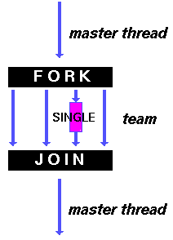
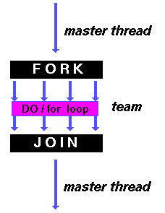
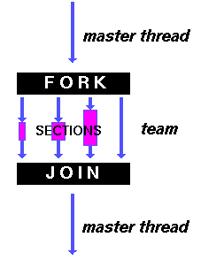
Work-sharing construct
A work-sharing construct divides the execution of the enclosed code region among the members of the team that encounter it
A work-sharing construct must be enclosed dynamically within a parallel region in order for the directive to execute in parallel
Work-sharing constructs do not launch new threads
There is no implied barrier upon entry to a work-sharing construct, however there is an implied barrier at the end of a work sharing construct
sections: breaks work into separate, discrete sections. Each section is executed by a thread.
A type of functional parallelism
for: shares iterations of a loop across the team.
A type of data parallelism
single: serializes a section of code.

Slide 25
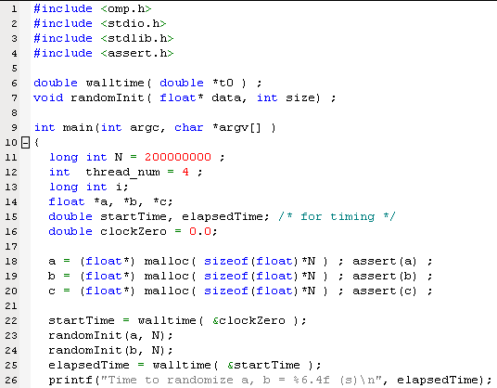
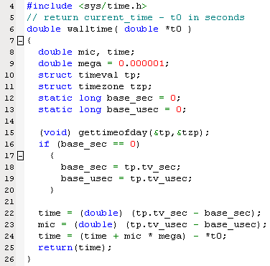
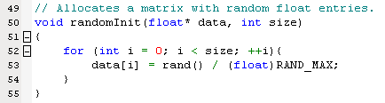
Example 2: vector addition [1]
vecadd.c
walltime.c
parameter
Tool for measuring time
only valid in Linux system
vecadd.c

Slide 26
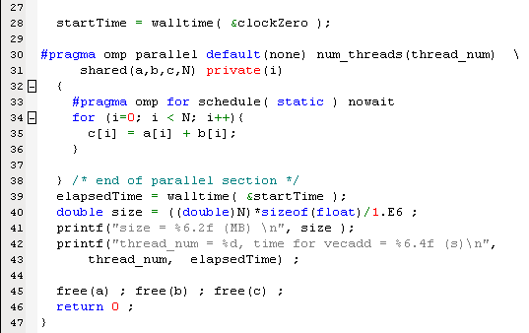
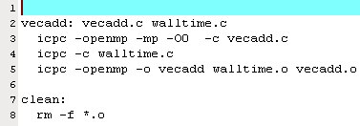
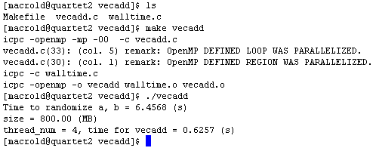
Example 2: vector addition [2]
vecadd.c
Makefile
“O0” means no optimization

Slide 27
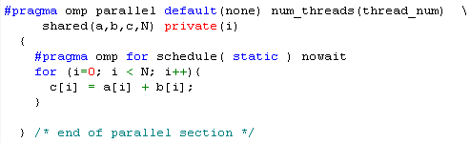
shared clause and default clause
The SHARED clause declares variables in its list to be shared among all threads in the team
A shared variable exists in only one memory location and all threads can read or write to that address (every thread can “see” the shared variable)
It is the programmer's responsibility to ensure that multiple threads properly access SHARED variables (such as via CRITICAL sections)
Question 6: Why index i must be private variable and a,b,c,N can be shared variable? What happens if we change i to shared variable? What happens if we change a,b,c,N to private variable?
The DEFAULT clause allows the user to specify a default PRIVATE, SHARED, or NONE scope for all variables in the lexical extent of any parallel region.

Slide 28
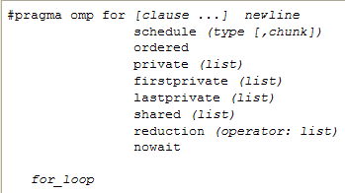
Work-Sharing construct: for Directive
SCHEDULE: Describes how iterations of the loop are divided among the threads in the team
- static: loop iterations are divided into pieces of size chunk and then
statically assigned to threads. If chunk is not specified, the iterations
are evenly (if possible) divided contiguously among the threads
- dynamic: loop iterations are divided into pieces of size chunk, and
dynamically scheduled among the threads; when a thread finishes
one chunk, it is dynamically assigned another.
The default chunk size is 1.
nowait: If specified, then threads do not synchronize at the end of the
parallel loop.

Slide 29

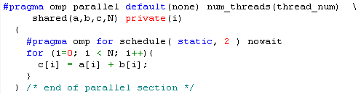
Example of static schedule
Assume we have 16 array elements, say a[16], b[16] and c[16] and use 4 threads
1
no chunk is specified, compiler would divide 16 elements into 4 threads
Thread ID
0
1
2
3
0
1
2
3
4
5
6
7
8
9
10
11
12
13
14
15
2
chunk = 2
Thread ID
0
1
2
3
0
1
2
3
0
1
2
3
4
5
6
7
8
9
10
11
12
13
14
15

Slide 30

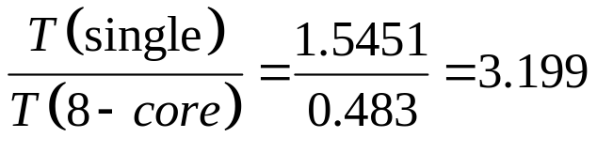
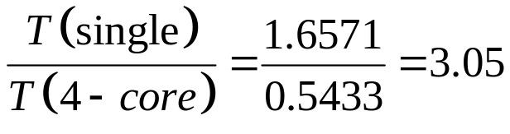
Results of example 2
compiler: Intel C compiler icpc 10.0
Compiler option: -O0
Number of thread | quartet2 | Octet1
1 | 1.6571 (s) | 1.5451 (s)
2 | 0.9064 (s) | 0.9007 (s)
4 | 0.5433 (s) | 0.5165 (s)
8 | 0.6908 (s) | 0.4830 (s)
16 | 0.7694 (s) | 0.5957 (s)
32 | 0.9263 (s) | 0.7098 (s)
64 | 0.9625 (s) | 0.7836 (s)
Octet1:
quartet2:
Question 7: the limitation of performance improvement is 3, why? Can you use different configuration of schedule clause to improve this number?

Slide 31
OutLine
OpenMP introduction
Example 1: hello world
Example 2: vector addition
enable openmp in vc2005
- vc2005 supports OpenMP 2.0
- vc 6.0 does not support OpenMP
Example 3: vector addition + Qtime
Example 4: matrix multiplication
Example 5: matrix multiplication (block version)

Slide 32
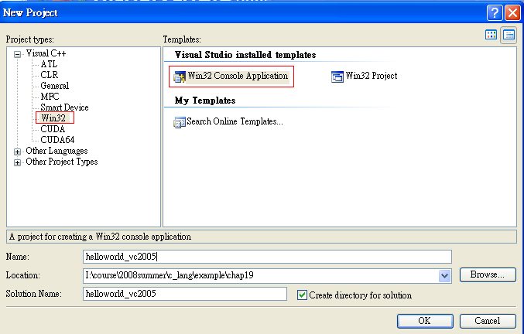
Example 1 (hello world) in vc2005 [1]
Step 1: create a empty consol application

Slide 33
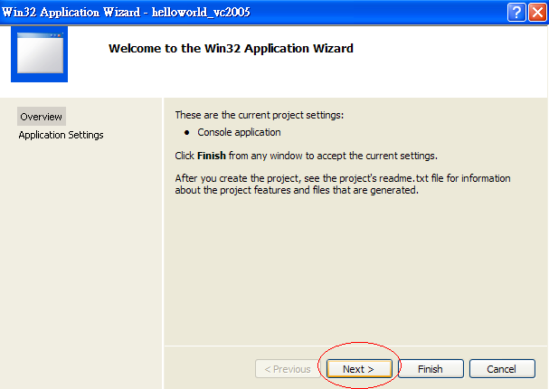
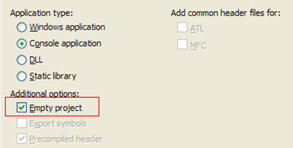
Example 1 (hello world) in vc2005 [2]

Slide 34
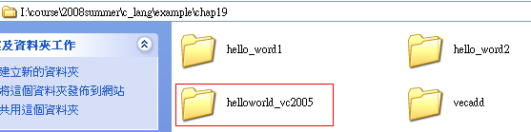
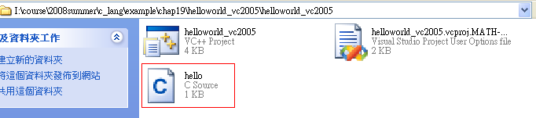
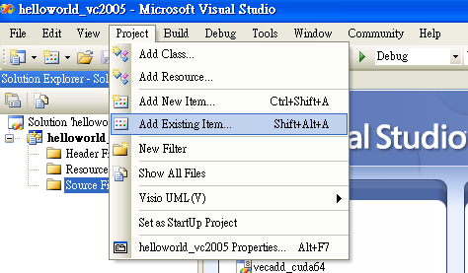
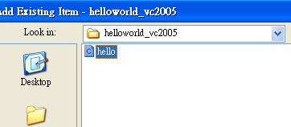
Example 1 (hello world) in vc2005 [3]
Step 2: copy hello.c to this project and add hello.c to project manager

Slide 35
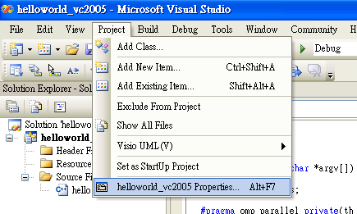
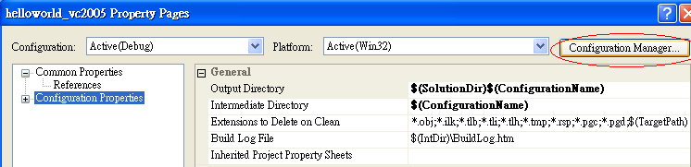
Example 1 (hello world) in vc2005 [4]
Step 3: change platform to x64

Slide 36
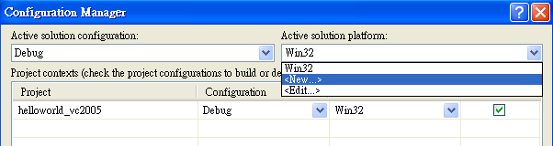
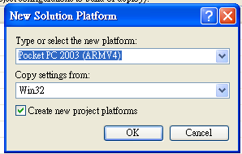
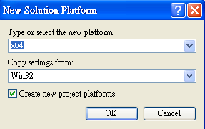
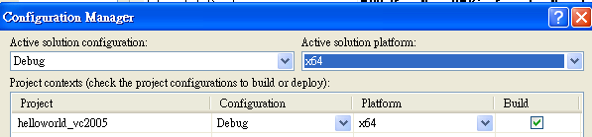
Example 1 (hello world) in vc2005 [5]
choose option “x64”
update platform as “x64”

Slide 37
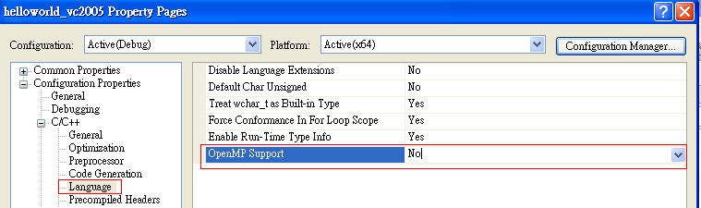
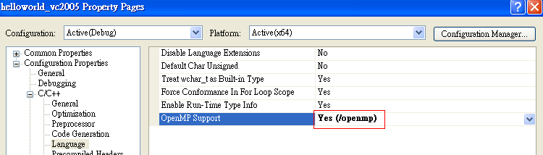
Example 1 (hello world) in vc2005 [6]
Step 4: enable “openmp” support
vc 2005 support OpenMP 2.0

Slide 38
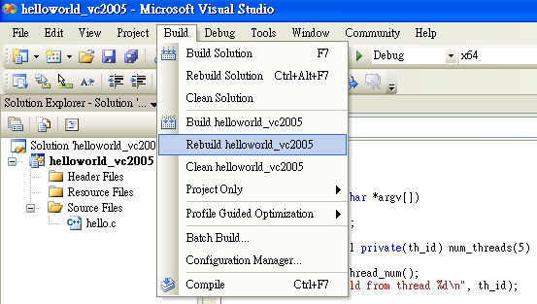
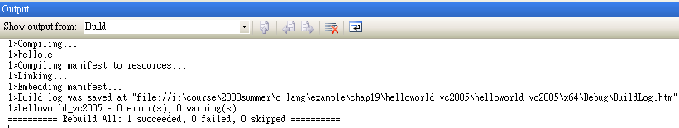
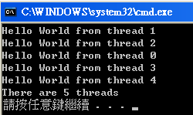
Example 1 (hello world) in vc2005 [7]
Step 5: compile and execute

Slide 39
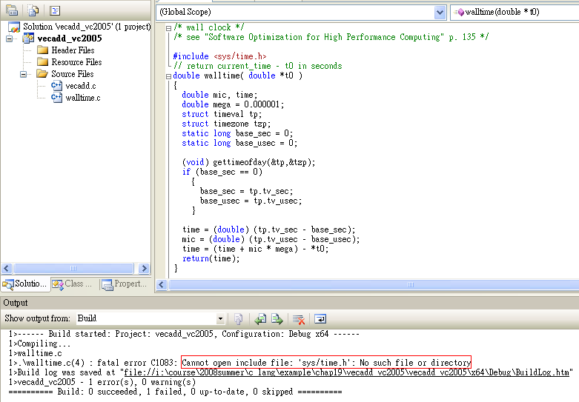
Example 2 (vector addition) in vc2005 [1]
walltime.c only works in Linux machine since no “sys/time.h” in windows
In time.h of ANCI C, no function “gettimeofday”, hence we give up walltime.c

Slide 40



Example 2 (vector addition) in vc2005 [2]
time_t time( time_t *tp)
returns the current calendar time or -1 if the time
is not available. If tp is not NULL, the return
value is also assigned to *tp.
double difftime( time_t time_2, time_t time_1)
returns time_2 – time_1 expressed in seconds
vecadd.cpp

Slide 41
OutLine
OpenMP introduction
Example 1: hello world
Example 2: vector addition
enable openmp in vc2005
Example 3: vector addition + Qtime
Example 4: matrix multiplication
Example 5: matrix multiplication (block version)

Slide 42

Example 3: vector addition (Qtime) [1]
vecadd.cpp
constructs the time 0 hours, minutes, seconds and milliseconds, i.e. 00:00:00.000 (midnight).
This is a valid time.
A QTime object contains a clock time, i.e. the number of hours, minutes, seconds, and milliseconds since midnight
QTime uses the 24-hour clock format; it has no concept of AM/PM. It operates in local time; it knows nothing about time zones or daylight savings time.
QTime can be used to measure a span of elapsed time using the start(), restart(), and elapsed() functions

Slide 43



Example 3: vector addition (Qtime) [2]
vecadd.cpp

Slide 44


Example 3: vector addition (Qtime) [3]
generate project file vecadd_qt.pro
generate Makefile
Makefile

Slide 45

Example 3: vector addition (Qtime) [4]
Embed Qt 3.2.1 non-comercial version into vc 2005
Step 1: setup an empty project

Slide 46



Example 3: vector addition (Qtime) [5]
Step 2: copy vecadd.cpp into this project
Step 3: add item “vecadd.cpp” in project manager

Slide 47





Example 3: vector addition (Qtime) [6]
Step 4: project → properties → C/C++ → General → Additional include Directories
.;$(QTDIR)\include;C:\Qt\3.2.1NonCommercial\mkspecs\win32-msvc

Slide 48


Example 3: vector addition (Qtime) [7]
Step 5: project → properties → C/C++ → Preprocessor → Preprocessor Definitions
WIN32;_DEBUG;_CONSOLE;_MBCS;UNICODE;QT_DLL;QT_THREAD_SUPPORT
Step 6: project → properties → C/C++ → Language → OpenMP Support

Slide 49

Example 3: vector addition (Qtime) [8]
Step 7: project → properties → Linker → General → Additional Library Directories
$(QTDIR)\lib;C:\Program Files (x86)\Microsoft Visual Studio 8\VC\lib

Slide 50

Example 3: vector addition (Qtime) [9]
Step 8: project → properties → Linker → Input → Additional Dependence
"qt-mtnc321.lib" "qtmain.lib" "kernel32.lib"
Step 9: compile and execute
Restriction: QT3 in windows only support 32-bit application, we must choose platform as “Win32”, we will solve this problem after installing QT4

Slide 51
OutLine
OpenMP introduction
Example 1: hello world
Example 2: vector addition
enable openmp in vc2005
Example 3: vector addition + Qtime
Example 4: matrix multiplication
Example 5: matrix multiplication (block version)

Slide 52






Example 4: matrix multiplication [1]
matrixMul.h
matrixMul.cpp
row-major index
sequential version

Slide 53

Example 4: matrix multiplication [2]
matrixMul.cpp
parallel version
Question 8: we have three for-loop, one is for “i”, one is for “j” and last one is for “k”, which one is parallelized by OpenMP directive?
Question 9: explain why variable i, j, k, sum, a, b are declared as private? Can we move some of them to shared clause?

Slide 54


Example 4: matrix multiplication [3]
main.cpp
use QT timer

Slide 55




Example 4: matrix multiplication [4]
main.cpp
use qmake to generate Makefile

Slide 56
Example 4: matrix multiplication [5]
Let BLOCK_SIZE = 16 and
Platform: oectet1, with compiler icpc 10.0, -O2
N | Total size | Thread 1 | Thread 2 | Thread 4 | Thread 8
16 | 0.75 MB | 53 ms | 31 ms | 21 ms | 24ms
32 | 3 MB | 434 ms | 237 ms | 121 ms | 90 ms
64 | 12 MB | 17,448 ms | 8,964 ms | 6,057 ms | 2,997 ms
128 | 48 MB | 421,854 ms | 312,983 ms | 184,695 ms | 92,862 ms
256 | 192 MB | 4,203,536 ms | 2,040,448 ms | 1,158,156 ms | 784,623 ms
Large performance gap amogn N = 32, N = 64 and N = 128, so this algorithm is NOT good. Besides improvement of multi-thread is not significant.

Slide 57



Example 4: matrix multiplication [6]
running
Use command “top” to see resource usage
CPU usage is 800 %, 8 cores are busy

Slide 58
Exercise 3: verify subroutine matrixMul_parallel
matrixMul.cpp

Slide 59


Combine Parallel Work-sharing constructs
matrixMul.cpp

Slide 60

Exercise 4: verify following subroutine matrix_parallel, which parallelizes loop-j , not loop-i.
Performance between loop-i and loop-j
why do we declare index i as shared variable? What happens if we declare index i as private variable?
matrixMul.cpp

Slide 61
OutLine
OpenMP introduction
Example 1: hello world
Example 2: vector addition
enable openmp in vc2005
Example 3: vector addition + Qtime
Example 4: matrix multiplication
Example 5: matrix multiplication (block version)

Slide 62

















Example 5: matrix multiplication (block version) [1]
(0,0)
(1,0)
(0,0)
(1,0)
(2,0)
(0,0)
(1,0)
(2,0)
(0,1)
(1,1)
(0,1)
(1,1)
(2,1)
(0,1)
(1,1)
(2,1)
(0,2)
(1,2)
(0,2)
(1,2)
(2,2)
0
1
2
3
0
1
4
5
6
7
0
1
0
Thread (0,0)
Thread (1,0)
8
9
10
11
0
(0,0)
(1,0)
12
13
14
15
1
(0,1)
(1,1)
1
Thread (0,1)
Thread (1,1)
16
17
18
19
2
(0,2)
(1,2)
20
21
22
23
global index
row-major

Slide 63




Example 5: matrix multiplication (block version) [2]
matrixMul_block.cpp
Shared memory in GPU
(0,0)
(1,0)
(0,0)
(1,0)
(2,0)
(0,1)
(1,1)
(0,1)
(1,1)
(2,1)
(0,2)
(1,2)

Slide 64





Example 5: matrix multiplication (block version) [3]
matrixMul_block.cpp
copy global data to small block, why?
(0,0)
(1,0)
(0,0)
(1,0)
(2,0)
physical index of first entry in block
(0,1)
(0,1)
(1,1)
(0,1)
(1,1)
(2,1)
(0,2)
(1,2)
physical index of first entry in block
(1,0)

Slide 65





Example 5: matrix multiplication (block version) [4]
matrixMul_block.cpp
Compute submatrix of C sequentially
(0,0)
(1,0)
(0,0)
(1,0)
(2,0)
(0,0)
(1,0)
(2,0)
(0,1)
(1,1)
(0,1)
(1,1)
(2,1)
(0,1)
(1,1)
(2,1)
for all
(0,2)
(1,2)
(0,2)
(1,2)
(2,2)
or equivalently
(0,1)
(1,0)
(1,1)
(1,1)
(1,1)

Slide 66




Example 5: matrix multiplication (block version) [5]
Parallel version
GPU code

Slide 67
Example 5: matrix multiplication (block version) [6]
Let BLOCK_SIZE = 16 and
Platform: oectet1, with compiler icpc 10.0, -O2
N | Total size | Thread 1 | Thread 2 | Thread 4 | Thread 8
16 | 0.75 MB | 40 ms | 34 ms | 34 ms | 44 ms
32 | 3 MB | 301 ms | 309 ms | 240 ms | 219 ms
64 | 12 MB | 2,702 ms | 2,310 ms | 1,830 ms | 1,712 ms
128 | 48 MB | 24,548 ms | 19,019 ms | 15,296 ms | 13,920 ms
256 | 192 MB | 198,362 ms | 151,760 ms | 129,754 ms | 110,540 ms
Non-block version
N | Total size | Thread 1 | Thread 2 | Thread 4 | Thread 8
16 | 0.75 MB | 53 ms | 31 ms | 21 ms | 24 ms
32 | 3 MB | 434 ms | 237 ms | 121 ms | 90 ms
64 | 12 MB | 17,448 ms | 8,964 ms | 6,057 ms | 2,997 ms
128 | 48 MB | 421,854 ms | 312,983 ms | 184,695 ms | 92,862 ms
256 | 192 MB | 4,203,536 ms | 2,040,448 ms | 1,158,156 ms | 784,623 ms
Question 10: non-block version is much slower than block version, why?

Slide 68
Example 5: matrix multiplication (block version) [7]
Block version, BLOCK_SIZE = 512
N | Total size | Thread 1 | Thread 2 | Thread 4 | Thread 8
2 | 12 MB | 3,584 ms | 1,843 ms | 961 ms | 453 ms
4 | 48 MB | 27,582 ms | 14,092 ms | 7,040 ms | 3,533 ms
8 | 192 MB | 222,501 ms | 110,975 ms | 55,894 ms | 28,232 ms
Block version, BLOCK_SIZE = 16
N | Total size | Thread 1 | Thread 2 | Thread 4 | Thread 8
64 | 12 MB | 2,702 ms | 2,310 ms | 1,830 ms | 1,712 ms
128 | 48 MB | 24,548 ms | 19,019 ms | 15,296 ms | 13,920 ms
256 | 192 MB | 198,362 ms | 151,760 ms | 129,754 ms | 110,540 ms
Question 11: larger BLOCK_SIZE implies better performance when using multi-thread, why?
Question 12: small BLOCK_SIZE is better in single thread, why?
Question 13: matrix-matrix multiplication is of complexity O(N^3), which algorithm is “good” to achieve this property?

Slide 69


Example 5: matrix multiplication (block version) [8]
Cache has 4 MB, we can have large BLOCK_SIZE
cache line is 64 byte (16 float)
In CPU
BLOCK_SIZE = 512
In GPU
BLOCK_SIZE = 16

Slide 70

Exercise 5: verify subroutine matrixMul_block_seq with non-block version, you can use high precision package.
Non-block version
Exercise 6: if we use “double”, how to choose value of BLOCK_SIZE, show your experimental result.
Exercise 7: Can you modify subroutine matrixMul_block_parallel to improve its performance?
Exercise 8: compare parallel computation between CPU and GPU in your host machine

